Slide 1
Solihull Formation Collaborative Trust
Be the best we can be

Slide 2
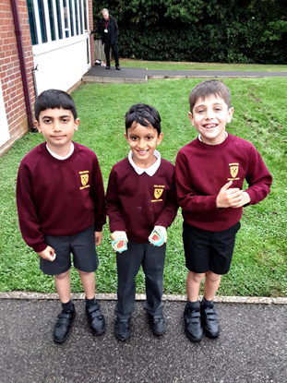
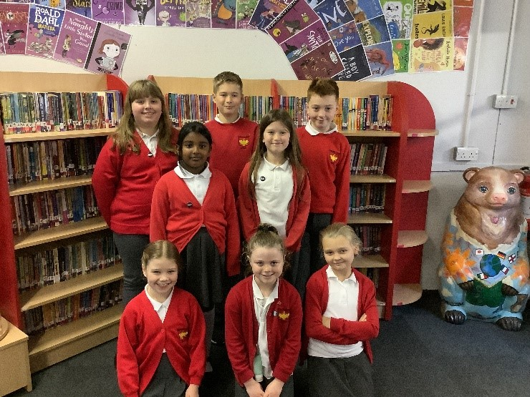
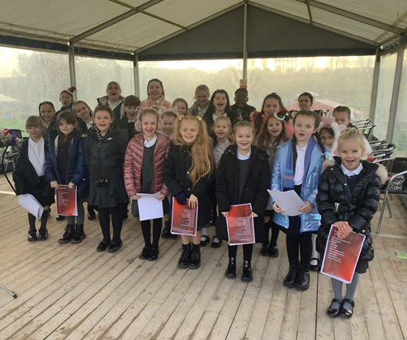
The Vision
To create a family of schools who are connected by a shared belief in working in a diverse and inclusive system with a shared desire to work in partnership in the best interests of all of our children

Slide 3
Our Values
We are a family of schools
We trust each other, and this trust will build over time
We are committed to best practice and good governance
We are role models for what we want from everyone in our Trust including our children
We are in service to our Trust and importantly our children
We are honest and open in all communication which will be the key to our success
We are courageous in our conversations, decisions and actions
We are committed to doing the best for our young people, keeping them at the heart of all that we do and giving them a stake in this process

Slide 4
The Trust Offer
We will commit to:
A funding agreement which is reasonable and competitive and ensures that individual schools retain pupil-specific funding
An investment in leadership to facilitate strong, cohesive collaboration
The centralisation of finance and IT teams and systems enabling access to sector leading professionals and resources
Importantly, regular opportunities for pupils to be part of the process and to work together

Slide 5
The Benefits
The chance to have a stake in the future of our schools, driving early transformation
The opportunity to promote and strengthen the unique, local ethos of our community of schools
The ability to achieve economies of scale
The potential to intervene early, wrapping support around vulnerable children to set them on a positive, strategic and cohesive trajectory
The capacity to jointly plan curriculums to ensure more effective transition for our children
The potential for cross-phase moderation to deepen our understanding of our children’s progress and attainment leading to improved outcomes for all
The creation of cross-phase teaching and learning communities to enable us all to learn from each other
Career professional development for staff across the family of schools
A better understanding for teachers of the journey pupils go on throughout their time at school

Slide 6
What will change?
Very little for pupils, parents and staff.
The way that governance is structured in each schools.
The local governing board will have responsibility for monitoring the quality of education and standards in individual schools.
The Trust Board will have overall responsibility for vision, people and finance.
There will be an executive leadership team who will facilitate collaboration and school improvement across the schools.
There will be more opportunities, in the future, for schools to work together to commission better services more efficiently.

Slide 7
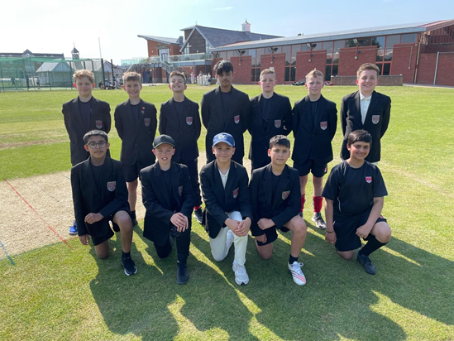
What will not change?
The Headteacher of each school
Terms and conditions for staff
The school’s admissions policy
Uniform
Term dates
Timings of the day
Day to day running of the school

Slide 8
Current Trust Ambitions
All of our schools are at least good and striving for outstanding
Attainment and progress is ambitious against local and national benchmarks
Attendance is good and at least in line with national figures
All schools are led by effective senior leaders, supported by well-trained, motivated staff, underpinned by the Trust CPD guarantee
There are opportunities for key staff to work across the Trust schools to support school improvement
All schools are well supported by strong governance at school and Trust Board level
Pupils have opportunities to work together across the Trust
The Trust remains financially stable

Slide 9
What Matters to Us
Our approach with our young people:
We encourage everyone ‘to be the best we can be’ in all that we do
We see everyone’s potential as limitless
We share the fundamental belief that a child’s past does not determine their future. Our mistakes do not define us
We see learning as an exciting gateway to opportunity
We value every individual for their skills, talent and identity, ensuring everyone in our community is enabled to thrive
We never give up and we are committed to finding the right path for everyone
We want our students to leave us as successful, good people, with a healthy sense of well-being and self-confidence and to be proud of themselves and their school

Slide 10
What Matters to Us
How we work together:
We share a clear sense of purpose, with young people at the centre of all that we do and strive for
We are committed to investing in positive relationships
We promote equality, celebrate diversity and prioritise inclusion
We make decisions with transparency and fairness, finding a route through the difficult rather than the easy
We take a solutions-focussed approach, concentrating on what we can do
We share a fundamental belief that collaboration enhances pupil experiences, outcomes and opportunities
We are a compassionate community with a shared set of values

Slide 11
Any questions?

