Slide 1
2023 - 2024

Slide 2
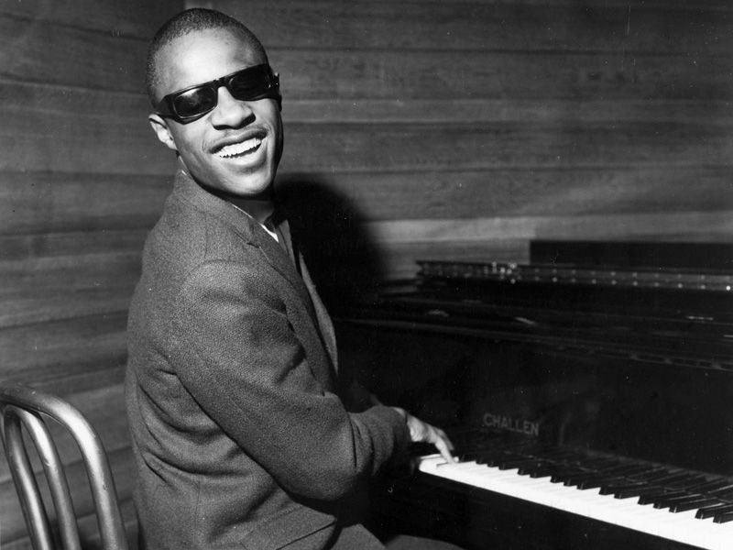
Stevie Wonder
September
Playlist
https://www.youtube.com/watch?v=oE56g61mW44
Stevie Wonder - Superstition (1974) - Bing video
You Are The Sunshine of My Life - Stevie Wonder - Bing video
Stevie Wonder - If You Really Love Me (Official Video) - Bing video
Born in 1950
A singer, songwriter, musician and record
producer.
Genre: funk, pop, soul, RnB, gospel

Slide 3
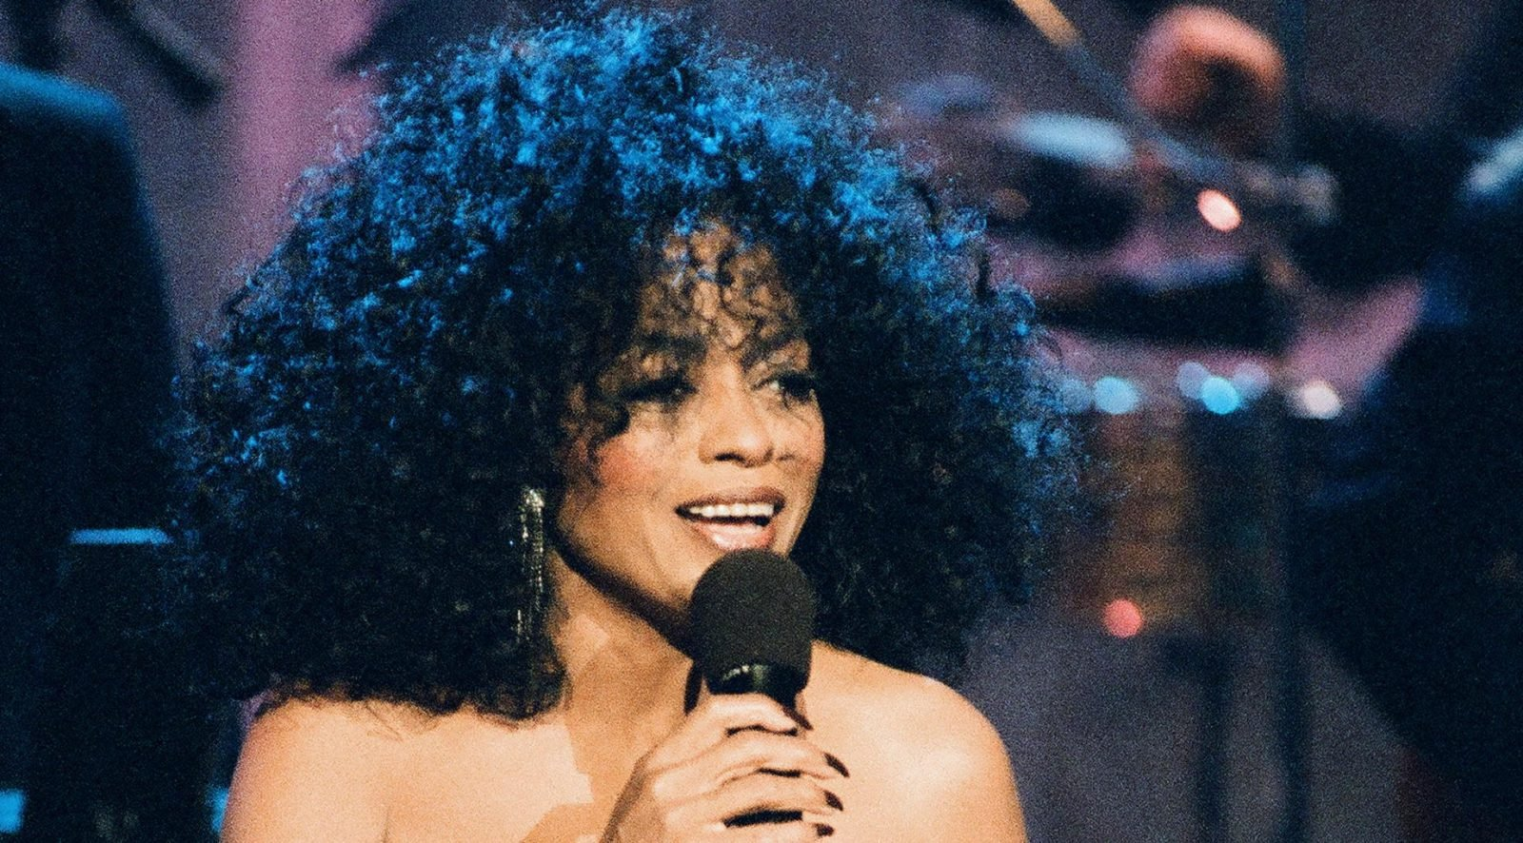
Diana Ross
October
Born in 1944
Formally in the band The Supremes before going solo.
Genre: Motown, RnB, Disco, Pop
Playlist
Diana Ross - I'm Coming Out – YouTube
Diana Ross - Chain Reaction (Official Video) – YouTube
Diana Ross: Ain't No Mountain High Enough (Ashford / Simpson), 1970 - Lyrics-Тексти-Paroles – YouTube
Diana Ross - I'm Still Waiting - YouTube

Slide 4
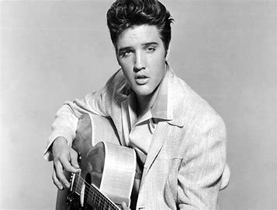
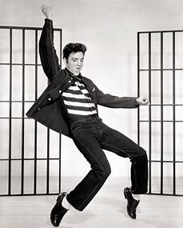
November
Elvis Presley
Born in 1935
An American singer and actor. Dubbed the "King of Rock and Roll“. He was a musician, singer and actor in his career.
Elvis died in his bathroom but rumors spread he died on the toilet.
Genre: Rock and Roll, Pop
Playlist
Elvis Presley - Suspicious Minds (Audio) - YouTubeElvis Presley - Hound Dog (1956) HD 0815007 – YouTube
JAILHOUSE ROCK (1957) - Elvis Presley - Classic Movie Musical Numbers – YouTube
Elvis Presley - Suspicious Minds (Audio) - YouTube

Slide 5
December
Michael Bublé
Born in 1979
Most famously known for singing Christmas songs.
Genre: Pop
Playlist
Michael Bublé - Let It Snow! [10th Anniversary] (Official Music Video) - Bing video
Michael Bublé - White Christmas [Official Animated Video] - Bing video
Michael Bublé - Holly Jolly Christmas [Official HD] - Bing video
Michael Bublé - It's Beginning To Look A Lot Like Christmas [Official HD Audio] - Bing video

Slide 6
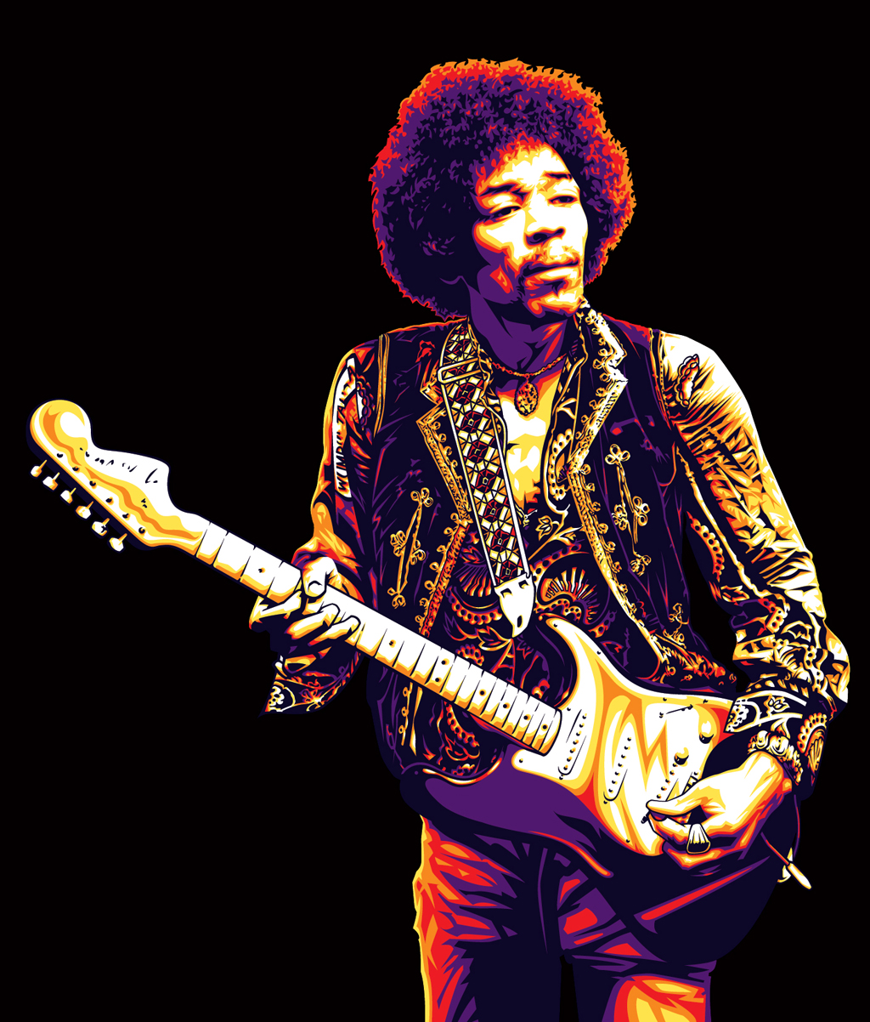
Jimi Hendrix
January
Born in 1942
An American singer and guitarist, one of the greatest of all time.
Genre: Guitarist, Rock
Playlist
The Jimi Hendrix Experience - All Along The Watchtower (Official Audio) - Bing video
The Jimi Hendrix Experience - Hey Joe (1967) - Bing video
Voodoo Child (Slight Return) - Bing video

Slide 7
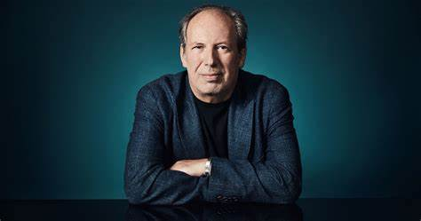
Hans Zimmer
February
Born in 1942
A German film score composer and music producer. He has composed music for 150 films such as The Pirates of the Caribbean and Batman.
Genre: Film Score, classical
Playlist
Hans Zimmer - Time (Official Audio) – YouTube
Hans Zimmer - The Dark Knight OST - A Dark Knight - HD – YouTube
Hans Zimmer - Pirates Of The Caribbean Medley – YouTube
Kung Fu Panda | Hans Zimmer - YouTube

Slide 8
Lucy Horsch
March
Born in 1999
Born in Netherlands and started playing the recorder at 5 years old. She has over 50,000 subscribers on YouTube.
Genre: Recorder
Playlist
Lucie Horsch, Fuse - Parker: Ornithology (Arr. Horsting for Recorder and Ensemble) - Bing video
Traditional: Pašona Kolo (Arr. Knigge for Recorder and Ensemble) – YouTube
Piazzolla: Libertango (Arr. Knigge for Recorder and Ensemble) – YouTube
Hart & Ziel 2019 - Lucie Horsch, Laurens de Man & Ensemble LUDWIG - YouTube

Slide 9
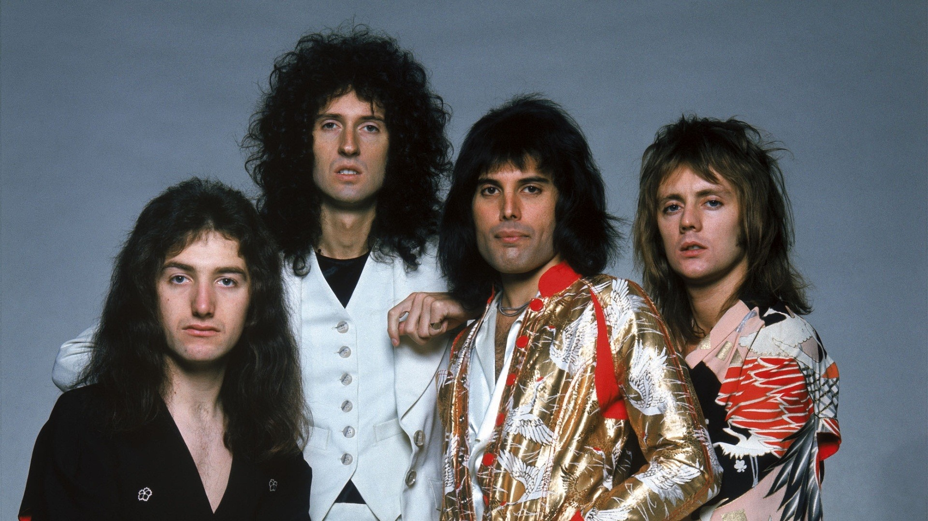
Queen
April
Queen are a British rock band formed in London in 1970.
The band was led the lead singer Freddie Mercury and musicians Brian May and Roger Taylor and John Deacon.
Genre: Rock
Playlist
Queen - Don’t Stop Me Now (Clean Version Lyrics) – YouTube
Queen - We Will Rock You [Lyrics] – YouTube
Queen - I want to break free Lyrics – YouTube
Queen - We Are The Champions [Lyrics] - YouTube

Slide 10
Taylor Swift
May
Born in 1989
She started her singing career singing country folk music but now sings pop songs.
She is the biggest digital selling artist in history.
Genre: Pop, folk, country
Playlist
Taylor Swift - Love Story (Lyrics) romeo save me - YouTube
Shake It Off - Taylor Swift (Lyrics) 🎵 – YouTube
Taylor Swift - Anti-Hero (Lyrics) – YouTube
Taylor Swift - You Belong With Me - YouTube

Slide 11
June
Dolly Parton
Born in 1946
She has sold 100 Million albums worldwide and she owns her own theme park.
She plays the gutair.
Genre: Country
Playlist
Dolly Parton - 9 To 5 – YouTube
Dolly Parton - Jolene (Audio) – YouTube
Dolly Parton - Coat Of Many Colors – YouTube
Dolly Parton - World On Fire (From The 58th ACM Awards) - YouTube

Slide 12
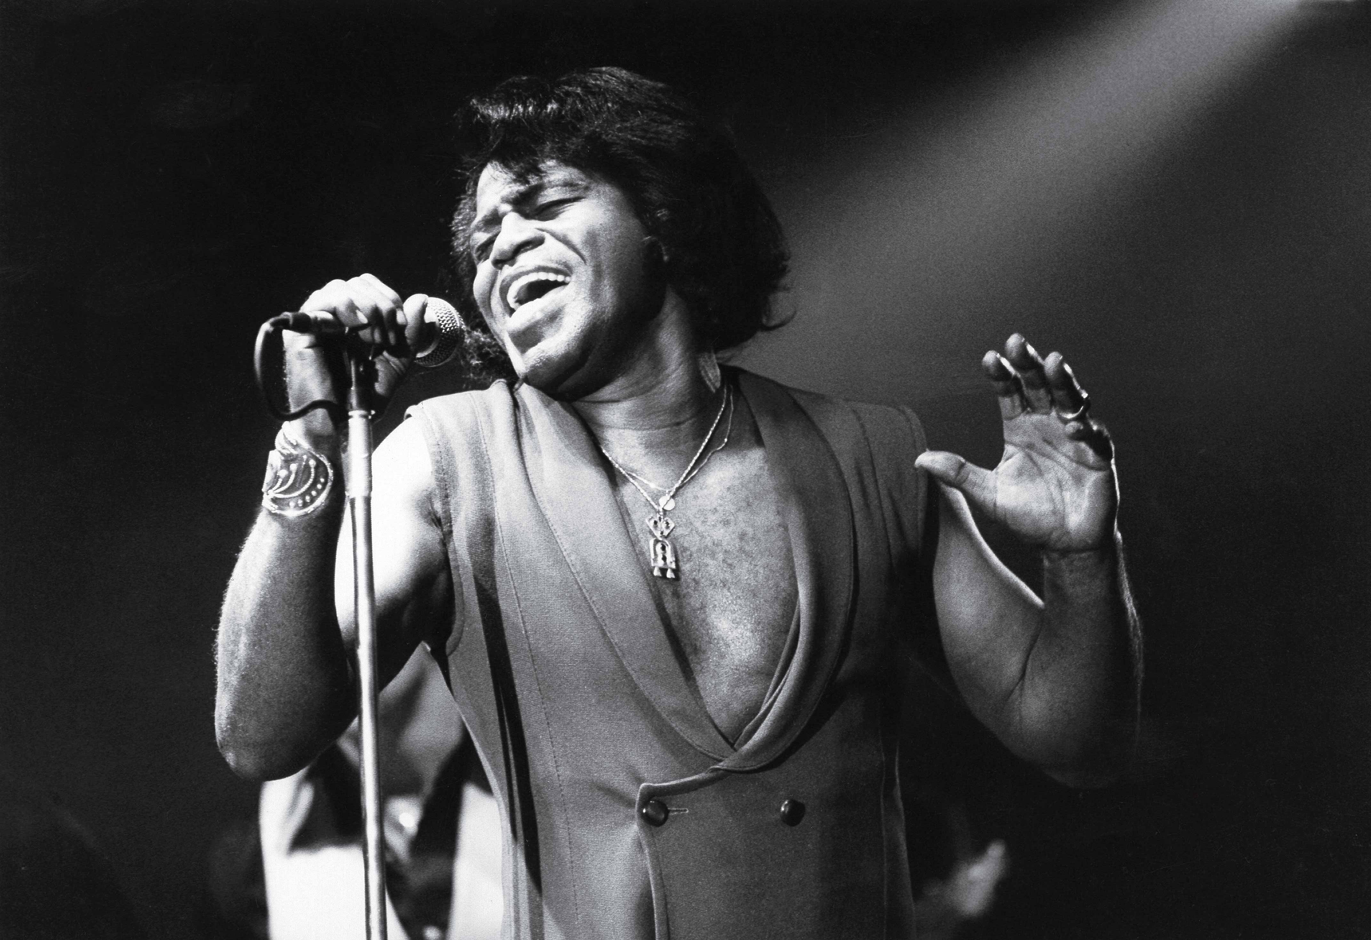
James Brown
July
Born in 1933 in America
Known for screaming on key and blending multiple vocal styles.
Genre: Soul, Funk, known as the Godfather of Soul.
Playlist
James Brown - I Feel Good (Lyrics) – YouTube
James Brown - It's A Man's Man's Man's World (Lyrics Video) – YouTube
James Brown - Living in America – YouTube
James Brown - I Got The Feelin' - YouTube

