Slide 1
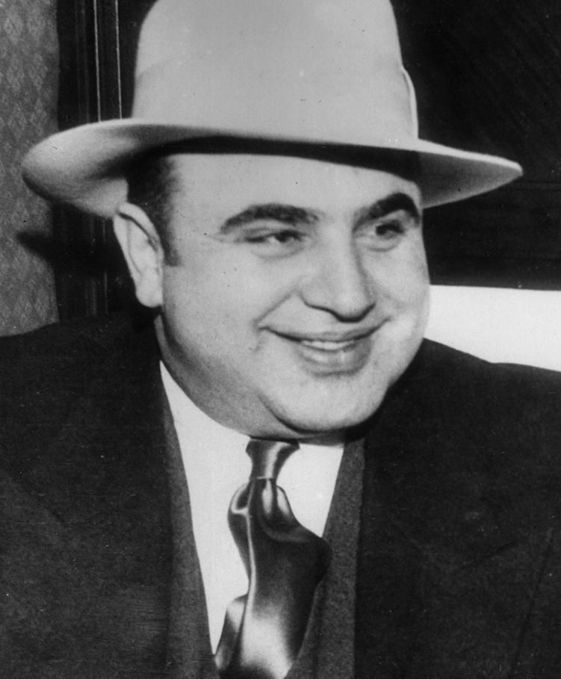
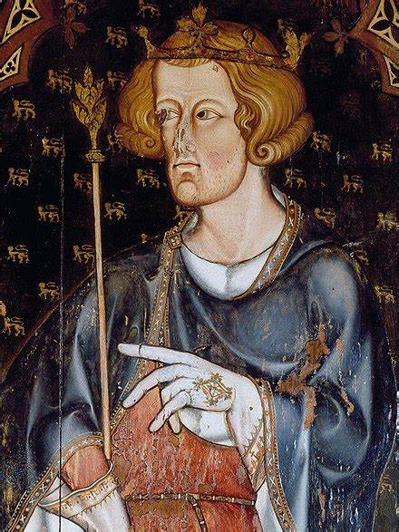
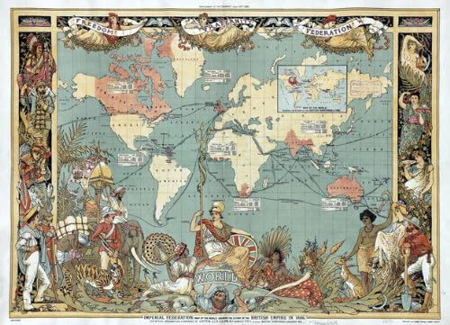
How to Revise GCSE History

Slide 2
CHS Revision Guides
You all have a paper copy of the Essentials Revision guide and it’s on Sharepoint/Satchel.
This contains all of the content and exam technique tips needed to get a grade 4.
However, you should also use the detailed revision guides which are on Satchel and Sharepoint.
These include the specification, model answers, detailed guides on exam technique and detailed revision notes. If you want more than a 4, you must use these lots!

Slide 3
Commercial Revision Guides
You may wish to order a commercial revision guide if you haven’t already done so. It’s not essential that you do – the CHS guides include everything you need. However, some students prefer the different layout/style. It’s up to you!
Oxford AQA GCSE History (9-1): America 1920-1973: Opportunity and Inequality Revision Guide : Wilkes, Aaron: Amazon.co.uk: Books
Conflict and Tension in Asia 1950-1975 Revision Guide: Get Revision with Results (Oxford AQA GCSE History): Amazon.co.uk: Bruce, Lindsay, Wilkes, Aaron: 9780198432869: Books
Oxford AQA GCSE History (9-1): Britain: Migration, Empires and the People c790-Present Day Revision Guide: Get Revision with Results: Amazon.co.uk: Wilkes, Aaron, Bruce, Lindsay: 9781382015035: Books
My Revision Notes: AQA GCSE (9–1) History: Medieval England: the reign of Edward I, 1272–1307: Amazon.co.uk: Linton, Rae: 9781398310193: Books
Click on the links to order a copy of each guide from Amazon. Other suppliers are available!

Slide 4
CHS History Support
We will provide you with lots of support in the build-up to exams.
Lessons will revise key content and exam technique.
After-school revision will run every Tuesday in H4 (3-4) and Friday in H7 (3-4).
We will put on a revision workshop from 3 to 5.15 the day before each of your exams.
Key Dates:
Paper 1 (USA/War in Asia):
15th May (morning)
Paper 2 (Migration and Empires/Edward I):
4th June (afternoon)

Slide 5
How to Revise History
There is an awful lot you need to revise!
Therefore, you need to produce a clear plan of what you are going to revise and when.
Revise little and often. Revise in bursts of 30 to 40 minutes then take a break.
It’s really important that you revise over Easter (and complete the booklet on the USA that your teacher has given you).
We will cover certain key topics in class but we don’t have time to revise everything.
Therefore, it is your responsibility to make sure that you have revised the whole course.

Slide 6
Great ideas for revising (1)
Flash cards are a great way of revising and are used by lots of students at CHS.
Write a question on one side of a small card and the answer on the back.
You can then test yourself with the card, or get a parent, carer, relative or friend to test them.
Top Tip: Keep flash cards in your blazer pocket then you can use them for quick revision in the car or on the bus to school.

Slide 7
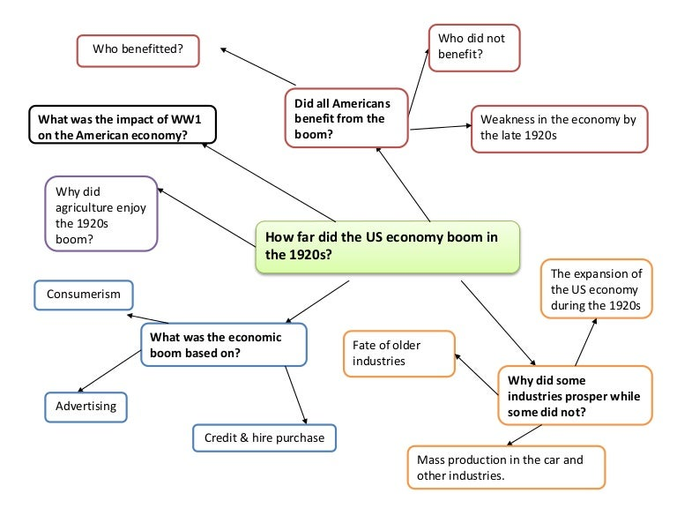
Great ideas for revising (2)
Mind-maps are a great way to revise if done properly.
Pick a topic and put it in a bubble in the middle of the page.
Then write down everything you can remember about the topic in one colour on the mind map.
Then get out your notes/revision guide and check to see how much you remembered.
Add in any information you forgot in a different colour.

Slide 8
Great ideas for revising (3)
Using past exam papers is a great way to get more familiar with how questions are worded and also practise retrieving knowledge.
There are two ways of using past exam papers that work well:
Work through the paper from memory and in timed conditions. Once you have finished a paper, either mark it yourself using a copy of the mark scheme, or get your notes out and add in extra detail that you did not remember. Do this in a different colour.
Another way of using papers is to plan answers from memory rather than write them out in full.
You will find lots of past History papers on Sharepoint.
Top Tip: Your teachers are always happy to mark any past papers you complete.

Slide 9
Great ideas for revising (4)
Divide a piece of paper into 6, 8 or 12 sections to make a retrieval clock.
Write the title of the revision topic in the middle of the page.
Each section is one aspect of the topic.
Spend five minutes, working from memory, to fill in each section.
Then use notes/a revision guide to make corrections/add in missing details.

Slide 10
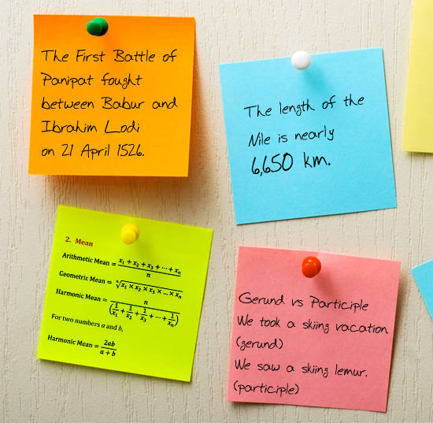
Other Revision Ideas
Working through notes and writing a summary of the key information.
Watching a suitable documentary or listening to a podcast can help develop subject knowledge. Teachers can provide guidance on suitable resources.
Revision websites such as BBC Bitesize contain key information and revision tasks.
Some students find writing key facts on post-it notes helps. These can then be stuck around the house or on a revision wall.

Slide 11
Ways of revising that don’t work very well
People can sometimes spend hours revising but not actually achieve much. This is because some revision methods are less useful at helping information stick in the brain, or simply waste time. Here are some things that do not work as well:
Re-reading notes, or copying notes out word-for-word.
Turning information into images.
Adding lots of pictures and colour to notes/mind-maps. This can feel like a useful activity but is actually a good way of wasting time!
Going through old work and highlighting it. This can make the notes look pretty but doesn’t actually help get the knowledge to stick in the brain.

Slide 12
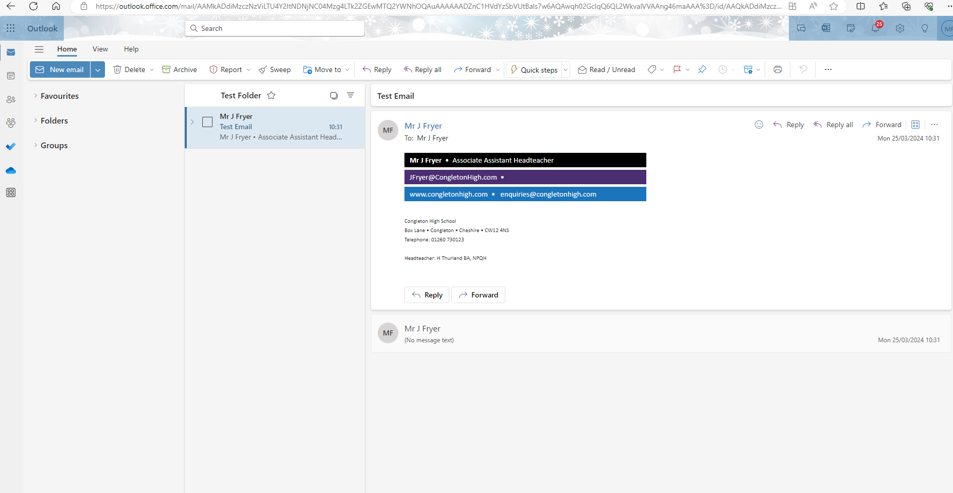
Sharepoint – How to access loads of helpful History resources.
Log in to your school email. Then click on the nine dotes in a square in the top left corner.
This brings up a drop-down menu. Select Sharepoint from the list.

Slide 13
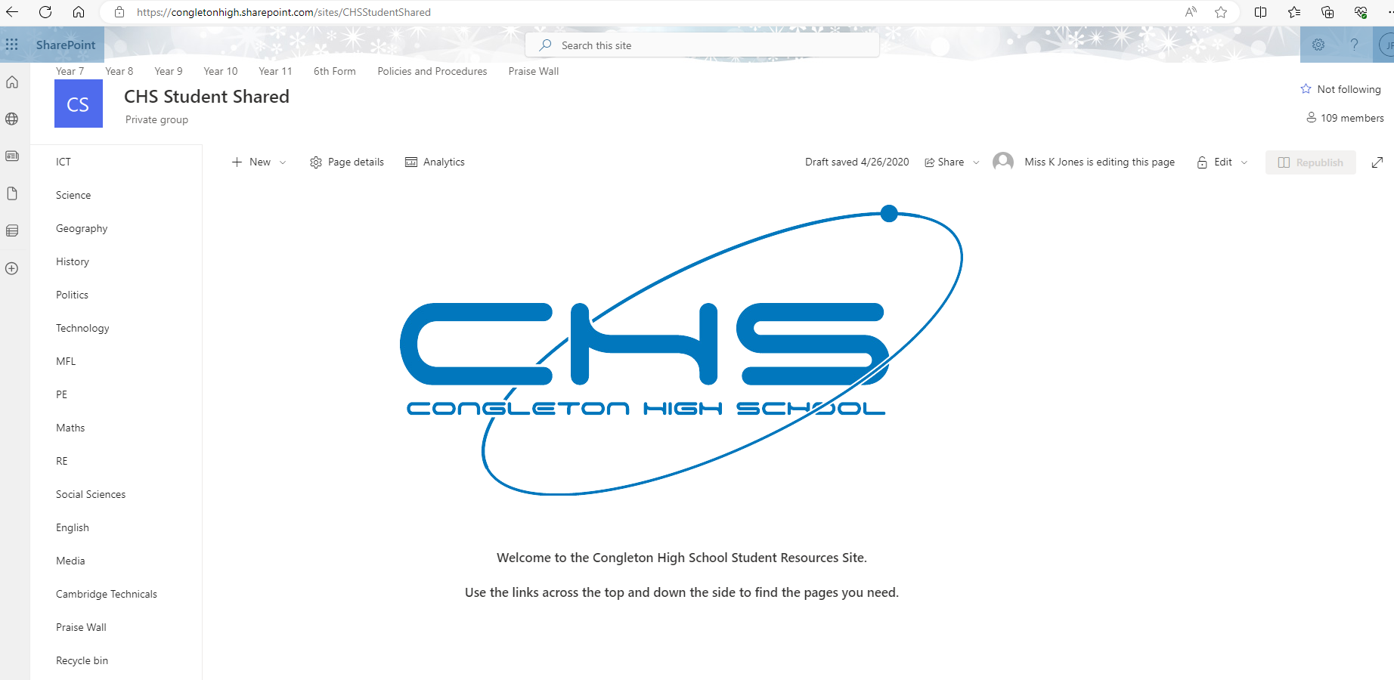
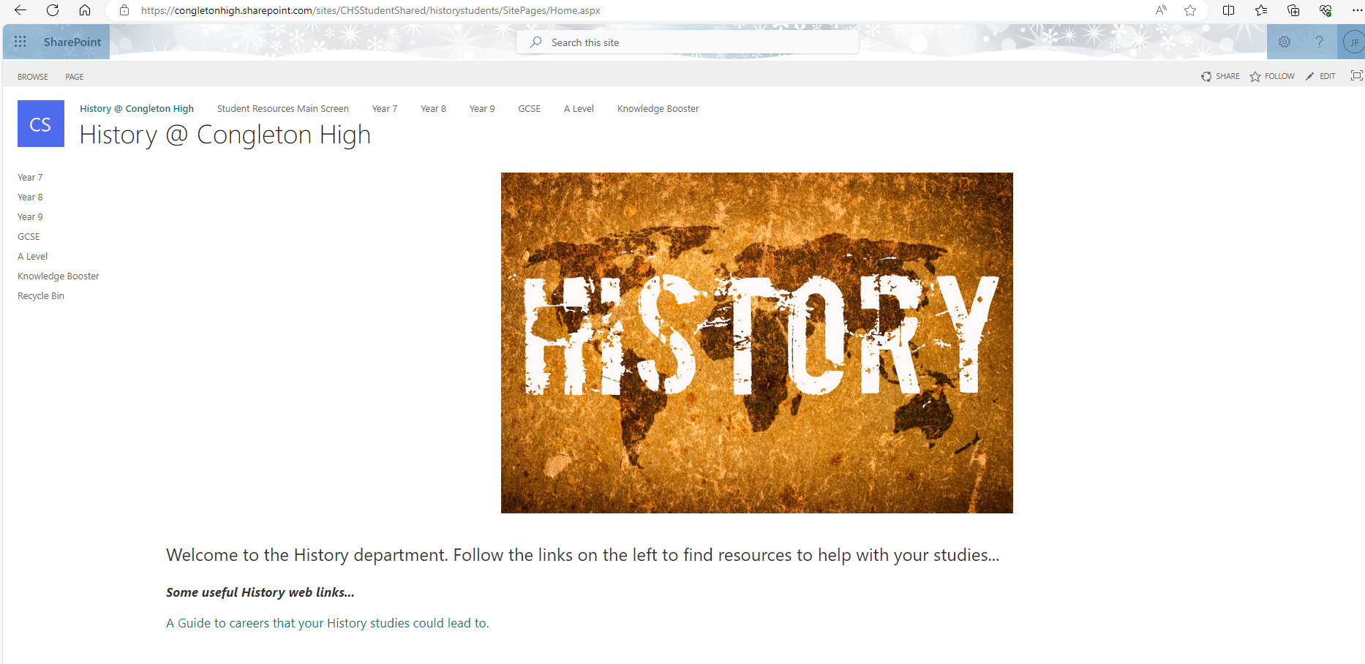
Once in Sharepoint, select CHS Student Shared. Then, select History from the menu.
Once in the History area, select GCSE.

Slide 14
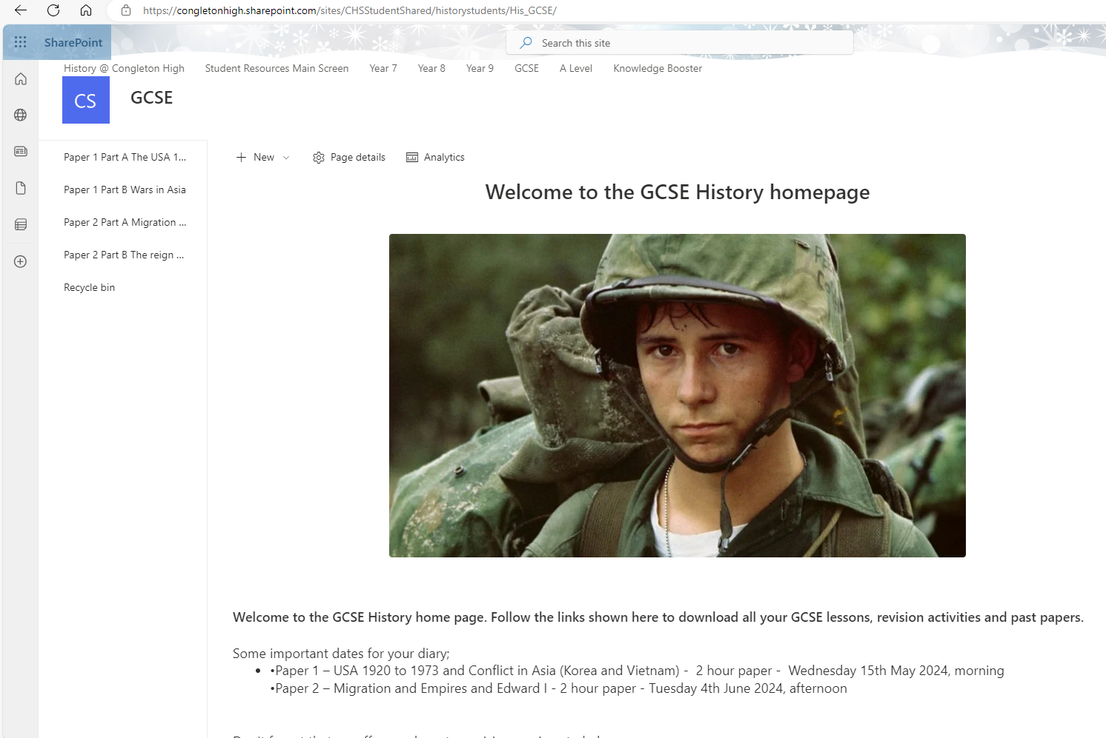
You can then select which unit you want to study.
For each unit, there are files containing the lesson Powerpoints, past papers, revision resources and some lessons with audio recordings.

Slide 15
To Finish…
GCSE History is a challenge…but it’s a challenge for every History student in the country.
Never give up, even if the going is tough.
Have a good plan.
Stick to it.
Revise hard.
Access all the support CHS is offering you.
Don’t be afraid to contact your teachers at any point with any questions.
Make sure you are the next big success story!

