Slide 1
Welcome to Conway
September 2025
Notes:
This week
Save ourselves time in the classroom – repetition of quizzes! I think most people were a little shocked with what they could remember / or couldn't remember so let's have another go!

Slide 2
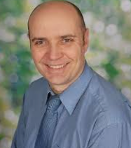
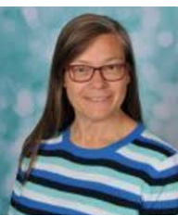
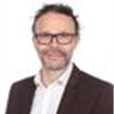
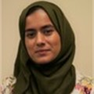
Meet the Senior Leaders

Slide 3
Meet the Year 3 Teachers
Miss Bi – 3B
Miss Malik 3M
Notes:
Add photos

Slide 4
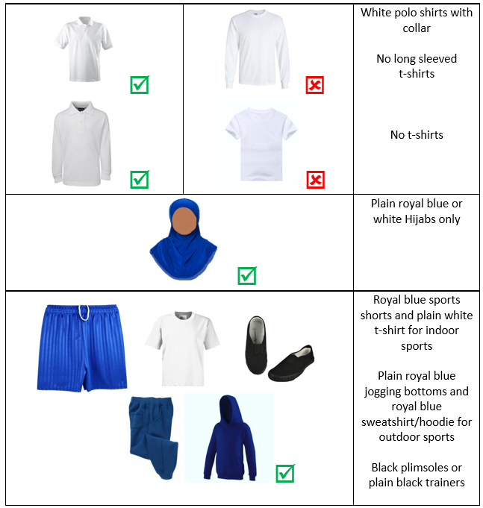
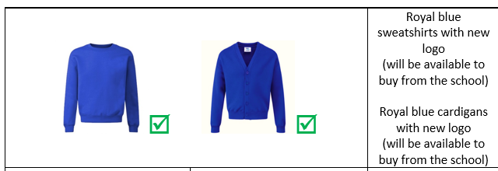
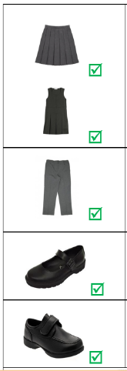
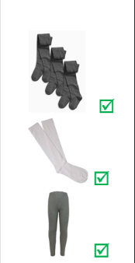
Uniform
PE - Black joggers and white polo shirt with collar.

Slide 5
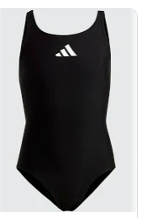
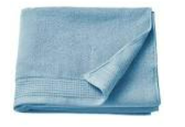
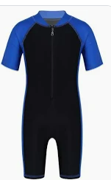
P.E/Swimming 3B
Your child will need a towel and a swimming costume.
This term 3B will have swimming every Thursday afternoon.
3M have swimming on Wednesday afternoon
Please ensure your child comes in their P.E kit on both days.
Black joggers and a plain white t-shirt.

Slide 6
P.E – 3R
3M and 3B will have P.E on a Friday afternoon.

Slide 7

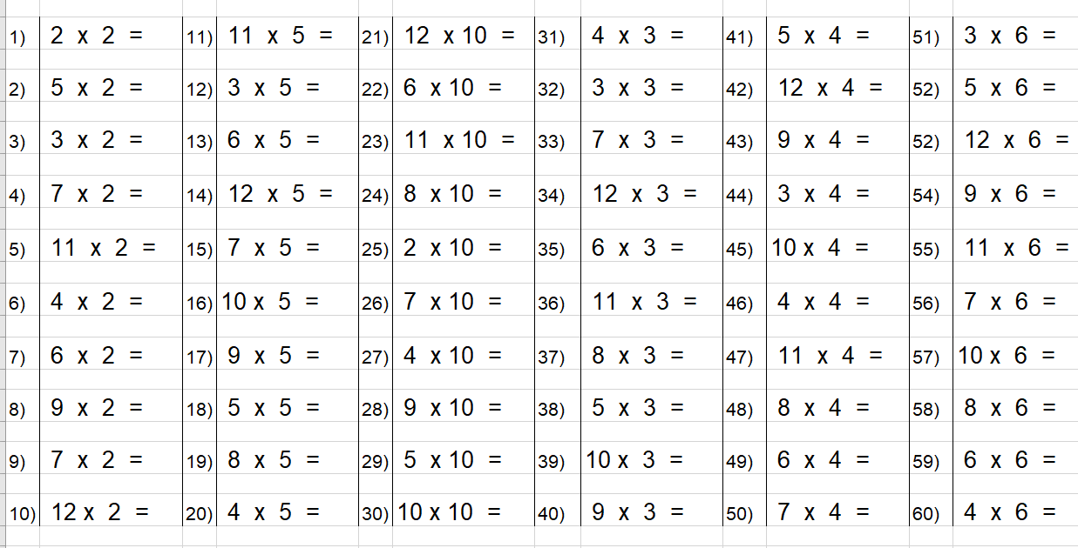

Maths
This half term in math, the children will be building on their knowledge of place value, as well as addition and subtraction.
We continue to focus on number-bonds and times tables. We use rolling numbers to practice our times-tables. You can also access these videos at home via the school website. Please encourage your child to access Times-table rockstars at home as often as possible.
All children should have their logins in their reading journals. speak to your child’s teacher if you require any assistance with this.
Notes:
What times tables, key facts and units to be covered

Slide 8
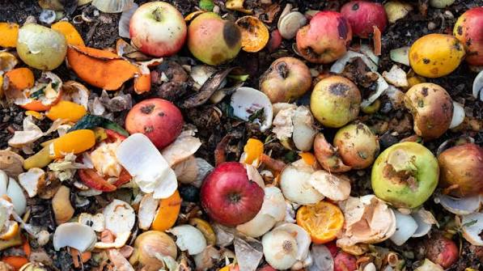
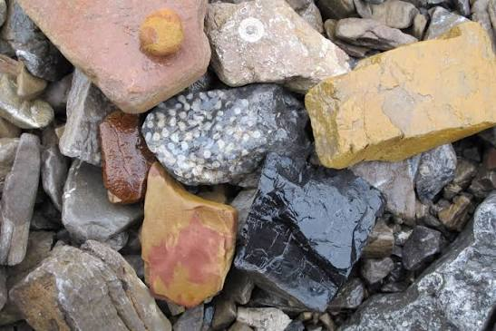
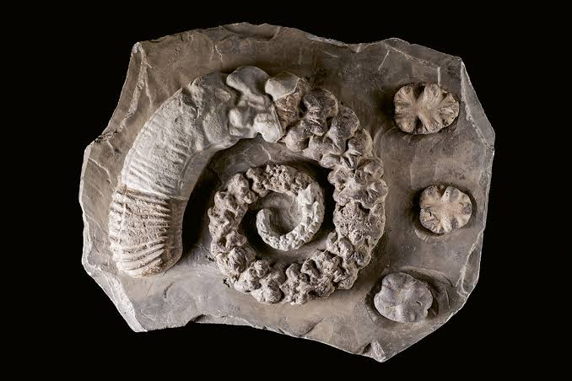
Curriculum Unit this half term – Science
We have been learning about food waste and how we can reduce it by only taking what we need, saving leftovers and recycling food scraps. This links to the Stone Age, when people had to use food carefully because they relied on hunting and gathering for survival.
We also learned about rocks and how they come in different shapes, colours, sizes and textures. Stone Age people used rocks to make tools and weapons.
Finally, we learned about fossils and how they help us understand plants, animals and environments from the past. This helps us understand the world that Stone Age people lived in.

Slide 9


Curriculum Unit this half term
–History
Stone Age
In history, we have been studying the Stone Age. The children have been learning all about the changes that occurred during this period.
We have also been learning about the technological advancements for this period.
Notes:
What is it called, what will you cover, what can parents do at home
Include information about any educational visits

Slide 10


Writing
In Writing, this half term we will continue to practice our handwriting using letter-join. We will be working to build our writing skills to produce a diary entry and setting description . We are currently reading Stone Age boy.
Notes:
What are nouns?
What are ENP?
What are the different part of clauses (independent/ dependent)
Looking at conjunctions – connecting sentences

Slide 11
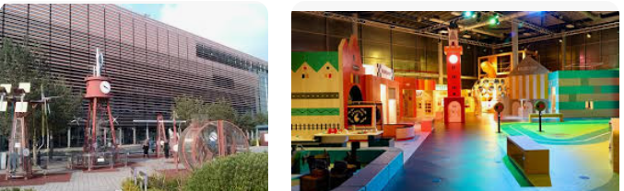
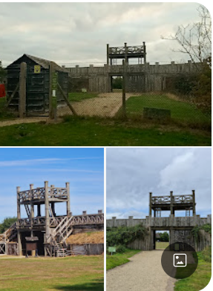
Trips
On October the 9th , we are taking the children to Think Tank in the City centre. This trip links to our science topic about bones and our Stone Age topic in History. The cost is £8 per child. The children will travel via public transport to keep costs to a minimum.
On The 21ST January 2026, we will be taking the children to the Lapworth museum at the University of Birmingham, this will cost £6.50 per child.
In ( Summer 1) June 2026 we will be taking the children to Lunt Fort, in Coventry. This will be linked to our history topic “ the Romans”. The approximate cost will be £25.
Our total cost for trips this year will be approx £40. You can pay in instalments so you can spread the cost out over the year.

Slide 12
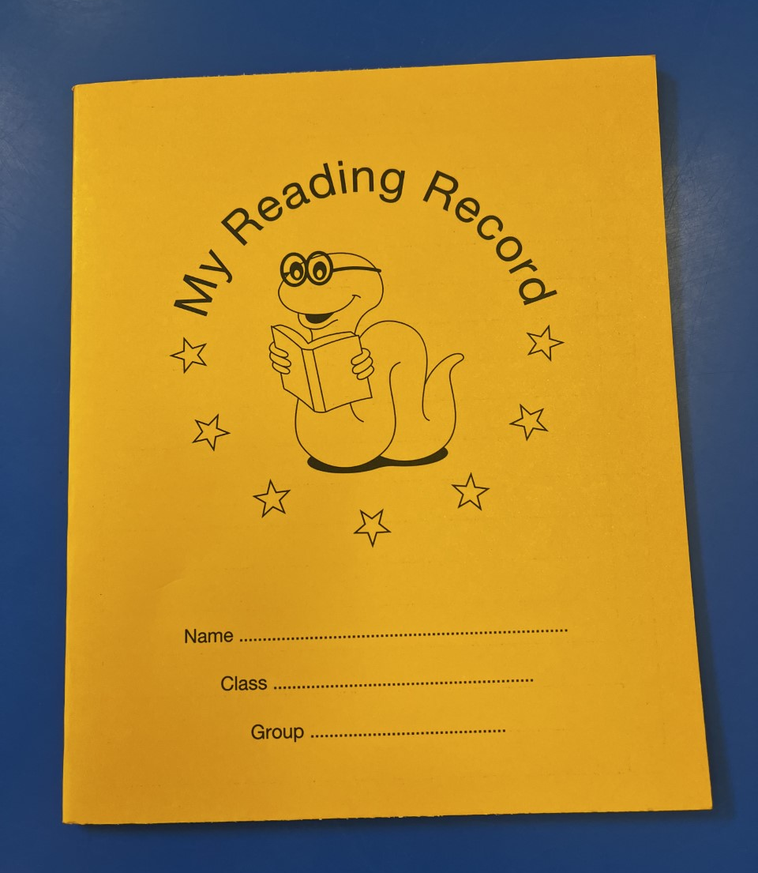
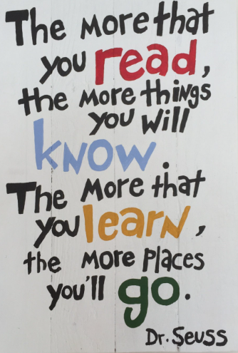

The importance of reading
Reading is one of the greatest gifts we can give to our children.
Notes:
Share text you will read in school, show how to complete reading diaries and encourage to read daily – home language is fine.

Slide 13
Our vision
For all children to have a love for reading and writing to prepare them for the next stage of education and beyond. We want our pupils to leave as confident readers and writers with a rich vocabulary that they can use in a wide variety of settings.

Slide 14
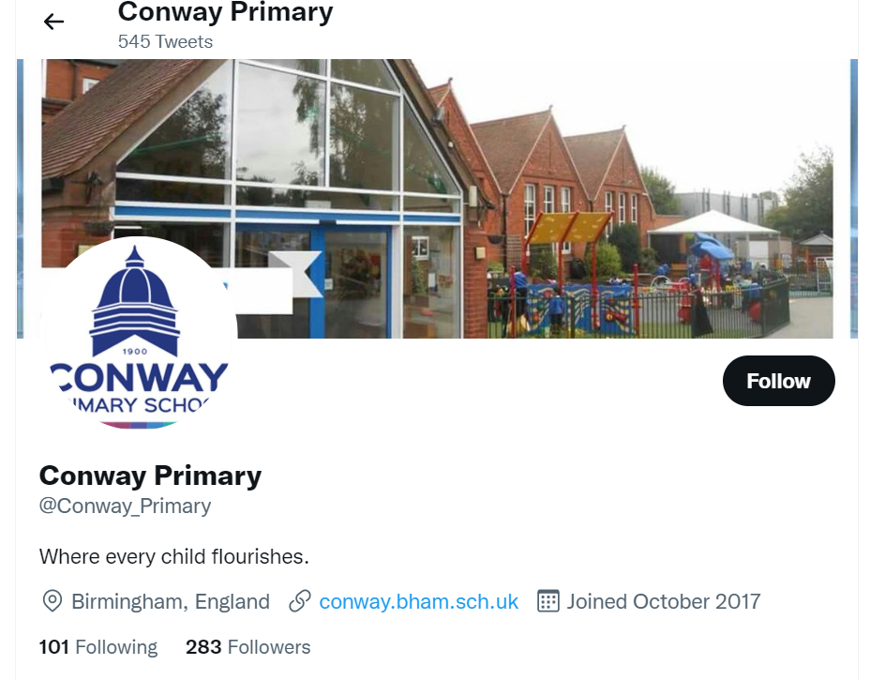
Social Media
We want everyone to be involved in our school as much as possible – community is important to us.
Our social media is regularly updated so please follow us on Facebook and Twitter.
Twitter:
@Conway_Primary
Notes:
Class teachers add twitter handles

Slide 15
Partnership
As a school, we want the very best for your child. This happens when we work together. If you have any concerns, please speak to us after school or make an appointment at the school office.

