Slide 1
Welcome to Conway
September 2026

Slide 2
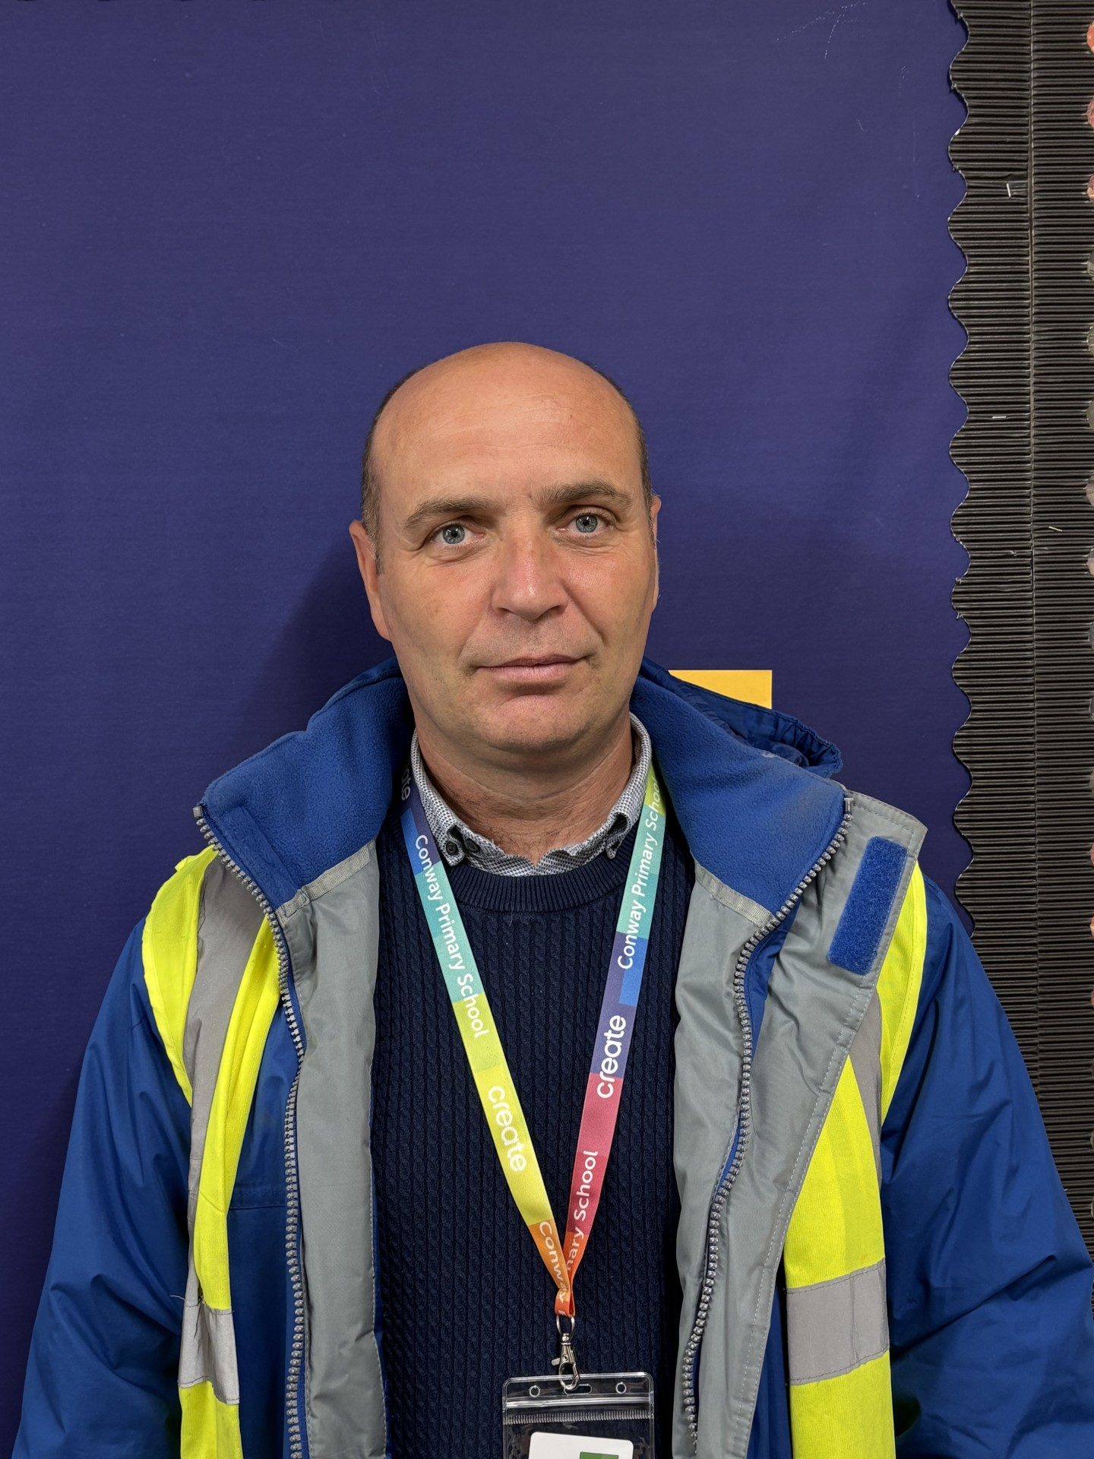
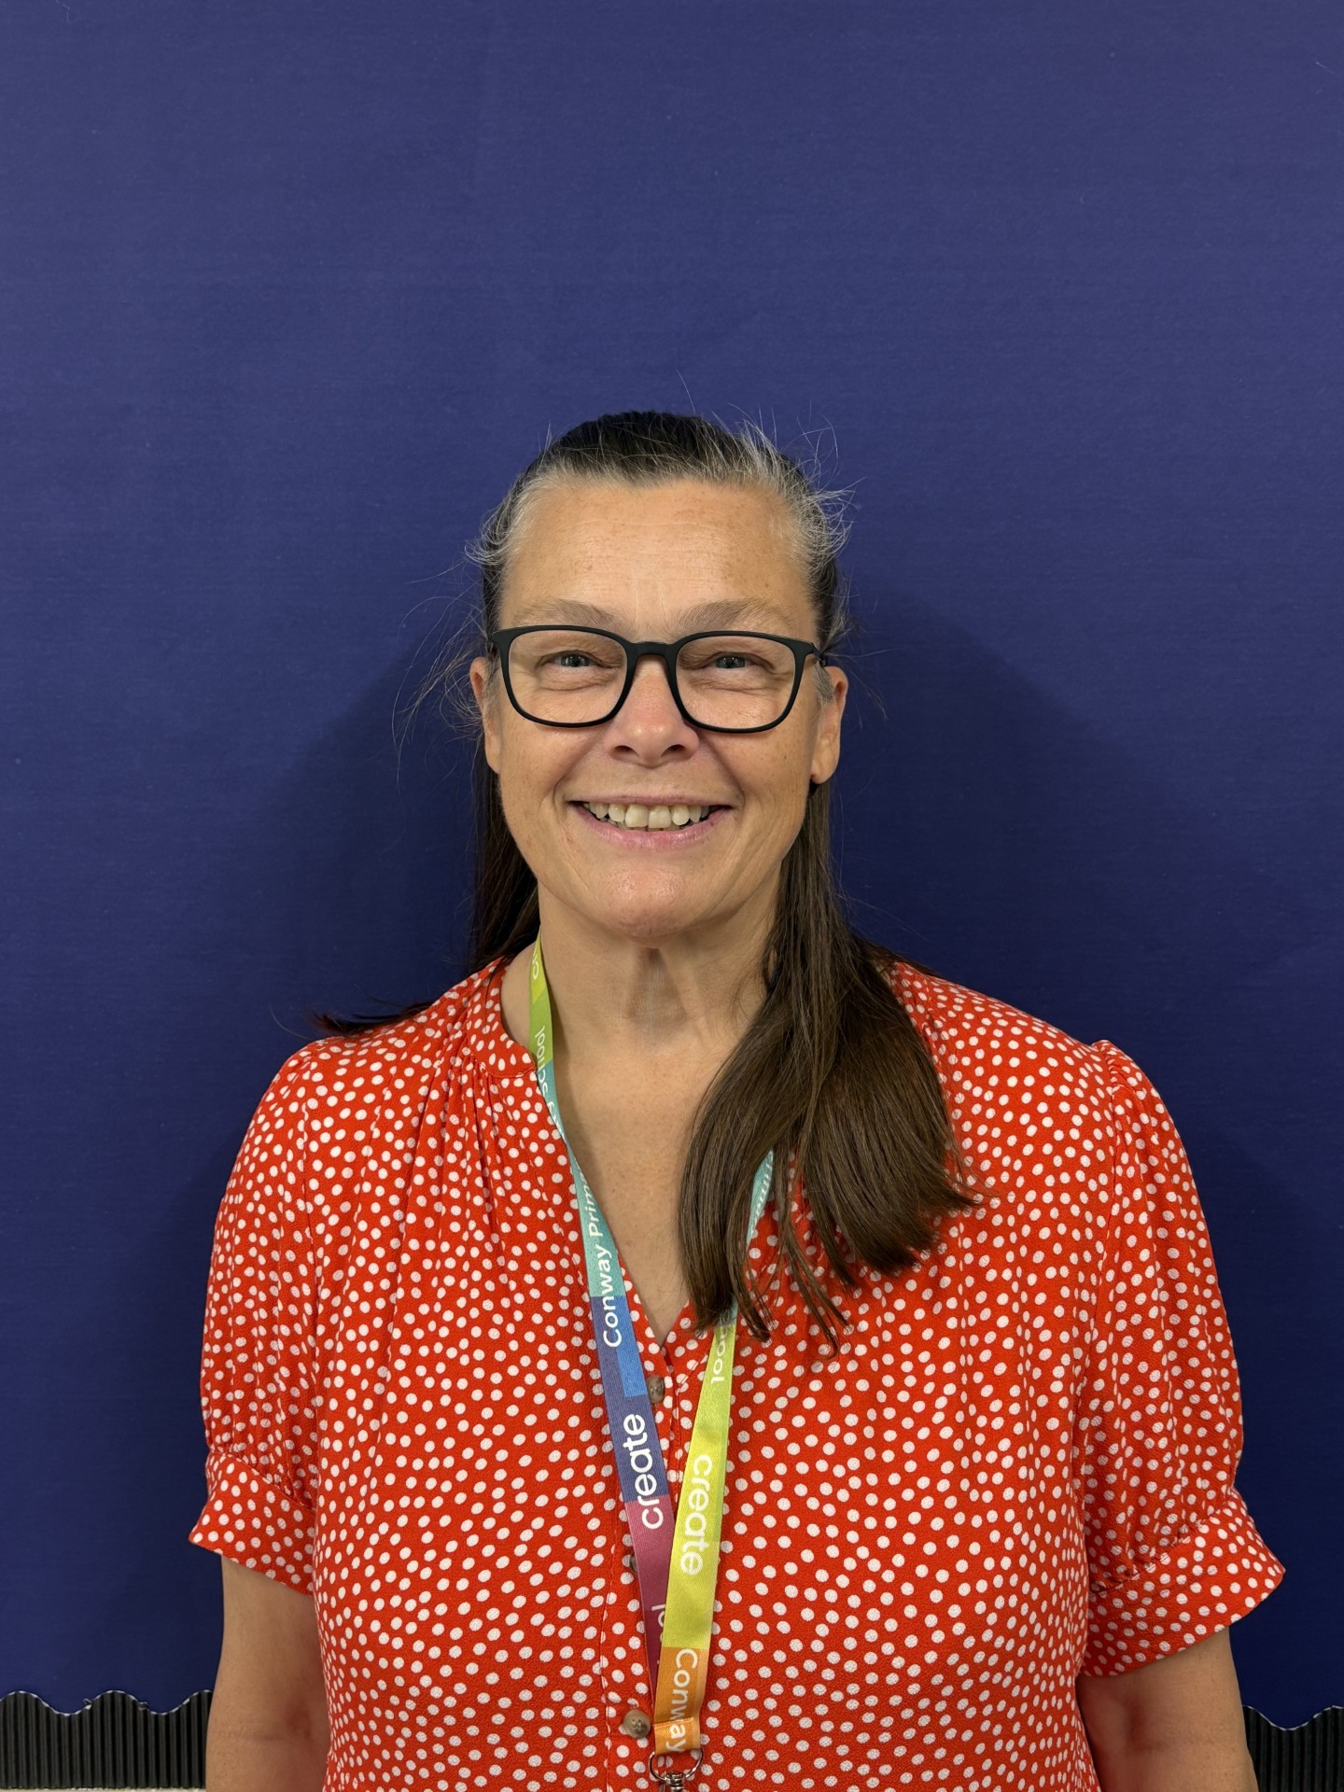
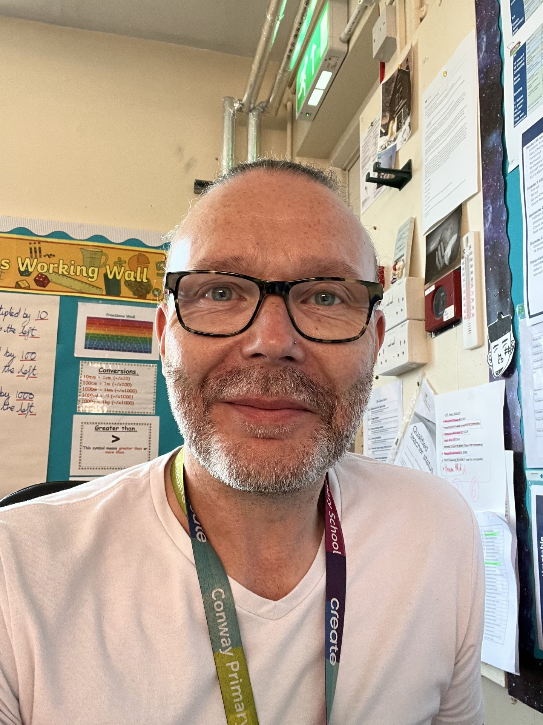
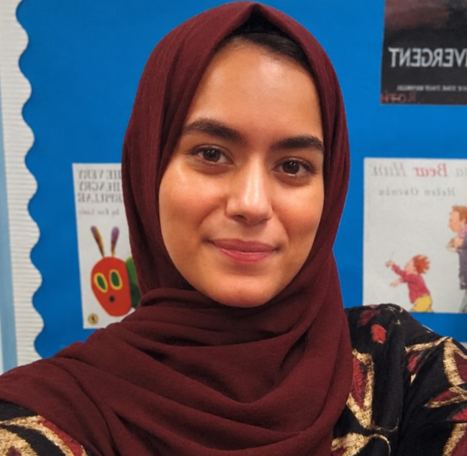
Meet the Senior Leaders
Mr Rose
Headteacher
Mrs Poval
Deputy Headteacher
Miss Jehangir
Assistant Headteacher
Mr Wheldall
Assistant Headteacher
Notes:
We will come to as many as we can – we can’t do Monday morning as we will be covering Y6 PPA

Slide 3
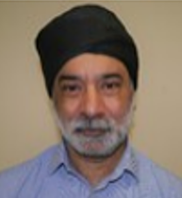
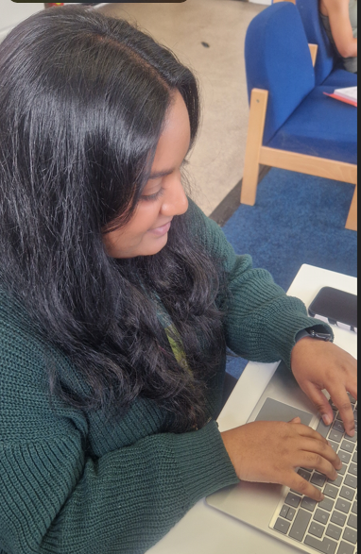
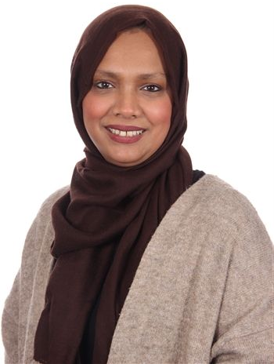
Meet the Year Group Team
Mr Singh
Miss Roy
Mrs Begum
Notes:
Take pics and introduce your team.

Slide 4
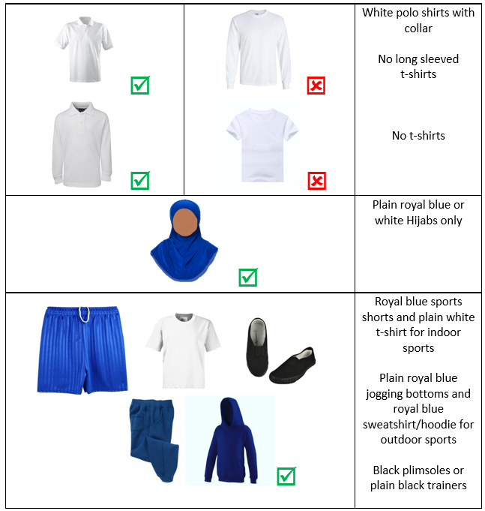
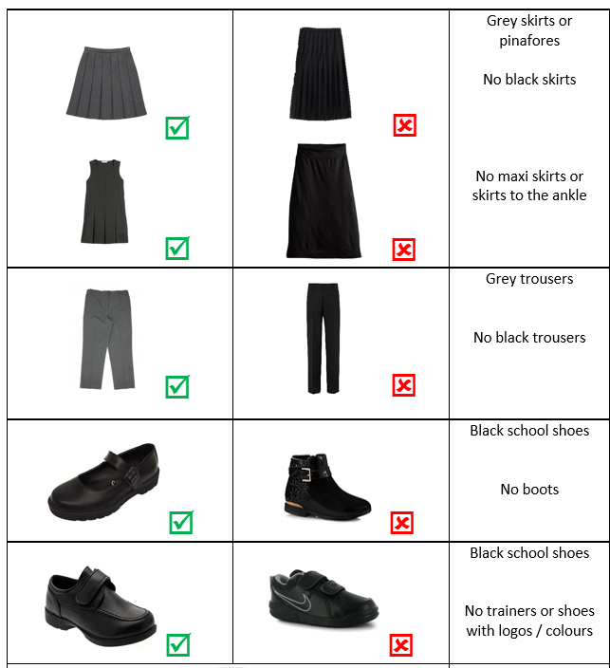
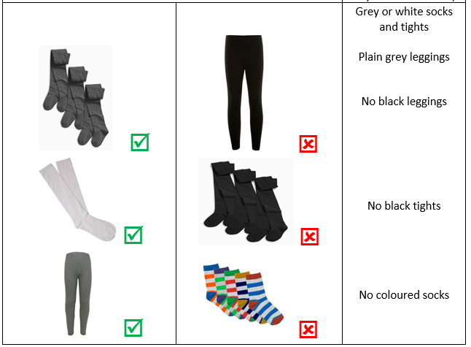
Uniform
Notes:
Explain the expectations for uniform and jewelry (inc. PE)

Slide 5
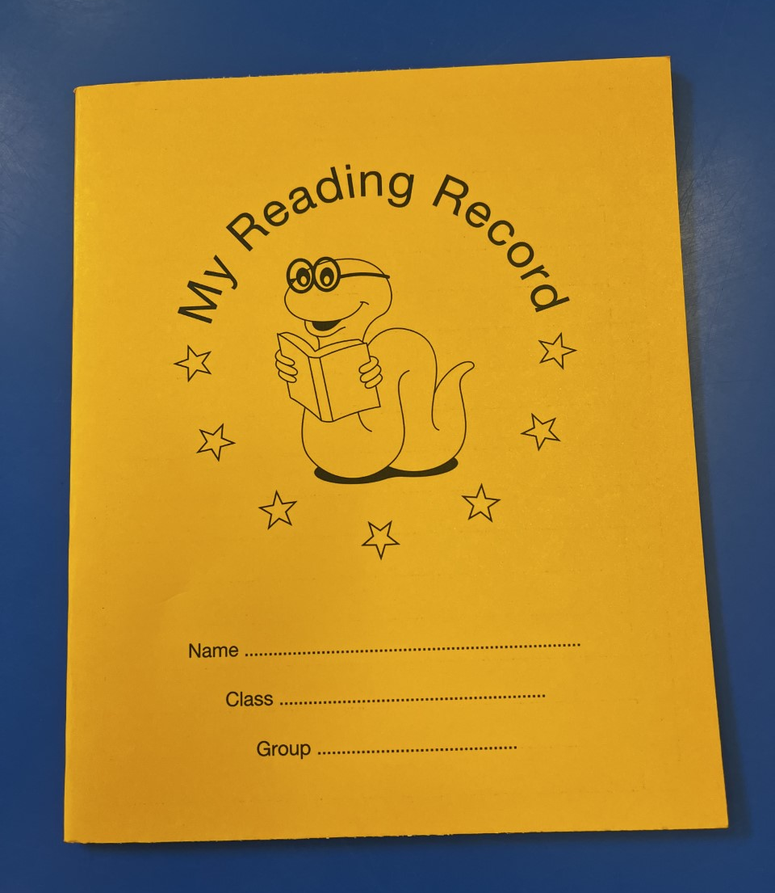
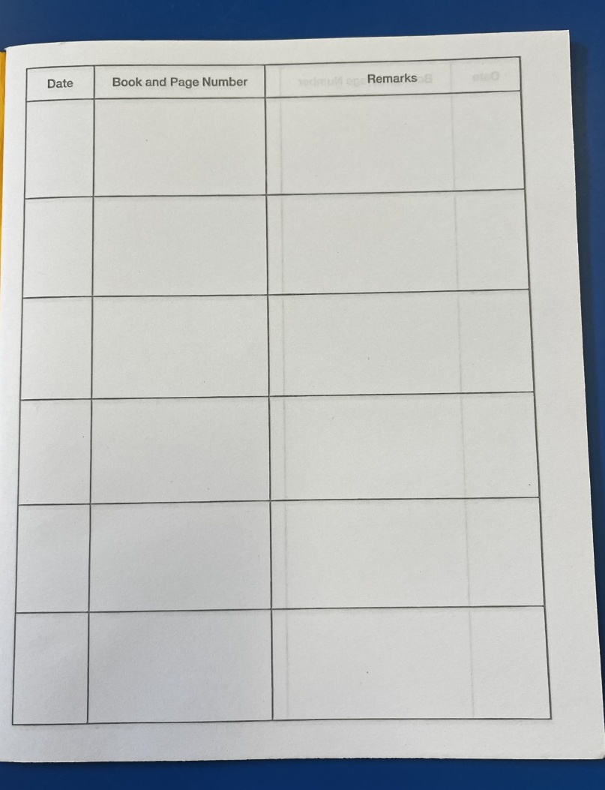
The importance of reading
‘Young people who enjoy reading very much are nearly five times as likely to read above the expected level for their age compared with young people who do not enjoy reading at all.’
Notes:
Share text you will read in school, show how to complete reading diaries and encourage to read daily – home language is fine.

Slide 6



Slide 7
Writing
For writing, the children will begin to write a letter where they see themselves at the end of Year 4.
Children will also write a non-chronological report about volcanoes, earthquakes and tsunamis. We will present this as a digital presentation, with images and hyperlinks.
Notes:
Rima

Slide 8
Curriculum Unit this term - Science
Our Science unit for this term is ‘Group and classify living things ’.
The children will learn to identify and sort animals into groups based on their features. The children will be shown examples of animals that are hard to categorise such as a platypus to challenge thinking and reasoning skills.
In addition to this, they will learn the scientific names for different parts of a plant and look at the difference between flowering and non- flowering plants. They will then use this information and group plants in different categories.
For scientific enquiry, the children will explore their local area to identify animals that are vertebrates and invertebrates. They will gather and record data.
Notes:
What is it called, what will you cover, what can parents do at home
Include information about any educational visits
hildren can explore their local area to identify different invertebrates. In this step, children should simply identify and count the animals they find. They will gather and record data using their local area in more detail in the next block.

Slide 9
Science
Children will also learn about Food Chain and States of Matter which includes liquids and gases and the Water Cycle.

Slide 10
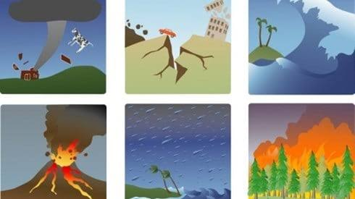
Curriculum Unit this half term- Geography
In this unit pupils will learn about Natural Disasters:
They will be looking at…
The layers of the Earth and tectonic plates
Volcanoes and why they erupt
Earthquakes and what causes them
Tsunamis and how they form
How natural disasters affect people and places
How communities prepare for and respond to natural disasters
Key skills:
Using maps • geographical vocabulary • comparing places • explaining cause and effect • exploring real-life case studies
Notes:
Key vocab:
Petty theft (stealing low-value items): Fines, public humiliation (such as being placed in the stocks or pillory)
Trespassing (entering or remaining on another person's property without permission): Fines or public shaming.
Vagrancy (wandering without a permanent home or means of support): Whipping, branding, or forced labour.
Major Offenses (Felonies):
Murder: Execution, typically by hanging.
Treason (betraying one's country or monarch): Execution, often by hanging, drawing (dragging behind a horse), and quartering (dismembering the
body).
Witchcraft: Execution, usually by burning at the stake.
High treason (plotting against the monarch or the state): Execution, often by beheading.
Robbery (stealing through force or threat of force): Fines, public humiliation, or imprisonment
Falak

Slide 11
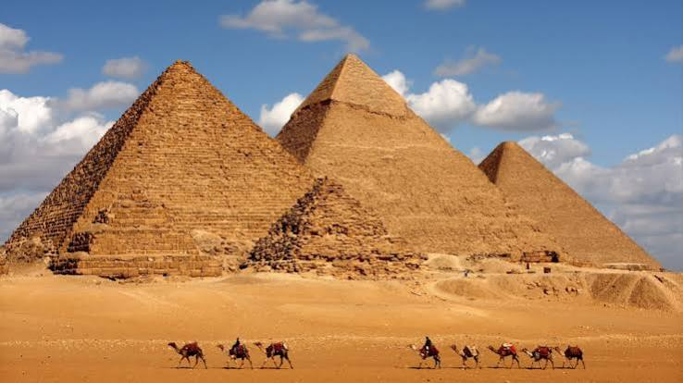
Curriculum Unit next half term- History
This term, children will learn about:
Where and when the Ancient Egyptians lived
How we use historical sources to learn about the past
Why the River Nile was so important
Egyptian society and the role of the Pharaoh
Egyptian gods, beliefs and the afterlife
The discovery of Tutankhamun and what it tells us about Ancient Egypt
Key skills:
Using timelines • exploring historical sources • asking questions • comparing past and present • using evidence

Slide 12

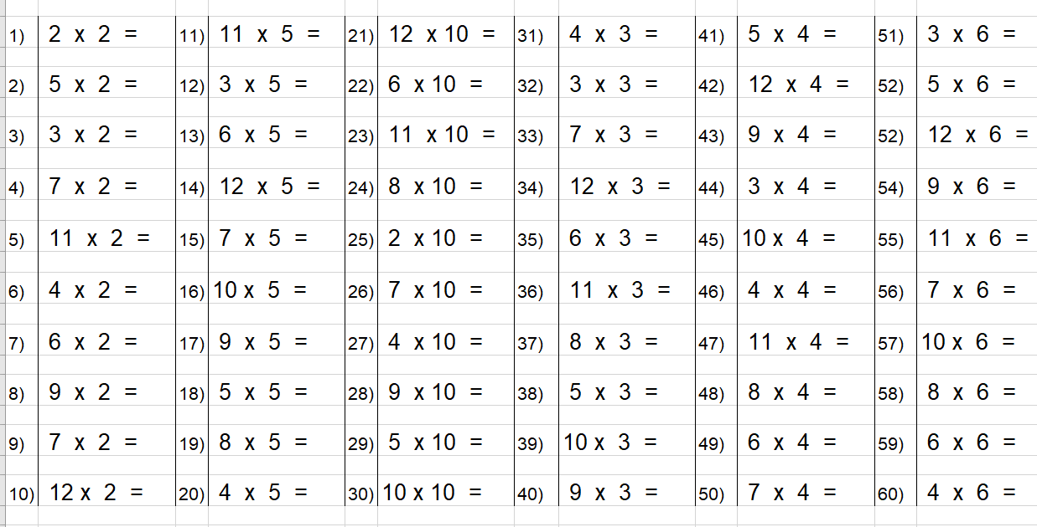

Maths
This half term in Maths, the children will be building on their knowledge of place value.
We continue to focus on number-bonds and times tables. We use rolling numbers to practice our times-tables.
You can also access these videos at home via the school website.
Please encourage your child to access Times-table rockstars at home as often as possible.
All children should have their logins in their reading journals. Speak to your child’s teacher if you require any assistance with this.
Notes:
What times tables, key facts and units to be covered

Slide 13
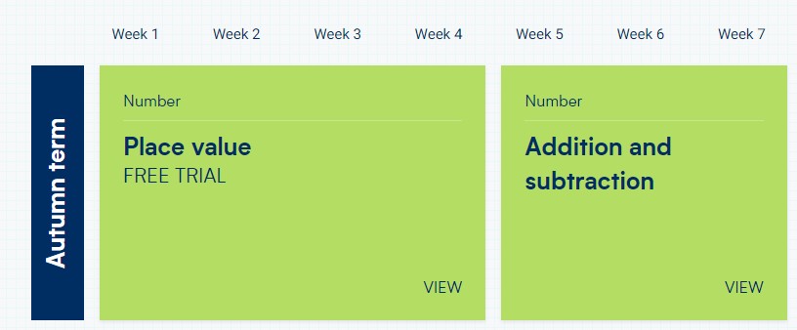
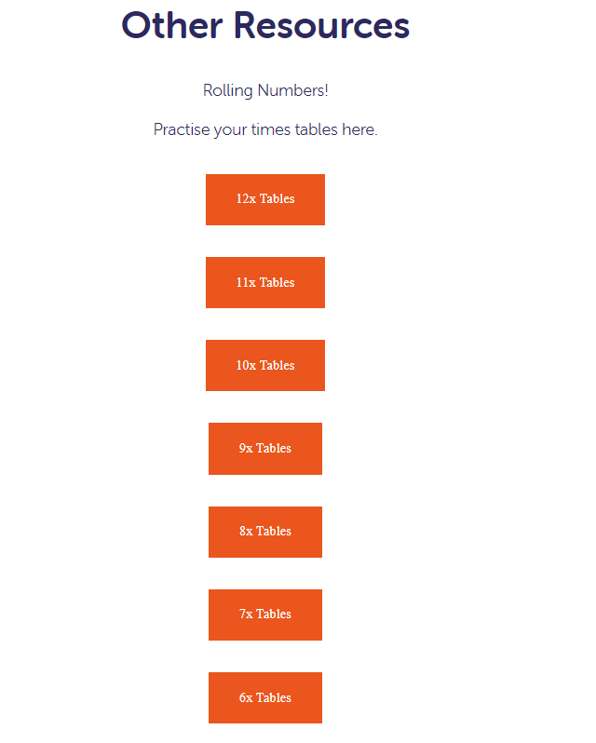
Maths
Rolling Numbers
How to access from home via our website
Conway Primary School
Go to our website >> Virtual School >>
Other Resources >>
This half term we are focusing on place value, addition and subtraction!
Notes:
This half term we are focusing on place value, addition and subtraction. This year it is really important for Year 4s as they will be sitting their multiplication test check where they need to know their times tables up to 12x tables. Rolling numbers is a great way to get them to know their times tables and they absolutely love it! We have access to this on our website. They should be fluent and be able to recall their times tables easily. We are constantly practicing them at school so if you could practice these with the children at home would be fantastic!
Show parents where and how to access.
Falak

Slide 14
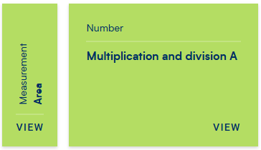
Maths
Rolling Numbers
How to access from home via our website
Conway Primary School
Go to our website >> Virtual School >>
Other Resources >>
Next half term we are focusing on measurement and multiplication and division!
Notes:
This half term we are focusing on place value, addition and subtraction. This year it is really important for Year 4s as they will be sitting their multiplication test check where they need to know their times tables up to 12x tables. Rolling numbers is a great way to get them to know their times tables and they absolutely love it! We have access to this on our website. They should be fluent and be able to recall their times tables easily. We are constantly practicing them at school so if you could practice these with the children at home would be fantastic!
Show parents where and how to access.
Falak

Slide 15

Statutory Testing MTC
The Multiplication Tables Check (MTC) is a key stage 2 assessment to be taken by pupils at the end of year 4 (in June). The MTC’s purpose is to ensure the times tables knowledge is at the expected level. This is a statutory for primary schools.
The Multiplication Times Tables Check is an online test where the pupils are asked 25 questions on times tables 2 to 12. For every question, the children will have 6 seconds to answer, and in between the questions, there is a 3-second rest. Questions about the 6, 7, 8, 9, and 12 times table come up more often. The questions are generated randomly based on the rules of the MTC.
Multiplication tables check
Schools must administer the multiplication tables check within the 2-week period from Monday 7 June 2027.
Notes:
Share if any for your year group. Tell parents there will be a dedicated workshop later in the year.

Slide 16
How to prepare
A good way to prepare is to start early and build a daily routine practising the times tables. With regular practise your child will learn all the questions and gain confidence. We suggest practising 10 to 15 minutes a day for optimal results.
You can use the following websites to help your child practice:
Times table Rock star -TTRS games and worksheets
Urbrainy.com
Timestable.co.uk
Hit the button
Topmarks.co.uk
In Spring 1 we will be holding an after -school times table club for those children that need the extra help.
Notes:
Share if any for your year group. Tell parents there will be a dedicated workshop later in the year.
Falak

Slide 17
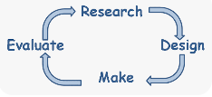
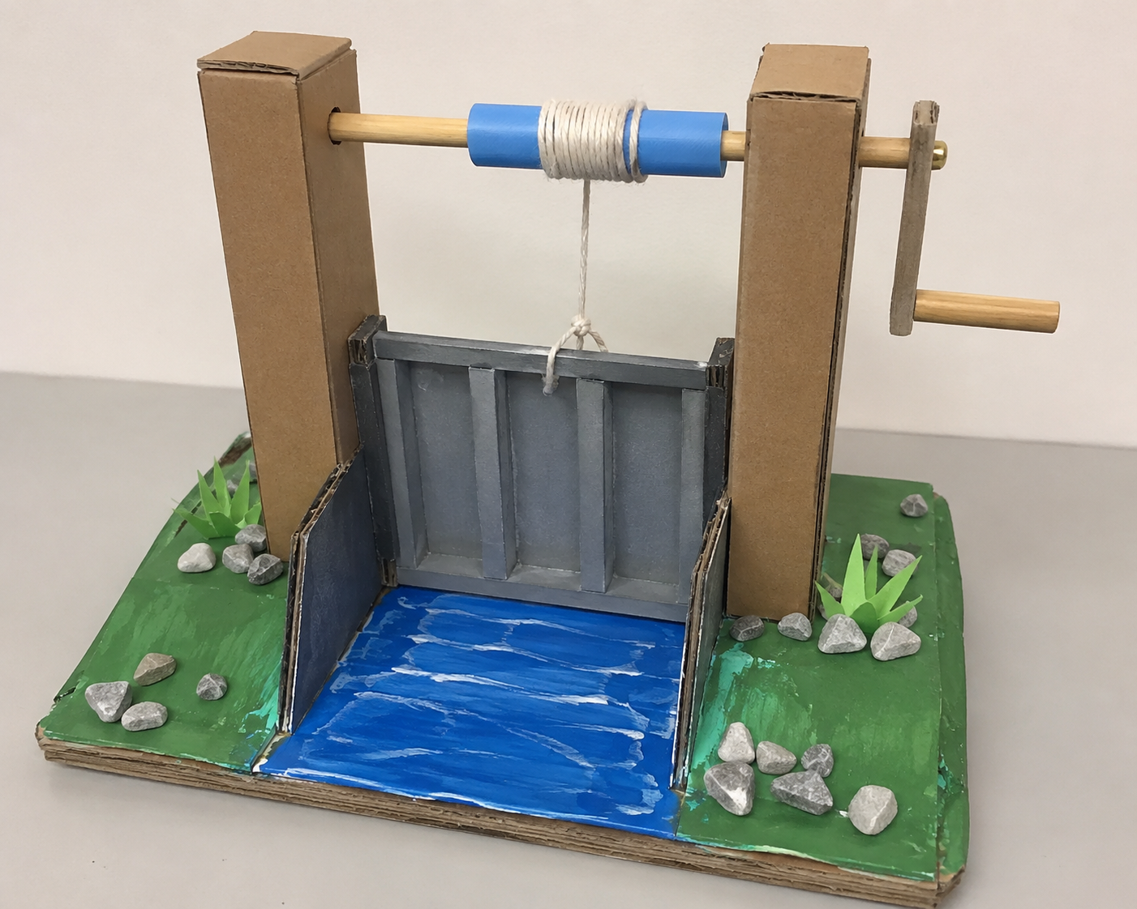
Design & Technology
Children will design, make and evaluate a Working Flood Barrier Using a Crank Mechanism

Slide 18
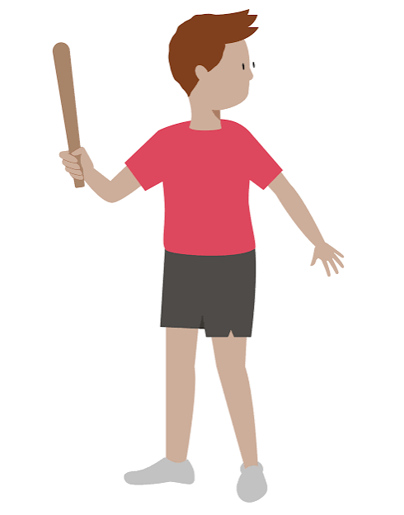
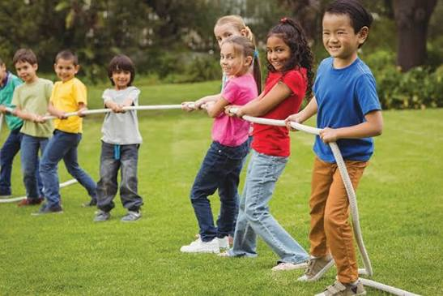
PE Days
Year 4 PE lessons will take place every Tuesday and Wednesday.
Correct school PE uniform
This half term, our PE focus is Rounders and Outdoor activities

Slide 19


Homework in Year 4
Checked every Friday
New spellings and tasks
given every Friday

Slide 20
Partnership
As a school, we want the very best for your child. This happens when we work together. If you have any concerns, please speak to us after school or make an appointment at the school office.

