Slide 1
Welcome to Conway
Thursday 17th September 2026

Slide 2
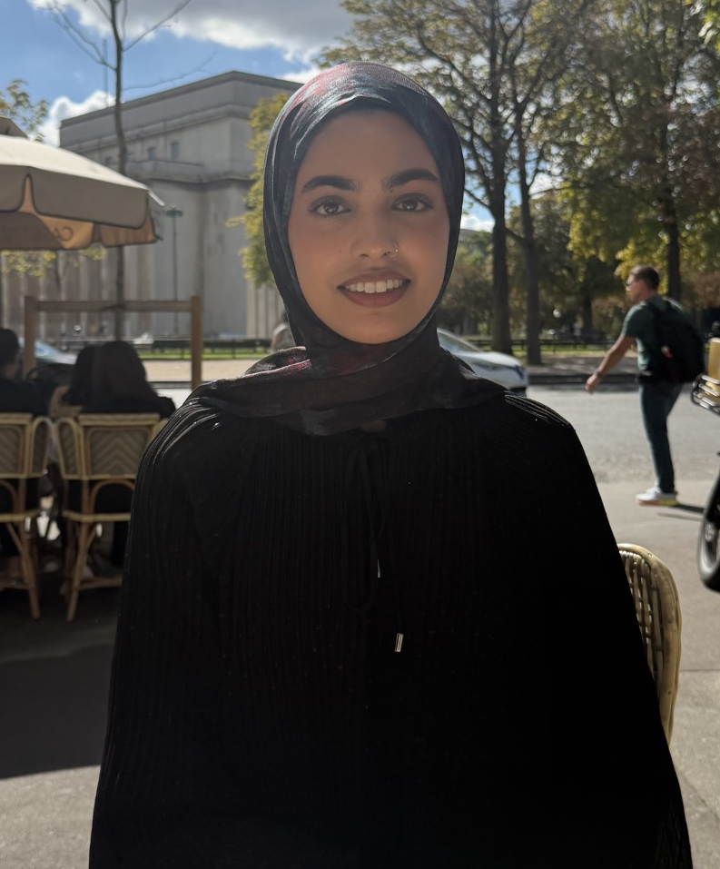
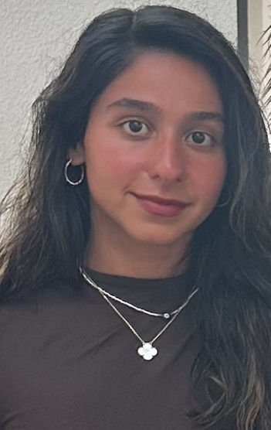
Meet the Year Group Team
Miss Javed
1J Class teacher
Miss Hares
1H Class Teacher
Notes:
Laura

Slide 3
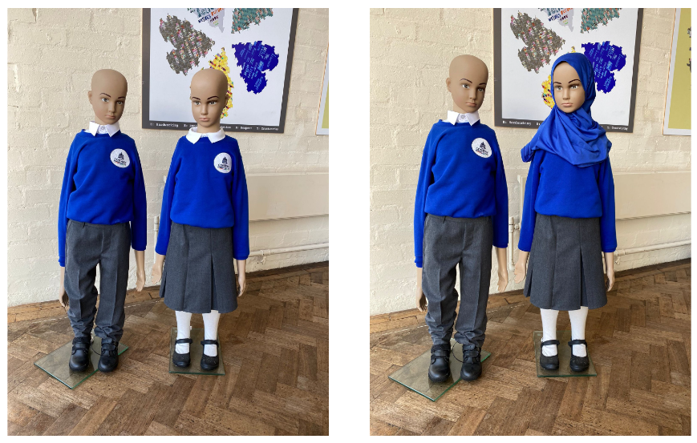

Uniform
At Conway we are proud of our school uniform. It gives pupils a sense of identity and belonging to our school family and culture.
Uniform requirements
All children must wear:
Royal blue jumper or cardigan (logo is optional)
White polo shirt
Grey trousers / skirts (mid-knee length, not long) / pinafore dresses / shorts in summer or blue checked school dresses in summer
Tights or socks may be worn with skirts or dresses, not skirts and trousers
Plain black, blue or white pull-on headscarf (short style) This item is optional
PE kit to be worn on Mondays and Thursdays. Children can wear trainers, joggers and a plain t-shirt.
Notes:
Zahra

Slide 4
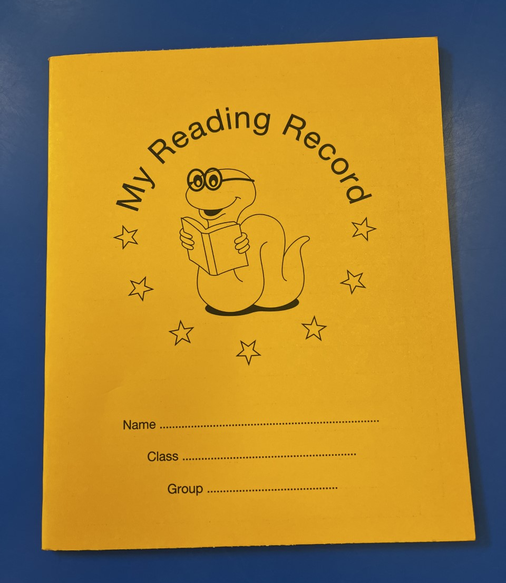
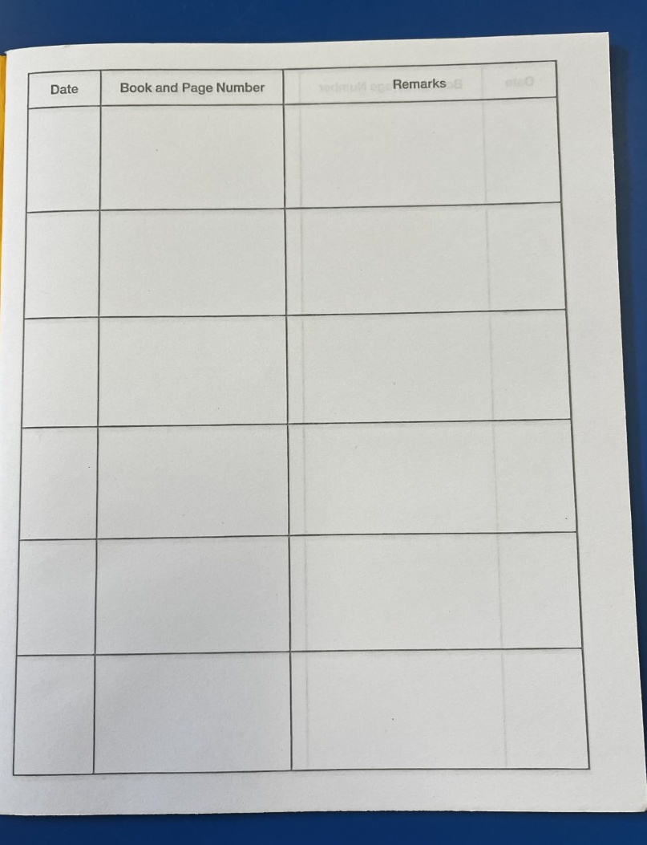
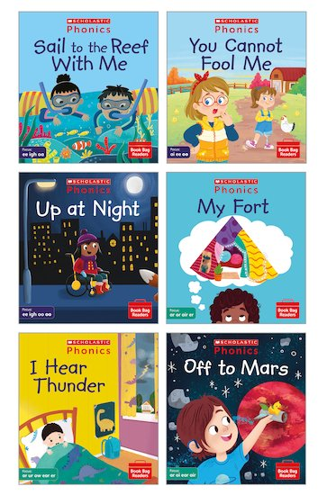
The importance of reading
We ALL want the children experience success:
We aim to provide books that are directly linked to the children’s phonics.
We encourage parents/ family to sign the reading record.
Year 1 will start visiting the school library and choosing a book to take home.
Our new phonics has 3 days of dedicated reading time.
Notes:
Zahra
Phonics everyday- Phonics is important because it teaches children how to read by connecting sounds to letters, which helps them decode new words. This foundation is crucial for reading fluency. By understanding how words are built from sounds, children can tackle unfamiliar words with confidence, leading to better reading skills and comprehension.
During phonics we also have word recognition time (tricky words) We help children learn "sight words" (common words like "the," "said") that they can recognize instantly, without sounding out. Mastering sight words boosts reading speed and confidence, as children encounter these frequently in texts.
PEEL sessions:-. Currently we are reading Jungle book
We ask questions about the text (like "Who are the characters?" or "Why did this happen?") to encourage children to think about the story. We focus on vocabulary in the book and investigare what they mean, Children are also encouraged to predict what might happen next or summarize what they've read to show understanding. They also learn to connect the story to their own experiences or other books, which deepens understanding.
Daily Reading in the morning : 10-15 minutes for them to read aloud daily. So it is vital children are on time.

Slide 5

Phonics
We have started a new phonics scheme called ‘Little Wandle’.
Children learn sounds and the different ways they can be written following different phases.
They practise blending sounds to read words and segmenting sounds to spell.
They learn tricky/common exception words that cannot always be sounded out.
They read decodable books matched to the sounds they know, building fluency and confidence.
In June Year 1 will have a Phonics Screening Check. The Phonics Screening Check is a short test in Year 1 to see how well children can read words using their phonics sounds. It usually takes about 10 minutes. Children read real words and made-up words.
After School Club:
A phonics after school club will begin in the Spring for 6 weeks with Miss Javed and Miss Hares.
Useful websites:
Phonics play
Notes:
Laura

Slide 6
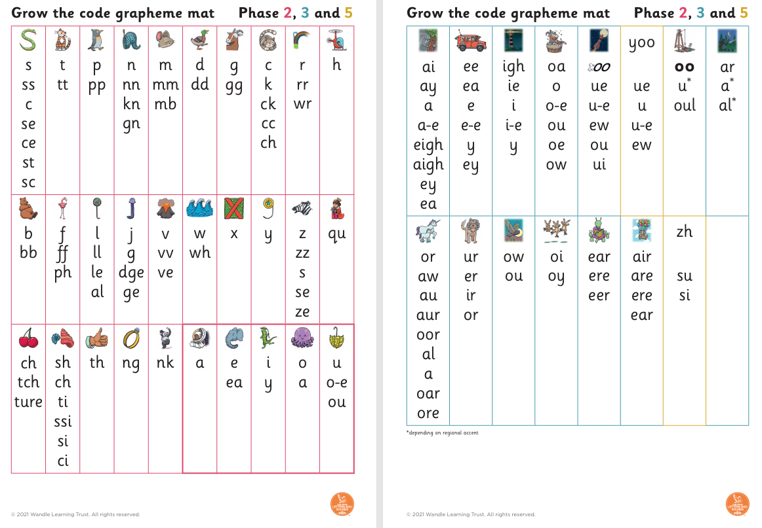
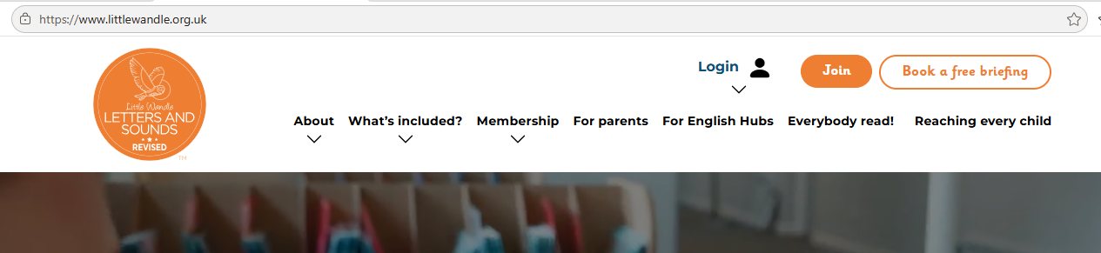
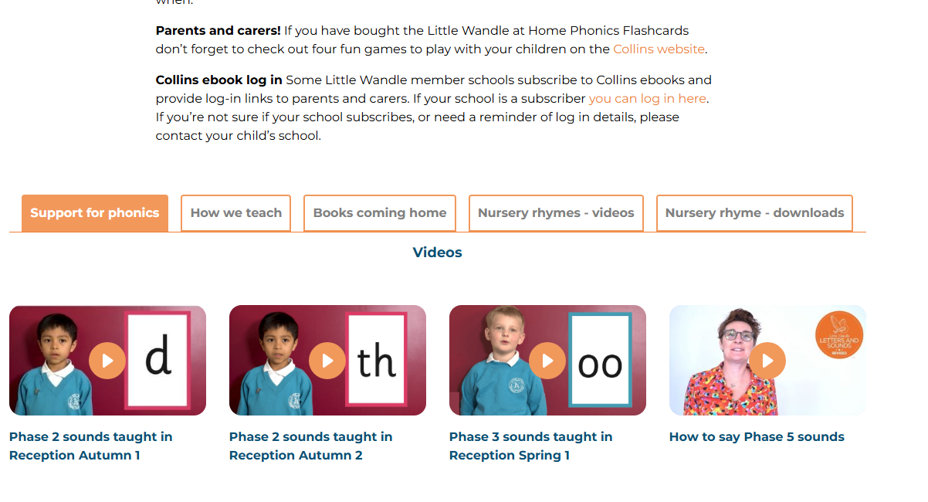
Little Wandle Phonics
www.littlewandle.org.uk
Notes:
Leoni

Slide 7


English
Autumn
During autumn, we will be focusing on capital letter, finger spaces, and full stops.
The children will be:
Writing about their family
Using captions to retell a familiar story – Jack and the Beanstalk
Linking to the history topic of Guy Fawkes and Gunpowder Plot , we will be writing a set of instructions for fireworks safety
Writing a character description from Goldilocks and the Three Bears.
Writing a report, linking to geography: What do I know about my local area.
Notes:
Zahra

Slide 8

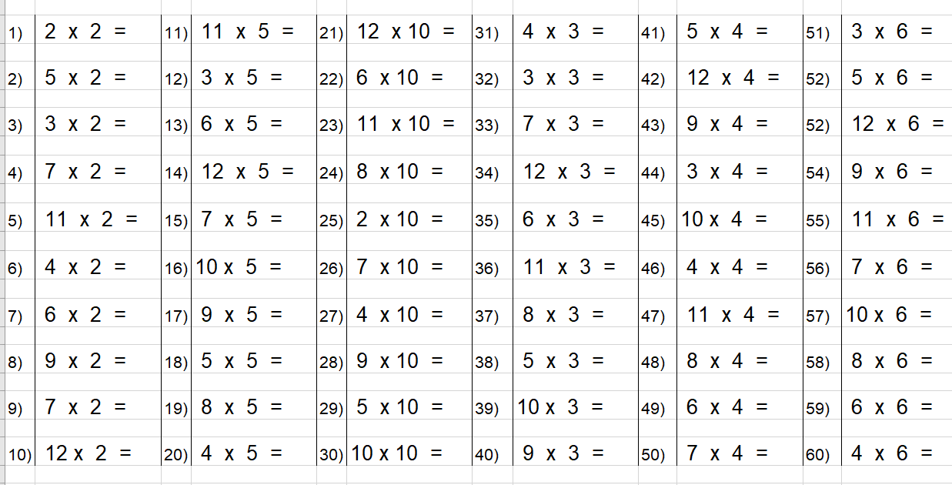

Maths
Topic: In Year 1, we are currently focusing on place value and addition and subtraction in Maths.
Multiplication: Children will be learning how to multiply numbers, starting with simple times tables (e.g., 2s, 5s, 10s).
Support at Home: Parents can support by practicing times tables using Times Tables Rockstars. https://ttrockstars.com/
We also encourage you to roll times tables with your child. These can be found on the school website.
Notes:
Laura

Slide 9
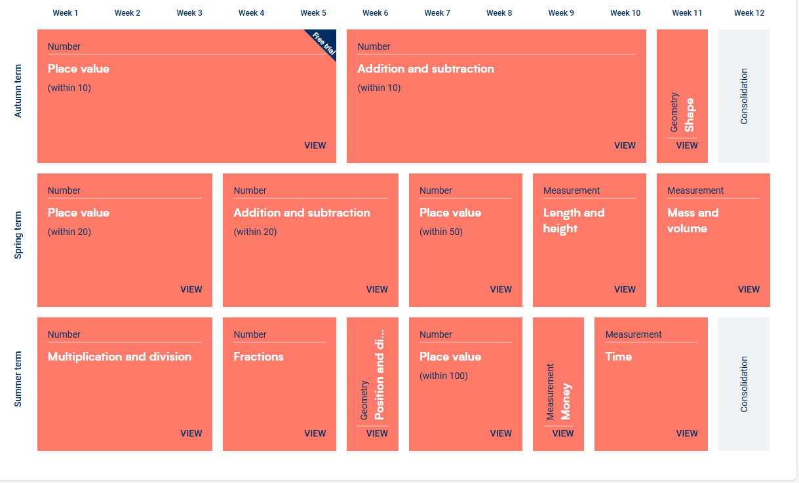
White Rose Maths
In Year 1 we are currently focusing on place value as well as addition and subtraction.
We are also focusing on recognising numbers as numerals and in written from.
Timetables is a key part of year 1. We have currently learnt our 2s, 5s and 10s timetables using ‘rolling numbers’. All children have a log in and can access TRS at home.
Notes:
Laura

Slide 10
Geography and History
Autumn 1: Where We Live
During this unit, the children will learn about:
Where they go to school
What makes Conway special
Where Conway is (Sparkbrook)
Where Sparkbrook is (Birmingham)
Where Birmingham is (England)
Autumn 2: The Gunpowder Plot
During this unit, the children will learn about:
King James
What the Gunpowder Plot was
Why the Gunpowder Plot happened
How we remember the Gunpowder Plot
Notes:
Zahra

Slide 11
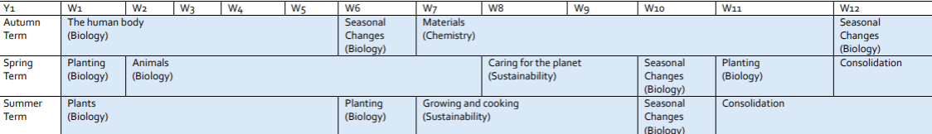
Science
Autumn 1: The Human Body
During this unit, the children will learn about:
Body Parts
Our 5 senses
Autumn 2: Materials
During this unit, the children will learn about:
The names of different materials (glass, metal, plastic and wood)
Opaque and transparent
Floating and sinking
Melting and freezing
Rock
Notes:
Zahra

