Slide 1
Welcome to Conway
16th September 2026

Slide 2
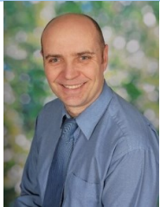
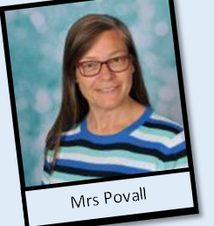


Meet the Senior Leaders
Head teacher
Mr Rose
Deputy Head
Mrs Povall
Assistant Head Teacher
Miss Jehangir
Assistant Head Teacher
Mr Wheldall
Notes:
Rima

Slide 3
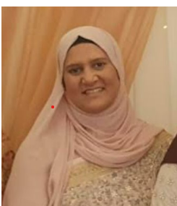
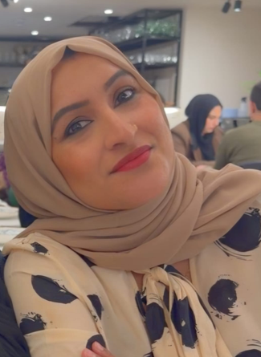
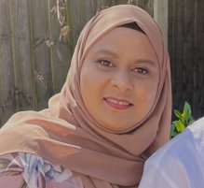
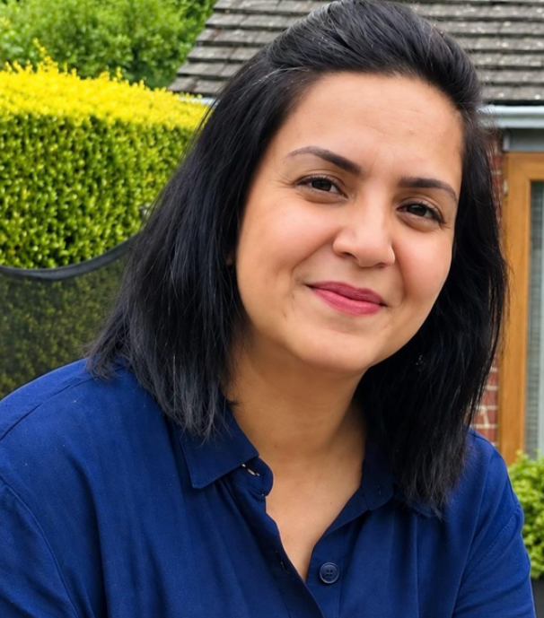
Meet the Year 5 Team
Mrs Hoque 5HK
Mrs Kaila 5HK
Mrs Khan 5HK
Mrs Shaheen
PSA
Notes:
Take pics and introduce your team.

Slide 4
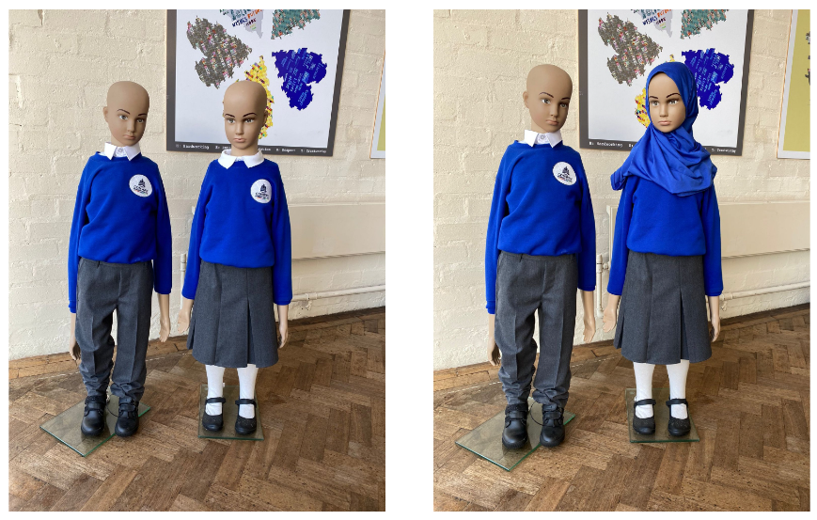
Uniform
At Conway we are proud of our school uniform. It gives pupils a sense of identity and belonging to our school family and culture.
Uniform requirements
All children must wear:
Royal blue jumper or cardigan (logo is optional)
White polo shirt
Grey trousers / skirts (mid-knee length, not long) / pinafore dresses / shorts in summer or blue checked school dresses in summer
Tights or socks may be worn with skirts or dresses, not skirts and trousers
Plain black, blue or white pull-on headscarf (short style) This item is optional
PE kit to be worn on Mondays and Fridays.
Notes:
Explain the expectations for uniform and jewellery (inc PE)
Rima

Slide 5
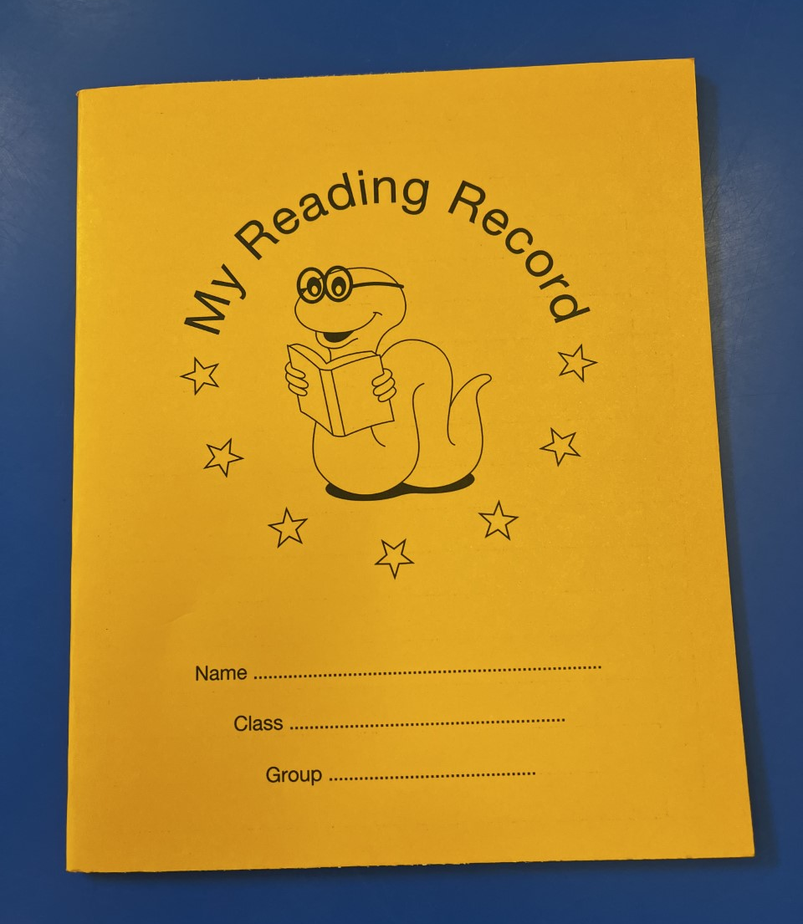

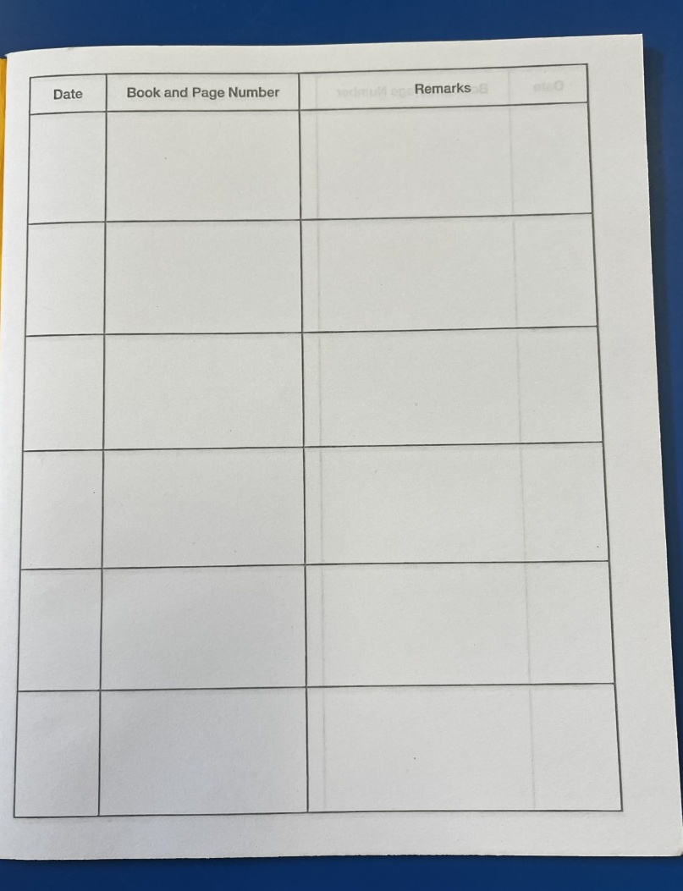
The importance of reading
Notes:
Share text you will read in school, show how to complete reading diaries and encourage to read daily – home language is fine.
Rima

Slide 6
Why do children need to read?
Reading for just 10-15 minutes a day can have a huge impact on a child's learning and confidence.
Benefits of Reading
📚 Builds vocabulary
Children encounter new words in books that they may not hear in everyday conversations.
A wider vocabulary helps with speaking, writing and understanding texts.
🧠 Improves comprehension
Reading regularly helps children understand what they read, make connections and think more deeply about texts.
✍️ Supports writing
Children learn sentence structures, punctuation and different ways authors communicate ideas.
Good readers often become stronger writers.
🎓 Boosts achievement across the curriculum
Reading skills support learning in all subjects, including maths, science, history and geography.
💭 Develops imagination and creativity
Books allow children to explore new places, characters and ideas.
❤️ Builds empathy and understanding
Reading helps children understand different experiences, cultures and perspectives
Notes:
Rima

Slide 7
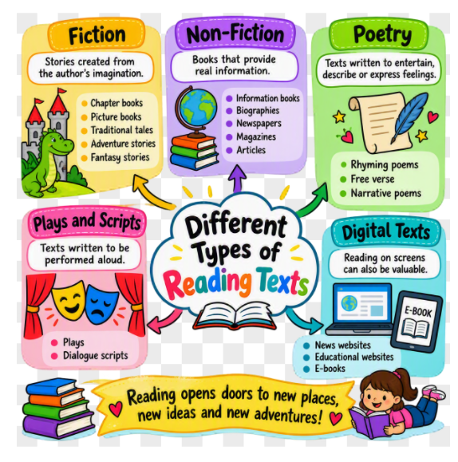
D
Different Types of Text Children Should Read
Encourage your child to read a variety of texts:

Slide 8

English
This term in Year 5, children will embark on an exciting writing journey filled with creativity, imagination and real-world challenges. As part of our very own Dragon's Den project, children will become inventors, designing an innovative product and preparing a persuasive pitch to present to a panel of "Dragons". They will learn how to use powerful language, persuasive techniques and confident speaking skills to convince others that their idea deserves to be invested in!
Our class text, Journey to Jo'burg, will provide opportunities for children to explore important themes, memorable characters and historical events. Through discussion, reading and writing activities, they will develop a deeper understanding of the characters' experiences and the challenges they face.
Later in the term, children will use The Secret Garden as inspiration for their own creative writing. They will become authors, crafting engaging short stories with believable characters, vivid setting descriptions and imaginative plotlines designed to captivate their readers.
We are looking forward to seeing the children's creativity, confidence and enthusiasm shine through their writing this term!
Notes:
Rima

Slide 9
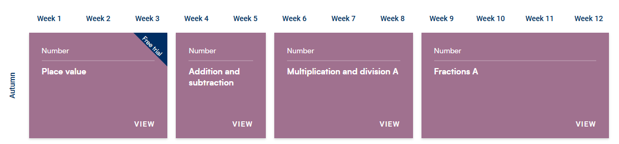

Mathematics
This term, children will learn about place value, addition and subtraction, multiplication and division, and fractions. They will build their number skills, develop confidence in solving problems and learn different strategies to help them work accurately. Throughout the term, children will be encouraged to explain their thinking and apply their maths skills in a variety of practical and real-life situations
How You Can Help at Home
✅ Practise times tables regularly
✅ Encourage children to explain their mathematical thinking
✅ Use real-life maths opportunities such as shopping, cooking and telling the time
✅ Play number games and maths quizzes to build fluency and confidence
Our aim is for every child to become a confident mathematician who can reason, problem-solve and enjoy learning maths
Notes:
What times tables, key facts and units to be covered

Slide 10

Science
Properties and Changes of Materials and Changing Materials
In Science this term, children will investigate the properties of materials, comparing and grouping them based on characteristics such as hardness, transparency, magnetism, and electrical and thermal conductivity.
Through practical enquiries, they will explore the suitability of different materials for specific purposes, including conducting and evaluating a heat insulation investigation. Children will also learn about the change of materials, exploring reversible and irreversible changes through activities such as heating, mixing and dissolving, while developing their scientific enquiry skills by making predictions, observing carefully and drawing conclusions from their results.
This term, children will explore the properties of materials and discover why different materials are chosen for different jobs. They will investigate electrical and thermal conductivity through practical activities, such as building simple circuits and testing which materials are the best conductors and insulators.
Children will also learn about how materials change by exploring reversible and irreversible changes. Through hands-on experiments, they will observe changes such as melting chocolate, dissolving substances in water and creating reactions that cannot be undone. These investigations will encourage children to think scientifically, ask questions and make predictions based on their observations.

Slide 11
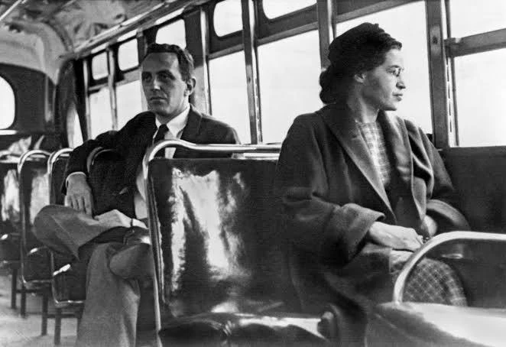
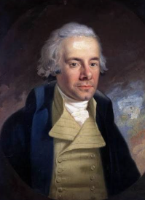
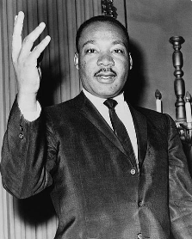
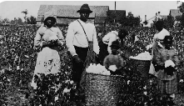
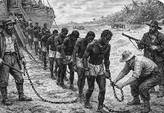
History
This term, in History, children will explore The Fight for Equality. They will learn about the meaning of equality and fairness before studying the Transatlantic Slave Trade, including the experiences of enslaved Africans and the impact of slavery on society.
Children will investigate the role of key historical figures such as Olaudah Equiano, William Wilberforce and Martin Luther King Jr., examining how individuals and campaigns helped challenge injustice and bring about change. They will also explore segregation and the Civil Rights Movement, considering how society has become more equal over time while recognising that challenges still remain today.

Slide 12

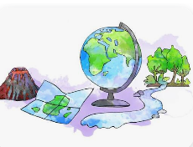
Geography
This term, children will build on their previous learning about the counties of England and develop their map-reading skills. They will learn how to use 8-figure grid references to locate places accurately on Ordnance Survey maps.
As part of this topic, children will take part in an educational visit to Stratford Upon Avon, where they will carry out geographical fieldwork and apply the skills they have learned in the classroom. They will collect information about the local area using a range of fieldwork techniques and present their findings through maps, charts and diagrams.
Through these practical experiences, children will develop their geographical knowledge, observation skills and confidence in investigating and understanding the world around them.

Slide 13


RE/PSHE
RE: In RE this term, children will explore values including caring for others, animals and the environment, sharing and being generous, being loyal and steadfast, and being hopeful and visionary. Through stories, discussions and reflection, they will consider how these values are demonstrated in different faiths and how they can apply them in their own lives.
PSHE: In PSHE this term, children will focus on the SCARF units Me and My Relationships and Valuing Difference. They will develop their understanding of positive relationships, respect, empathy and inclusion, while learning to appreciate diversity, celebrate individual differences and build healthy friendships within their community.

Slide 14


Music/MFL
Music: In Music this term, children will explore the genres of Rock and Jazz through the Charanga units Livin’ on a Prayer and Bossa Nova and Swing. They will listen to, appraise and perform a range of music, developing their singing, rhythm and instrumental skills while learning about the key features and history of these musical styles.
French: In French this term, children will learn vocabulary linked to Seasons and Ice-Creams through the Language Angels programme. They will develop their speaking, listening, reading and writing skills by describing the weather and seasons, expressing preferences, and using simple phrases with increasing confidence and accuracy.

Slide 15
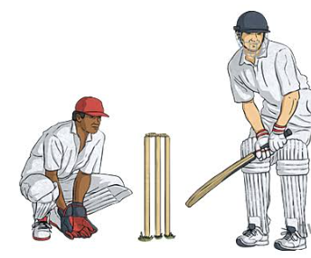
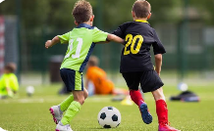
PE
In PE this term, children will develop their teamwork, coordination and sporting skills through football and cricket. They will learn and practise key techniques including passing, dribbling, shooting and defending in football, alongside batting, bowling, catching, throwing and fielding in cricket. Through games and challenges, pupils will also build their understanding of tactics, fair play, resilience and effective teamwork.

Slide 16
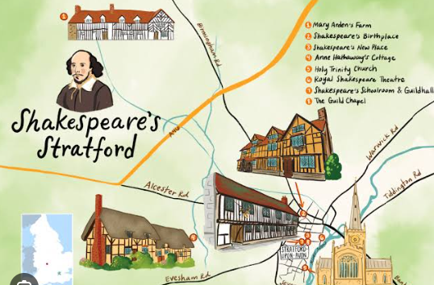
Educational trip
In Autumn Term 2, children will take part in an exciting educational visit to Stratford-upon-Avon as part of their Geography learning. During the visit, they will apply their classroom knowledge by developing a range of geographical fieldwork skills, including map reading, observation, data collection and identifying human and physical features within the local area.
Children will explore the town, use maps and grid references, and gather information about the environment through practical activities. They will then use their findings back in school to create maps, charts and reports. This hands-on experience will help bring their learning to life and develop their confidence in using geographical skills in a real-world setting.
Further details about the visit, including dates, timings and arrangements, will be shared with parents. closer to the time

Slide 17

Partnership- Working together
As a school, we want the very best for your child, and this is achieved when we work in partnership with parents and carers. We believe that open communication and strong home-school relationships help children to feel happy, supported and successful in their learning.
If you have any questions, concerns or information that you would like to share, please do not hesitate to speak to a member of the Year 5 team after school or arrange an appointment through the school office. No concern is too small, and we would much rather address any issues early so that we can support your child effectively.
We greatly value your support and look forward to working together to make this a happy, successful and rewarding year for every child.

