Slide 1
Year 6 Parent Meeting
September 2026

Slide 2
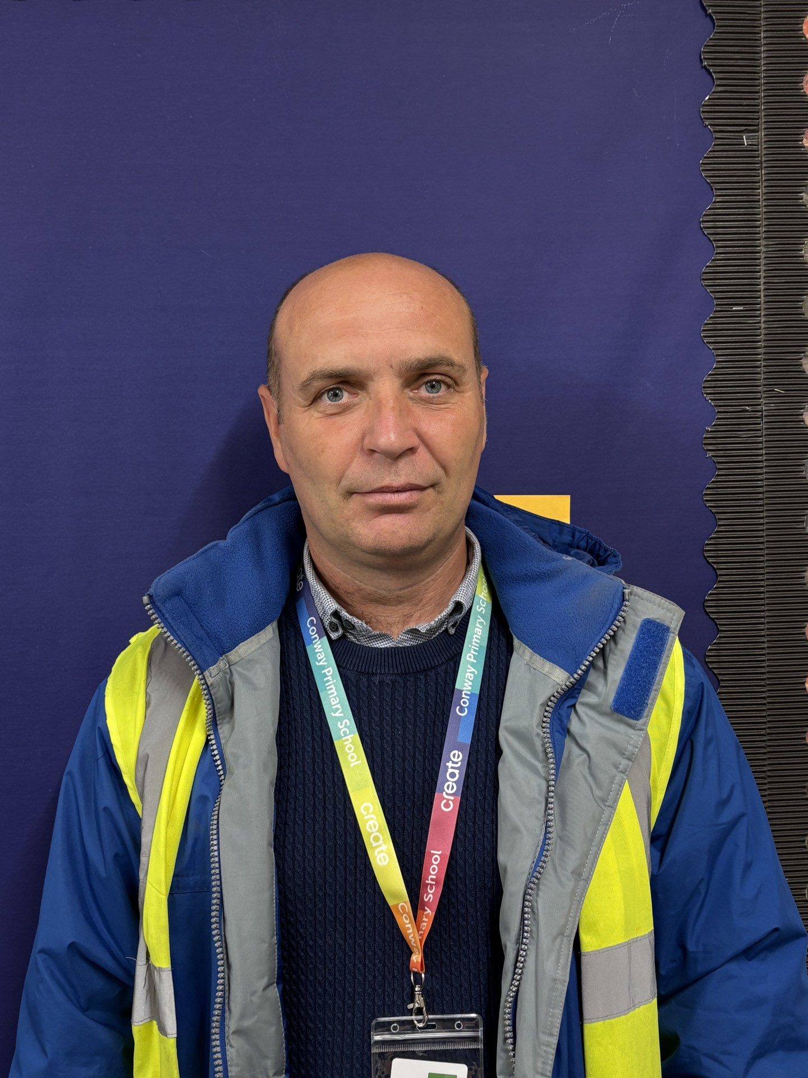
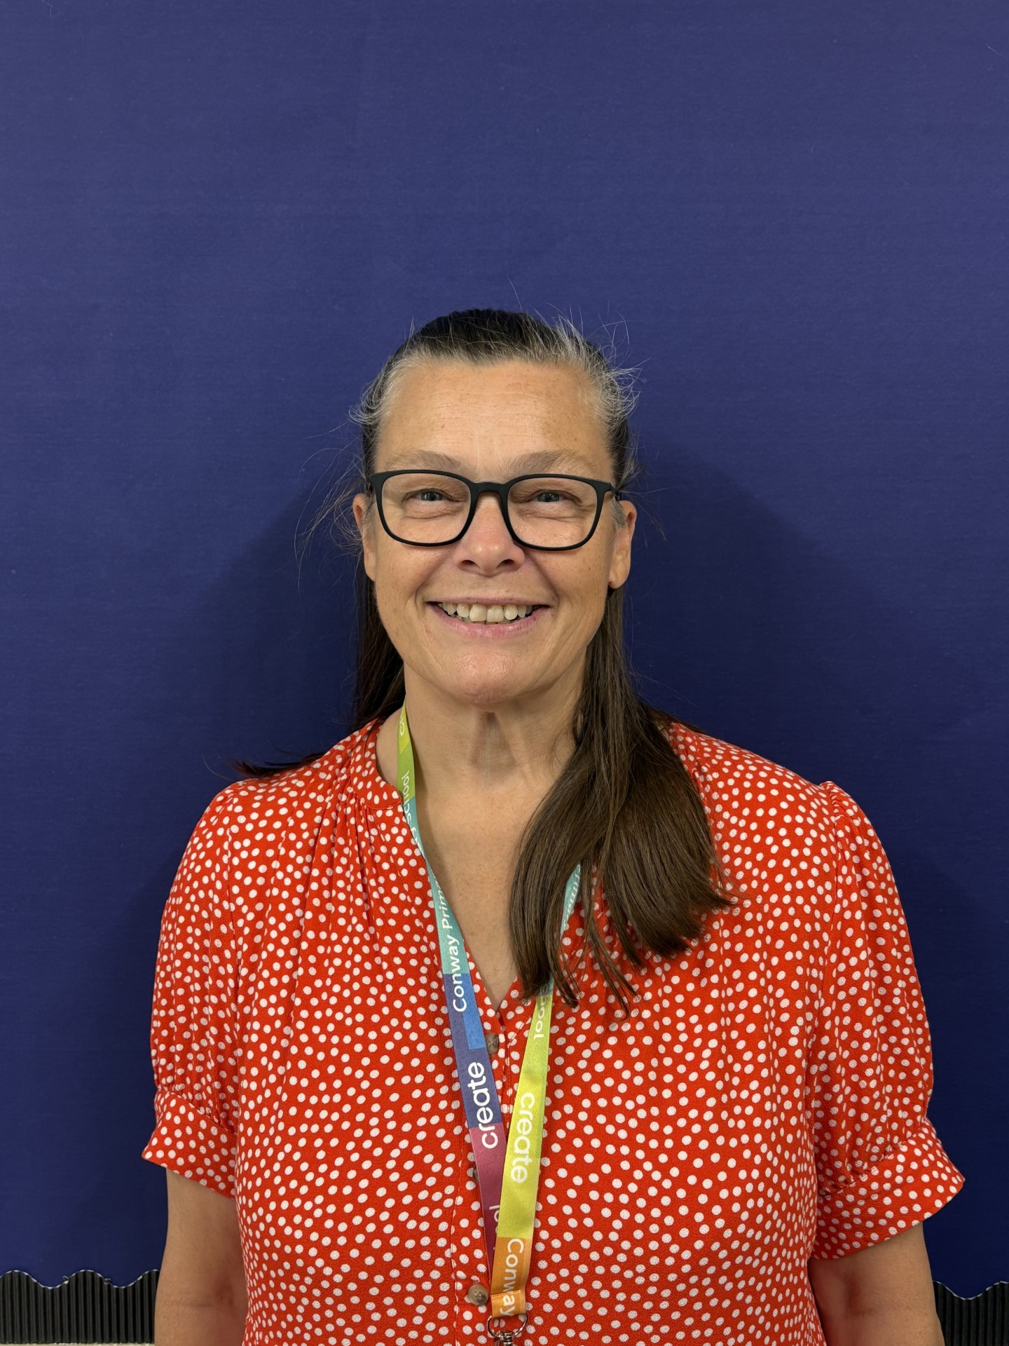
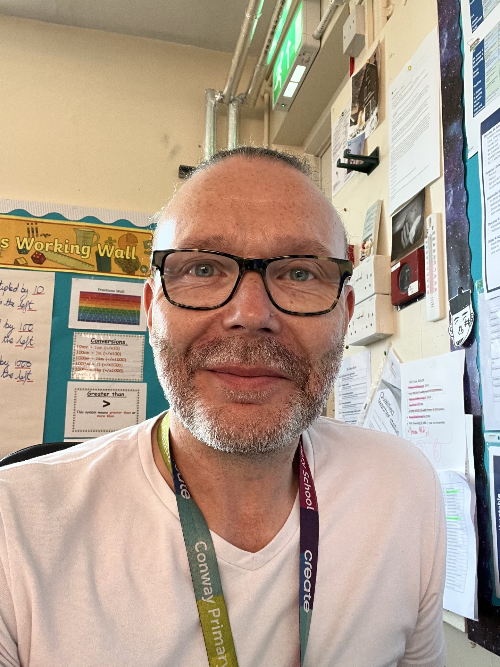
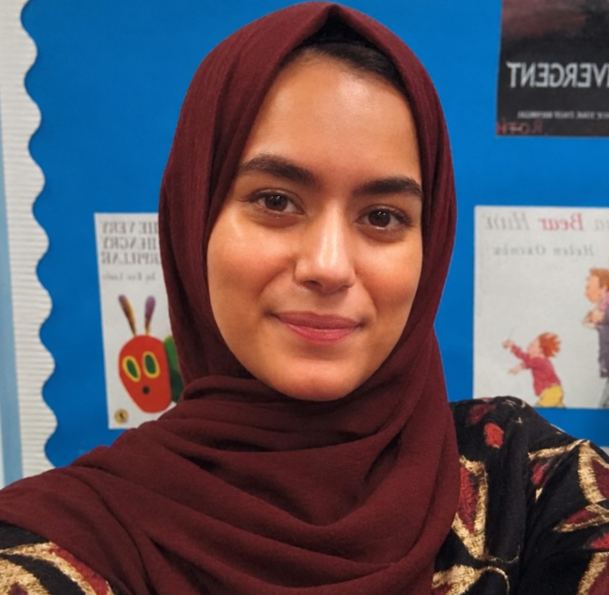
Meet the Senior Leaders
Mr Rose
Headteacher
Mrs Poval
Deputy Headteacher
Miss Jehangir
Assistant Headteacher
Mr Wheldall
Assistant Headteacher
Notes:
We will come to as many as we can – we can’t do Monday morning as we will be covering Y6 PPA

Slide 3
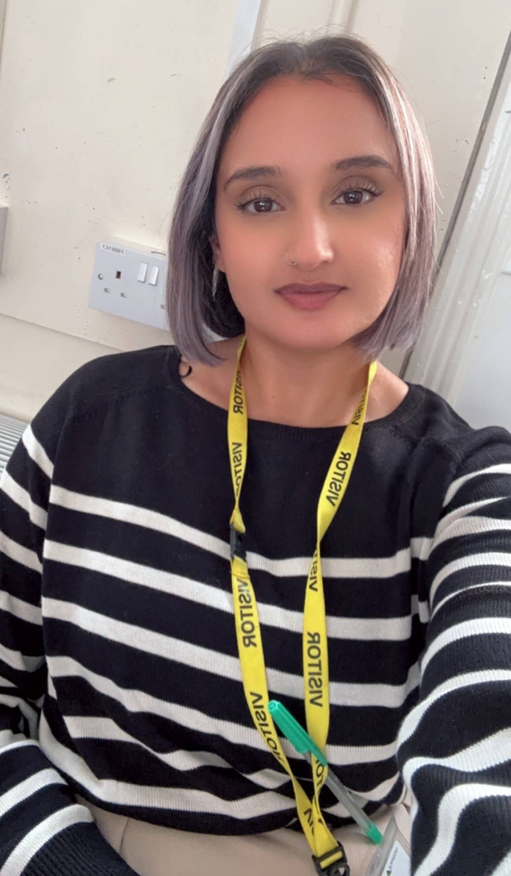
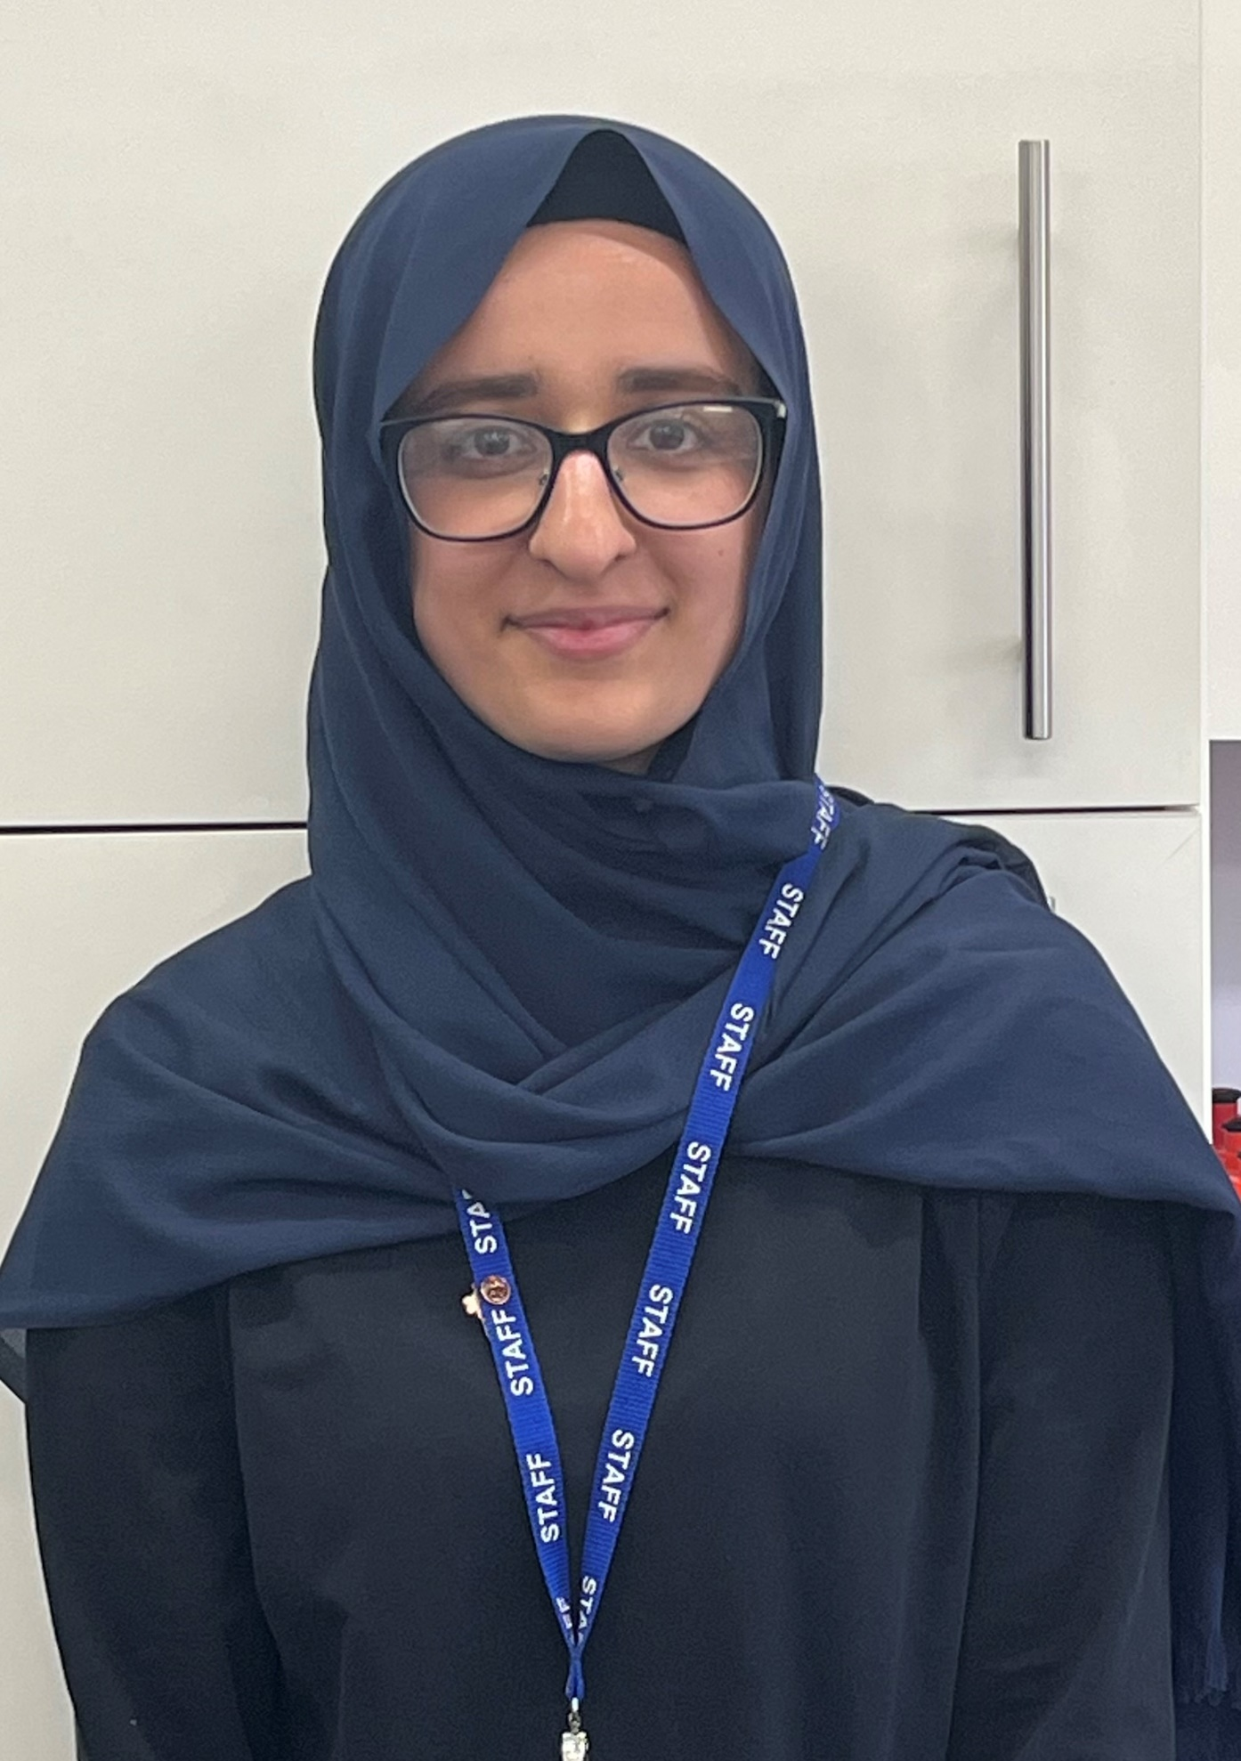
Meet the Year 6 Team
Miss Hussain
Y6 Class Teacher &
Phase Lead
Miss Ahmed
Y6 Class Teacher
Mr Wheldall
Assistant Headteacher
Notes:
Take pics and introduce your team.

Slide 4
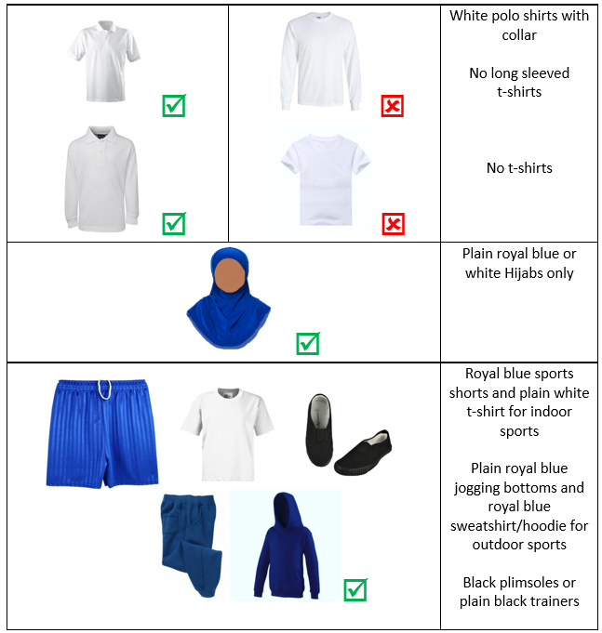
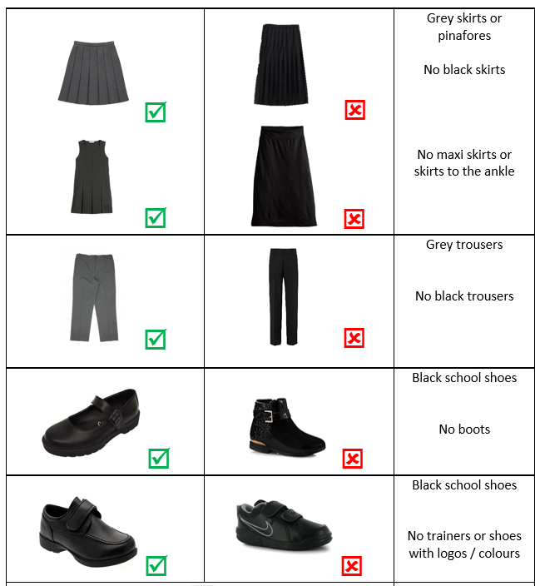
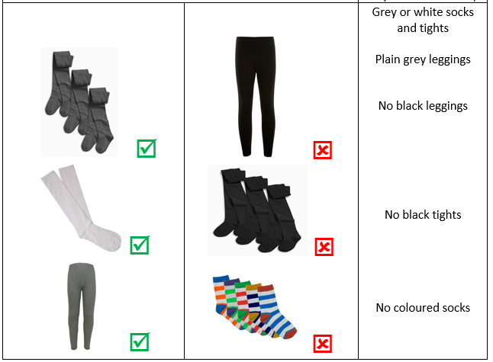
Uniform
Notes:
Explain the expectations for uniform and jewelry (inc. PE)

Slide 5

Migration
In this unit, pupils will conduct a geographical comparison of Birmingham to a region within the Middle East. They will explore some of the reasons why people leave their homes to come to England including a look at the possible reasons that people are forced to leave their home countries. They will also conduct a mini-survey to discover the diverse make up of their own class. This study will be consolidated by the book study from our reading lessons: The Boy at the Back of the Class by Onjali Rauf.
Notes:
What is it called, what will you cover, what can parents do at home
Include information about any educational visits

Slide 6
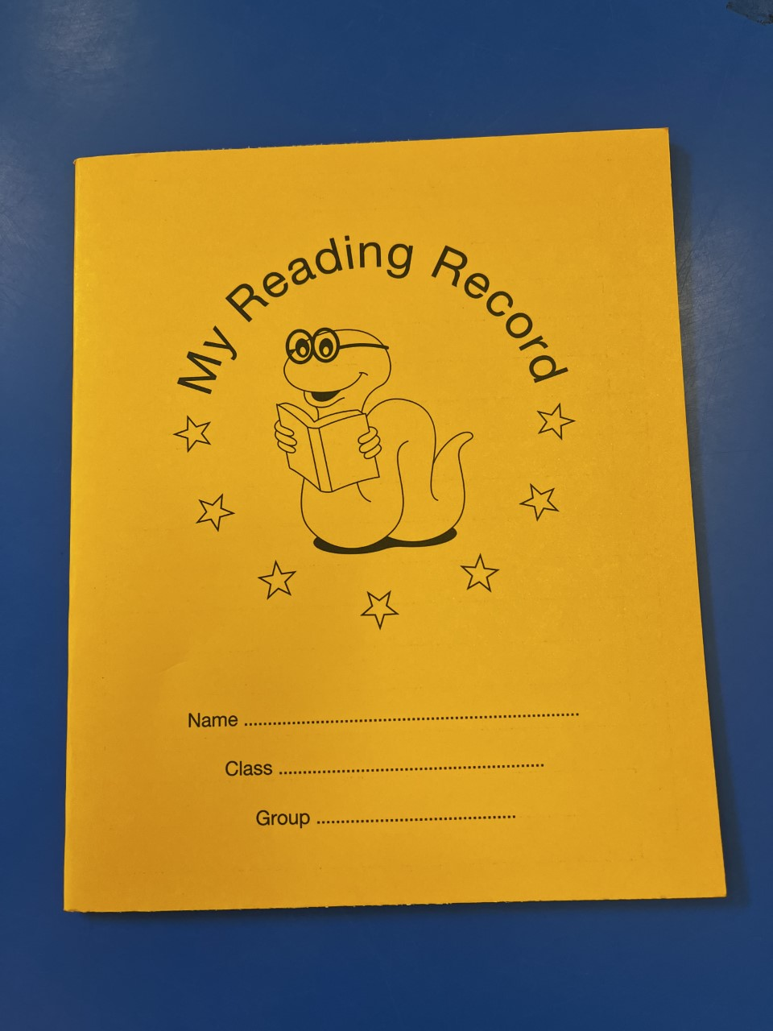
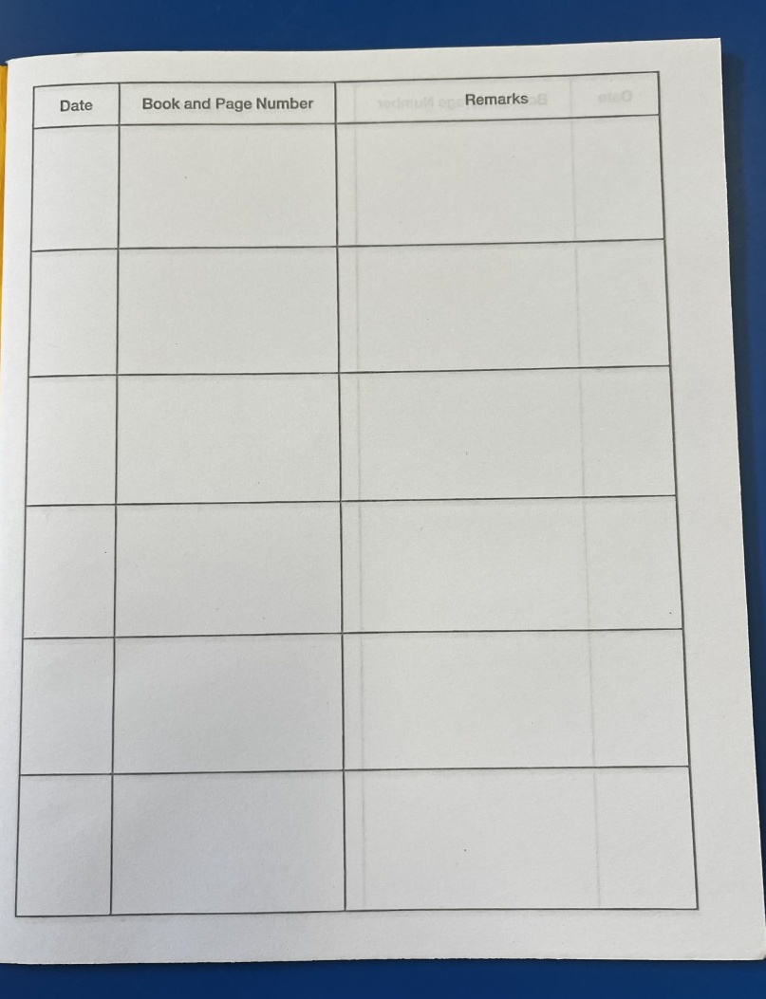
The importance of reading
‘Young people who enjoy reading very much are nearly five times as likely to read above the expected level for their age compared with young people who do not enjoy reading at all.’
Notes:
Share text you will read in school, show how to complete reading diaries and encourage to read daily – home language is fine.
Muqaddas

Slide 7
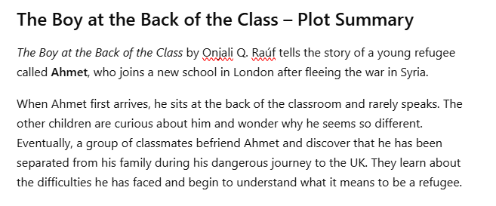
Reading
Notes:
Share text you will read in school, show how to complete reading diaries and encourage to read daily – home language is fine.
Muqaddas

Slide 8




Writing
Notes:
Handwriting. Cohesion

Slide 9
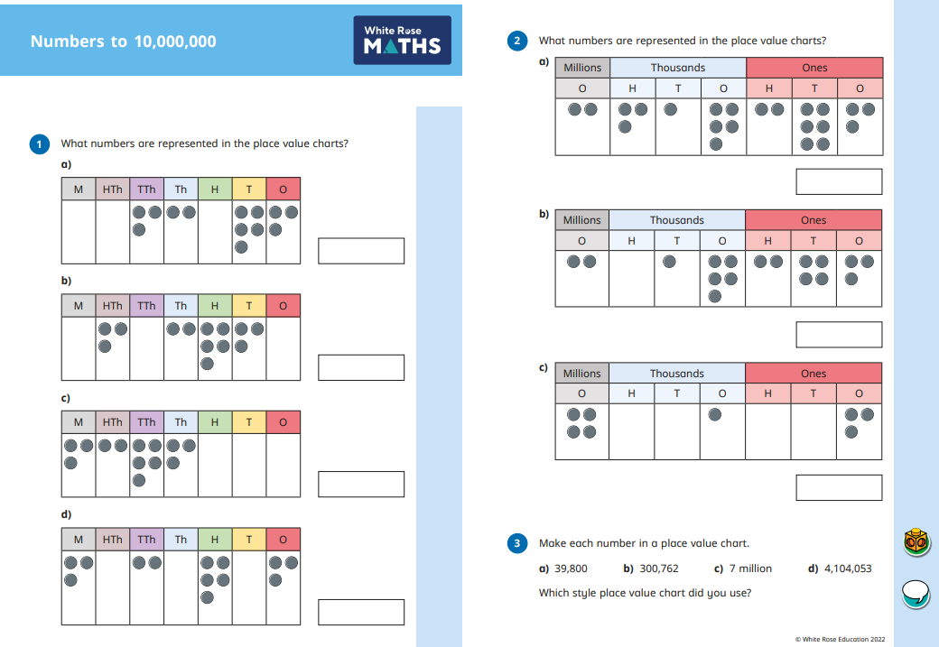
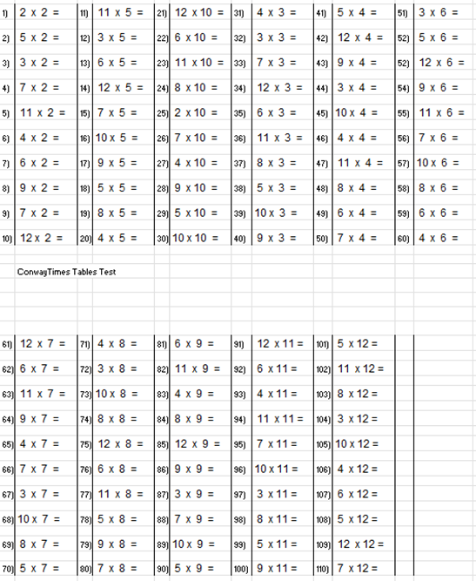

Maths
Notes:
What times tables, key facts and units to be covered.
Emphasise importance of TTRS daily

Slide 10

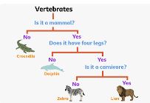
Science - Classification
How living things are classified into groups according to their similarities and differences.
Explore how animals, plants and micro-organisms can be identified and grouped using observable characteristics.
Children will also learn to use and create classification keys and explain the reasons for their classifications.

Slide 11

Religious Education
Birmingham Agreed Syllabus.
Explore how religious beliefs and values influence the way people live.
They will consider why rules are important, how different faiths guide people in making choices, and what it means to be fair and just.

Slide 12

PSHE
Explore what makes a healthy and positive relationship.
They will learn about friendship, trust, respect and communication, as well as how to manage disagreements and recognise appropriate boundaries.
Consider how their actions and choices can affect the feelings and wellbeing of others.

Slide 13
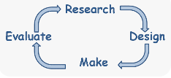
Design & Technology
Children will design, make and evaluate a working model of the respiratory system.
Explore how different materials and components can be used to represent the respiratory system.
Develop practical skills by planning their design, constructing their model and making improvements after testing it.

Slide 14
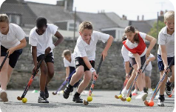
PE Days
Year 6 PE lessons will take place every Tuesday and Wednesday.
Correct school PE uniform
This half term, our PE focus is Hockey, where children will develop their passing, dribbling, teamwork and game-play skills.

Slide 15

Homework in Year 6

Slide 16
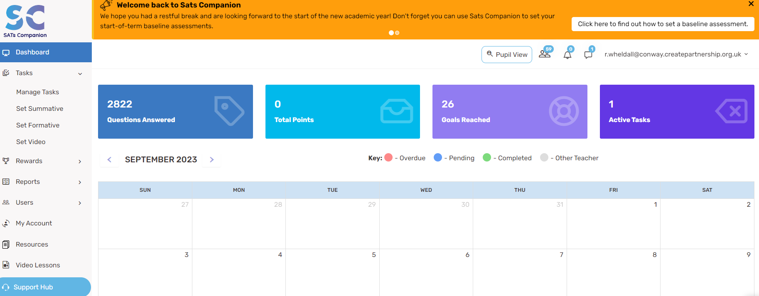
SATs Companion
Notes:
SATs Companion is an excellent tool that will support your children: all homework will be electronic.
You will need to sign a form in order for your children to take home a laptop – show.
SATs companion workshop next week?

Slide 17
Educational Visits
November – Black Country Living Museum
January- Staffordshire Regiment Museum

Slide 18
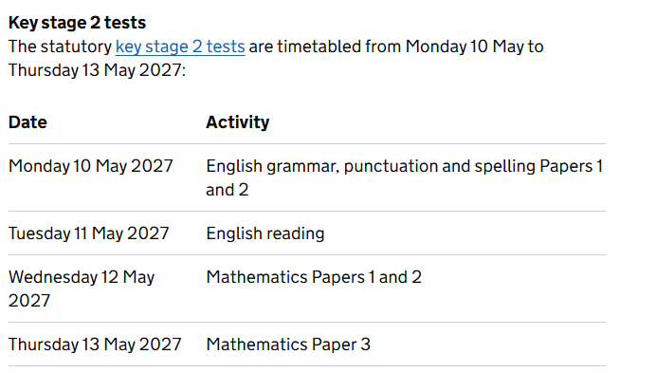
Statutory Testing
Notes:
There will be other meetings for SATs development later on in the year.

Slide 19
Partnership
As a school, we want the very best for your child. This happens when we work together. If you have any concerns, please speak to us after school or make an appointment at the school office.

Slide 20
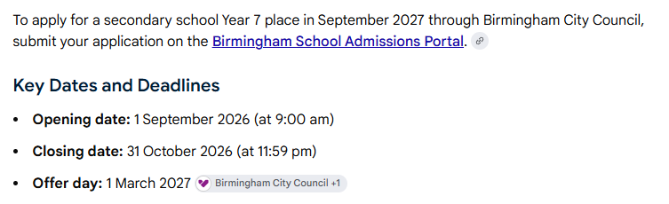
Secondary School Transfer
It is very important that you apply on time. If you apply late, you are less likely to get offered a place at any of your preferred schools.
Apply on time: Applications received after 31 October 2026 are considered late and are processed after 1 March 2027. Late applicants have a lower chance of getting a place at their preferred schools
Notes:
Forms to be completed online for preferred schools.
Deadline is end of October
Secondary schools are announced at the start of March.

Slide 21
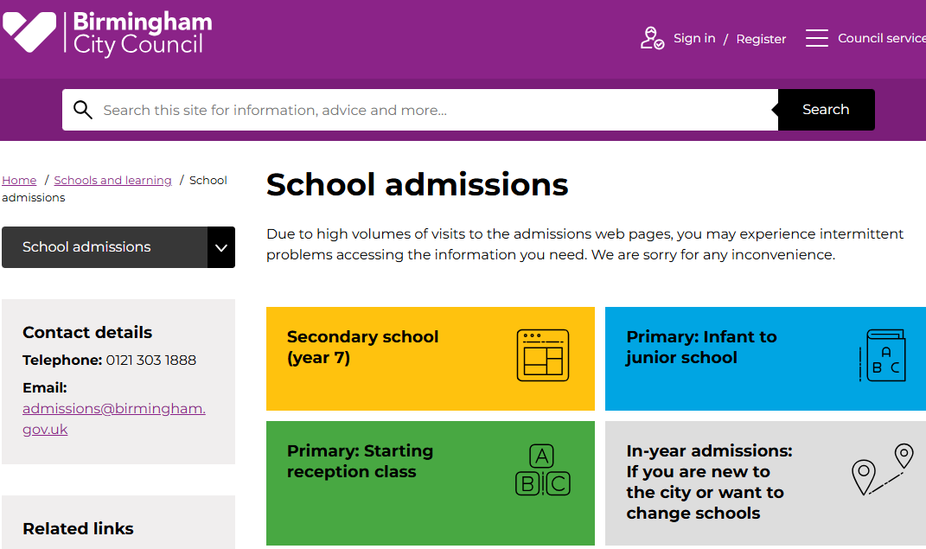
Secondary School Transfer

Slide 22
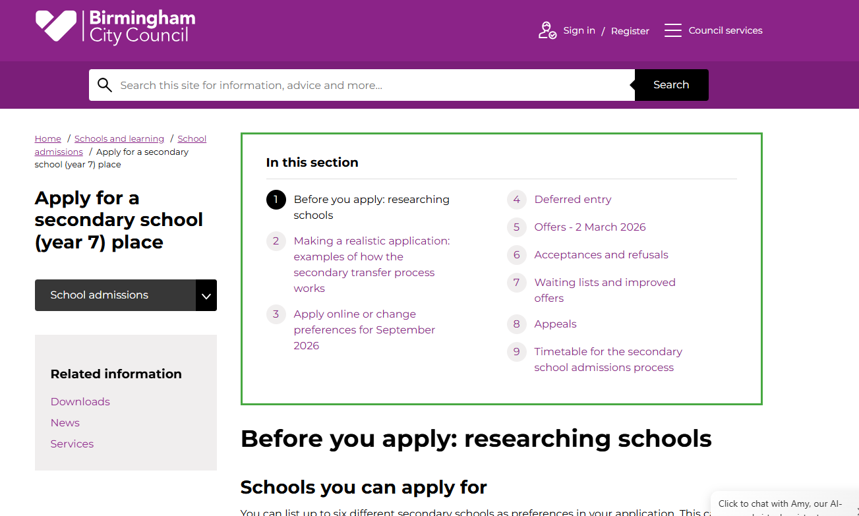
Secondary School Transfer

Slide 23
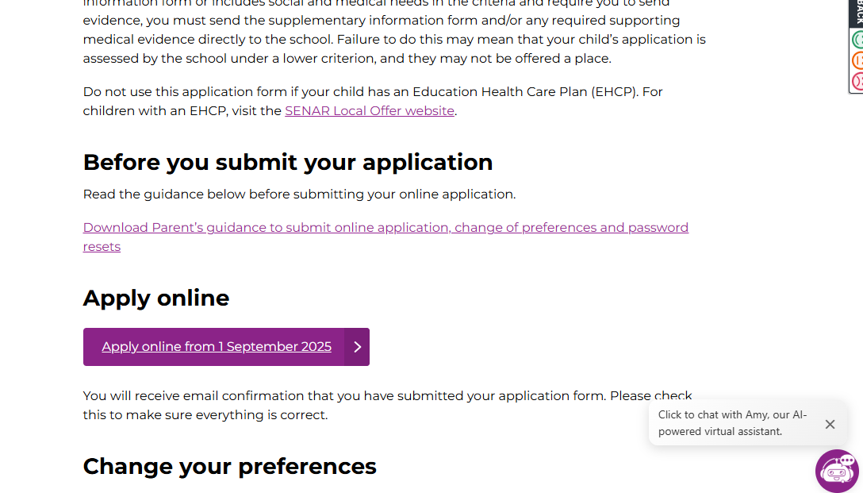
Secondary School Transfer

Slide 24
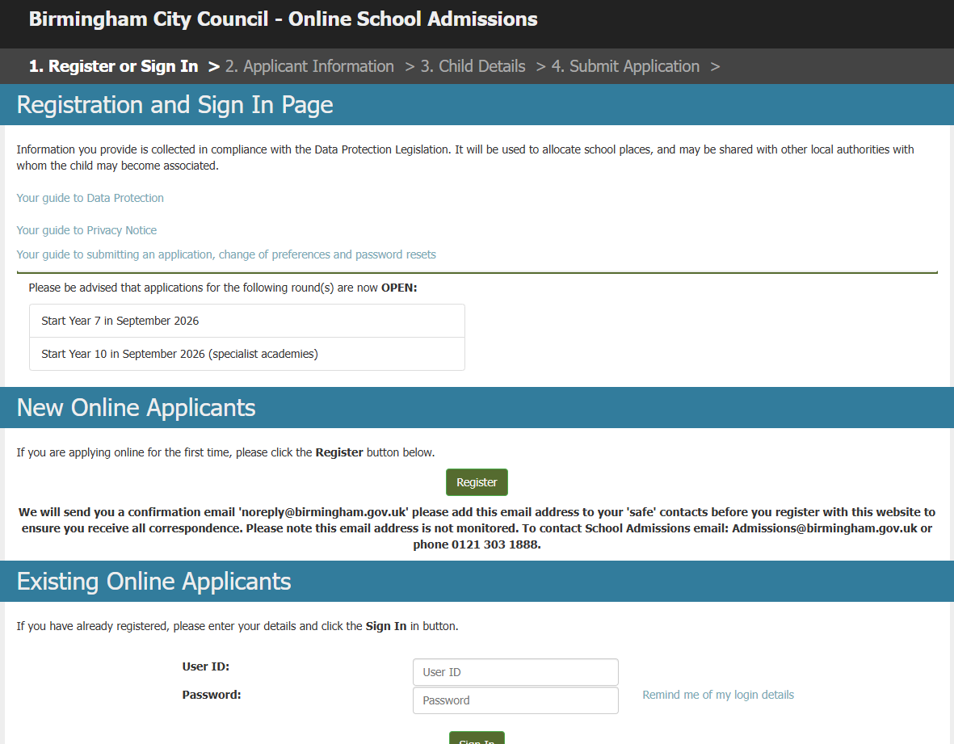
Secondary School Transfer

