Slide 1
Welcome to Conway
September 2026
Notes:
Laura

Slide 2
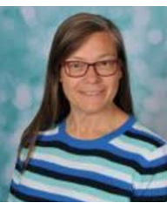
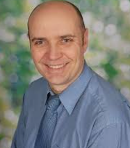
Meet the Senior Leaders
Mr Rose Mrs Povall
Head teacher Deputy head
Notes:
Laura

Slide 3
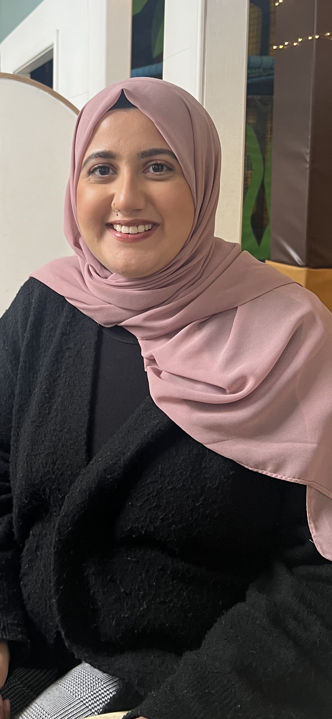
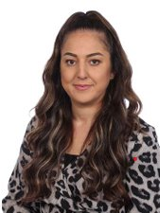
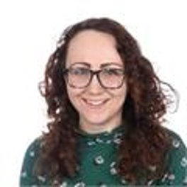
Meet the Year 2 Teachers
WB 14th September 2026
Phonics
Spelling
2YA: Ms Yousaf (Mon, Tues, Wed)
Ms Antoniou (Wed, Thurs, Fri)
2D: Miss Day
KS1 Phase Leader
Notes:
All

Slide 4
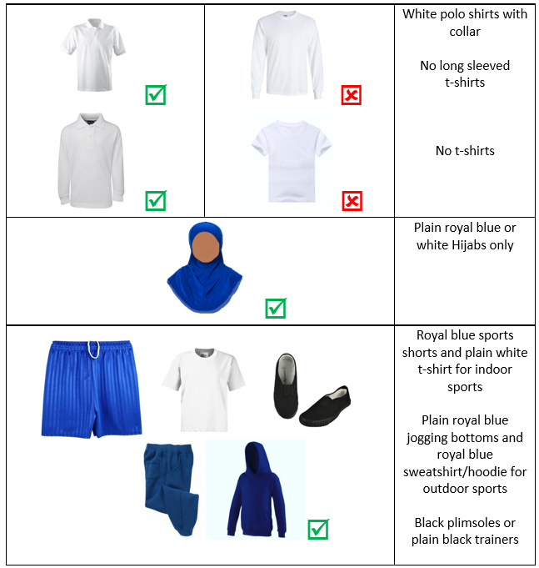
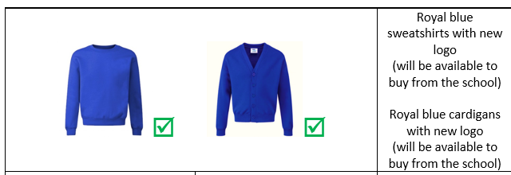
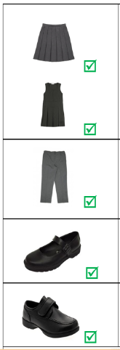
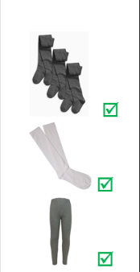
Uniform
PE - Black joggers and white polo shirt with collar.
Notes:
Neelam

Slide 5

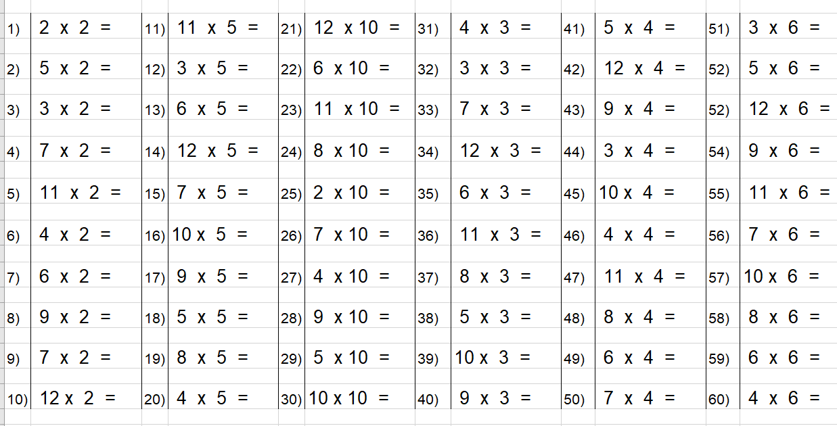

Maths
This half term in maths, the children will be building on their knowledge of place value, as well as addition and subtraction.
We continue to focus on number-bonds and times tables. We use rolling numbers to practice our times-tables. You can also access these videos at home via the school website. Please encourage your child to access Times-table rockstars at home as often as possible.
All children should have their logins in their reading journals. speak to your child’s teacher if you require any assistance with this.
Notes:
Leoni
Show parents reading record and where they can find their login for TTRS

Slide 6
Little Wandle Phonics
This year, we have introduced Little Wandle Letters and Sounds Revised, replacing Read Write Inc. as our phonics and early reading programme.
Little Wandle provides a clear and consistent approach to teaching phonics. Children are regularly assessed so that we can quickly identify where extra support or practice may be needed.
Reading books are carefully matched to the sounds children know, helping them to develop accuracy, fluency and confidence as readers.
Notes:
Leoni

Slide 7
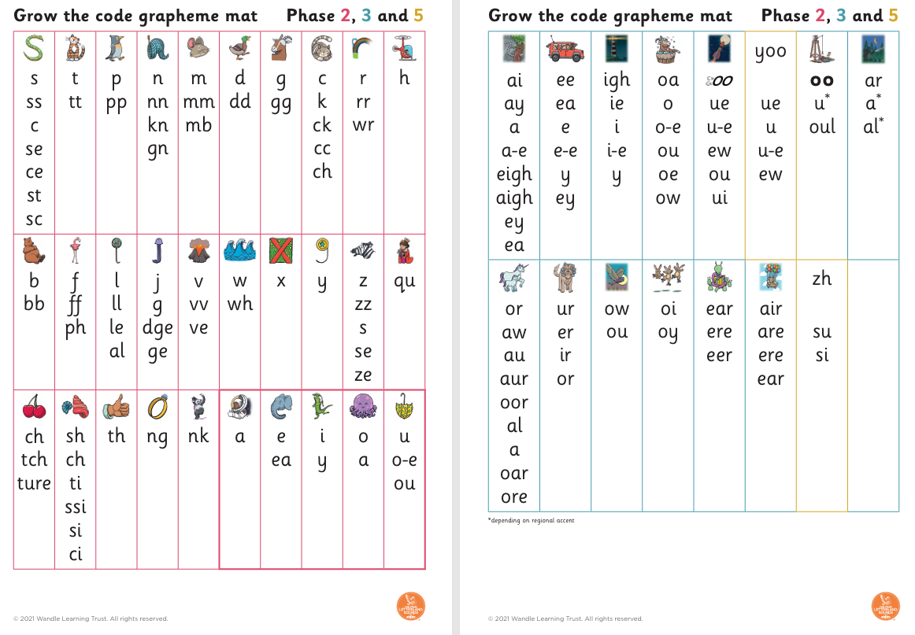
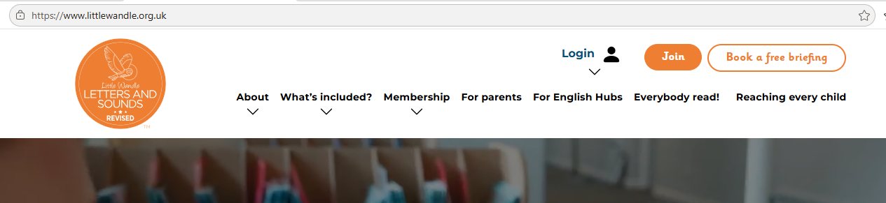
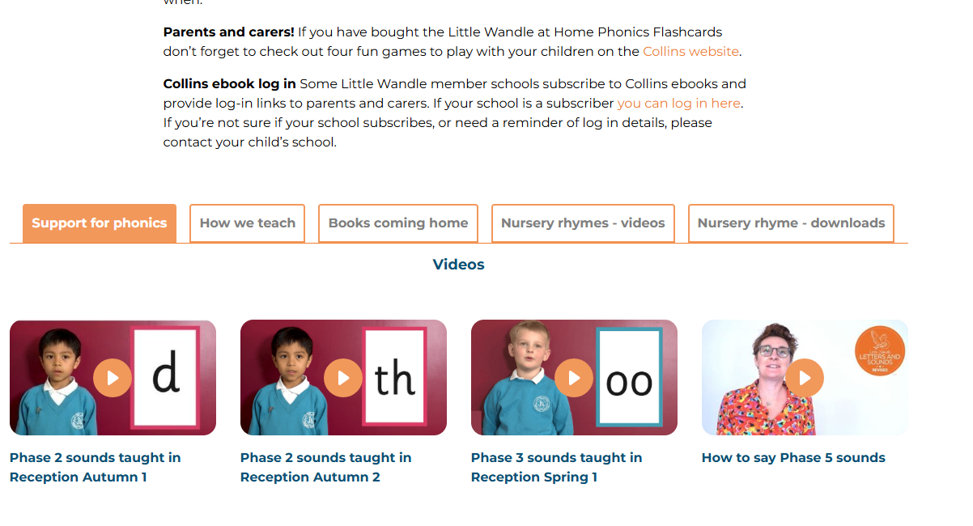
Little Wandle Phonics
www.littlewandle.org.uk
Notes:
Leoni

Slide 8
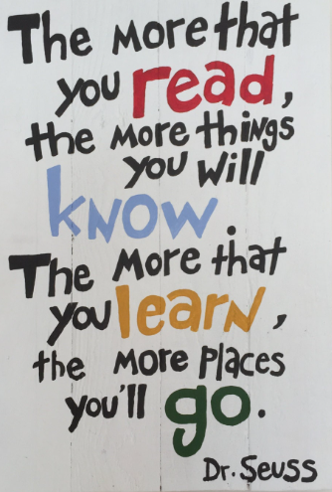
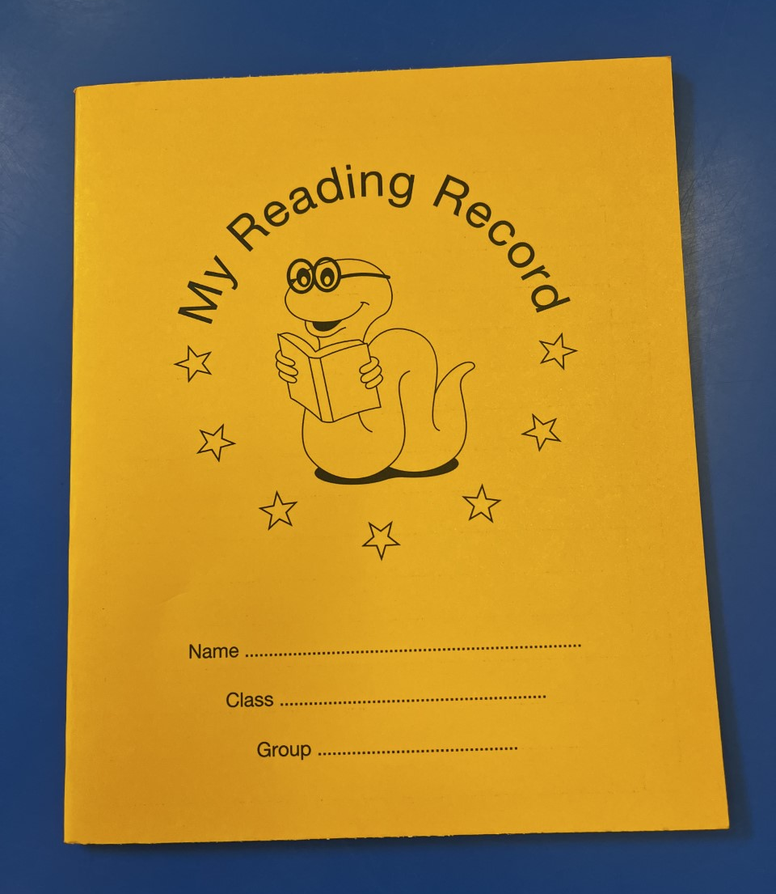
The importance of reading
Reading is one of the greatest gifts we can give to our children.
Notes:
Leoni

Slide 9
Writing
We’ll also be developing our writing skills through exciting tasks, such as creating our own setting descriptions and writing a diary entry.
Our aim is not just to improve accuracy but to help children discover the joy of writing – using their imagination, building their own voice, and feeling proud of the stories and ideas they can share.
Notes:
Laura

Slide 10
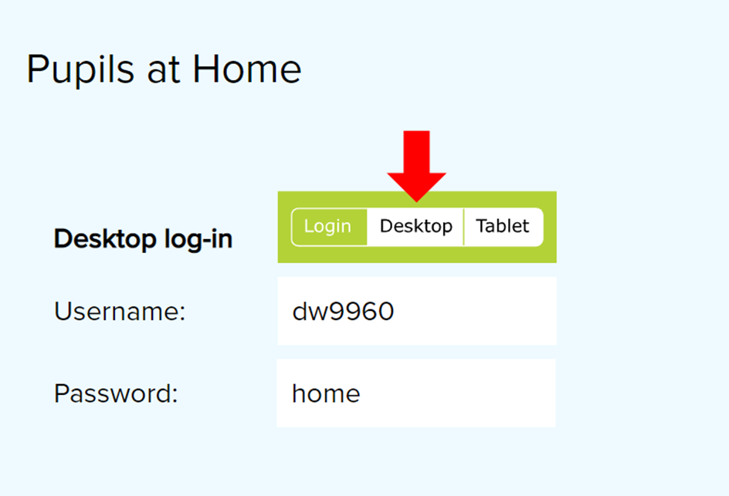
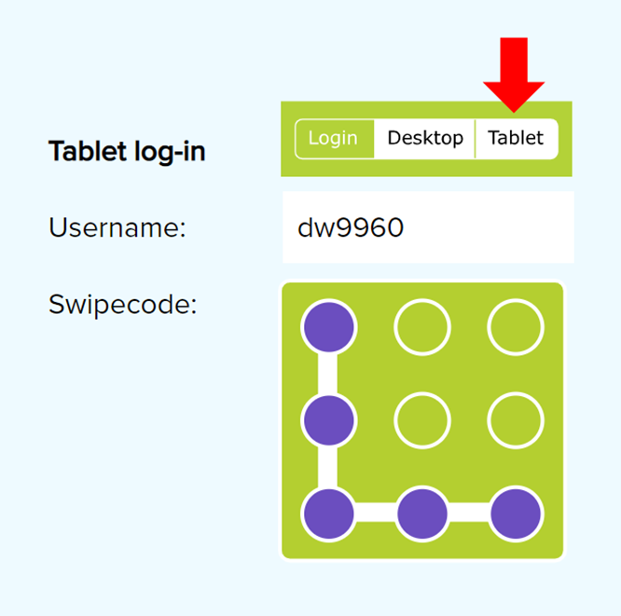
Letter-join
Notes:
Laura
Handwriting is a basic skill that influences the quality of work throughout the curriculum. At the end of Key Stage 2 we want our pupils to Conway with the skill to produce fluent, legible and joined-up handwriting at pace.

Slide 11
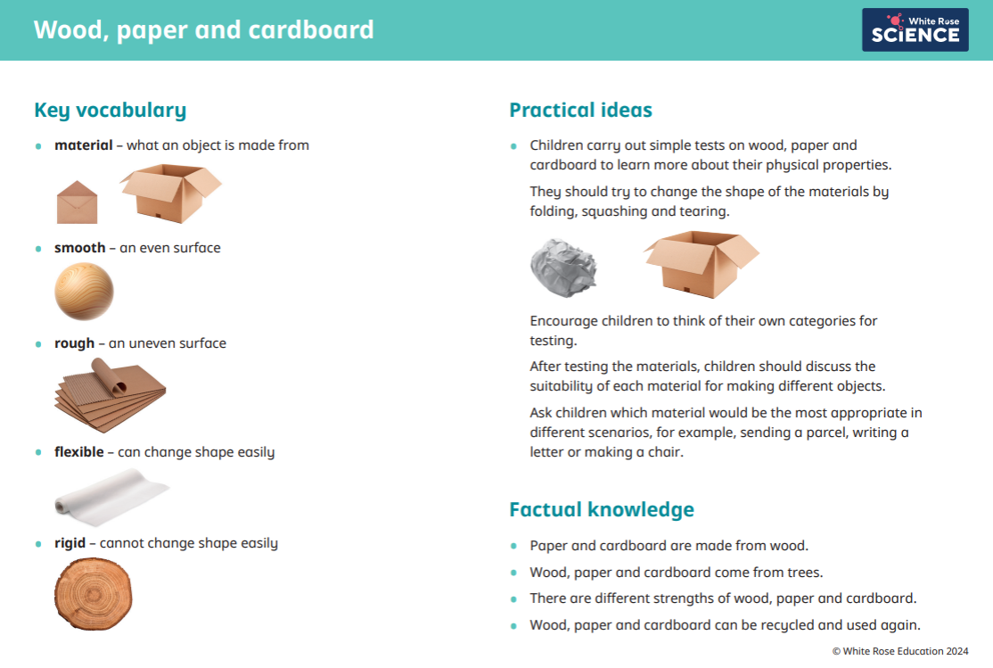
Curriculum Unit this half term – Science: Everyday materials
In Year 2 Science, children will begin to learn about materials, their properties and their uses in everyday life.
After the half term, children are learning about the different animal classifications and their characteristics.
Notes:
Neelam

Slide 12


PSHE / R.E
In R.E we will be learning about Judaism and then move on to Hinduism. We will focus on Diwali and have an assembly later on for parents to watch.
In PSHE, our topic is Me and Myself. We will discuss how to look after ourselves, what makes us happy, our life at school and at home.
Notes:
Neelam

Slide 13
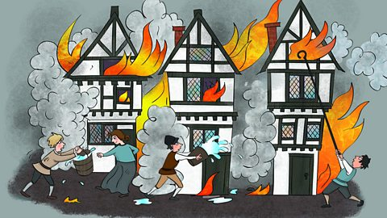
Curriculum Unit this half term
–History
The Great Fire of London
This term, Year 2 are learning about the Great Fire of London and the Plague.
They’ll explore how the fire started in 1666, why it spread so quickly, and how it changed the city. They’re also learning about the Plague in 1665 and how it affected people's lives.
This topic helps children understand important events from the past and how they shaped London’s history.
Notes:
Laura

Slide 14
P.E – Year 2
Year 2 will have P.E on Wednesdays and Thursdays. Please ensure children come dressed in their P.E kit on both days.
Year 2 will start their swimming lessons after the February half term .
Notes:
Neelam

Slide 15
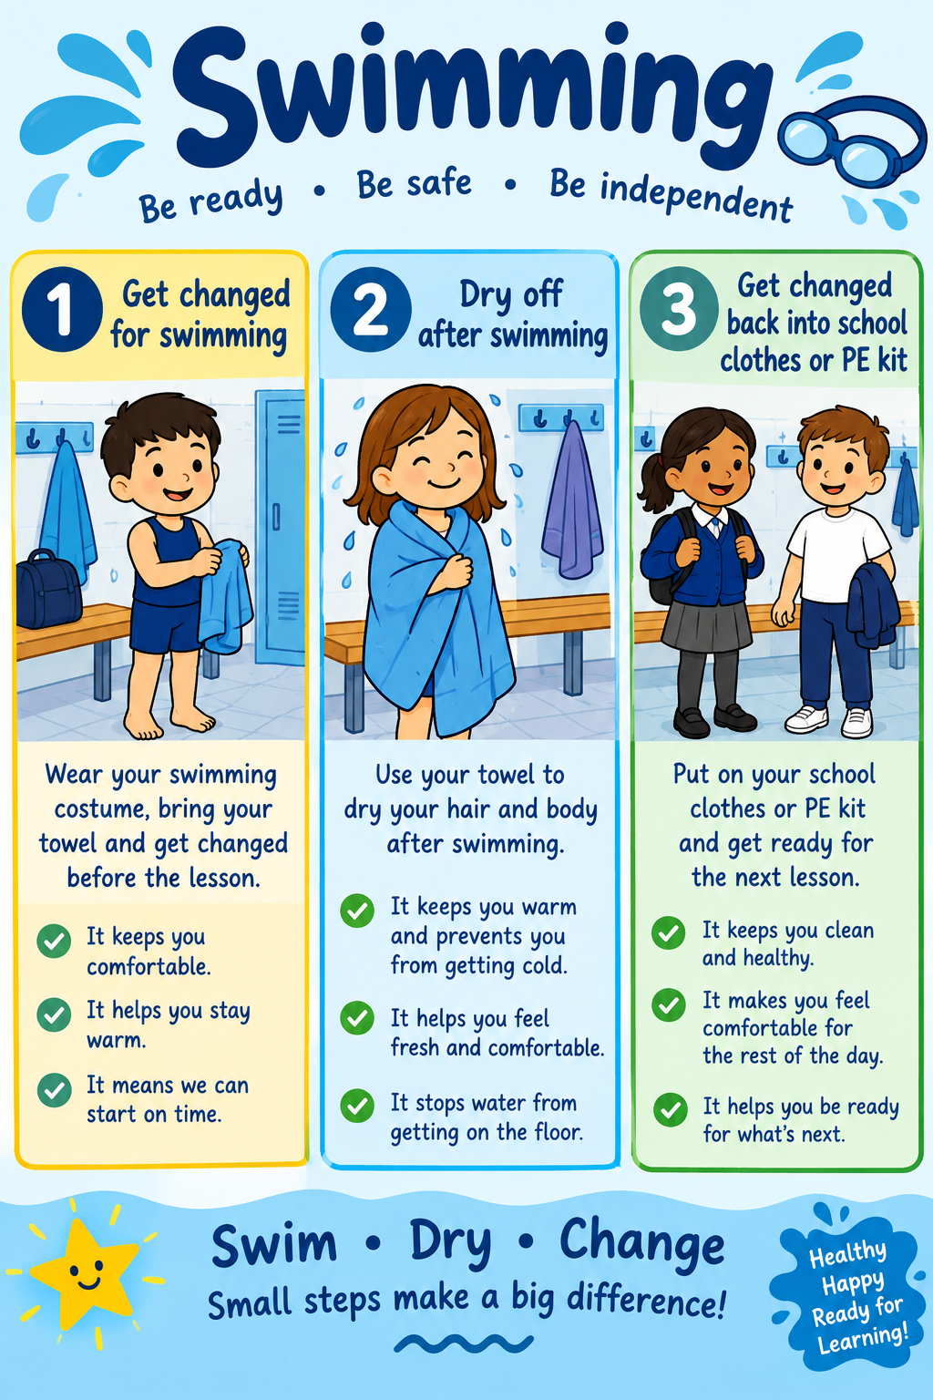
Swimming
Notes:
Neelam

Slide 16
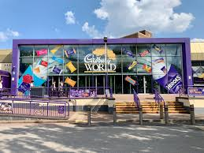
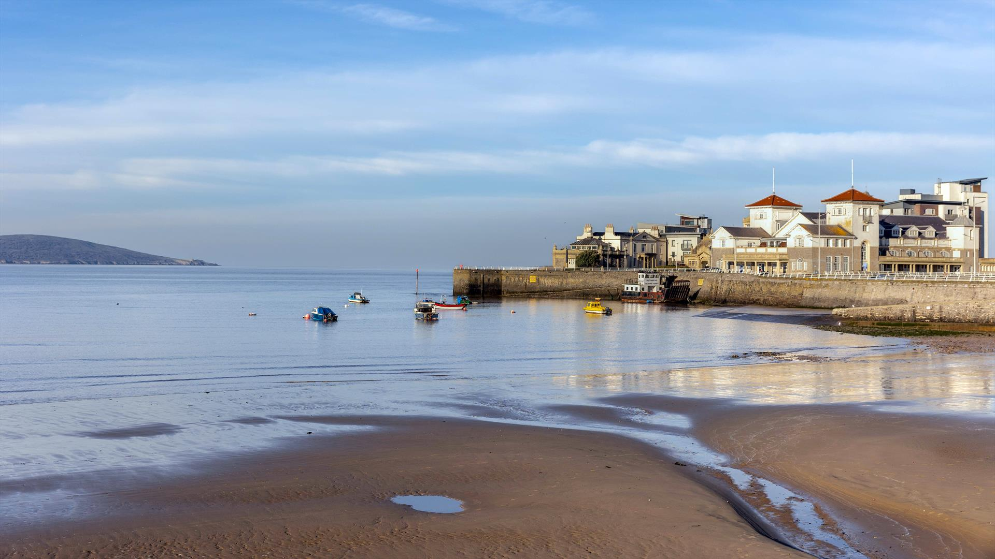
Trips
We are excited to give children memorable learning experiences this year. We keep costs as low as possible.
🍫 Cadbury World – exploring the story of chocolate and its history in Birmingham
Notes:
Laura

Slide 17
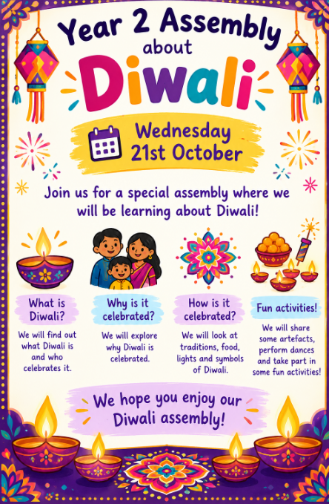
Our Year 2 assembly
Our Year 2 assembly will be based on Diwali and
will be on Wednesday 21st October 2026.
Notes:
Leoni

Slide 18
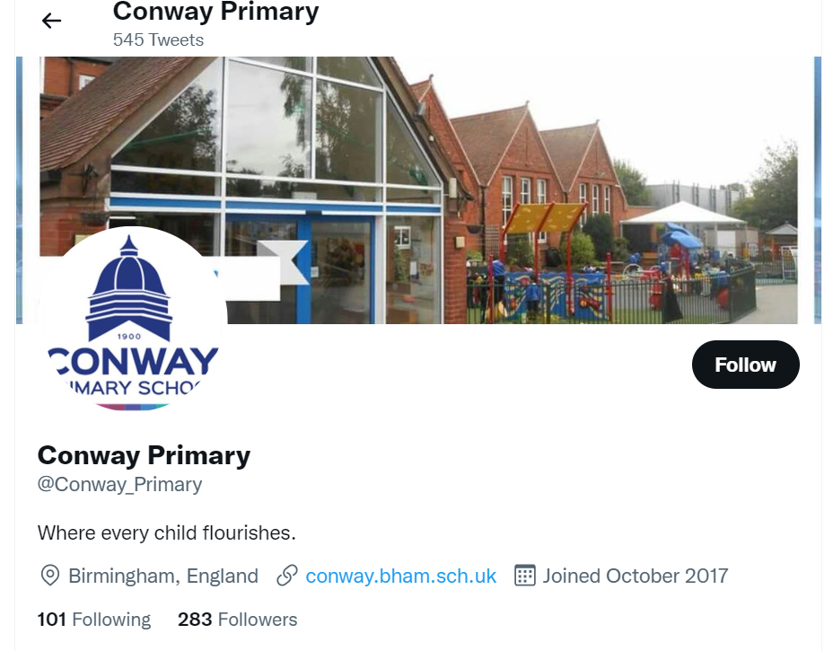
Social Media
We want everyone to be involved in our school as much as possible – community is important to us.
Our social media is regularly updated so please follow us on Facebook and Twitter.
Twitter:
@Conway_Primary
Notes:
Leoni

Slide 19
Partnership
As a school, we want the very best for your child. This happens when we work together. If you have any concerns, please speak to us after school or make an appointment at the school office.
Notes:
All

