Slide 1
Composer of the term
2025 to 2026

Slide 2
Composers of the term 2025 to 2026
Autumn 1 Scouting for girls 1979
Autumn 2 Anna Meredith 1978
Spring 1 Einaudi 1955
Spring 2 Bob Marley 1945
Summer 1 Delia Derbyshire 1937
Summer 2 Florence Price 1887

Slide 3

Autumn 1 1979 Roy Stride (Scouting for girls)
Roy Stride (born 11 March 1979) is an English musician, songwriter and producer, and lead singer of the band Scouting for Girls,, an English pop rock band. He has sold more than 15 million albums and songs , he has had three UK No. 1 albums, and has been streamed on Spotify more than 2 billion times.
Their debut album 'Scouting for Girls' topped the charts in 2008 and sold over a million copies
The founding members had known each other since childhood. Stride and Ellard met in the Cub Scouts and Churchouse met Stride on their first day at school in South Ruislip in West London. They attended the school until 1998 then moved on towards a music career. At the age of 15 Roy and Greg were playing together at small gigs in west London. Scouting for Girls are official ambassadors for the children's charity, Wellchild, and raised over £20,000 for the charity by cycling from London to Brighton on children's chopper bikes in 2010.
The band also hold an annual intimate show at the highest pub in the UK, The Tan Hill Inn to raise money for Children in Need. In 2016 both the band and audience were trapped overnight in the pub after a snow storm blocked roads down from the venue. Each year the event raises over £10,000 for charity
Castles
Elvis ain't dead
Everybody wants to be on TV
I wish I was James Bond
Silly song

Slide 4
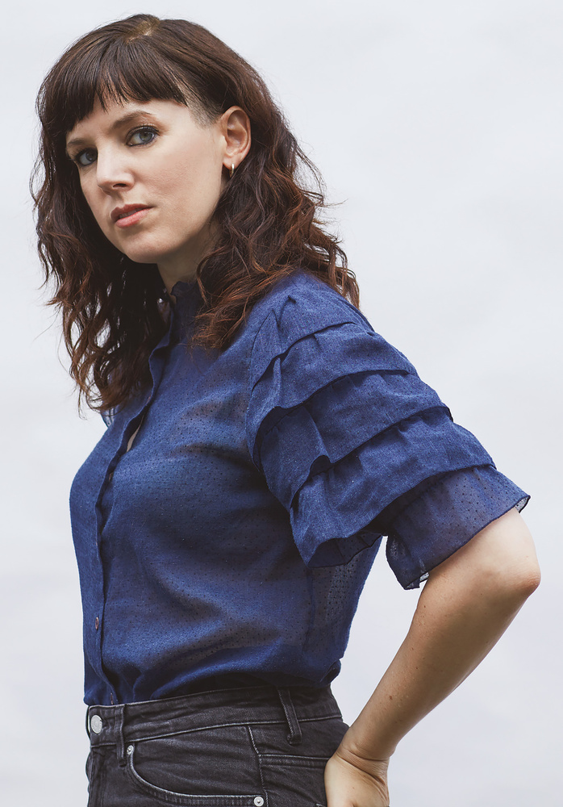
Autumn 2 Anna Meredith 1978
Anna Howard Meredith 12/1/78 is a Scottish composer and performer, who creates amazing electronic and acoustic music. She's even been a special composer for the BBC Scottish Symphony Orchestra!
In 2016, Anna released her first big album, Varmints. It was a huge hit and won the Scottish Album of the Year Award. Her music often mixes different styles, making it really unique and exciting! Anna Meredith was born in North London, England. When she was two, her family moved to South Queensferry, Scotland. She loved music and studied it at the University of York, where she earned top honours. Anna first became widely known in 2008, when she created a piece called for the BBC Last Night of the Proms. This huge concert was watched by 40 million people!
For her amazing contributions to music, Anna was given a special honour. She was appointed a Member of the Order of the British Empire (MBE) in 2019. This is a big award in the United Kingdom.
Moon moons
Vapours
Sawbones
Nautilus

Slide 5
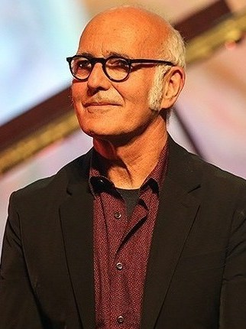
Spring1 Einaudi 1955
Ludovico Maria Enrico Einaudi 23/11/55 is a famous Italian pianist and composer. He learned music at the Milan Conservatory in Milan. Einaudi started his career writing classical music, thern later, he began to mix in other styles like pop, rock, folk, and world music.
Einaudi has created music for many movies and TV shows. Some of these include This Is England, The Intouchables, and I'm Still Here.
Einaudi started writing music for films in the mid-1990s. He won an award called the Grolla d'oro for his music in the film Acquario (1996).
Ludovico Einaudi's music is often described as calm and thoughtful. It uses simple melodies and repeating patterns, which is part of a style called minimalism. His music is also sometimes called "New Age" because it aims to be relaxing and positive, often inspired by nature.
Le onde
Nuvole bianche
Experience
I giorni
Oltremare

Slide 6
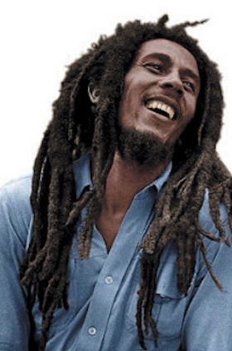
Spring 2 Bob Marley 1945 - 1981
Robert Nesta Marley was born 6/2/45 , Jamaica. His mother, Cedella Malcolm, was black, and his father, Norval Marley, was white. Norval’s family disapproved of his marriage to Cedella, so he rarely saw his father. He lived in the neighborhood of Trench Town in Kingston, the capital of Jamaica. The poverty and cultural influences of Trench Town were important to Marley’s music. In the early 1960s, Marley and several of his friends formed a band, - the Wailers and had its first big hit, “Simmer Down,” in 1963. It gave a voice to the urban poor of Jamaica. Marley soon became a star performer. His songs were a combination of rhythm and blues, rock, and reggae
In the years after his death, Bob Marley and his music became even better-known worldwide. He was also a politician .He tried to bring together groups in Jamaica that were fighting for control of the country. To do that he organised the One Love concert in 1978. Marley won an award from the government for his efforts. Soon after he died of cancer in 1981
High tide or low tide
Buffalo soldier
One love
Three little birds

Slide 7
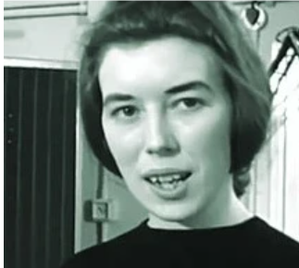
Summer 1 Delia Derbyshire 1937
Delia Ann Derbyshire ( 5/5/37 to 3/7/2001 was an English musician and composer. She was a pioneer in electronic music. Delia worked at the BBC Radiophonic Workshop in the 1960s, where she created the electronic version of the famous Doctor Who theme music. Many people call her "the unsung heroine of British electronic music." and she has inspired many people
She was a very smart child and by age four, she was already teaching other kids to read and write. She once said, "The radio was my education." Her parents bought her a piano when she was eight.
After university, Delia wanted to work with sound and music. She applied to Decca Records, a music company but they told her they didn't hire women in their recording studios. One of Delia's most famous works was in 1963. She created the electronic version of the Doctor Who theme music. This was one of the first TV themes made entirely with electronics. In 1973, Delia left the BBC and she continued to work on film soundtracks for a short time. By 1975, she stopped making music professionally. Delia Derbyshire passed away in July 2001, at the age of 64, after an illness. After Delia's death, many of her old tapes and papers were found. These were given to the University of Manchester to be saved.
Ziwzih Ziwzih OO-OO-OO
Dr who
Golden sand

Slide 8
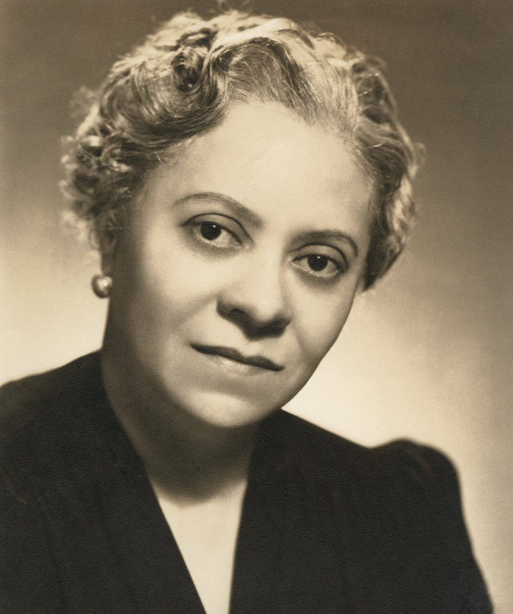
Summer 2 Florence Price 1887
Florence Beatrice Price April 9, 1887 – June 3, 1953 – Florence was an American classical composer, pianist, organist and music teacher, .who is is known as the first African-American woman to be recognised as a symphonic composer, and the first to have a composition played by a major orchestra. Price composed over 300 works: four symphonies, four concertos, as well as choral works, art songs, chamber music and music for solo instruments.
She was one of three children in a mixed-race family. Her father was the only African-American dentist in the city, and her mother was a music teacher. Despite racial issues of the era, her family was well respected and did well within their community. She gave her first piano performance at the age of four and had her first composition published at the age of 11.
In 1910, she became the head of the music department of what is now Clark Atlanta University, a historically Black college. In 1912, she married Thomas J. Price, a lawyer , gave up her teaching position and moved back to Little Rock, Arkansas, where he had his practice and had two daughters. She could not find work in the by now racially segregated town. After a series of racial incidents in Little Rock, the Price family decided to leave. Florence really wanted to be a doctor but felt the difficulties of becoming a woman doctor at the time were too formidable. Instead, she became that even greater rarity—a woman composer of symphonies. After her divorce, she worked as an organist for silent film screenings and composed songs for radio ads under a pen name. Despite these challenges, Price received praise for the blending of both her traditional western education and African American culture in her music, and was seen as a pioneer for both her gender and race.^{[43]}
Missisippi river suite
Piano sonata in E minor
The Oak
Symphony no 1 in E minor

