Slide 1



Primary KS1

Slide 2



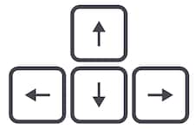

Learning from home?
Here are some ideas of how to get the most out of this lesson at home.
Share your thoughts with the parent, family member or caregiver who’s helping you!
Talk to someone else in your family, like a brother or sister, and find out their opinions!
For some of the activities, you might need a pen & paper as you get creative!
How to use this lesson…
Use these buttons to get the most out of your lesson.
Find this button in the bottom right of you screen to start your lesson.
Use the arrow keys to go forwards and backwards through your lesson.
To go back to your normal screen, press the esc key on your keyboard.
In the classroom?
You need the same things, but will need to swap the parent for a partner!
Parents’ & Carers’ Note:
Please see the Notes section below each slide for any further guidance.
Don’t forget to vote…
You can find the link to do this on the final slide. Get your whole household involved!
Notes:
Images:
https://icons8.com/

Slide 3

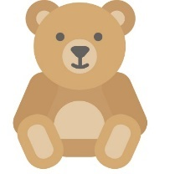
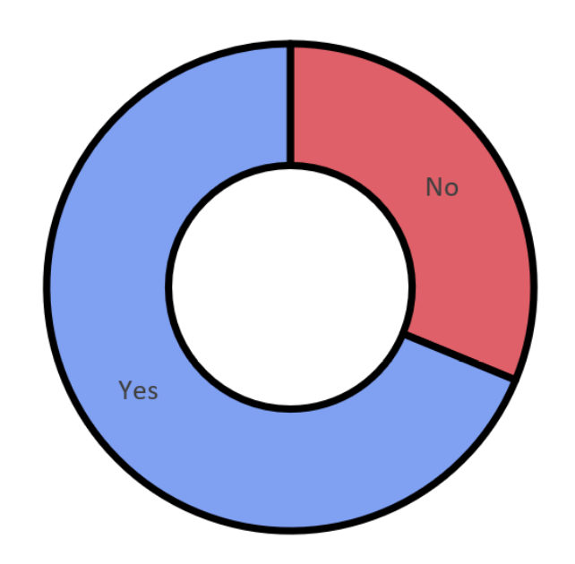


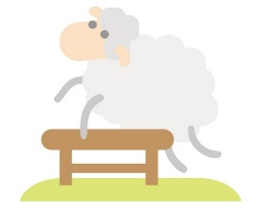




Last week’s vote:
Do you get enough sleep?
68.8%
31.2%
Primary national vote result
Notes:
Images
iStock

Slide 4





Starter: Who would you ask?
Discuss (2-3 mins)
Discuss with your partner. Who would you ask for help if…
You needed help with your school work?
Someone was being mean to you?
Had a bad dream at night?
You got lost in a supermarket?
Saw something scary on the internet?
You were worried about a friend?
Challenge:
Would you want these people to help you? What if they said no?
Notes:
Images:
iStock

Slide 5

Should you stand up for other people?
Notes:
Images:
iStock

Slide 6






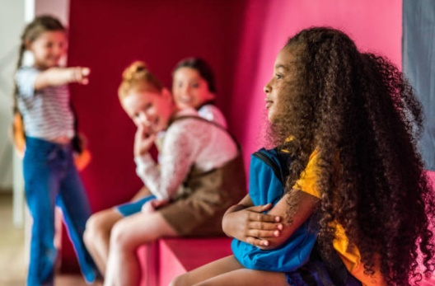



Our learning journey for this week!
Starter: who would you ask?
Why are we talking about this?
What would you do?
Should I get involved?
How can we help?
Vote!
Extension:
An important cause
Notes:
Images:
iStock

Slide 7
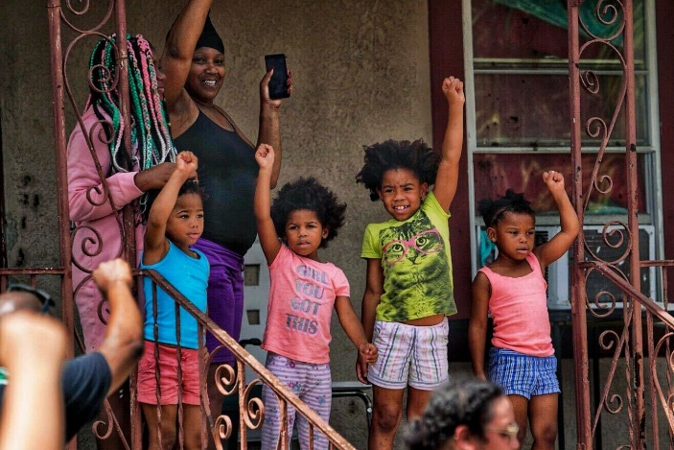
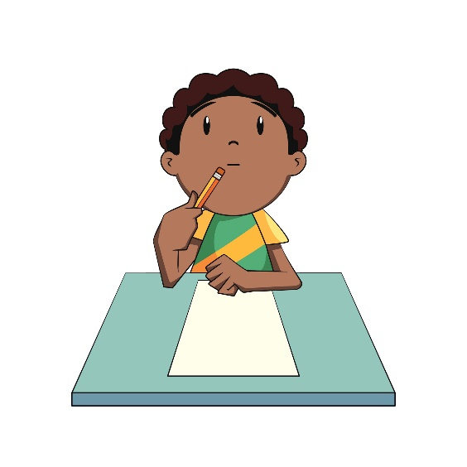
Why are we talking about this?
Right now, there are lot of people protesting in America because they don’t think black people are being treated fairly.
Lots of people around the world are also speaking out online and in protests to support them, even if it doesn’t affect them.
But should you stand up for other people? Or is it better to leave it to other/older people? That’s what you’ll be thinking about today.
Notes:
Images:
iStock
https://abcnews.go.com/US/photos-moments-peace-unity-george-floyd-protests/story?id=70994503
References:

Slide 8
Our learning journey for this week!
Starter: who would you ask?
Why are we talking about this?
What would you do?
Should I get involved?
How can we help?
Vote!
Extension:
An important cause
Notes:
Images:
iStock

Slide 9
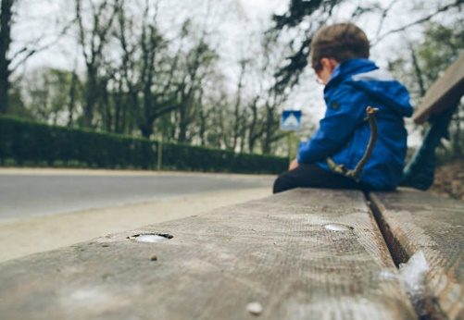
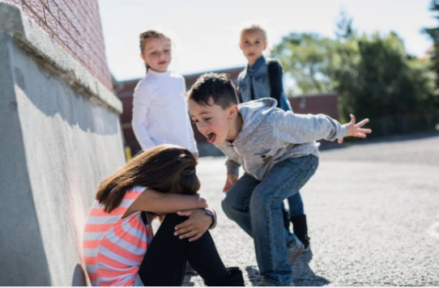
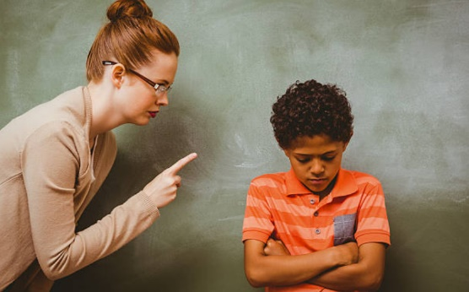
What would you do?
What would you do? (5-10 mins)
On the next four slides, you’ll see different situations where you could get involved to stand up for someone. Read each situation and decide what you’d do!
Notes:
Images:
iStock
References:

Slide 10

What would you do?
Someone in your class is getting shouted at by the teacher for throwing their book on the floor, but you saw that it was an accident. But if you say something, you’re worried the teacher might shout at you. What would you do?
a) Stand up for them.
What would you do?
b) Wait for someone else to stand up for them.
c) Ignore it and carry on with my work.
Notes:
Images:
iStock
References:

Slide 11

What would you do?
You’re in the playground and you see girl from a younger year group getting pushed around by some kids in your class. You don’t know who the girl is, but she looks upset.
What would you do?
a)I would go over and tell them to stop.
What would you do?
b)I would find someone older than me to help them.
c)I would help them.
Notes:
Images:
iStock
References:

Slide 12

What would you do?
Charlotte’s older cousin is supposed to walk her home from school everyday. Sometimes he leaves and goes home without which means she’s left to walk home on her own. You live in the opposite direction to Charlotte. What would you do?
a) Tell him to walk Charlotte home
What would you do?
b) Tell the teacher or a parent.
c) Ignore it because your mum walks you home, so you’re ok.
Notes:
Images:
iStock
References:

Slide 13
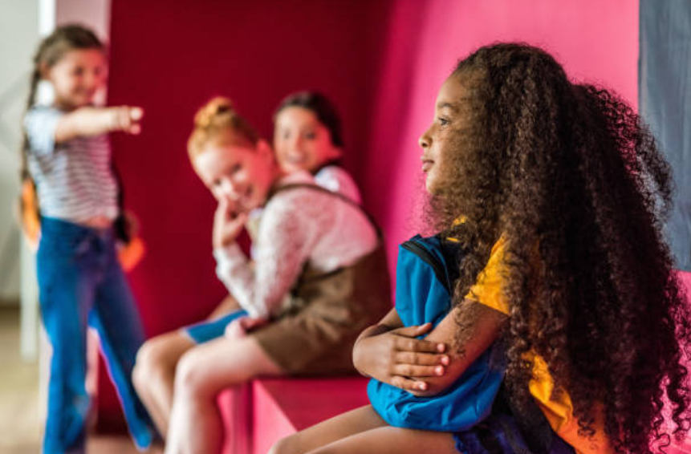
What would you do?
You hear one of your friends say to a new girl “go back to your country”. Your teacher has told you that it’s not ok to say that because it’s rude and mean. What would you do?
a)Tell your friend they’re wrong to say that.
What would you do?
b)Tell a teacher.
c) Ignore them.
Notes:
Images:
iStock
References:

Slide 14
What would you do?
Reflect (2-3 mins)
Based on this, if there’s a problem, do you it’s better to get involved, leave it to someone else or just ignore it?
a) Get involved.
b) Leave it to someone else.
c) Ignore it.
Notes:
Images:
iStock
References:

Slide 15
Our learning journey for this week!
Starter: who would you ask?
Why are we talking about this?
What would you do?
Should I get involved?
How can we help?
Vote!
Extension:
An important cause
Notes:
Images:
iStock

Slide 16





Should I get involved?
Giving advice! (5-10 mins)
Do you know when the right time is to get involved? These kids aren’t too sure! Read each situation and tell them whether they should or shouldn’t get involved and why!
Yes, they should!
No, they shouldn’t!
Notes:
Images:
iStock
References:

Slide 17

Should I get involved?
My friend has asked me to join her protest to get rid of school uniforms, but actually I don’t mind school uniforms! Should I join her, even though I don’t agree?
Should he get involved? Why/why not?
Yes, she should!
No, she shouldn’t!
Notes:
Images:
iStock
References:

Slide 18

Should I get involved?
A girl in my class is in a wheelchair and can’t get up the stairs. She’s asked everyone to sign a petition to get a ramp in school. I don’t have a wheelchair, but should I sign the petition?
Should she get involved? Why/why not?
Yes, she should!
No, she shouldn’t!
Notes:
Images:
iStock
References:

Slide 19

Should I get involved?
My friend keeps starting fights with other people. He said I should stand up for him, even though he’s the one starting it and I don’t like to fight. Should I get involved?
Should he get involved? Why/why not?
Yes, she should!
No, she shouldn’t!
Notes:
Images:
iStock
References:

Slide 20

Should I get involved?
My school has started a student council and my friends think I should join because I have lots of good ideas on how to help our school. However, I’m really shy and don’t know anyone on the council. Should I get involved?
Should she get involved? Why/why not?
Yes, she should!
No, she shouldn’t!
Notes:
Images:
iStock
References:

Slide 21
Our learning journey for this week!
Starter: who would you ask?
Why are we talking about this?
What would you do?
Should I get involved?
How can we help?
Vote!
Extension:
An important cause
Notes:
Images:
iStock

Slide 22
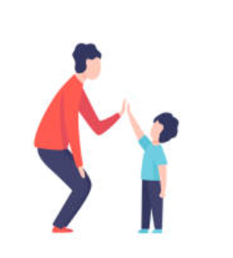
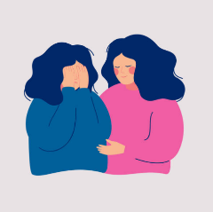



How can we help?
What other ways are there to help someone, other than standing up
Work it out! (5-10 mins)
Draw this table. On one side, write different write way to stand up for people. On the other side, write other ways to help! Use the ideas on the next slide to help you.
Standing up!
Helping in other ways!
Notes:
Images:
iStock
References:

Slide 23
How can we help?
Join their protest.
Listen to them.
Encourage them to speak out.
Ask an adult for help.
Talk to their bully.
Standing up!
Other ways!
Sign a petition.
Challenge:
Which do you think are the best ways to help other people?
Notes:
Images:
iStock
References:

Slide 24
Our learning journey for this week!
Starter: who would you ask?
Why are we talking about this?
What would you do?
Should I get involved?
How can we help?
Vote!
Extension:
An important cause
Notes:
Images:
iStock

Slide 25


Should you stand up for other people?
Yes
No
It’s important that we all stand up for each other.
If I was in trouble, I would hope that someone would stand up for me.
If there’s a problem, everyone should get involved to solve it.
It’s the right thing to do!
I’m just a child, so it’s better if someone else does it.
It’s more important to stand up for things that affect me.
There are other, more helpful things you could do.
It’s safer if I don’t get involved in our people’s problems.
Calling all voters!
You can still vote at home! Just follow the link: https://www.surveymonkey.co.uk/r/vfs-primary-ks1-stand-up-others

Slide 26







Extension: An important cause
Create! (10-15 mins)
Think of a cause that’s important to you and create a poster encouraging more people to get involved!
Hospitals?
Animal rights?
Equality?
Children in need?
Climate change?
Changes in school?
Notes:
Images
iStock
References

Slide 27
You can vote from home at… https://www.surveymonkey.co.uk/r/vfs-primary-ks1-stand-up-others
To have your voice heard!
If you have any issues, feedback or comments, email amy@votesforschools.com
Notes:
Alternative video link: https://youtu.be/FoQ45XPO_WQ

