Slide 1
Welcome to our reading meeting. This session will last around 40 minutes. This presentation will be posted on our website and helpful resources will be sent home to you.
reckley.312@lgflmail.org for any questions

Slide 2







National Curriculum Expectations
By the time children reach year 3, they should be able to apply their knowledge of phonics and read and discuss a range of books.
By the time they leave year 4, children are expected to:
increase their familiarity with a wide range of texts;
identify themes;
retrieve and record information from non-fiction texts;
identify the main ideas;
draw inferences;
check their understanding of new words;

Slide 3




National Curriculum Expectations
By the time they leave year 4, children are expected to:
make predictions about what might happen;
prepare poems and play scripts to read out loud and perform;
participate in discussions about books;
discuss words and phrases;
ask questions to improve their understanding of a text.

Slide 4
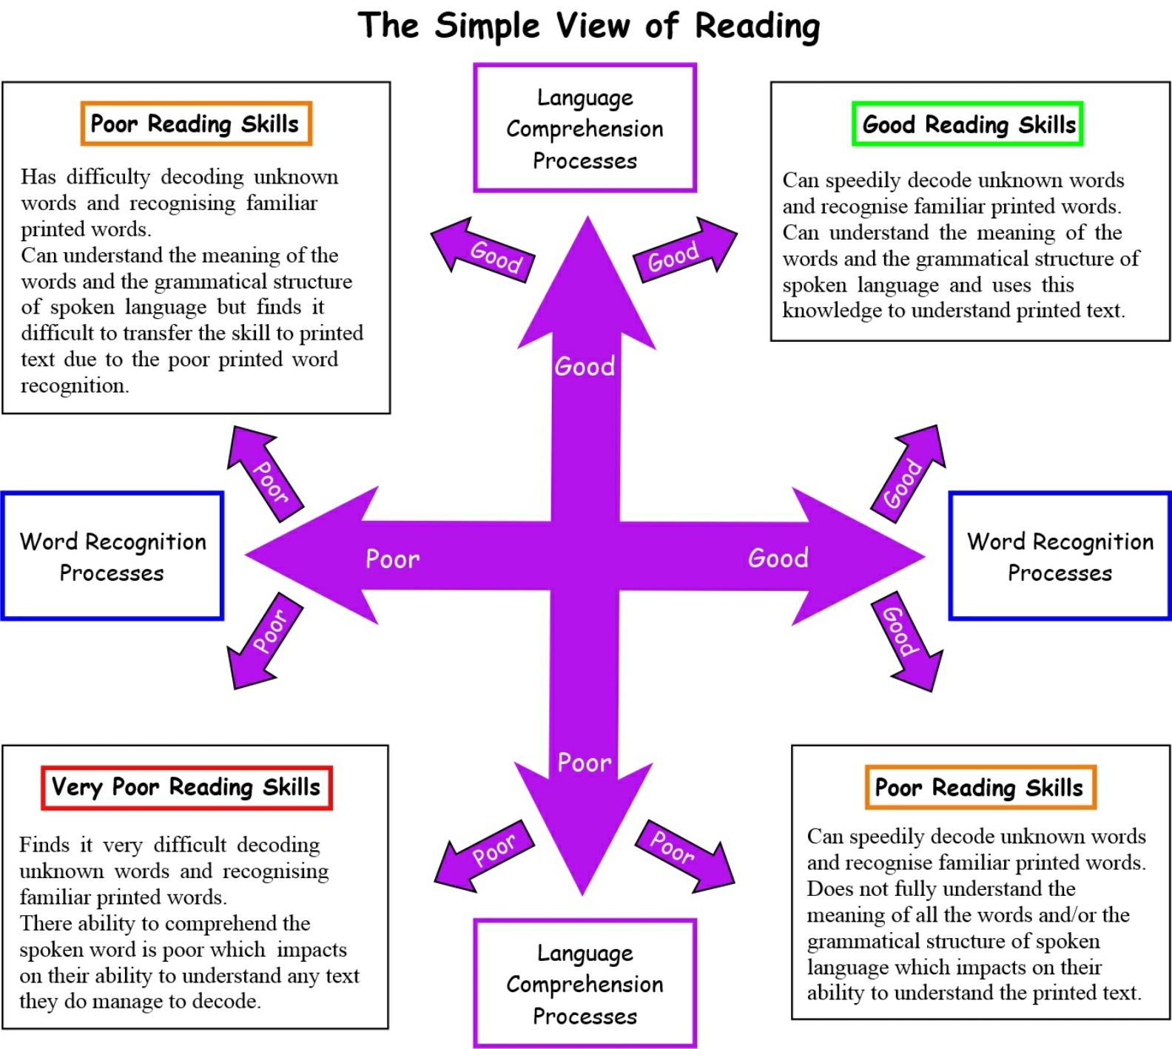

Slide 5
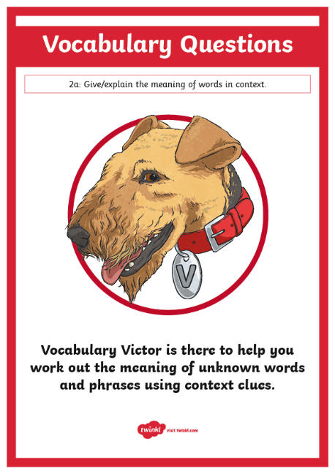
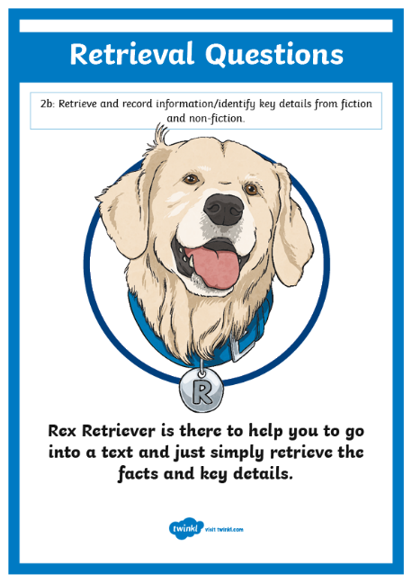
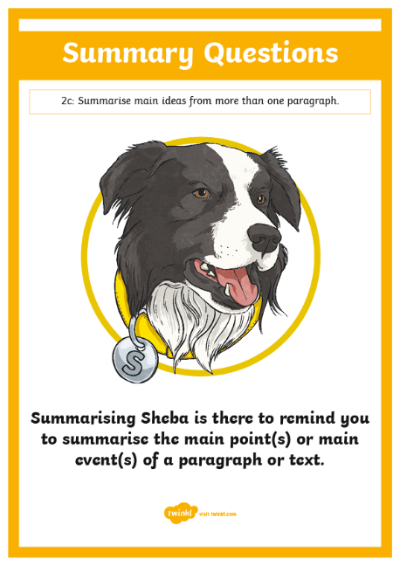
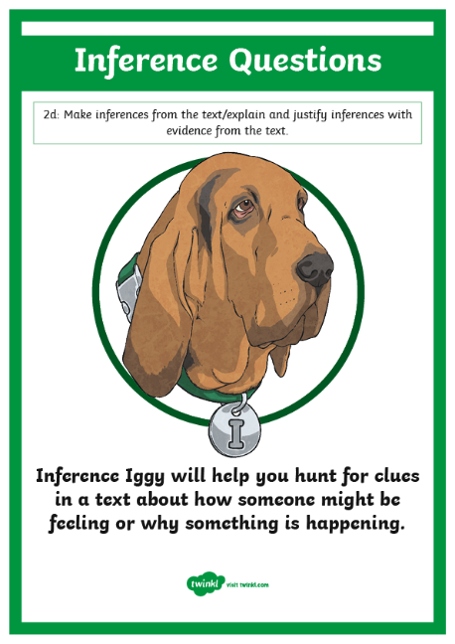
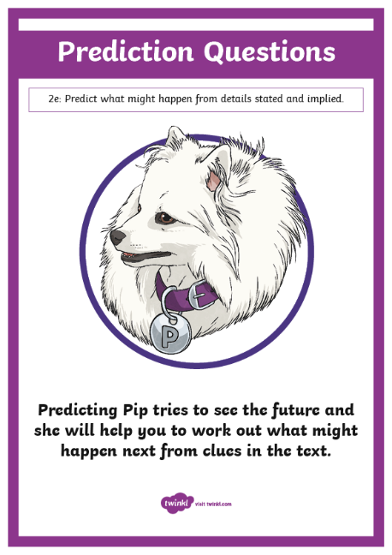
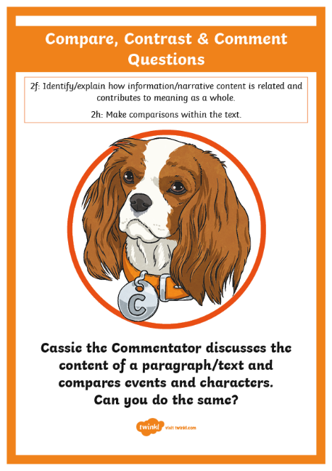
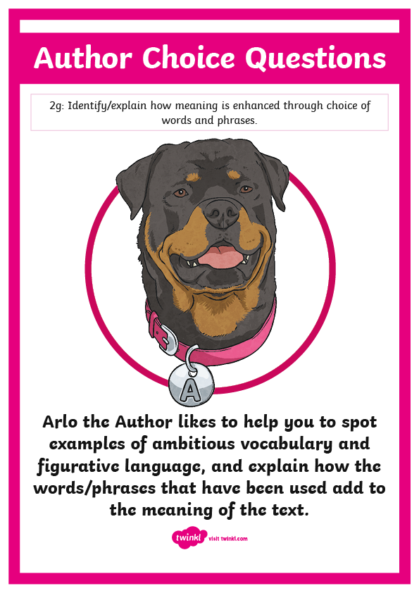
KS2 Reading Content Domains
In the National Curriculum, there are eight content domains that children need to answer questions from.

Slide 6


Vocabulary Victor
2a: Give/explain the meaning of words in context.
Vocabulary Victor is there to help you work out the meaning of unknown words and phrases using context clues.

Slide 7
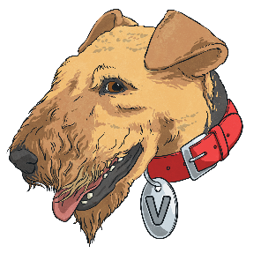
What Types of Questions Could You Ask?
Content domain 2a is all about understanding the meaning of words in context. To help your child practise this content domain, try asking these questions when they’re next reading.
What does this word tell us about the character or setting?
What does that suggest about…?
What does this word/phrase mean?
The author has used the word ________ to describe the main character. Can you think of another word they could have used?
Can you find a word in this paragraph which means the same as ________?

Slide 8
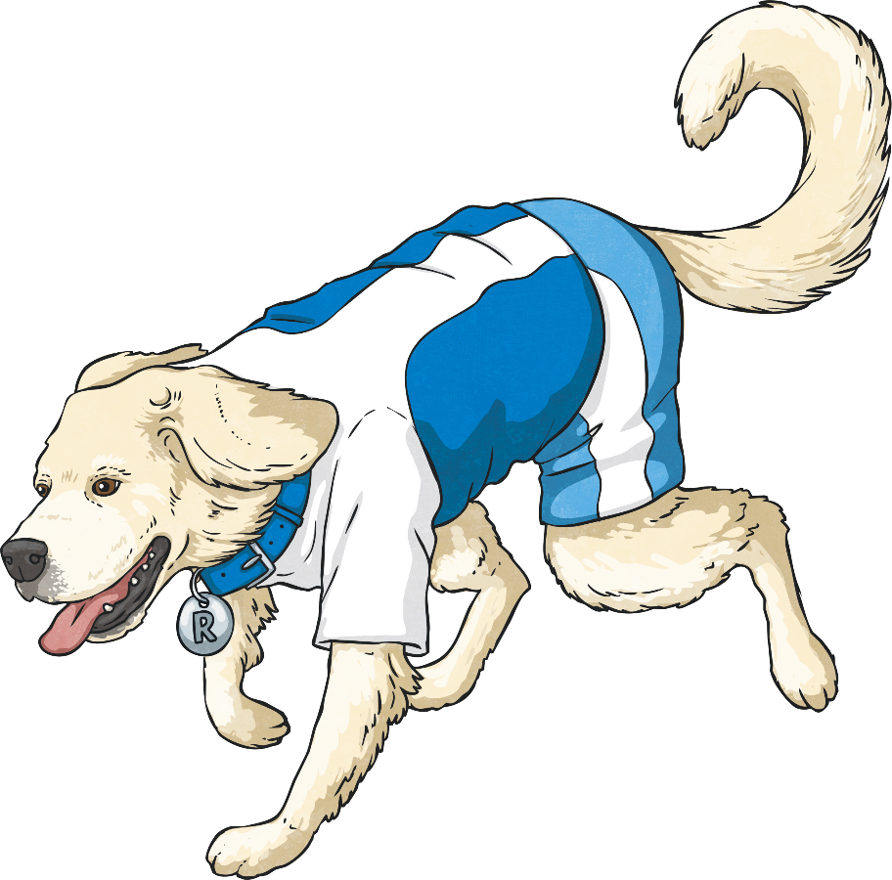
Rex Retriever
2b: Retrieve and record information/identify key details from fiction and non-fiction.
Rex Retriever is there to help you to go into a text and just simply retrieve the facts and key details.

Slide 9

What Types of Questions Could You Ask?
Content domain 2b is all about retrieving key details from a text. To help your child practise this content domain, try asking these questions when they’re next reading.
Where is the story set?
Where did ________ go?
What did ________decide to do when ________?
Which paragraph tells you that ________?
Who are the most important characters in the book?

Slide 10
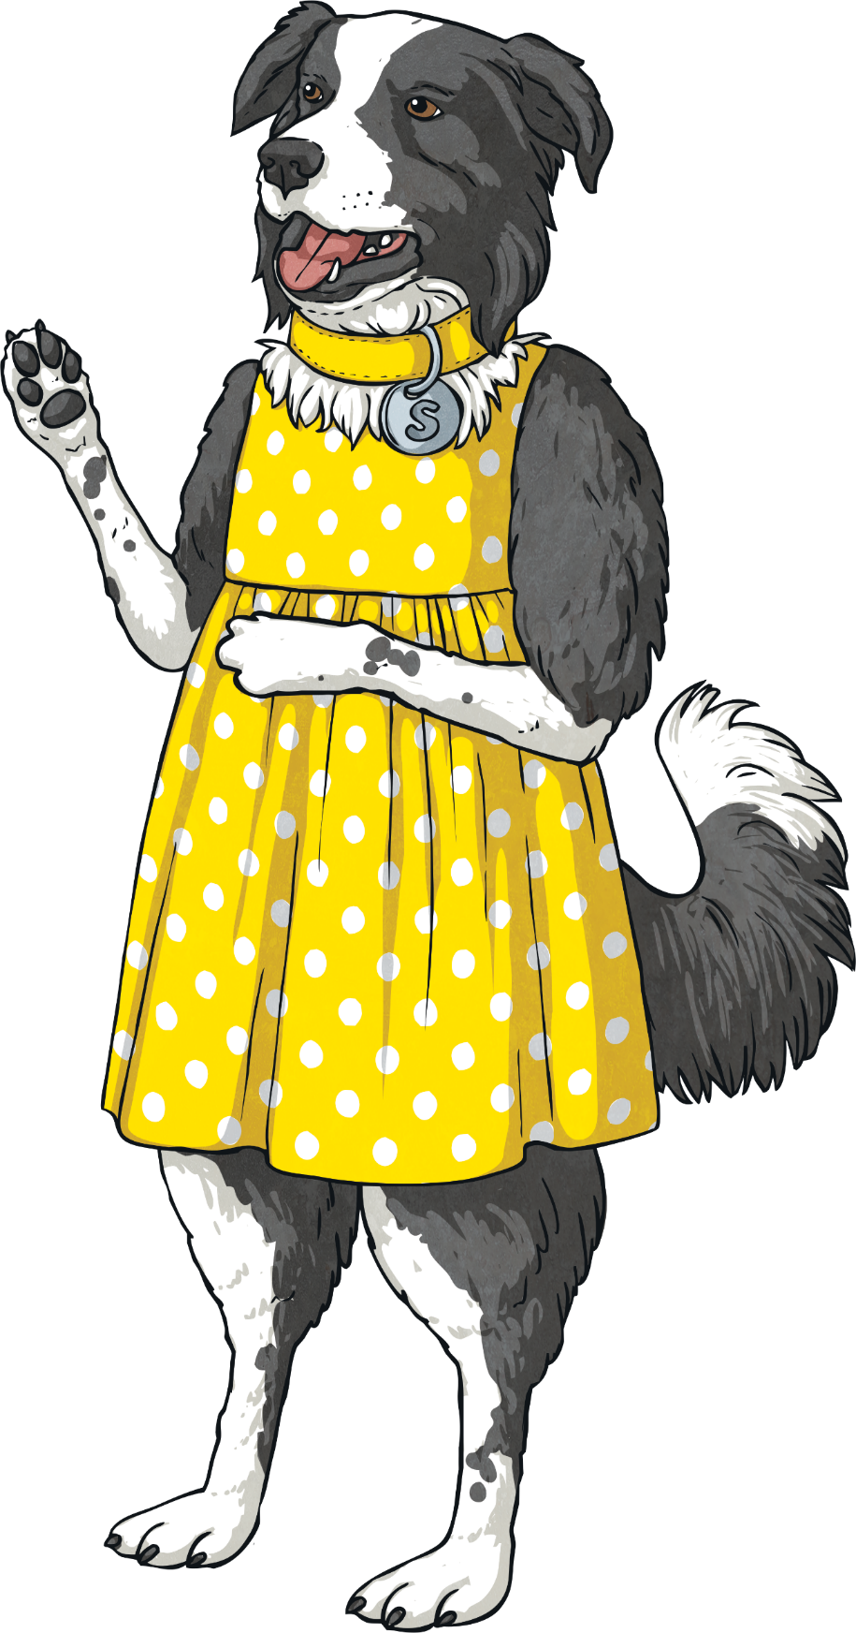
Summarising Sheba
2c: Summarise main ideas from more than one paragraph.
Summarising Sheba is there to remind you to summarise the main point(s) or main event(s) of a paragraph or text.

Slide 11
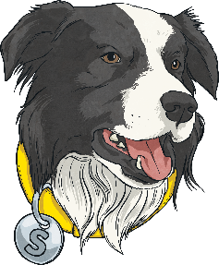
What Types of Questions Could You Ask?
Content domain 2c is all about summarising the main ideas or events in a text. To help your child practise this content domain, try asking these questions when they’re next reading.
What is the main point in this paragraph?
Can you describe what happened in this paragraph/chapter?
Using less than 20 words, can you write an advert for this book?
Can you remind me about what happened the last time we read?
What do you remember most about ________?

Slide 12
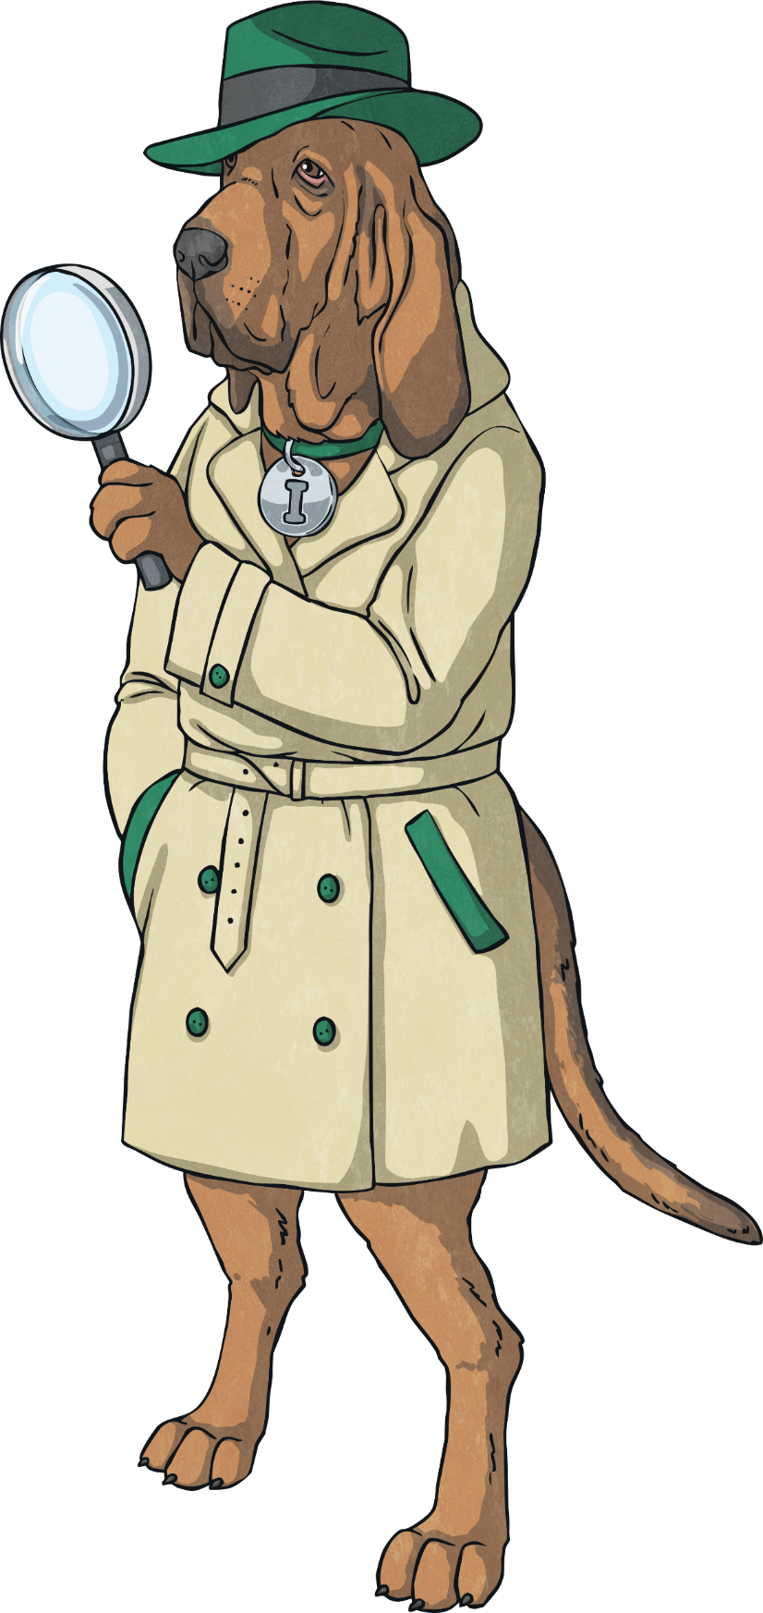
Inference Iggy
2d: Make inferences from the text/explain and justify inferences with evidence from the text.
Inference Iggy will help you hunt for clues in a text about how someone might be feeling or why something is happening.

Slide 13

What Types of Questions Could You Ask?
Content domain 2d is all about making inferences and justifying them using evidence from the text. To help your child practise this content domain, try asking these questions when they’re next reading.
Why did the character act like that?
What do the characters think about each other?
What does ________ think? How do you know?
Can you find evidence that shows this character is going to ________ in the future?
What do you think will happen to the main character now? Can you explain why you think that?

Slide 14
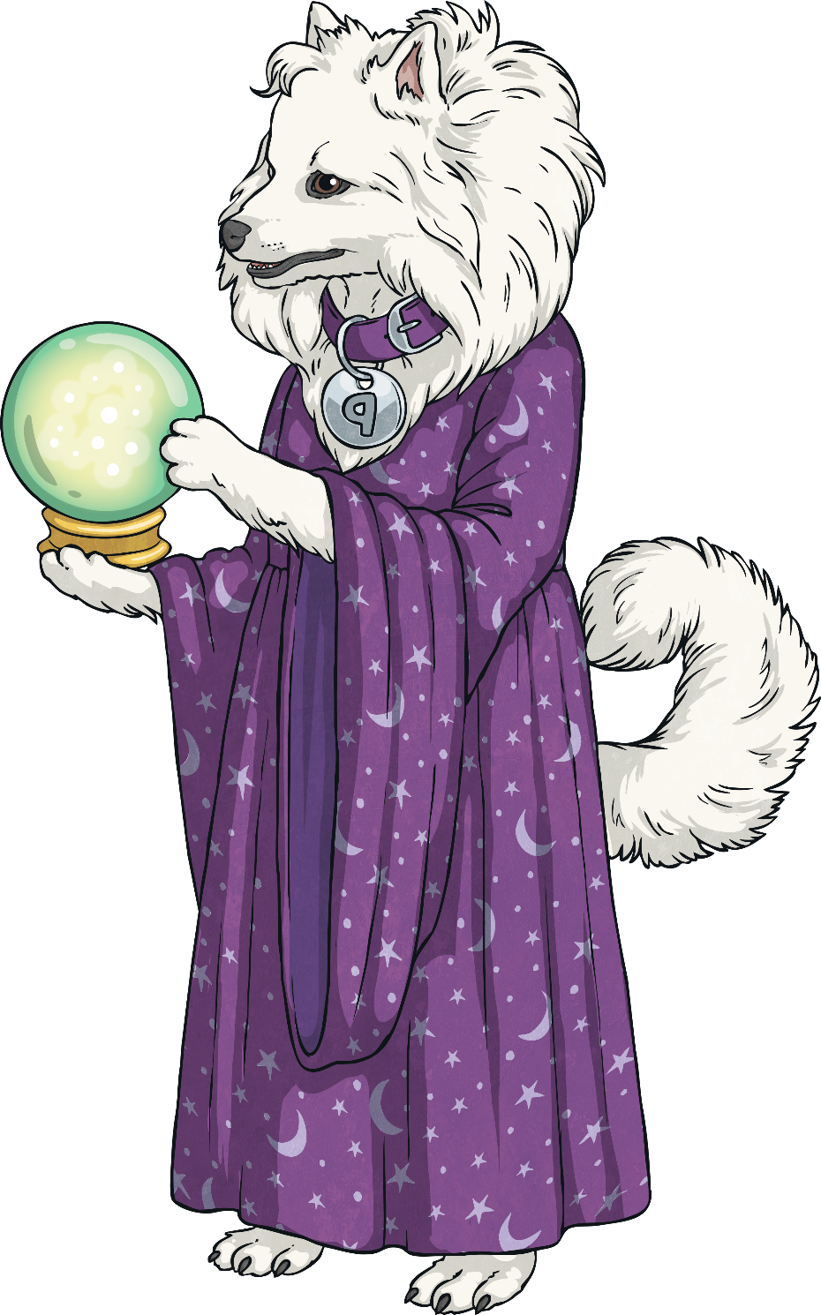
Predicting Pip
2e: Predict what might happen from details stated and implied.
Predicting Pip tries to see the future and she will help you to work out what might happen next from clues in the text.

Slide 15
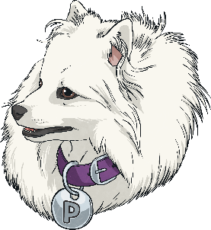
What Types of Questions Could You Ask?
Content domain 2e is all about making predictions. To help your child practise this content domain, try asking these questions when they’re next reading.
Do you think the author has another plan for this character?
What do you think is likely to happen when ________?
What do you think will happen the next time we read?
Based on what you know about the character, what do you think will happen to them in the future?
Do you think the character will change their behaviour in the future? Can you explain what makes you think that?

Slide 16
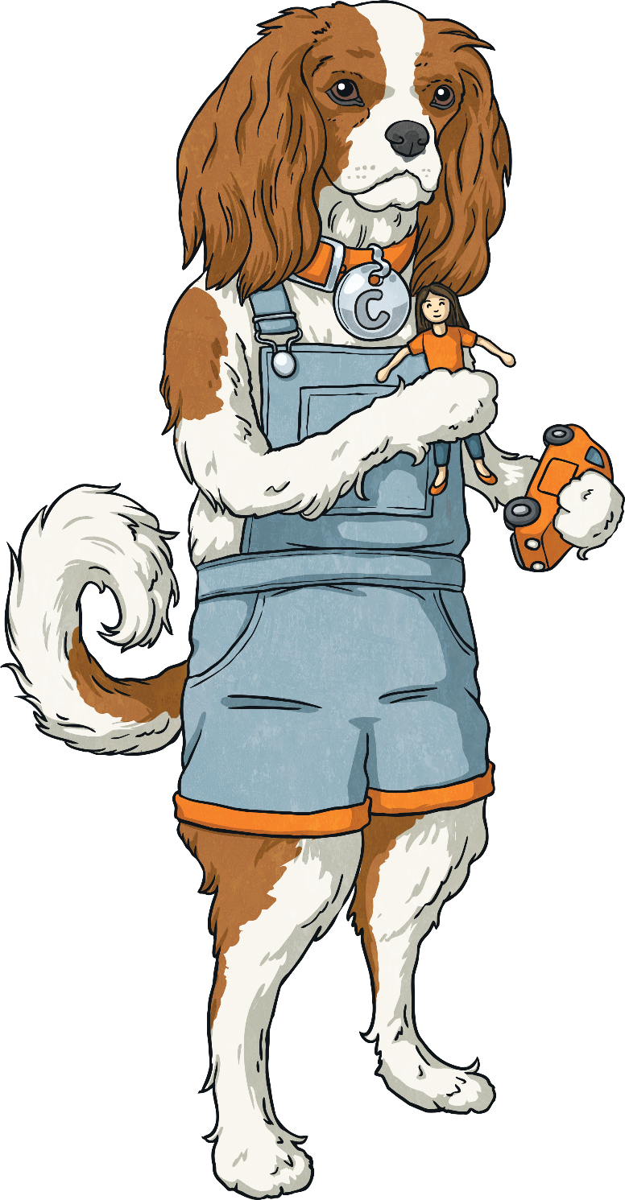
Cassie the Commentator
2f: Identify/explain how information/narrative content is related and contributes to meaning as a whole.
2h: Make comparisons within the text.
Cassie the Commentator discusses the content of a paragraph/text and compares events and characters. Can you do the same?
Cassie the Commentator is unique because she supports children with two separate content domains.

Slide 17

What Types of Questions Could You Ask?
Content domains 2f and 2h are all about making comparisons within the text and commenting on how the content of a text contributes to the meaning. To help your child practise this content domain, try asking these questions when they’re next reading.
Compare one character to another. How are they different or the same?
How has the character changed since the start of the text?
What was your favourite part of the story? Why was it your favourite part?
This text has been split into different sections. How does that help you to understand it?
Look at the section titled ________. Why is this an important part of the text?

Slide 18
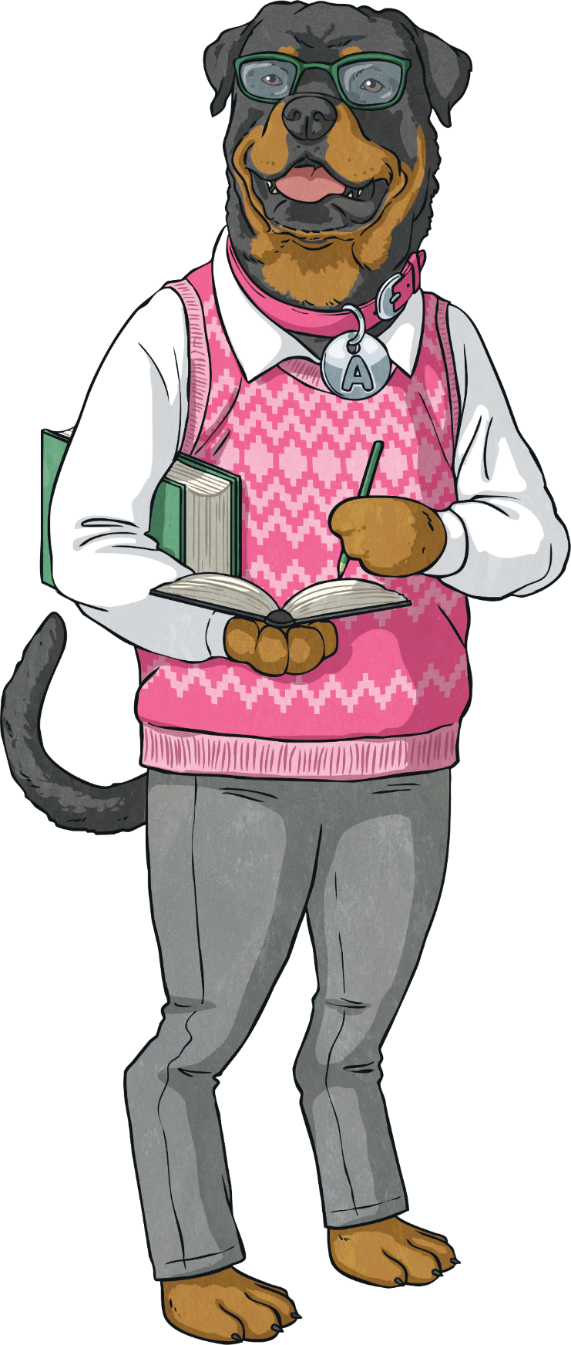
Arlo the Author
2g: Identify/explain how meaning is enhances through choice of words and phrases.
Arlo the Author likes to help you to spot examples of ambitious vocabulary and figurative language, and explain how the words/phrases that have been used add to the meaning of the text.

Slide 19
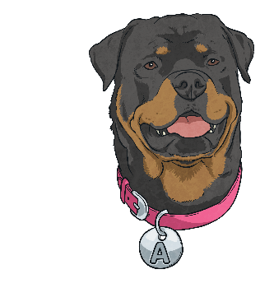
What Types of Questions Could You Ask?
Content domain 2g is all about recognising why certain words or phrases have been used. To help your child practise this content domain, try asking these questions when they’re next reading.
How has the author made us feel worried/happy for the character?
How does the author show that the character is happy/angry?
How does the author show that the setting is safe/dangerous?
Find your favourite word on this page. Why do you think the author chose that word?

Slide 20




Recap
To support your child to achieve their reading potential, have a go at the following:
make time for reading every day;
ask a variety of questions;
set up a special place dedicated to reading;
make sure that you have a variety of reading materials available such as recipe books, fiction texts, non-fiction texts, reference books or shopping lists;
show that you enjoy reading too by sharing what you’ve read;
take part in activities related to reading, such as going to see a book you’ve just read at the theatre or cinema;
make sure that reading is seen as a fun and enjoyable activity rather than a punishment or a chore.

Slide 21






