Slide 1
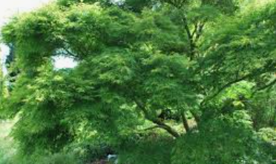
Acer information meeting

Slide 2
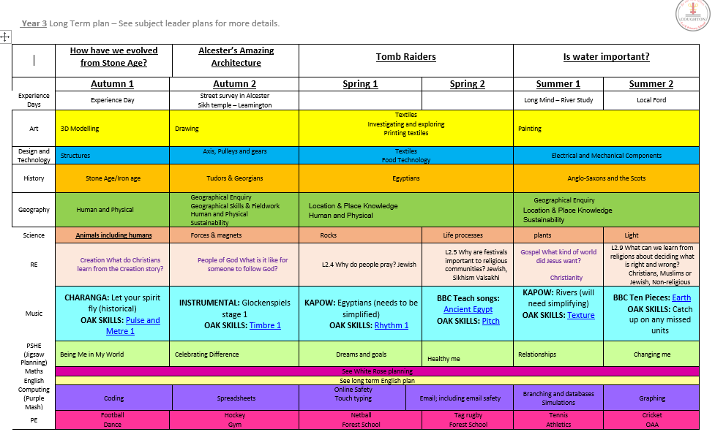
What are we learning about?

Slide 3
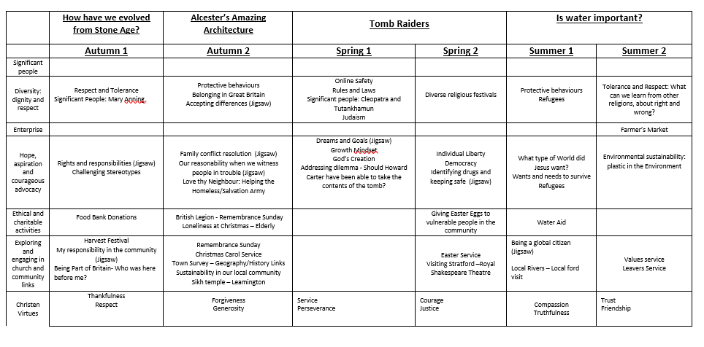

Slide 4


Slide 5
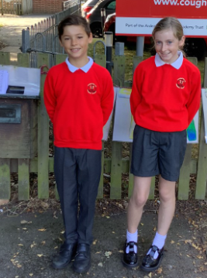
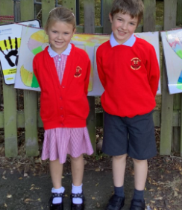
Uniform

Slide 6




Key texts

Slide 7
Reading expectations
Children should read every day at home. Planners should be signed by parents/carers to indicate this.
Bookmarks will be given to identify progress throughout the reading bands and to highlight next steps.
More ‘freedom’ when reading in Key Stage 2. Develop an interest in genres and authors.
Peter’s 100 greatest reads for Y3 https://peters.co.uk/uploads/downloads/files/Year%203%20100%20books%20A4%20AW.pdf

Slide 8
Spelling expectations
No longer sending spelling sheets home or having spelling tests –
Instead a 2 week cycle of practical activities which are to be done daily in school
15 spell it out words to investigate which will embed phonic/grammar rules
Spelling progress checks will occur during the year to support with future next steps

Slide 9
Homework
Acer
Reading every day with planners signed
1 activity- education city online
Weekly use of TT Rockstars
All pupils will have logins in planners by the end of the week.

Slide 10

Extra curricular activity
A range of clubs and musical instruments are available for the children.
Some information has been sent out via studybugs. If you have not got this it is well worth signing up for.

Slide 11
SEND
Pupils with special educational needs will receive bespoke termly meetings to discuss progress against targets

Slide 12
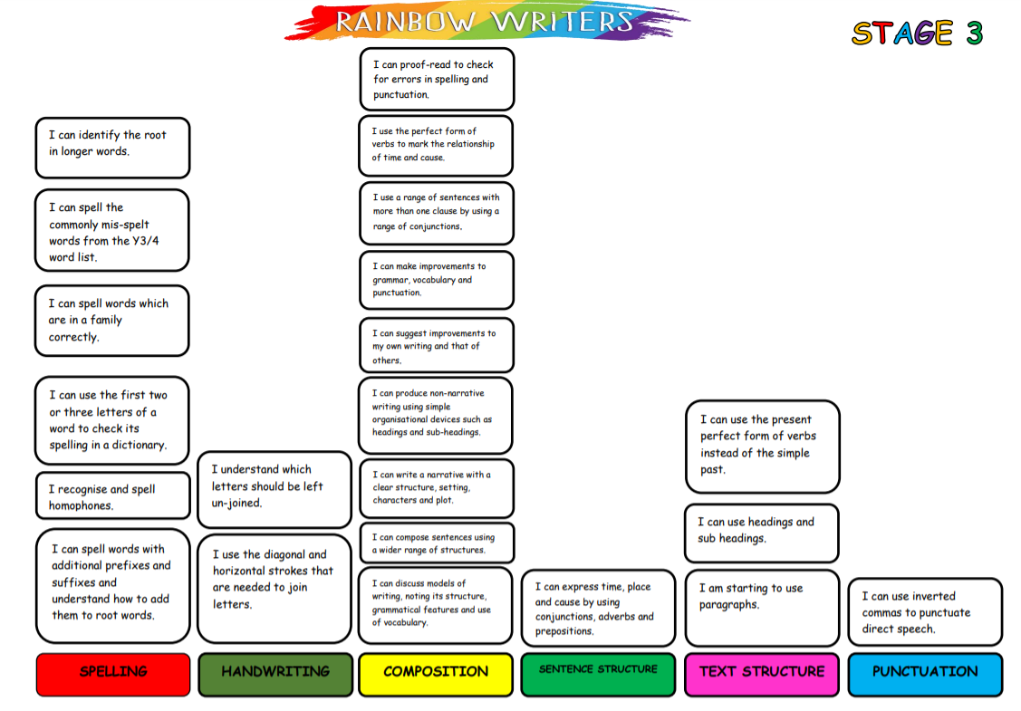

Slide 13
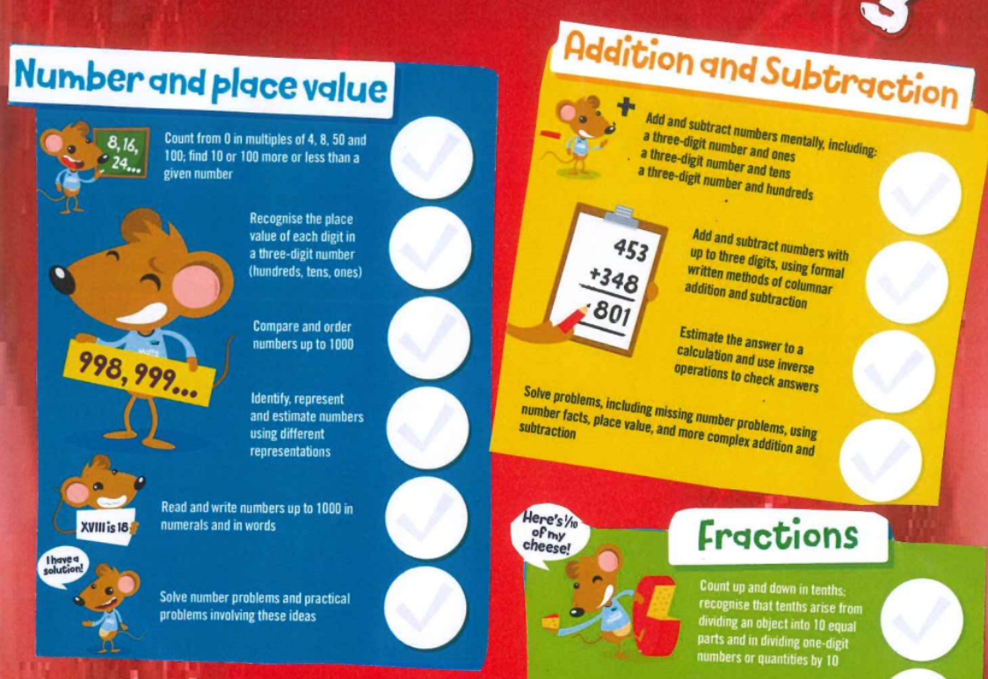

Slide 14
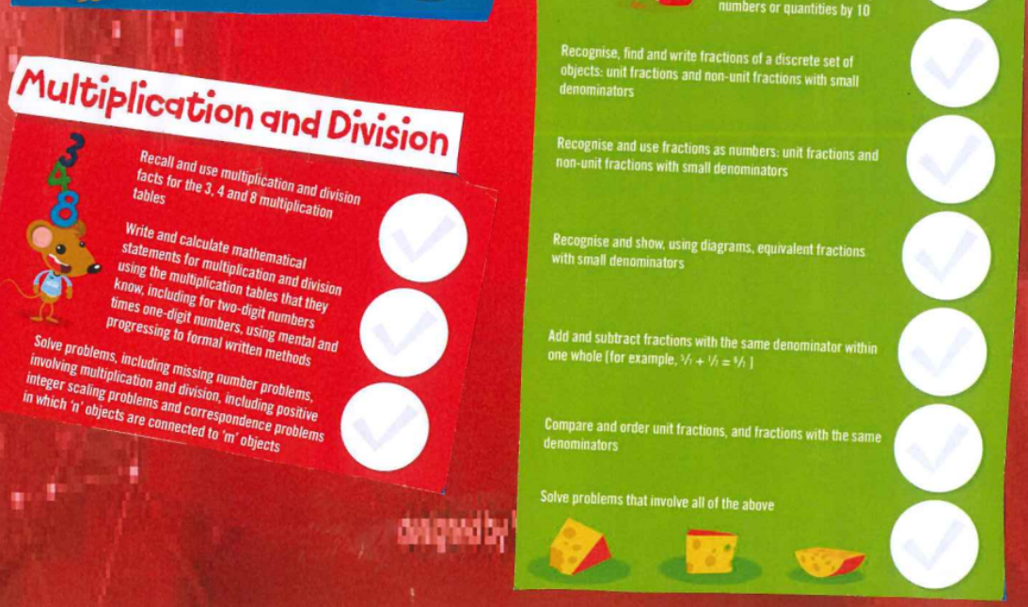

Slide 15
Resources and activities
White rose maths
https://whiterosemaths.com/homelearning/year-3/
TT Rockstars
https://ttrockstars.com/
Education city
https://go.educationcity.com/

