Slide 1
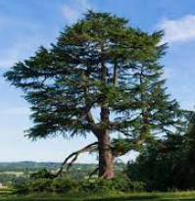
Cedar information meeting

Slide 2
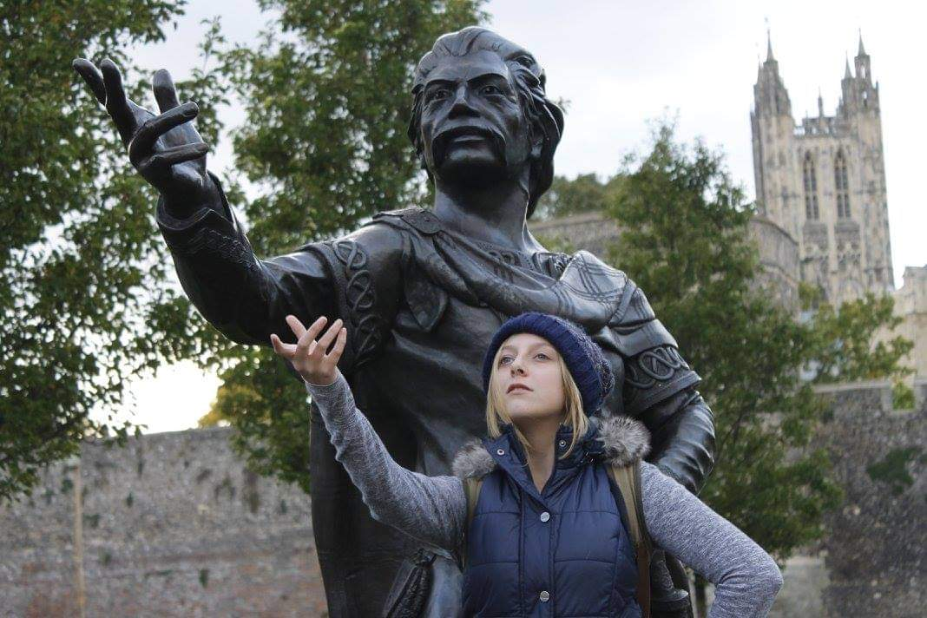
All about me
Before becoming a teacher, I studied architecture at university in Canterbury.
A previous job of mine was working in a children’s care home for complex trauma.
As a teenager, I lived in Switzerland for 3 ½ years. I can speak German as result, however it is very rusty.
Reading a good book is one of my favourite past times.
I enjoy being in the outdoors. This Summer I decided to walk Hadrian’s Wall.
I enjoy traveling, whether it is in the UK or abroad. One of my most memorable trips was visiting Japan when I was 19.
I can both ski and snowboard.

Slide 3
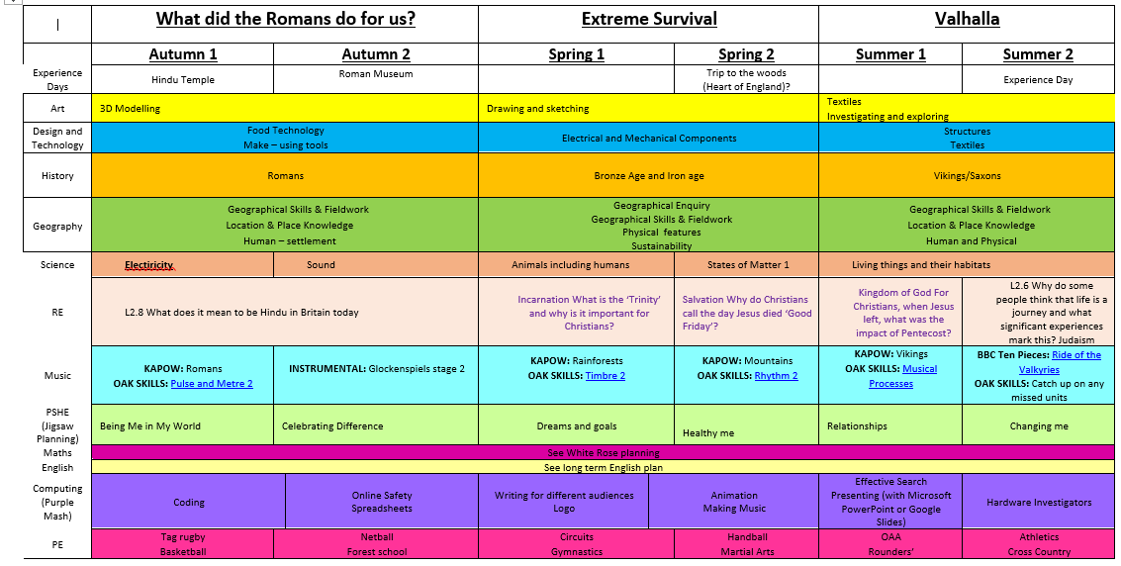
What are we learning about?

Slide 4
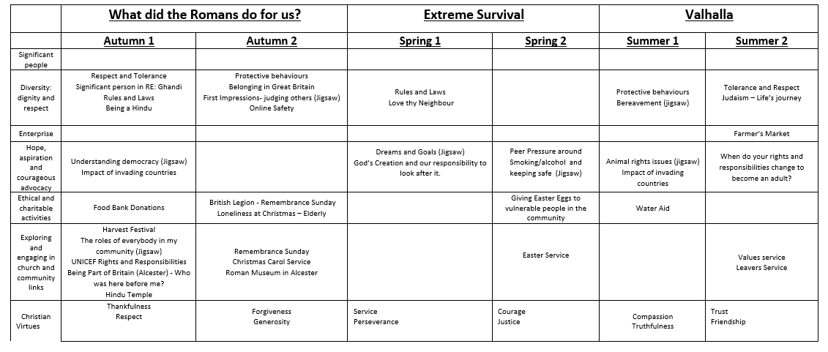

Slide 5
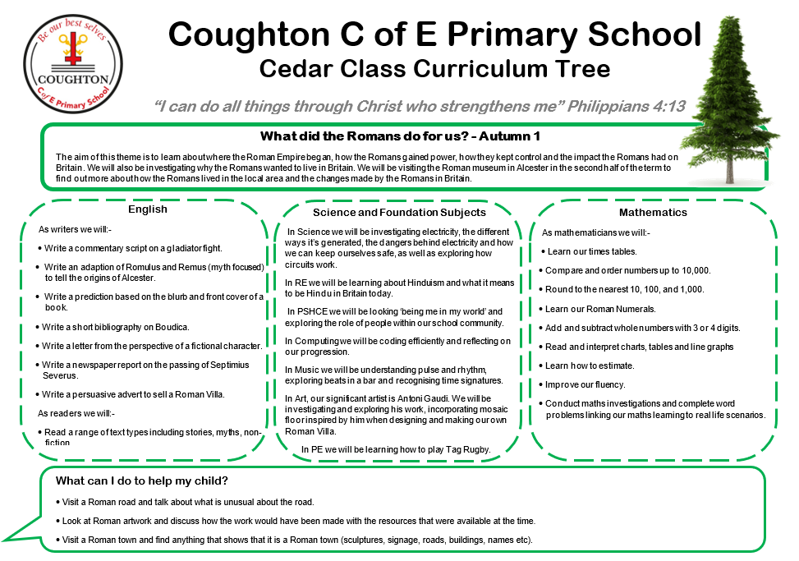

Slide 6
Key texts
Meet the Ancient Romans by James Davies
Empires End by Leila Rasheed
Boudica by Emma Fischel
Roman Invasion by Jim Eldridge
Escape from Pompeii by Christina Balit

Slide 7
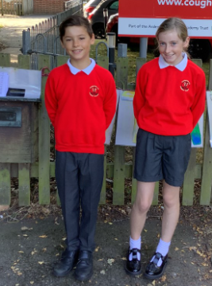
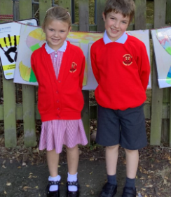
Uniform

Slide 8
Reading expectations
Children should read every day at home. Planners should be signed by parents/carers to indicate this.
Bookmarks will be given to identify progress throughout the reading bands and to highlight next steps.

Slide 9
Spelling expectations
No longer sending spelling sheets home or having spelling tests –
Instead a 2 week cycle of practical activities which are to be done daily in school
15 spell it out words to investigate which will embed phonic/grammar rules
Spelling progress checks will occur during the year to support with future next steps

Slide 10
Homework
Cedar
Reading every day with planners signed
1 activity- education city online
Weekly use of TT Rockstars to support number fluency

Slide 11
Extra curricular activity
A range of clubs and musical instruments will be available for the children.

Slide 12
SEND
Pupils with special educational needs will receive bespoke termly meetings to discuss progress against targets

Slide 13
Assessment
MTC
Multiplication Check
The purpose of the MTC is to determine whether pupils can recall their times tables fluently, which is essential for future success in mathematics. It will help schools to identify pupils who have not yet mastered their times tables, so that additional support can be provided.

Slide 14
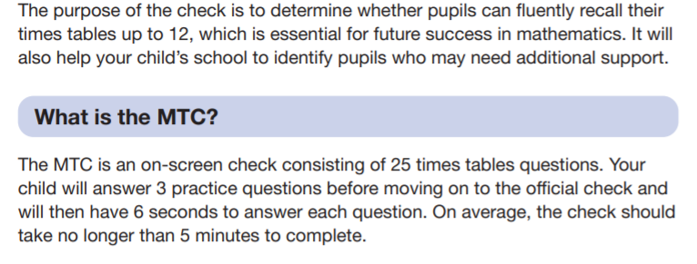
https://www.gov.uk/government/collections/multiplication-tables-check

Slide 15
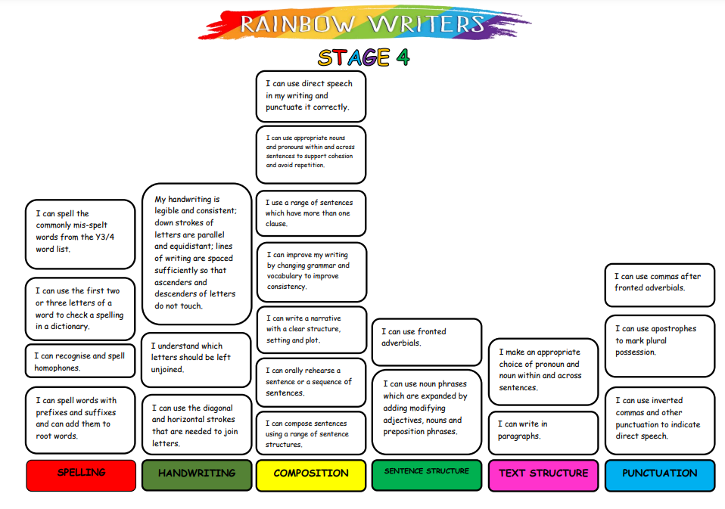

Slide 16
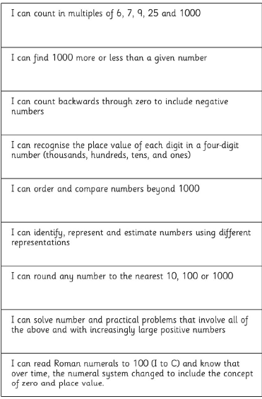
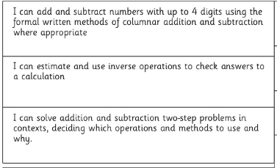
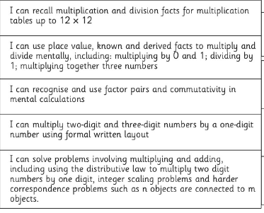

Slide 18
Resources

