Slide 1
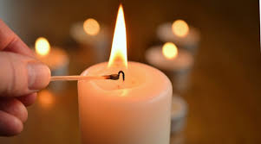
Let us light the candle to signify the start of our Worship today.
In the name of God The Father, God The Son and God The Holy Spirit.

Slide 2
Welcoming Words
The glory of the Lord has risen upon us.
Let us rejoice and sing God’s praise for ever.

Slide 3
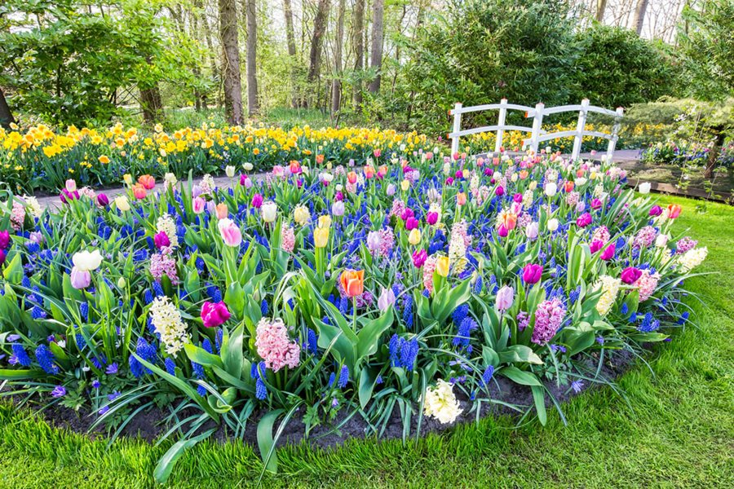
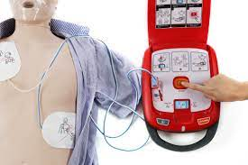
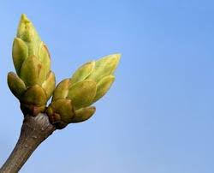
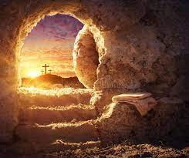
Resurrection

Slide 4
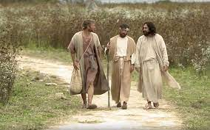
The Road To Emmaus

Slide 5
How do you think you would feel if you were the two men?

Slide 6
What would you do?

Slide 7
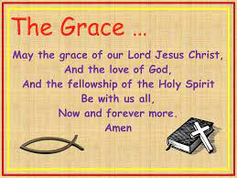
Closing Prayer

Slide 8
Closing Words
Glory to the Father and to the Son and to the Holy Spirit;
as it was in the beginning is now and shall be forever
Amen.

