Slide 1
Deepdale Community Primary School
Welcome to Reception Meeting
Thursday 26th September 2024

Slide 2
Welcome to Reception
We are all extremely proud of the way the children have settled into school and their new class.

Slide 3
English
Maths
R.E
Autumn Term 1 Learning
Over the course of the half-term, the children will enjoy learning lots of new, exciting things.
Art
History
Phonics
Science
Geography

Slide 4
English
The children have already been learning a series of Nursery Rhymes and will soon be looking at the core text ‘Shark in the Park’.
Retelling the story
Acting out the story
Ordering the story
Changing the story to become authors themselves

Slide 5
weight
numbers 1,2,3
capacity
same/different
size
Maths
patterns
matching
sorting

Slide 6
Phonics
Phonics is at the core of the Reception Curriculum.
Phase 1
Phase 2
Developing speaking and listening skills.
Introducing phonemes and graphemes and developing blending and segmenting skills.
ck e u r
h b f ff l ll ss

Slide 7
Enunciation (schwaring)
Phonemes (sounds) should be articulated clearly and precisely.
a b c d e f g h i j k l m n o p q r s t u v
w x y z

Slide 8
Tricky Words
In Phase 2 and Phase 3 the children are taught to read and spell Tricky Words.
Phase 2 | Phase 3
I no go to the | he you she are we me be you are her was all they my

Slide 9
Class Dojo
Every week the teachers will post videos of the new sounds the children have been learning so that you can practice at home.
Tomorrow, you will receive a Red Rose Phonics sound mat that looks like this. Use this to practise the phonemes at home with your child.

Slide 10
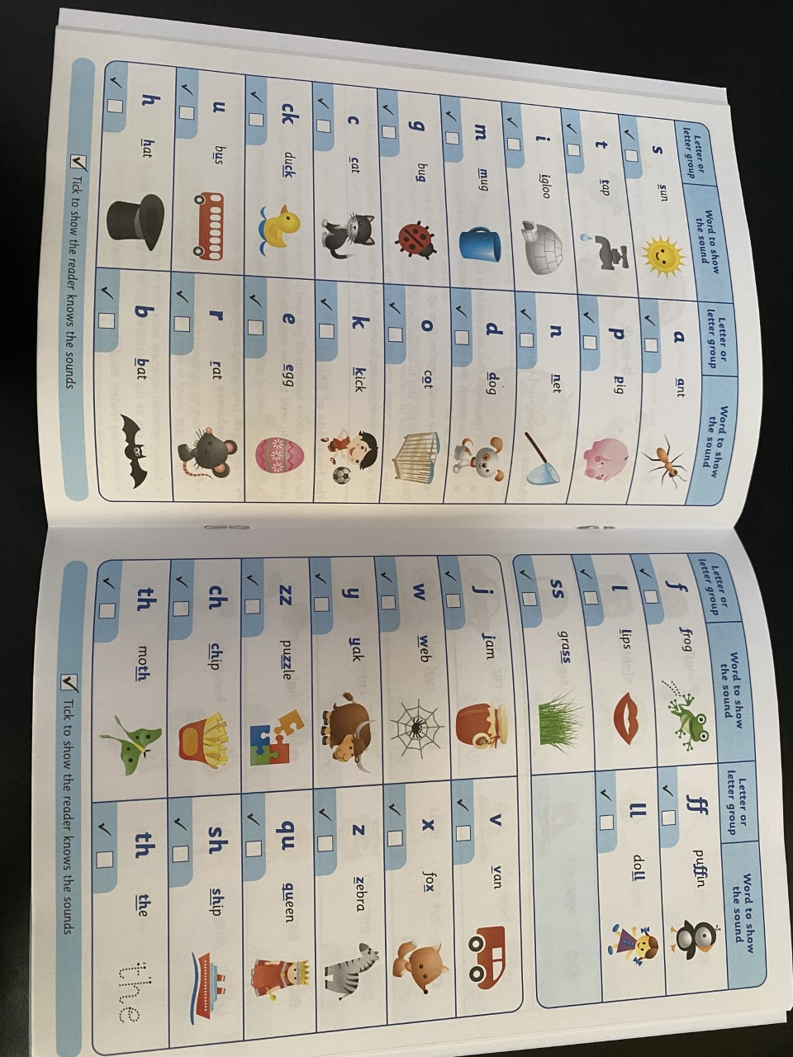
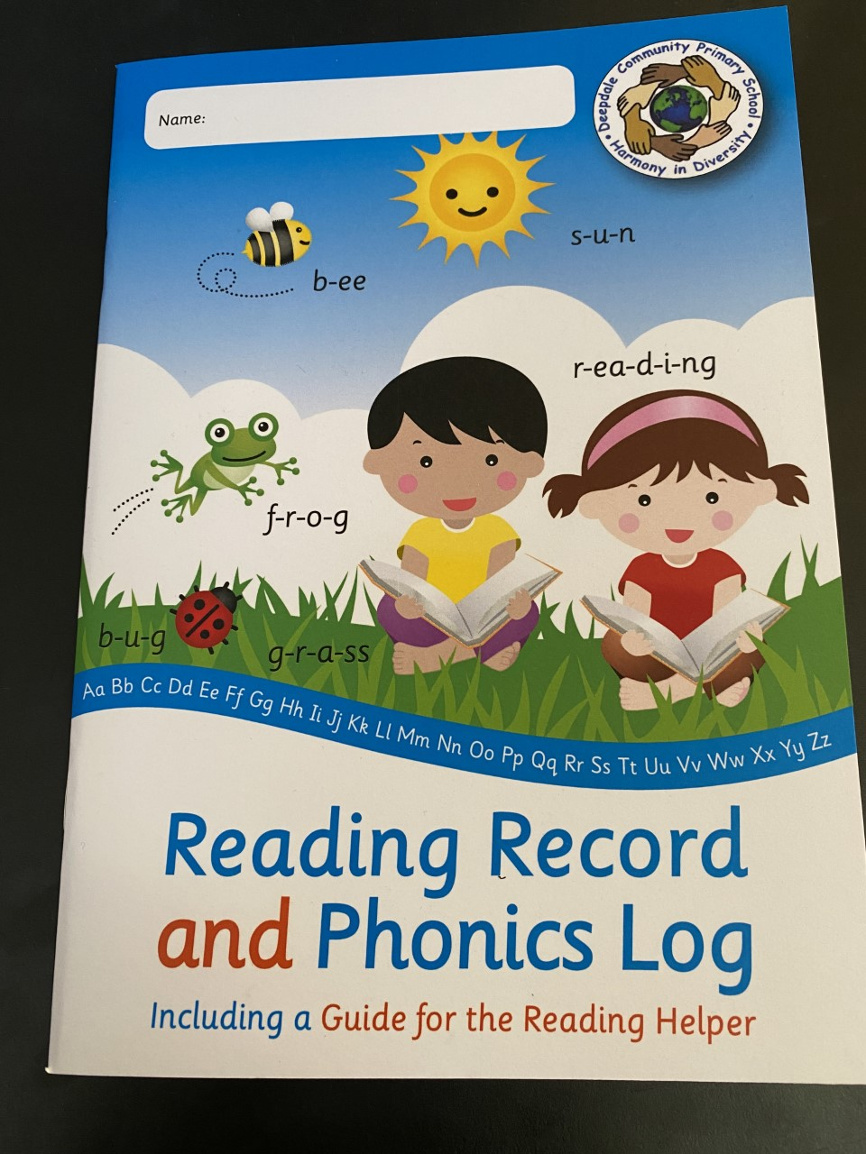
Home Reading
At Deepdale the children have Reading Diaries and Reading books that closely match their phonic ability.
First book to be sent home on Friday
Lilac level – no words
Books will be changed every Friday
Reading Diaries and books are to come to school every day.

Slide 11
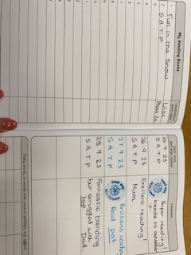
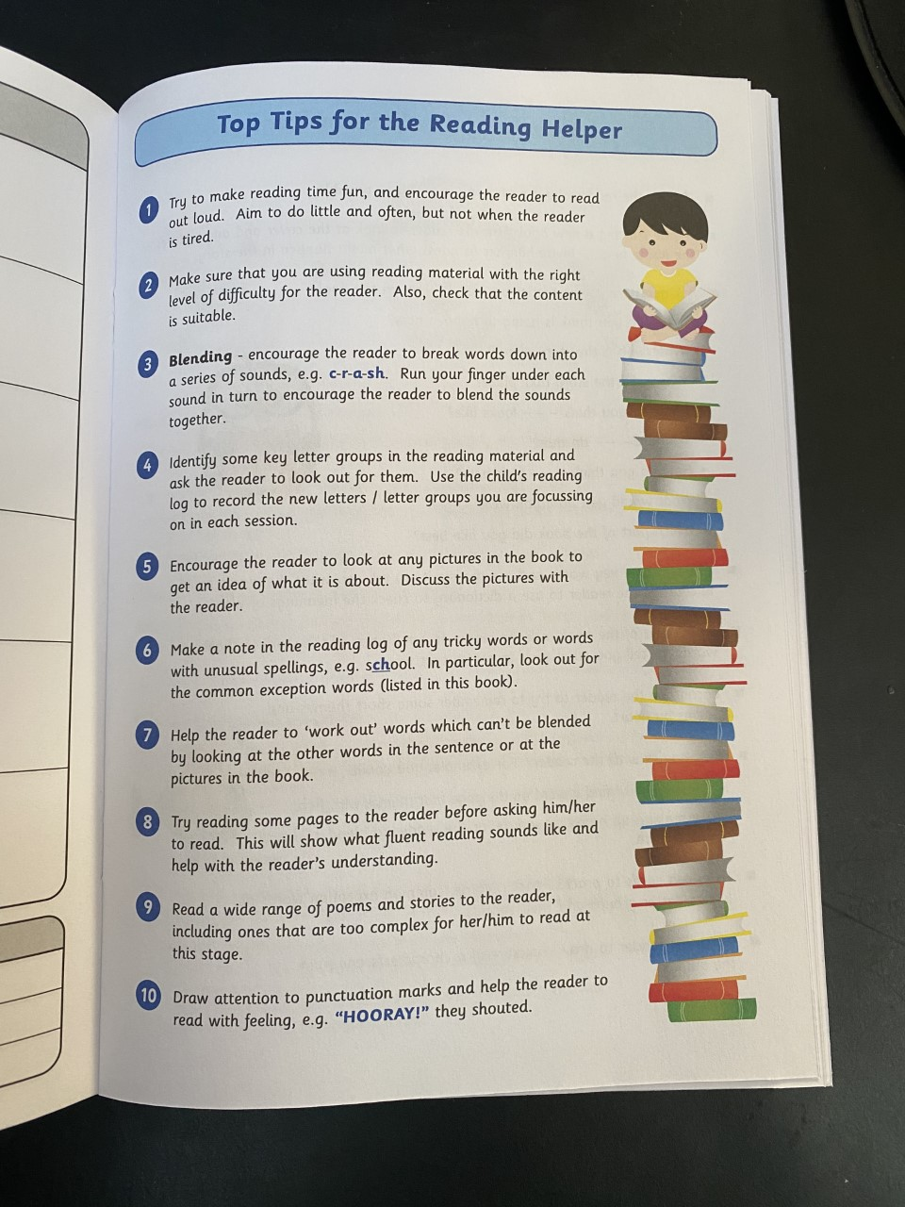
Home Reading
Parents to sign here each time they listen to their child read.
Useful reading ideas for parents
Phonics sounds and words

Slide 12
Reading Awards
At Deepdale, the children in Reception can work towards 3 different Reading awards for their home reading.
 |  |  |  |  |  | 6 stickers
 |  |  |  |  |  | 12 stickers
 |  |  |  |  |  | 18 stickers
If the children read at home 3 x weekly they receive a sticker on their chart to work towards special reading awards

Slide 13
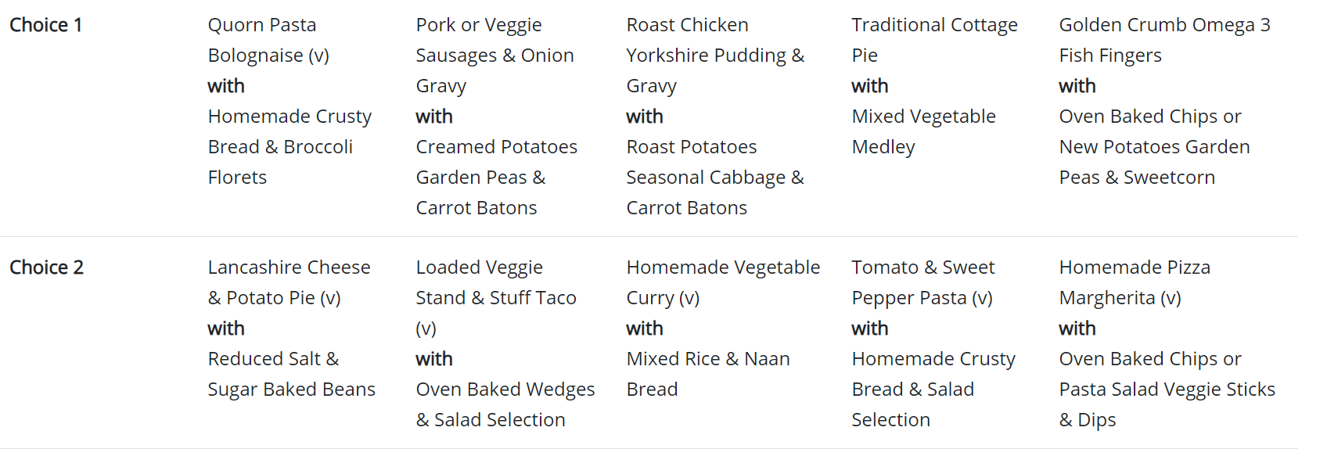
Dinner Time
At Deepdale, all children in Reception are entitled to a free school meal.
If you would prefer, your child may wish to bring a packed lunch.

Slide 14
Fruit and Milk
The children will all receive a piece of fruit and a drink of milk during the school day.
snack
water bottle

Slide 15
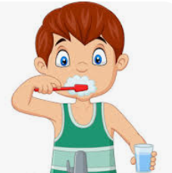
Importance of teeth
Brushing teeth is very important, we are looking into a new scheme to help support this.
Clean teeth
Morning and evening

Slide 16
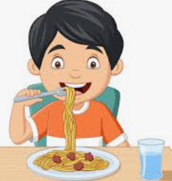
Importance of developing independence
Putting on their coat
Eating by themselves

Slide 17
Assessments
All children across the country who have started Reception, must take part in a statutory Government assessment called the Reception Baseline.
Early Mathematics
Early Literacy, Communication and Language
Practical Games
1:1 with the class teacher
Further information to be sent out on 27.9.24

Slide 18
Start and End of the Day
The teachers will be at the front door to greet the children
The children will come into school on their own and hang their coats up
At the end of the day, parents will come in as usual.

Slide 19
How can I help my child?
To support your child as they start their journey at school, there are a number of things that parents can do at home to help.
Read at home for 10 minutes a day
Practice Phonic sounds on a regular basis
Count objects around the house
Write their name

Slide 24
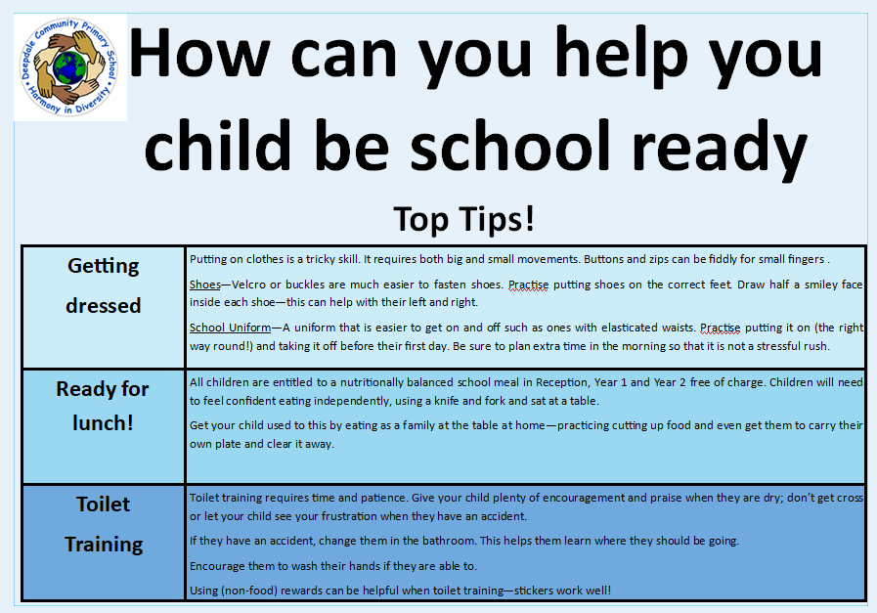

Slide 25
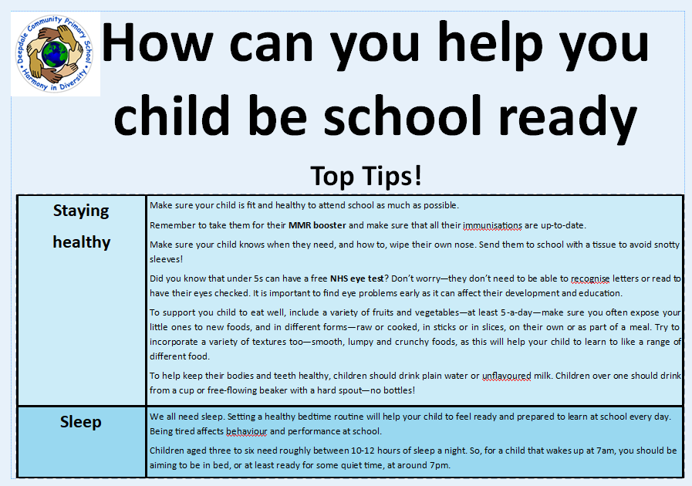

Slide 27
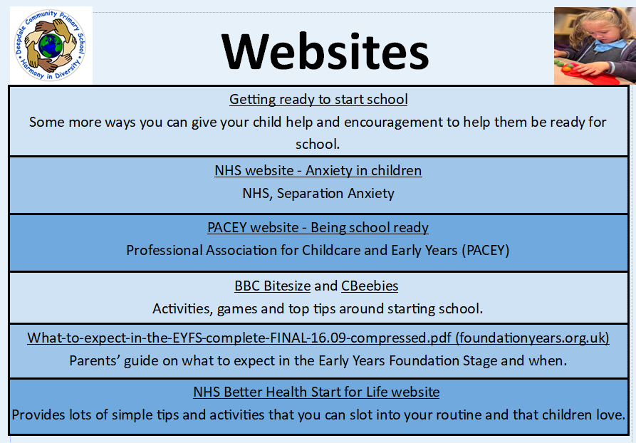

Slide 28
Thank you for all your support.

