Slide 1
Year 9 Options Presentation
Supporting your family in making choices

Slide 2
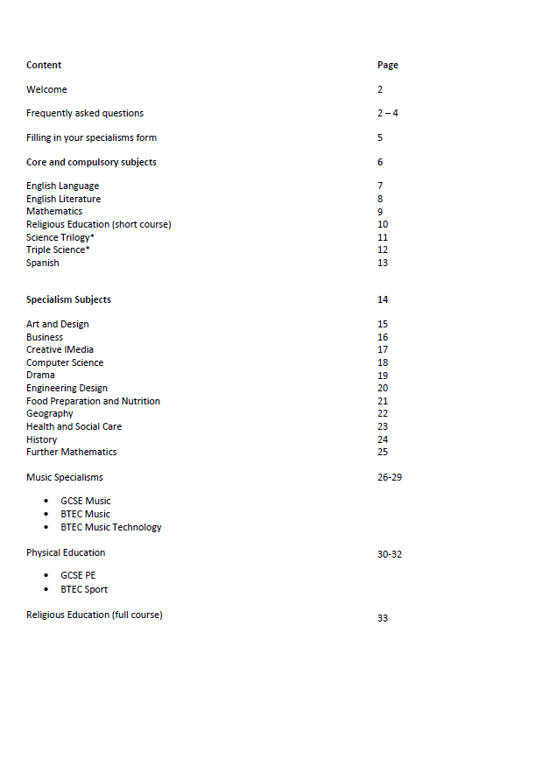

Welcome to the Options Process!
What is the ‘options process’?
What choices do we have?
What if we have questions?
What are our next steps?

Slide 3

What is the ‘Options Process?’
The process has already started for your child!
Options conversations in tutor time
PSHE Lessons
Subject interest questionnaire

Slide 4
What is the ‘Options Process?’
16th January – Options Evening – booklets given out to students
17th January – collective worship in school
22nd January – options taster lesson week (option forms emailed out)
26th January – option subject videos added to website
Opportunities to ask questions…
y9options@derbycathedralschool.org.uk
Deadline of 9th February to hand in your form.

Slide 5

Frequently Asked Questions
What is the Ebacc and why is it important?
Which subject do they have to take?
What are the different pathways?
What are the differences between BTECs and GCSEs?
Will my child definitely get their first choices?

Slide 6
Frequently Asked Questions
What is the Ebacc and why is it important?
The ‘English Baccalaureate’ or ‘EBacc’ is a suite of academic subjects: English Language; English Literature; Mathematics; Science; a modern foreign language (Spanish) and History or Geography. Computing has also been added to the list as a science.
Achievement in the English Baccalaureate is seen as an indicator of a strong performance by a student as they enter the competitive world of further education, higher education and the workplace.
The vast majority of students will continue to study Spanish at GCSE to ensure this full and balanced curriculum.

Slide 7
Which subjects do they have to take?
Much of the curriculum stays the same with the
following subjects all continuing:
English, maths, science, RE short course, PSHE, PE, Spanish* and History/geography**
Your child will receive an individualised option form which will outline any choices that are available to them.

Slide 8
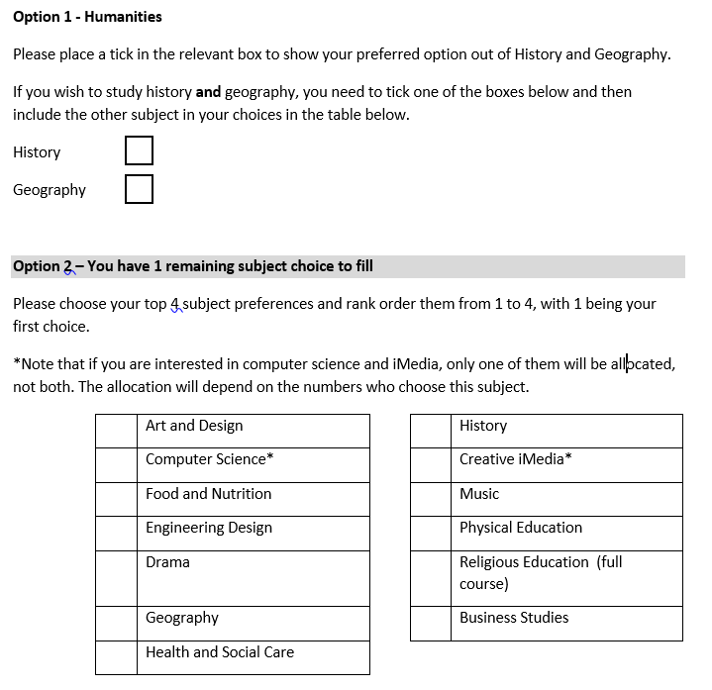
What are the different pathways?
Pathways (Red, Blue and Yellow)
Each student has a specific pathway that is just for them.
These pathways are carefully chosen based on target grades, previous
attainment and teacher consultation.
Much of the curriculum stays the same across all pathways with the
following subjects all continuing:
English, maths, science, RE short course, PSHE, PE, Spanish* and
history/geography**.
Your child’s individualised option form will outline any choices that are
available to you – the form and a digital copy of the options booklet will be sent to you on
Monday 22nd January.

Slide 9



What other qualifications can we do?
BTEC
Health and Social Care
Music Practice
Cambridge National
Creative iMedia
Sport Science
NCFE CACHE
Child Development
Lower exam percentage, assessed throughout the course through modules

Slide 10
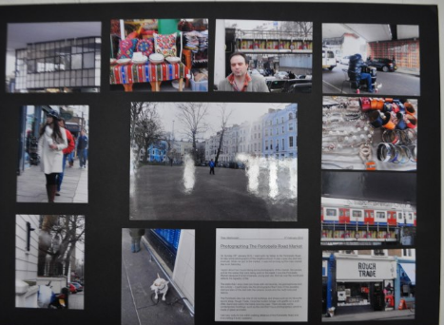
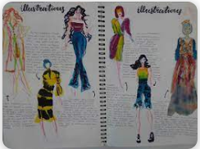
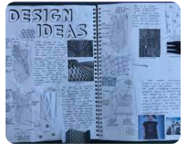
New Subjects for 2024-2025
Art and Design – Photography
Child Development
Design Technology – Textiles

Slide 11
Will my child definitely get their first choice?
Whilst we try to give everyone their top choices, this is not always possible as we have to fit everything in to the timetable and make sure class sizes are reasonable.
For the final form we will ask you and your child to make between 5 and 6 choices in order of preference, so that if we cannot give your child their first preferences we will be able to give them a back up choice.

Slide 12
Making Decisions
It is important to make choices that are broad and balanced so you are more open to options in your future education and employment.
There are some very good reasons for choosing a subject:
Your child enjoys it in year nine and it interests them.
They have performed well in the subject, and know they will succeed with it.
It is important to them and will help with their future after Year 11.
You and their teachers have advised them that it is a good choice for them.

Slide 13
Making Decisions
There are also some reasons that must not influence decision making:
Their friends have said they are going to choose it – there are no guarantees that students will be in the same class as their friends.
They think it is an easy course and they will not have to try their hardest .
They like the teacher that teaches them now – again, there are no guarantees that students will have the same teacher in the years to come.

Slide 14
What are the next steps?
As a family read through the booklet, even those subjects that might not immediately be of interest.
Encourage your child to ask questions in their taster sessions, so they have a clear understanding of what the course will entail. Please communicate with the subject teacher if there are any subject specific questions.
Make a note of the subjects you are interested in. The final electronic form will be emailed out to you on Monday 22nd January to be completed by Friday 9th February.

Slide 15
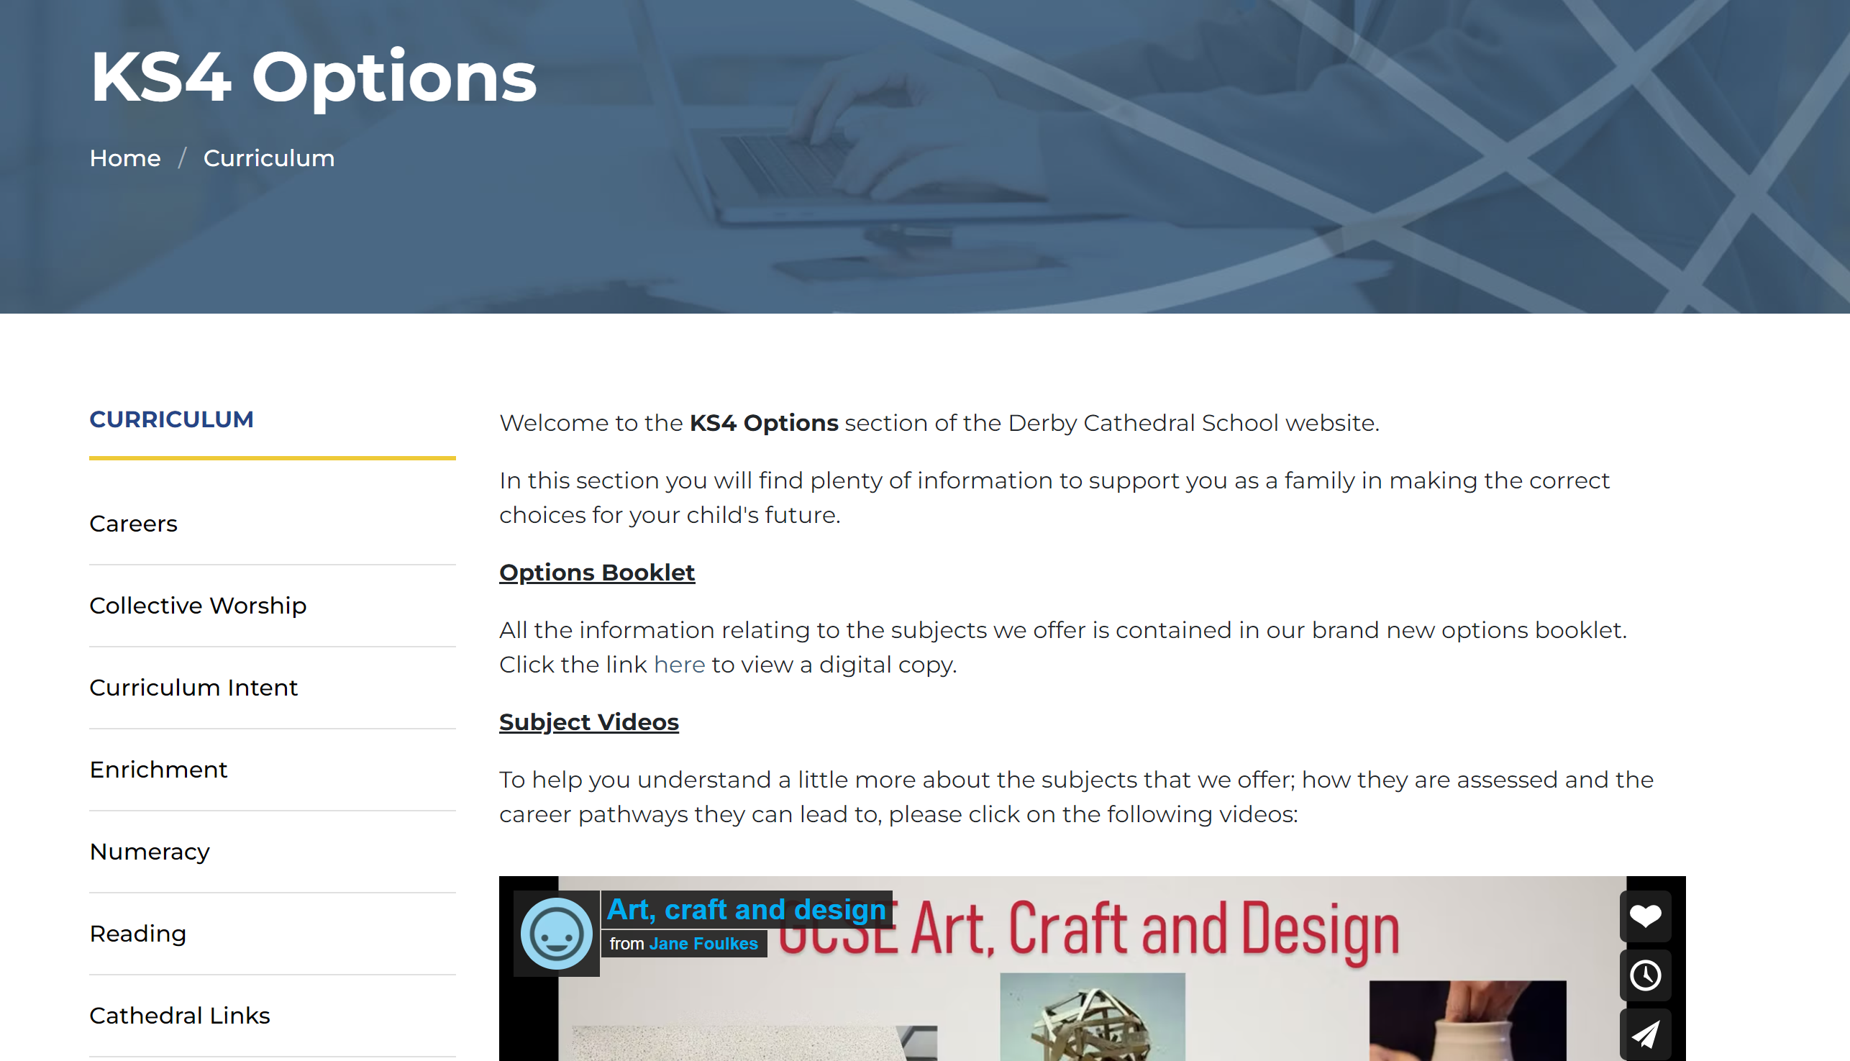
Questions
If you have any questions or queries about the option process please email them to:
y9options@derbycathedralschool.org.uk
If you have questions related to specific subjects, please contact the subject leader directly.

Slide 16
What now
Use the room guide to help you navigate where each session is being held.
English, Maths and Science are all here too so please take the opportunity to learn a little about what you will cover in Y10 and 11.
Yellow pathways...
Business Studies – Mr Williamson is ill so I will be running sessions from 6:30 onwards for anyone interested.

