Slide 1
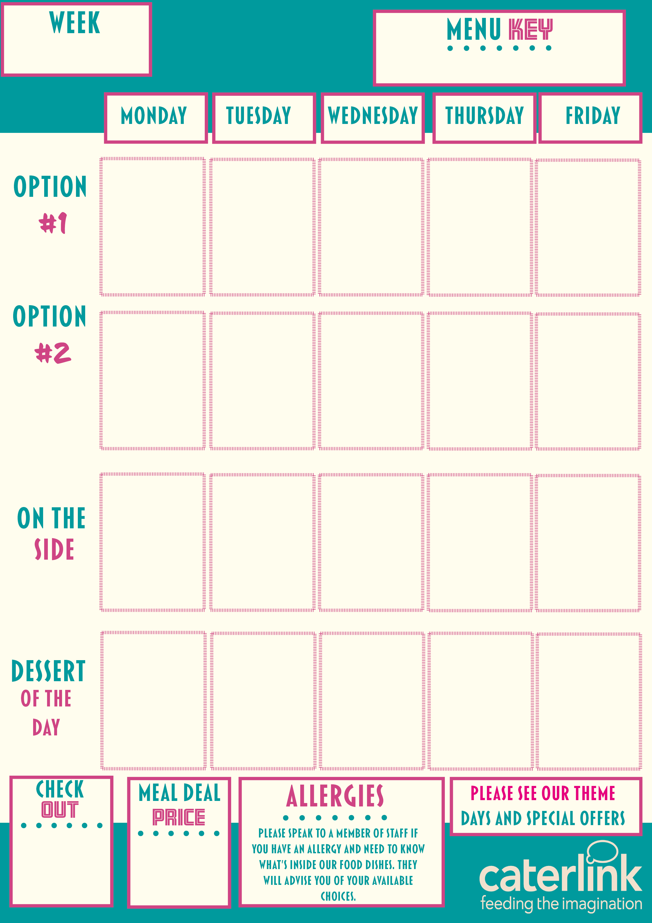






ONE
ADDED PLANT PROTEIN
VEGAN OPTION
SOURCE OF WHOLEMEAL
MAC & CHEESE
With Crunchy Topping
BEEF CHILLI
with Rice and
Sour Cream
PORK OR CHICKEN SAUSAGE
Roast Potatoes
and Gravy
CHICKEN TIKKA MASALA
With 50/50 Rice
CHIP SHOP
FRIDAY
with Chips &
Garden Peas
QUORN & VEGETABLE CHOW MEIN
FALAFEL
WRAPS
with Couscous
and Mint & Yoghurt Dip
VEGAN
SAUSAGE
With Roast Potatoes and Gravy
SWEET
POTATO & CHICKPEA CURRY
with 50/50 Rice
CHEESE & LEEK PASTA BAKE
with Chips and Garden Peas
Vegetables of the Day
Vegetables of the Day
Vegetables of the Day
Vegetables of the Day
Vegetables of the Day
SELECTION OF HOMEBAKES
SELECTION OF HOMEBAKES
HOT PUDDING & CUSTARD
SELECTION OF HOMEBAKES
SELECTION OF HOMEBAKES
OUR HOT AND COLD GRAB & GO SELECTION
XXX

Slide 2

TWO
ADDED PLANT PROTEIN
VEGAN OPTION
SOURCE OF WHOLEMEAL
SWEET & SOUR VEGETABLES
With Potato Wedges
BEEF LASAGNE
with Garlic Bread
and Slaw
CHEFS PIE OF THE DAY
with New Potatoes
JERK CHICKEN WRAP With Reggae Reggae Wedges & Pineapple Slaw
CHIP SHOP
FRIDAY
with Chips, Mushy Peas and Gravy/
Curry Sauce
CRUNCHY
VEGETABLE PASTA BAKE
with Garlic Bread
VEGETABLE LASAGNE
With Garlic Bread and Slaw
LEEK, ONION & POTATO
TRAY BAKE
CURRIED SQUASH & BUTTERBEAN STEW
with Rice and Peas & Slaw
Vegetable Burger
with Chips
Vegetables of the Day
Vegetables of the Day
Vegetables of the Day
Vegetables of the Day
Vegetables of the Day
SELECTION OF HOMEBAKES
SELECTION OF HOMEBAKES
HOT PUDDING & CUSTARD
HOT PUDDING & CUSTARD
SELECTION OF HOMEBAKES
OUR HOT AND COLD GRAB & GO SELECTION
XXX

Slide 3

THREE
ADDED PLANT PROTEIN
VEGAN OPTION
SOURCE OF WHOLEMEAL
CHEESY CHILLI CHICKEN PASTA
CHICKEN SOUVLAKI
with Golden Rice or Seasoned Potatoes
ROAST OF
THE DAY
New Potatoes & Gravy
ENCHILADAS
Chicken
Served With
Rice
CHIP SHOP
FRIDAY
with Chips, Mushy Peas and Gravy/
Curry Sauce
SPAGHETTI & PLANT BASED MEATBALLS
SPINACH & CHEESE WHIRL
Golden Rice or Seasoned Potatoes
ROASTED VEG WELLINGTON
with New Potatoes & Gravy
MEXICAN
SOYA CHILLI
with 50/50 Rice and Sour Cream
VEGAN
SAUSAGE
Chips, Mushy Peas
& Gravy/
Curry Sauce
Vegetables of the Day
Vegetables of the Day
Vegetables of the Day
Vegetables of the Day
Vegetables of the Day
SELECTION OF
HOMEBAKES
SELECTION OF HOMEBAKES
HOT PUDDING & CUSTARD
SELECTION OF HOMBAKES
SELECTION OF HOMEBAKES
OUR HOT AND COLD GRAB & GO SELECTION
XXX

