Slide 1




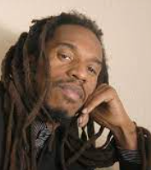




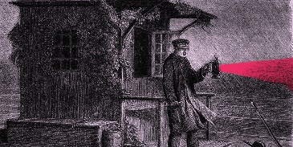







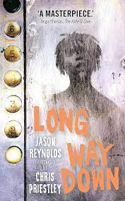






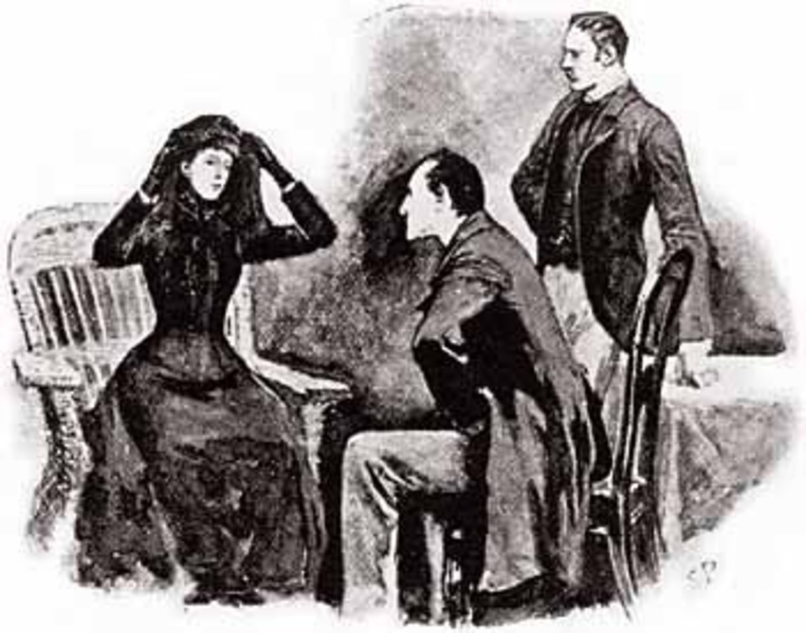
KS3 English
1. Belonging and Identity
2. The Art of Rhetoric
YEAR 7
3. A Significant Place
YEAR 8
2. Revenge and Redemption
1. Dystopias
3. Good vs Evil
Travel and the world around us
2. Gender Roles and Social Inequalities
3. Crime Writing
Year 9
Notes:
Y7

