Slide 1
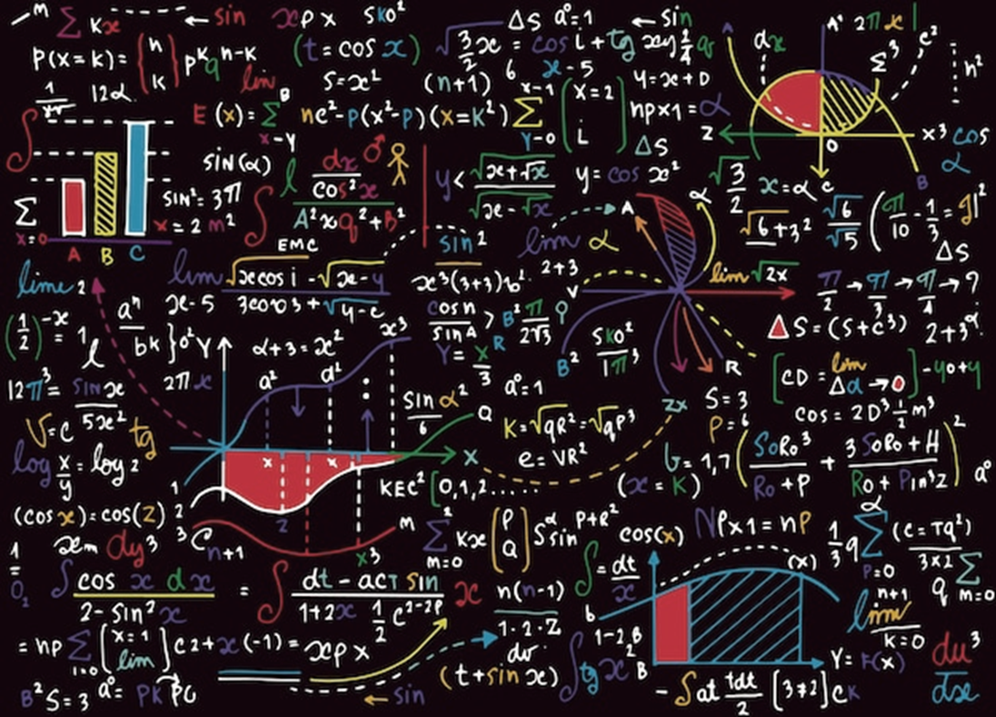
Simply…
Log in to Dr Frost Maths using the email that has been sent to your school email address
Complete weekly tasks
One completed task = one entry
The more tasks completed the more chance of winning
WORKS ON YOUR PHONE!!!

Slide 2
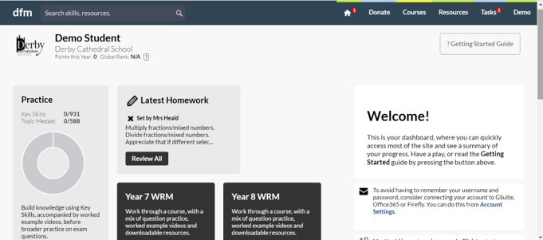
Do this task!
There will be 6 tasks appearing throughout the summer holidays- more tasks means more entries to win!
If you have any questions your form tutor can pass them on to me or email me directly.
S.Heald@derbycathedralschool.org.uk

