Slide 1







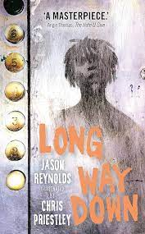
















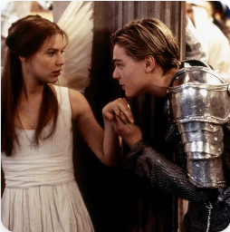

KS3 English
1. A Significant Place
2. The Art of Rhetoric
3. Belonging and Identity
YEAR 7
YEAR 8
2. Revenge and Redemption
1. Dystopia and Corruption
3. Good vs Evil
Year 9
Travel and the world around us
2. Gender Roles and Social Inequalities
3. Crime and Mystery
KS4
Notes:
Y7

Slide 2

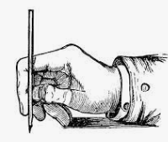




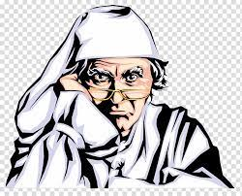



KS4 English
English Literature: Paper 2 Modern Play: An Inspector Calls
3. English Literature: Paper 2
Poetry Anthology: Power and Conflict
Year 10
2. English Language: Paper 1 Section B: Writing Fiction
4.English Language: Paper 1 Section A: Reading Fiction
8. English Literature: Paper 1 19th Century Novel: A Christmas Carol
Year 11
5. English Literature: Paper 2 Unseen Poetry
7. English Language: Spoken Language
6. English Language: Paper 2 Section B: Writing Non-Fiction
Curriculum Outline for Years 10 -11
9. English Language: Paper 2 Section A Reading Non-Fiction
Post 16
10. English Literature: Paper 1 Shakespeare – Macbeth
11. English Language and Literature – Revision
Notes:
Y7

