Slide 1
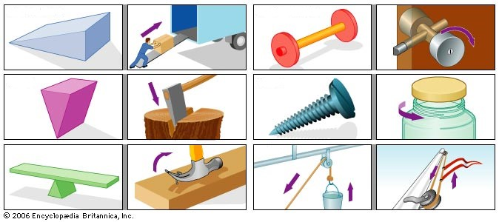
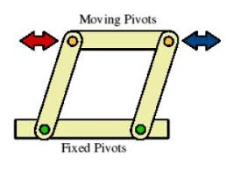
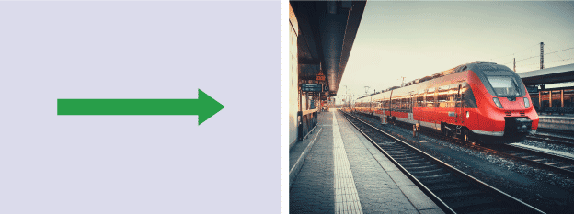
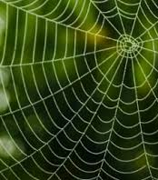
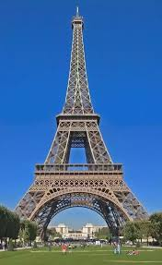
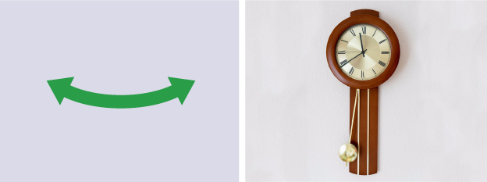
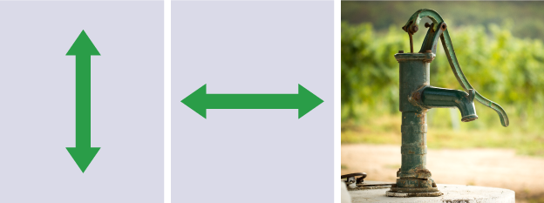
YEAR 7 GRAPHICS KNOWLEDGE ORGANISER – MRS YOUNG
A
6 Simple machines
F CAM shapes
Wheel & Axel
The dwell on a CAM is the time when the follower is not moving either up or down.
Can you spot the area of dwell on each of the shapes?
Incline plane
Screw
Wedge
G Linkages and pivot points
Pulley
Pivot points are centres of rotation.
Linkages connect parts of a mechanism together.
Pivot points can be fixed or moving.
Lever
E
B
4 types of motion
H Structures
Linear
Rotary
Structures can be divided into natural and manmade.
Natural structures are made by insects and weathering.
Manmade structures are made by humans.
Humans often mimic or copy nature as it has elegant solutions to problems.
Triangles are the strongest shape when loaded with a force.
So other shapes are often broken up into triangles.
Oscillating
Reciprocating
C
As simple machine is a device that makes work easier by magnifying or changing the direction of a force.
D
Automata - a moving mechanical device made in imitation of a human being
Natural Manmade

