Slide 1
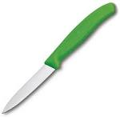
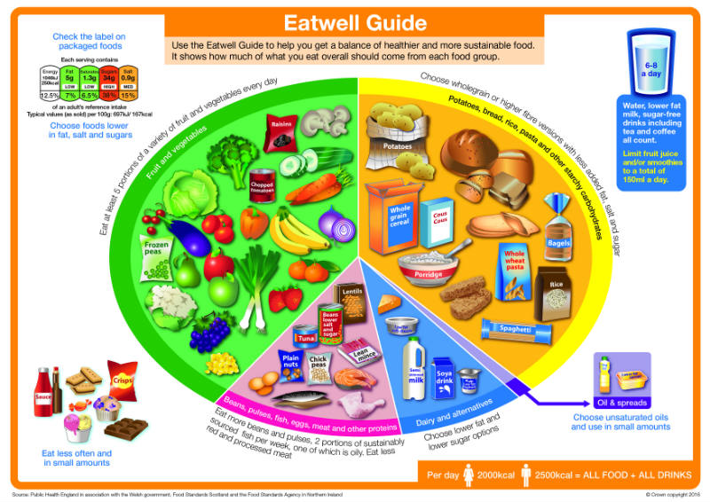
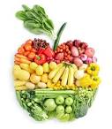
Creative Technologies
Food Technology Knowledge Organiser
A: Key words
B: Key Verbs
Cross- Contamination- the transfer of harmful bacteria between raw and cooked food.
Danger Zone- temperatures between 5c and 63c where most bacteria can multiply
Emulsification- the mixing of two liquids that are usually unmixable together to form an emulsion.
Mise-en- place- preparation time at the start of a practical
Macronutrient- are needed in large amounts by the body and are called protein, fats and carbohydrates.
Micronutrient- are needed in smaller amounts and are called vitamins and minerals.
The Eatwell Guide- A healthy eating guide for a balanced diet
Whisking
Beating
Measuring
Chopping
Mixing
Weighing
Sieving
Rubbing in
D: Bridge and claw method for safe cutting
Make a bridge over the vegetable with your hand
Make a claw with your hand by partly curling your fingers together
E: How much sugar is in your food?
C: Eat Well Guide
Children aged 11 and over should be having no more that 7tsp of sugar per day.
G: 8 government guidelines for a healthy diet
Base your meals on starchy foods.
Eat lots of fruit and vegetables.
Eat more fish- including a portion of oily fish each week.
Cut down on saturated fat and sugar.
Eat less salt- no more than 6g a day for adults.
Get active and be a healthy weight.
Don’t get thirsty- drink plenty of water.
Don’t skip breakfast.

