Slide 1
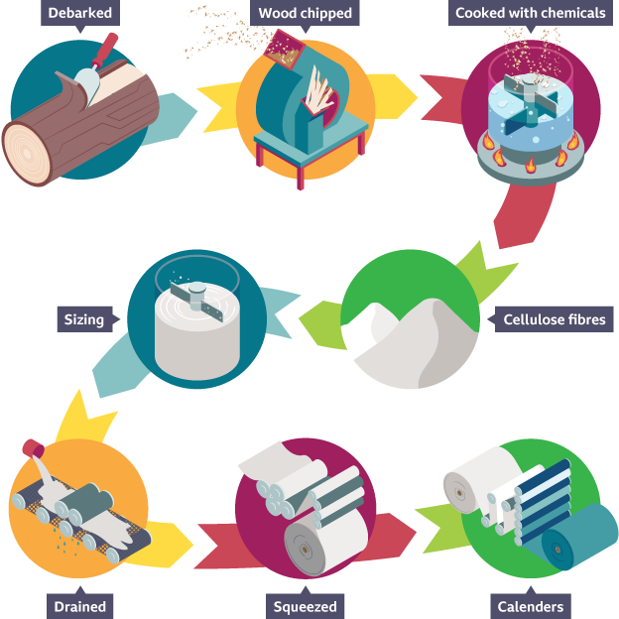
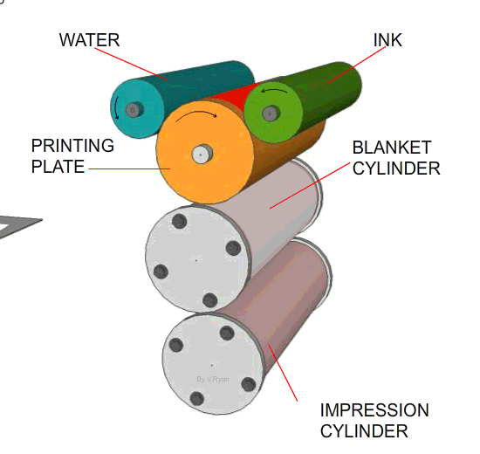
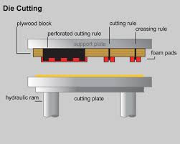
YEAR 9 GRAPHICS KNOWLEDGE ORGANISER – MRS YOUNG
Paper/ Board | Properties | Common uses
Bleed proof | Smooth paper, often used with water and spirit based markers Prevents marker bleed (when ink runs and seeps through paper) | Used for presentation drawings
Cartridge paper | Good Quality white paper often with a slight texture Available in different weights | Due to the good-quality surface, it can be used for paints and markers as well as drawing
Grid | Paper printed with different grids a guidelines (these can be isometric or differently sized grids.) | Quick model making and working drawings
Layout paper | Thin transparent light weight paper Can be drawn on with markers and takes colours well | Initial quick sketching and tracing
Tracing paper | Thin transparent paper | Tracing copies of drawings
Duplex Board | Thin board which often has one side that is suitable for printing | Used for food packaging Can be easily recycled
Corrugated board | Strong, light weight material. Made up of two or more layers and a fluted middle section leading to good instating properties. Available in different thicknesses | Used for packaging such as pizza boxes and large boxes for heavy items that need protecting.
Foil-lined board | White card coated or laminated with aluminium foil bonded onto one side. It has moisture and thermal retention properties | It is used for drinks cartons & takeaway containers.
Foam-core board | Foamcore, foam board, or paper-faced foam board is a lightweight and easily cut material. | Used for mounting photographs and for making scale models
Laminated paper | Paper layered sheets of clear plastic over it, to improve the durability of it. | Wide range of uses where protecting the paper from moisture or wear is needed
Inkjet card | Treated so it can be used in all inkjet printers | Printing on inkjet printers
Solid white board | Top quality cardboard, smooth and white Good for printing on. | Book covers
C
A
B
Off Set Lithography
CMYK – Cyan, Magenta, Yellow and Black
F
D
Embossing the design is raised by pushing the material upwards from the back.
Debossing the design is pressed into the surface from the front.
Foil blocking a heated die applies a foil to the surface of the material for a high end finish.
E
Die cutting cuts and deforms the material for easy folding, deforming is better than scoring as the material is compressed not cut making it stronger.
SRA sizes of paper are slightly larger than ‘A’ sizes to allow for a bleed area in printing.

