Slide 1
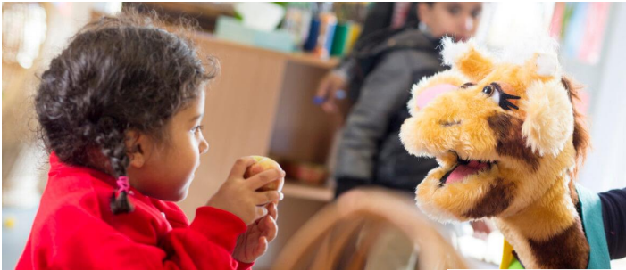


RSE curriculum: Keeping children safe

Slide 2

What will my children learn in SCARF lessons?
We cover 6 important themes in every year group:
Me and My Relationships
Explores feelings and emotions, develops skills to manage conflict, helps identify our special people and equips children to recognise the qualities of healthy friendships and how to manage them.
Valuing Difference
Includes a strong focus on British Values, supports children to develop respectful relationships with others, recognise bullying and know their responsibilities as a bystander. We will also be thinking about the importance of staying safe online.
Keeping Safe
Covers a number of safety aspects, including being able to identify trusted adults in their lives, what to do when faced with a dilemma and recognising appropriate and inappropriate touch.

Slide 3
What will my children learn in SCARF lessons?
We cover 6 important themes in every year group:
Rights and Respect
Explores broader topics including looking after the environment, economic education and the changing rights and responsibilities children have as they grow older. We teach the ‘protected characteristics’ under the Equality Act 2010, as the Government state ‘All children should gain an understanding of the world they are growing up in, and learn how to live alongside, and show respect for, a diverse range of people.’ At Devonshire, we want all staff, children and families to feel safe and belong to our community. We are committed to ensuring equality of education, irrespective of race, gender, disability, belief, religion, socio-economic background or sexual orientation.
Being My Best
Includes a focus on keeping physically and mentally healthy, building resilience and setting goals and ways to achieve them.
Growing and Changing
Has age-appropriate plans to cover the physical and emotional changes that happen as children as they grow older, including changes at puberty, menstruation and how to approach this with confidence. Age-appropriate lessons on relationships and sex education are also included.

Slide 4
What is RSE?
RSE, also known as Relationships and Sex Education, teaches the fundamental building blocks and characteristics of positive relationships, as well as emotional, social and physical aspects of growing up, plus human sexuality and sexual health in an age-appropriate way (the majority of which is already covered in PSHE and National Curriculum for Science).
Our RSE lessons help children and young people to be safe, healthy and happy, both as they grow, and in their future lives. These lessons help to meet safeguarding, and emotional wellbeing requirements, as well as ensuring that schools cover the requirements of the Government’s RSE guidance.

Slide 5
DfE’s requirements for teaching RSE
We make sure we teach the children all of the DfE Relationships Education and Health Education statutory requirements, including:
The importance of respecting others, even when they are very different from them.
Key facts about puberty and the changing adolescent body, particularly from age 9 through to age 11, including physical and emotional changes.
About menstrual wellbeing including the key facts about the menstrual cycle.
How to report concerns or abuse, and the vocabulary and confidence needed to do so.
That each person's body belongs to them, and the differences between appropriate and inappropriate or unsafe physical, and other, contact.

Slide 6
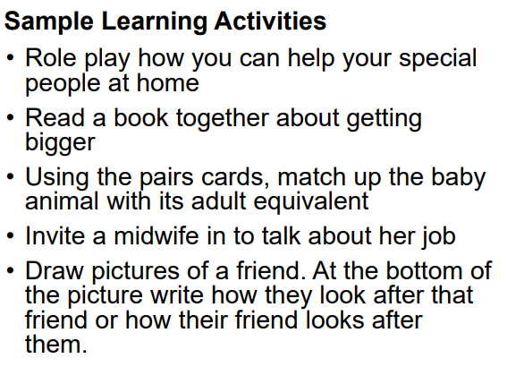
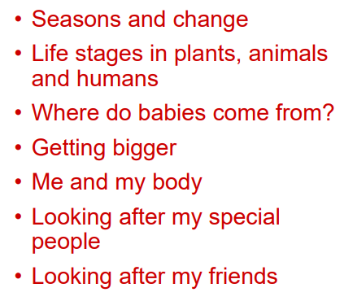
Reception lessons
Content:

Slide 7
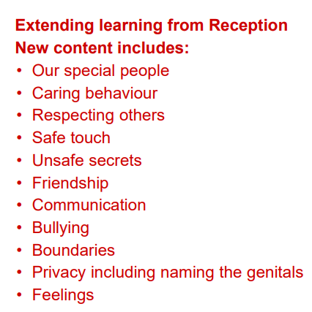
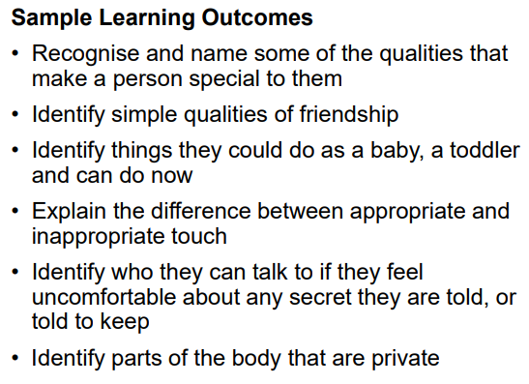
Year 1 lessons

Slide 8
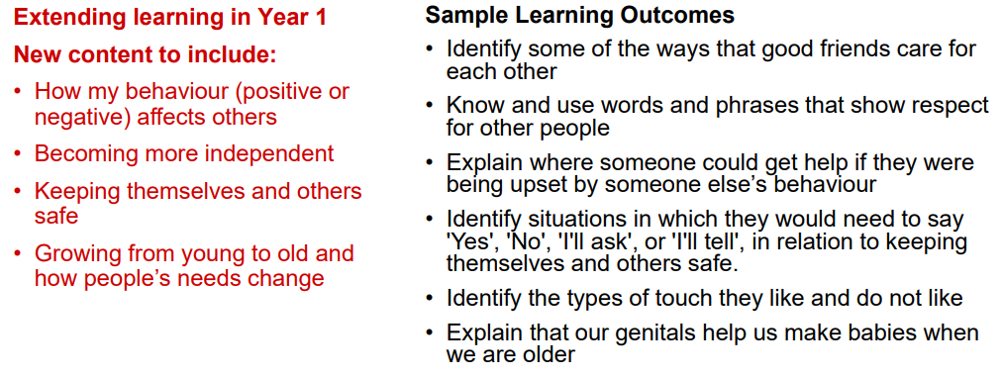
Year 2 lessons

Slide 9
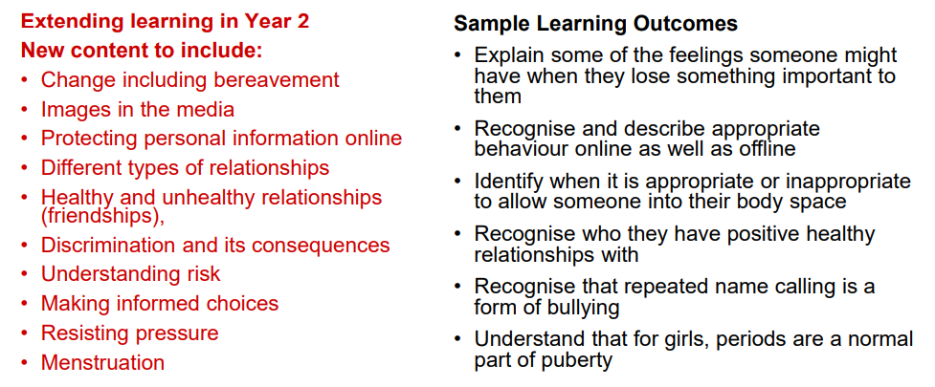
Year 3 lessons

Slide 10
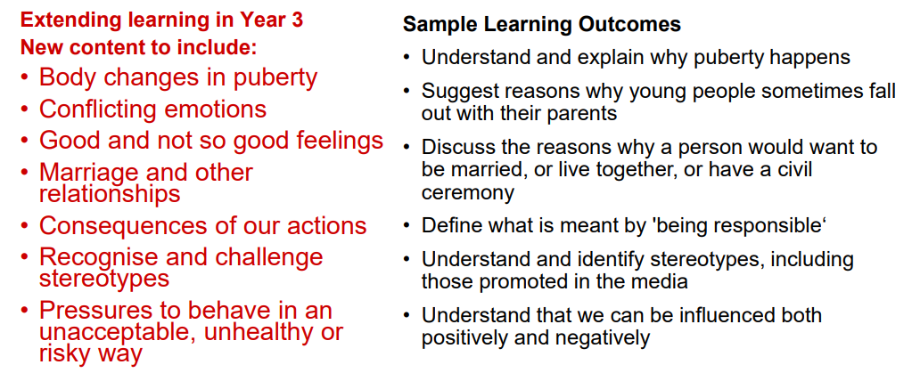
Year 4 lessons

Slide 11
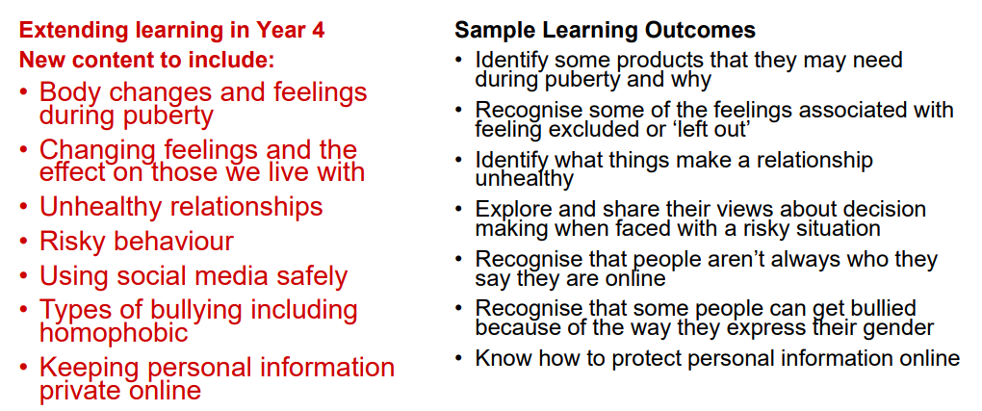
Year 5 lessons

Slide 12
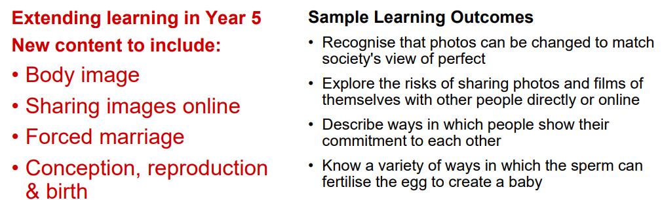
Year 6 lessons
(with a right to withdraw the child)

