Slide 1

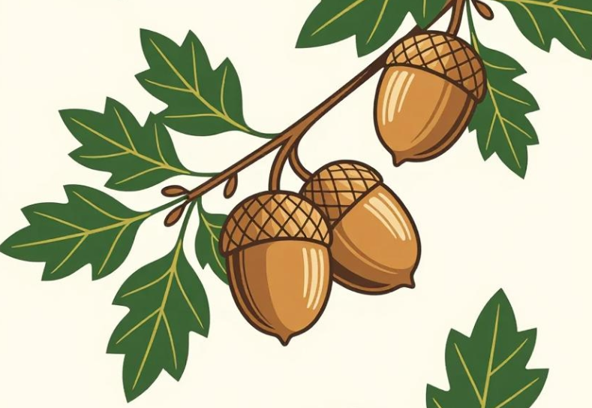
English
Throughout this term we will be looking at texts linked to explorers and exploring. We are beginning with stories by the same author and we are looking at Simon Bartram’s books, ‘Man on the Moon’ and ‘A Right Royal Disaster’.
We will be exploring diary recounts, narrative writing and moving onto non-chronological reports which will be linked to our learning about real explorers.
Some of the grammatical skills we will be developing are our use of apostrophes and conjunctions to help organise and add more details to our writing. Also our use of adjectives and spellings we have been learning.
Mathematics
Really developing, embedding and broadening the children’s understanding and concept of addition and subtraction, is the main focus for this half term. This will be done through lots of practical activities and use of resources to demonstrate addition and subtraction in multiple ways. Children will be developing strategies for completing practical, mental and written addition and subtraction calculations.
They will also be exploring statistics particularly pictograms in a combined Maths and computing unit.
Later in the half term they will begin work on multiplication and division by creating and exploring arrays.
Acorn Class
Mrs Gibson
Mrs White
Spring 1

Slide 2

Class Information
Hello and welcome back to school in 2026! We hope you have enjoyed a good Christmas and managed to rest in amongst the business! We are very excited about our new topic which is ‘Explorers’ for KS1 and ‘Special People, Special Places’ for our EYFS children.
PE continues to take place on Thursdays and on Fridays (taught by Mr Swindells). Please send children to school in their PE kits on these two days.
Reading books will continue to be sent home for children to enjoy. Please bring them in each day, as we try to read with the children as often as possible -thank you!
Religious Education
In this half term the children will explore the value and importance of the church to Christians. They will compare different churches both inside and outside using our trip to church before Christmas to help them.
Children will reflect upon what makes a church special to Christians as well as special places of worship for people of other faiths. They will compare similarities and differences between places of worship developing an understanding of their importance to different people.
Science
In Science this half term the children will be learning about life-cycles and health. They will explore the life cycle of humans, other animals and plants when they observe the progress of the bulbs they planted just before the Christmas holidays. They will be working scientifically to carefully observe changes over time, to use secondary sources for research and to use simple measuring equipment.
Geography
This term Geography takes us much further afield on an adventure to the Bahamas which was discovered by the explorer Christopher Columbus! This will be part of our non-European study when we will make comparisons between life in England and life in the Bahamas. The children will use globes and maps with locations and they will also look at transport and plan out routes to explore outside of Europe.

