Slide 1

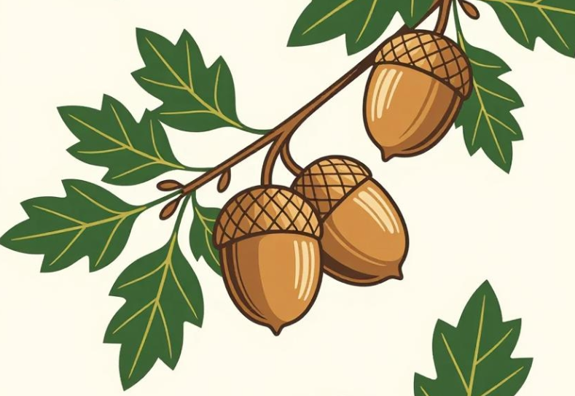
English
This half term the children will begin by exploring ‘The Tale of Peter Rabbit’. They will develop their skills in inference when reading the story. They will explore the characters and garden setting before innovating the tale and writing their own version.
Next the children will learn how to write clear instructions. Through planting activities, they will investigate the features of instructional texts and use their experiences to create their own step-by-step guidance.
Finally the children will enjoy a range of garden-themed poems exploring rhythm, patterns and rhyming words before creating their own poems.
Mathematics
This half term the children will begin by exploring money. They will learn to recognise coins and notes, compare values and solve money problems through practical activities and real-life scenarios.
Next the children learn about fractions. They will use shapes and everyday objects to understand different fractions. They will identify equal parts and use this knowledge to solve fraction tasks.
Finally the children will start work on time, learning to read and order the hours of the day before moving on to telling the time. They will practice using clocks to understand how time passes in familiar daily routines.
Acorn Class
Mrs Gibson
Mrs White
Summer 1

Slide 2

Class Information
Hello! We hope you have all enjoyed a really happy Easter and that you are ready to start the last term of this year. There is so much exciting learning to be enjoyed during this term when we will begin to think about transition to the next year group.
PE will continue to take place on Thursdays and on Fridays. Please send children to school in their PE kits on these two days.
Reading books will continue to be sent home for children to enjoy every night. Please bring them into school each day, as we try to read with the children as often as possible -thank you!
Religious Education
In this half term the children will explore the idea that Jesus was a friend to everyone. They will look at stories from the Bible where Jesus showed great friendship by welcoming people or healing them.
Children will reflect upon the impact of Jesus to the lives of those within the stories they have studied. They will reflect upon what people can learn from the example of Jesus and the impact of his friendship on people today.
Science
In Science this half term the children will be continuing their exploration of plants and plant growth. They will investigating seeds, bulbs and plants and they will recognize the conditions required for germination and healthy plant growth. They will set up comparative tests, make measurements and record growth data in tables.
Geography
In Geography so far, we have learned about Haskayne and we have contrasted this by learning about the Bahamas. Now we will return to this country as we learn about ‘Travel and Transport’ and understand how places are linked. There is no place quite like home but it is good to be able to travel around the world so we can always come back home!

