Slide 1
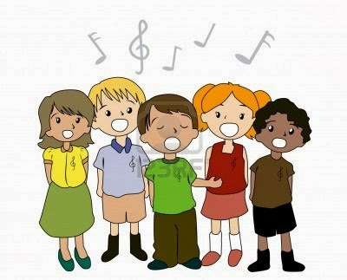
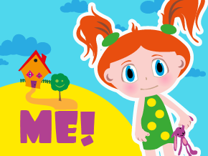

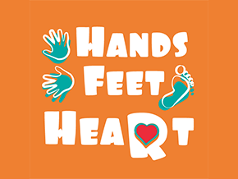
Music roundup
RECEPTION have learnt to sing:
Pat-a-cake
1, 2, 3, 4, 5, Once I Caught a Fish Alive
Five Little Ducks
Name Song
YEAR 1 Hey You! is written in an Old-School Hip Hop style for children to learn about the differences between pulse, rhythm and pitch and to learn how to rap and enjoy it in its original form.
As well as learning to sing, play, improvise and compose with this song, children will listen and appraise other old-school Hip Hop tunes.
YEAR 2: All the learning is focused around one song: Hands, Feet, Heart. The material presents an integrated approach to music where games, the dimensions of music (pulse, rhythm, pitch etc), singing and playing instruments are all linked. As well as learning to sing, play, improvise and compose with this song, children will listen and appraise different styles of South African music.

