Slide 1


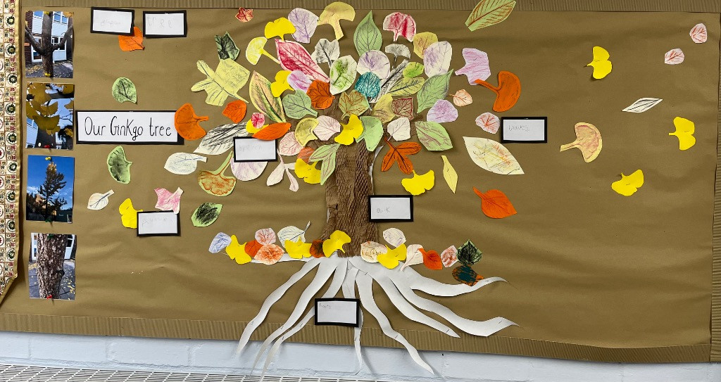
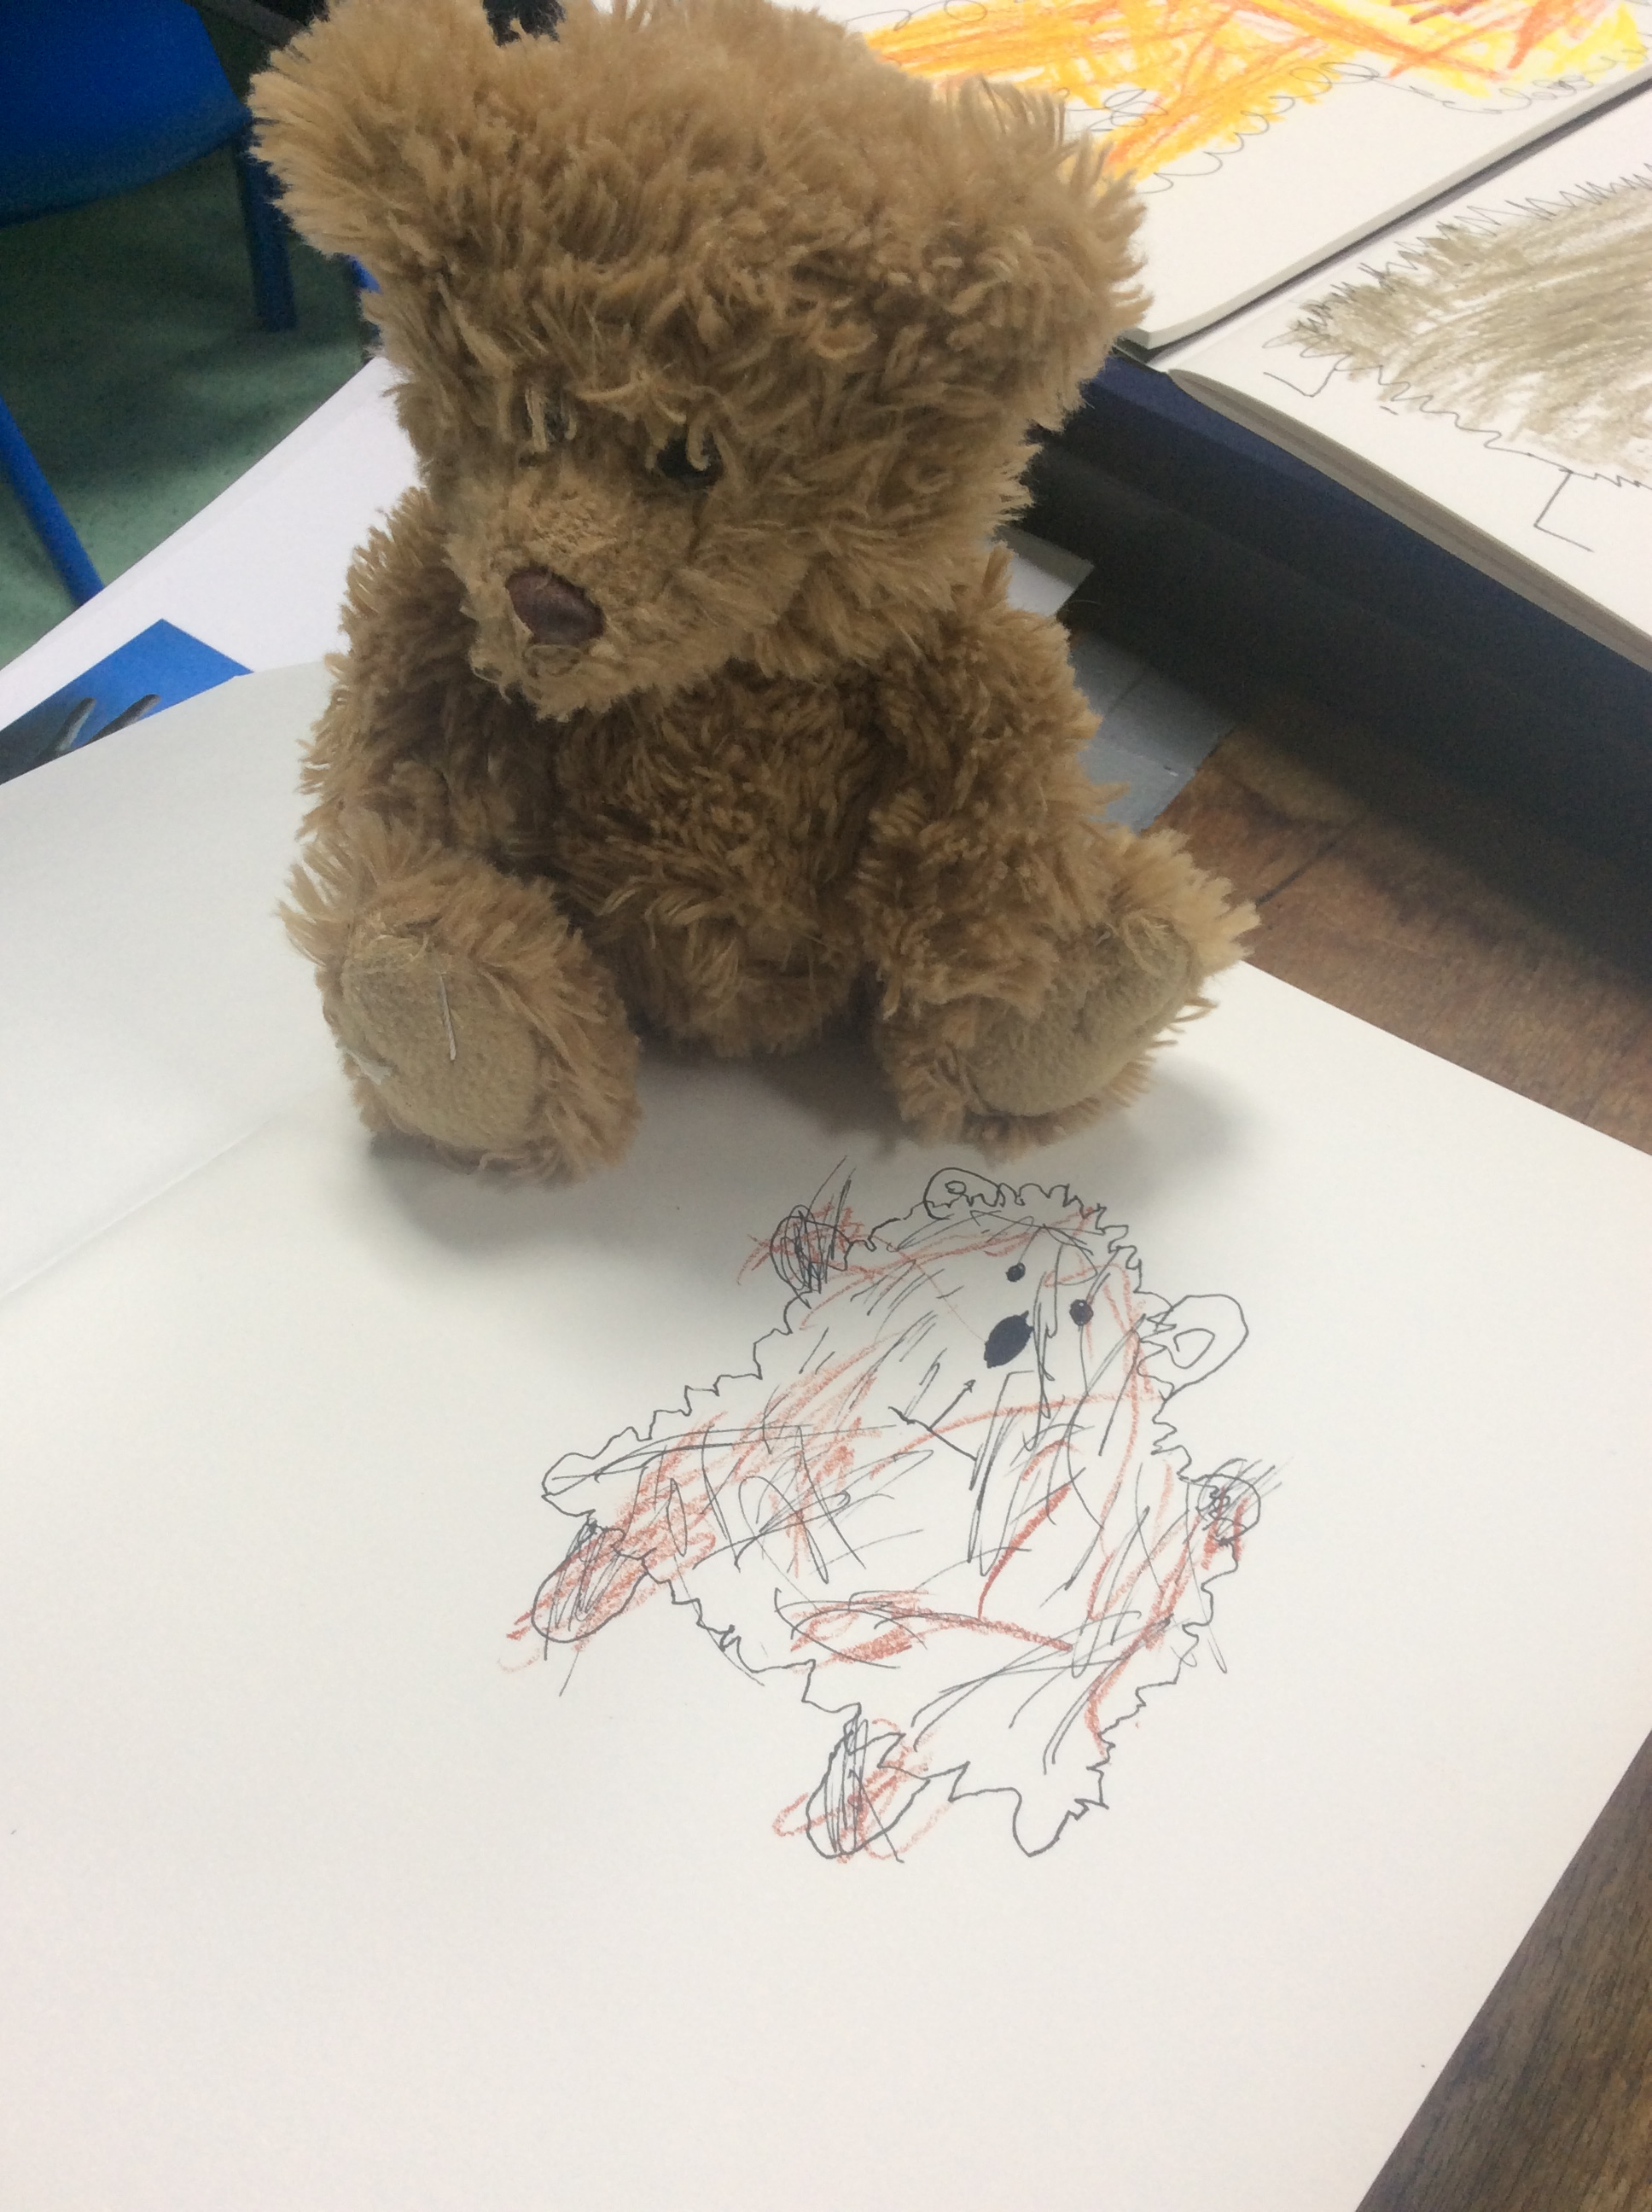
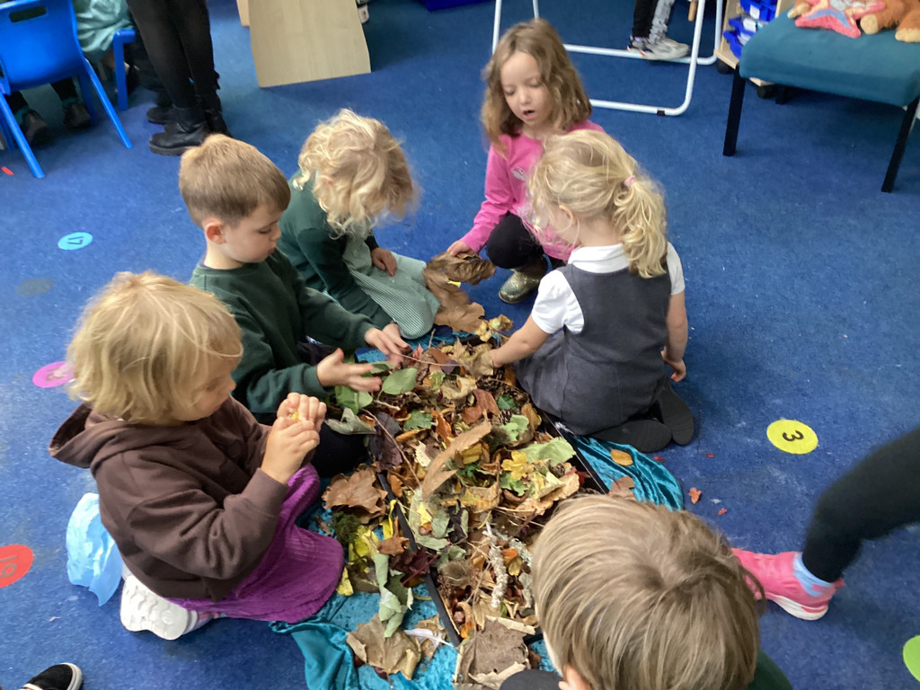
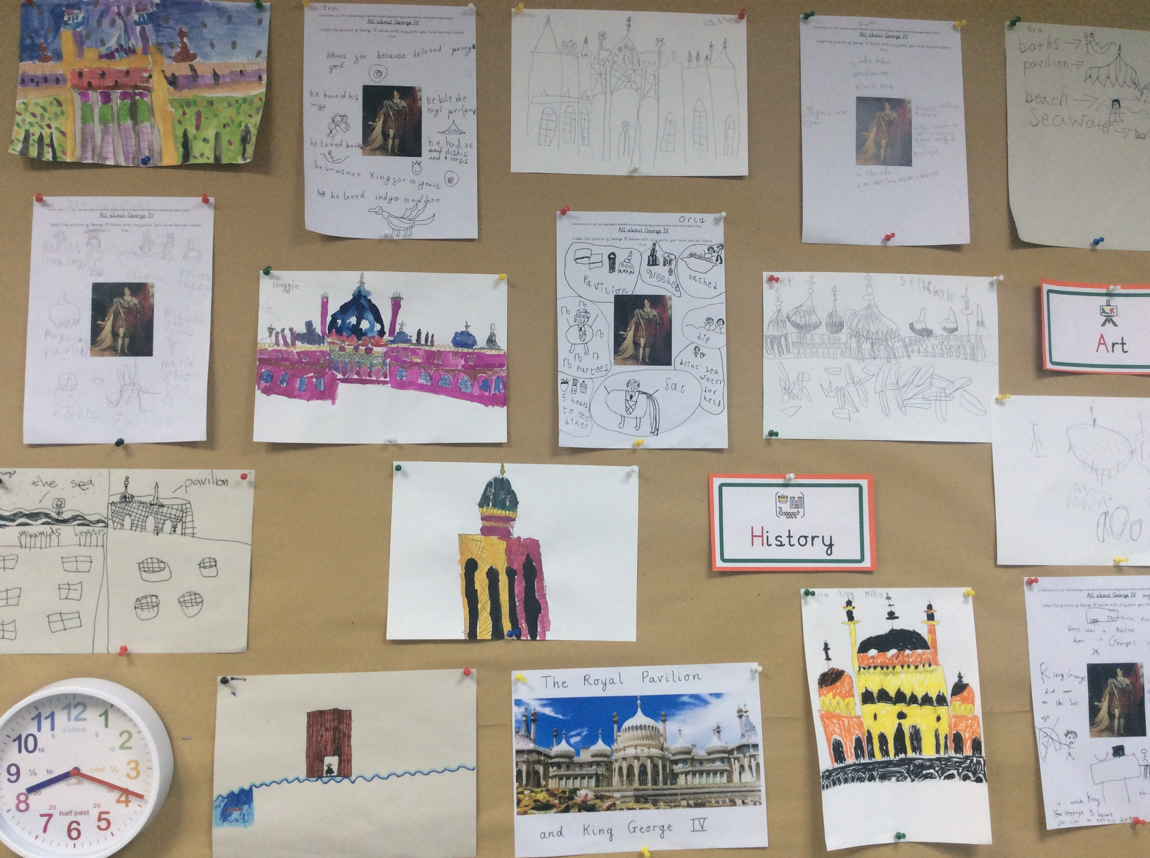
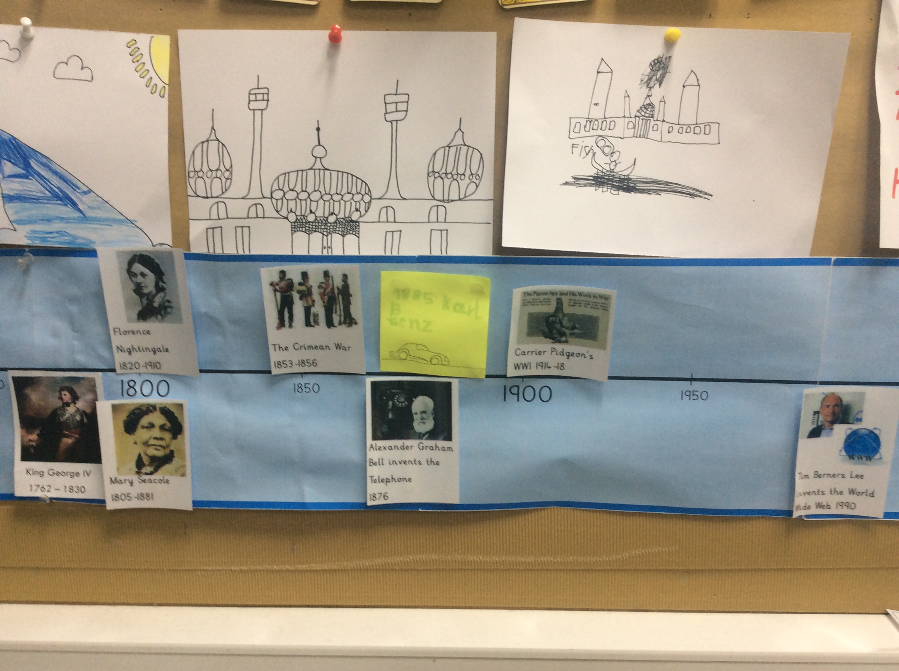
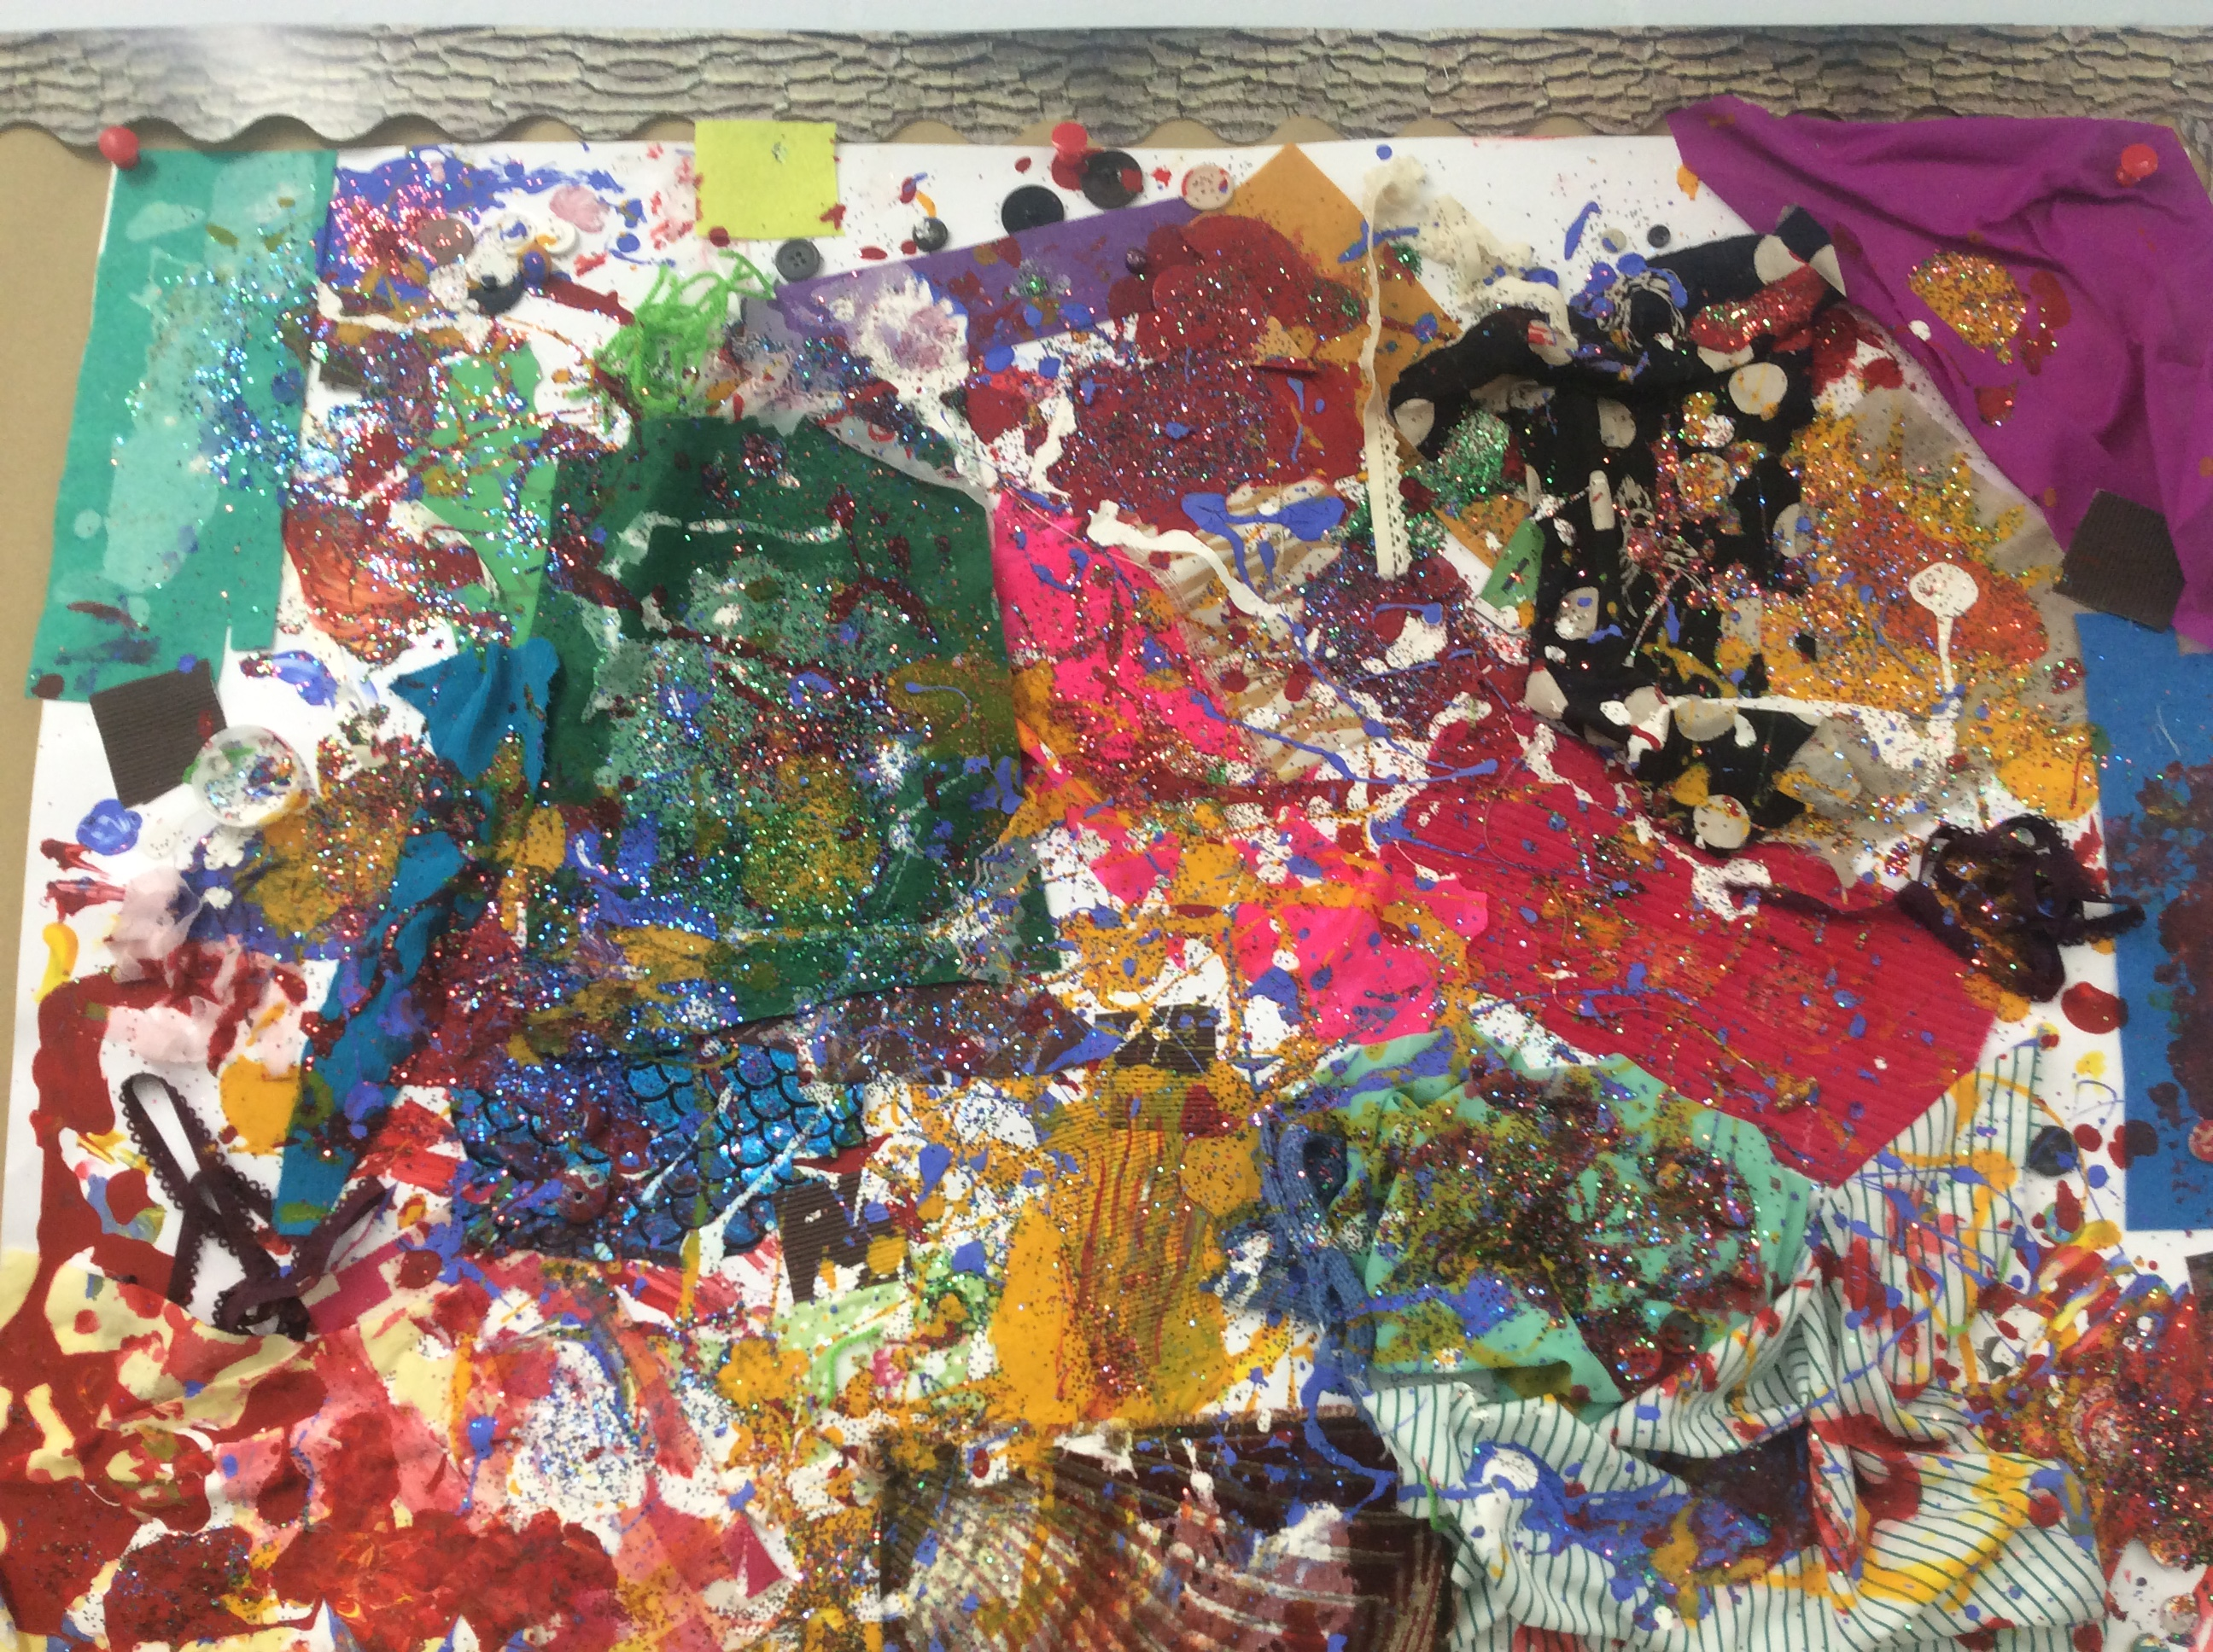
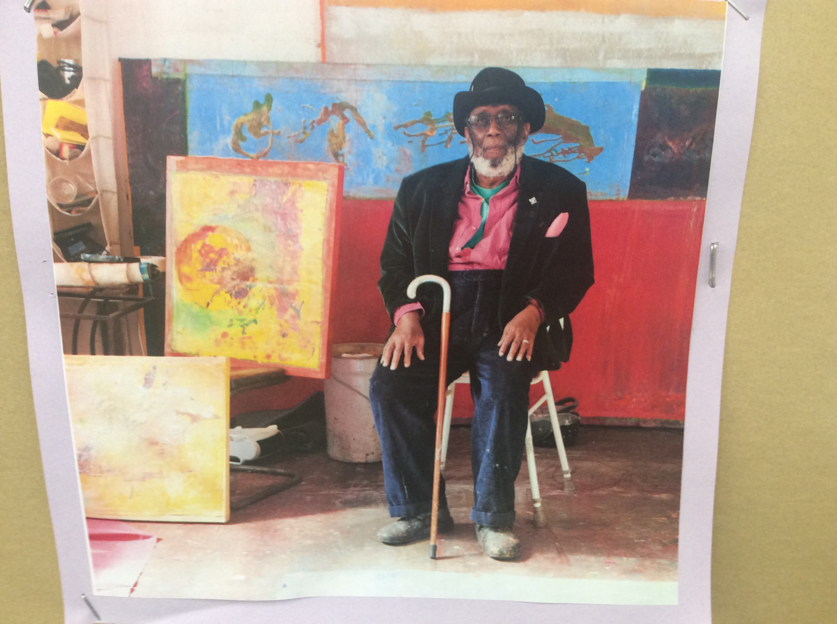
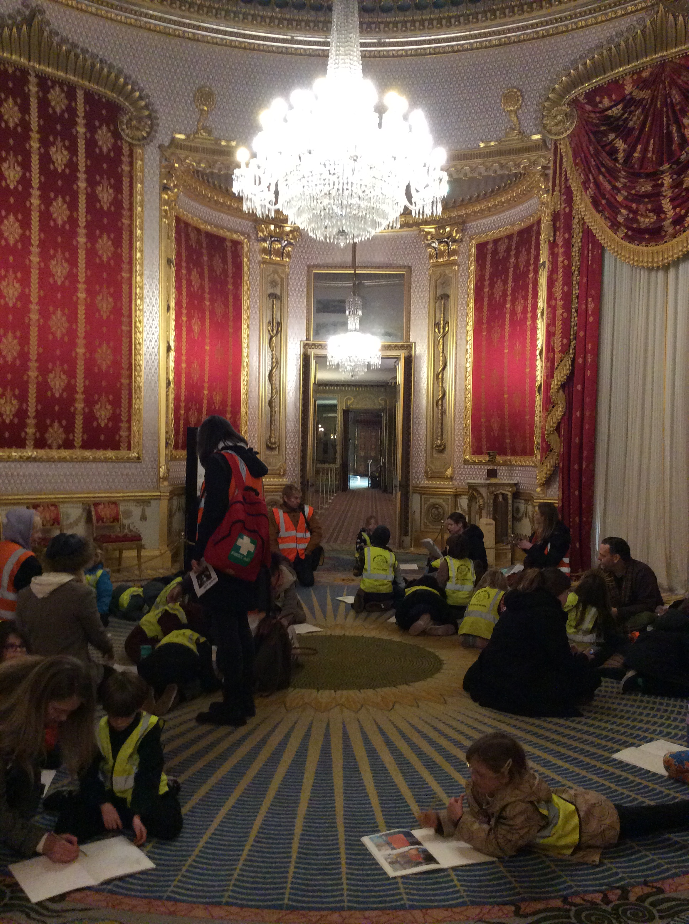
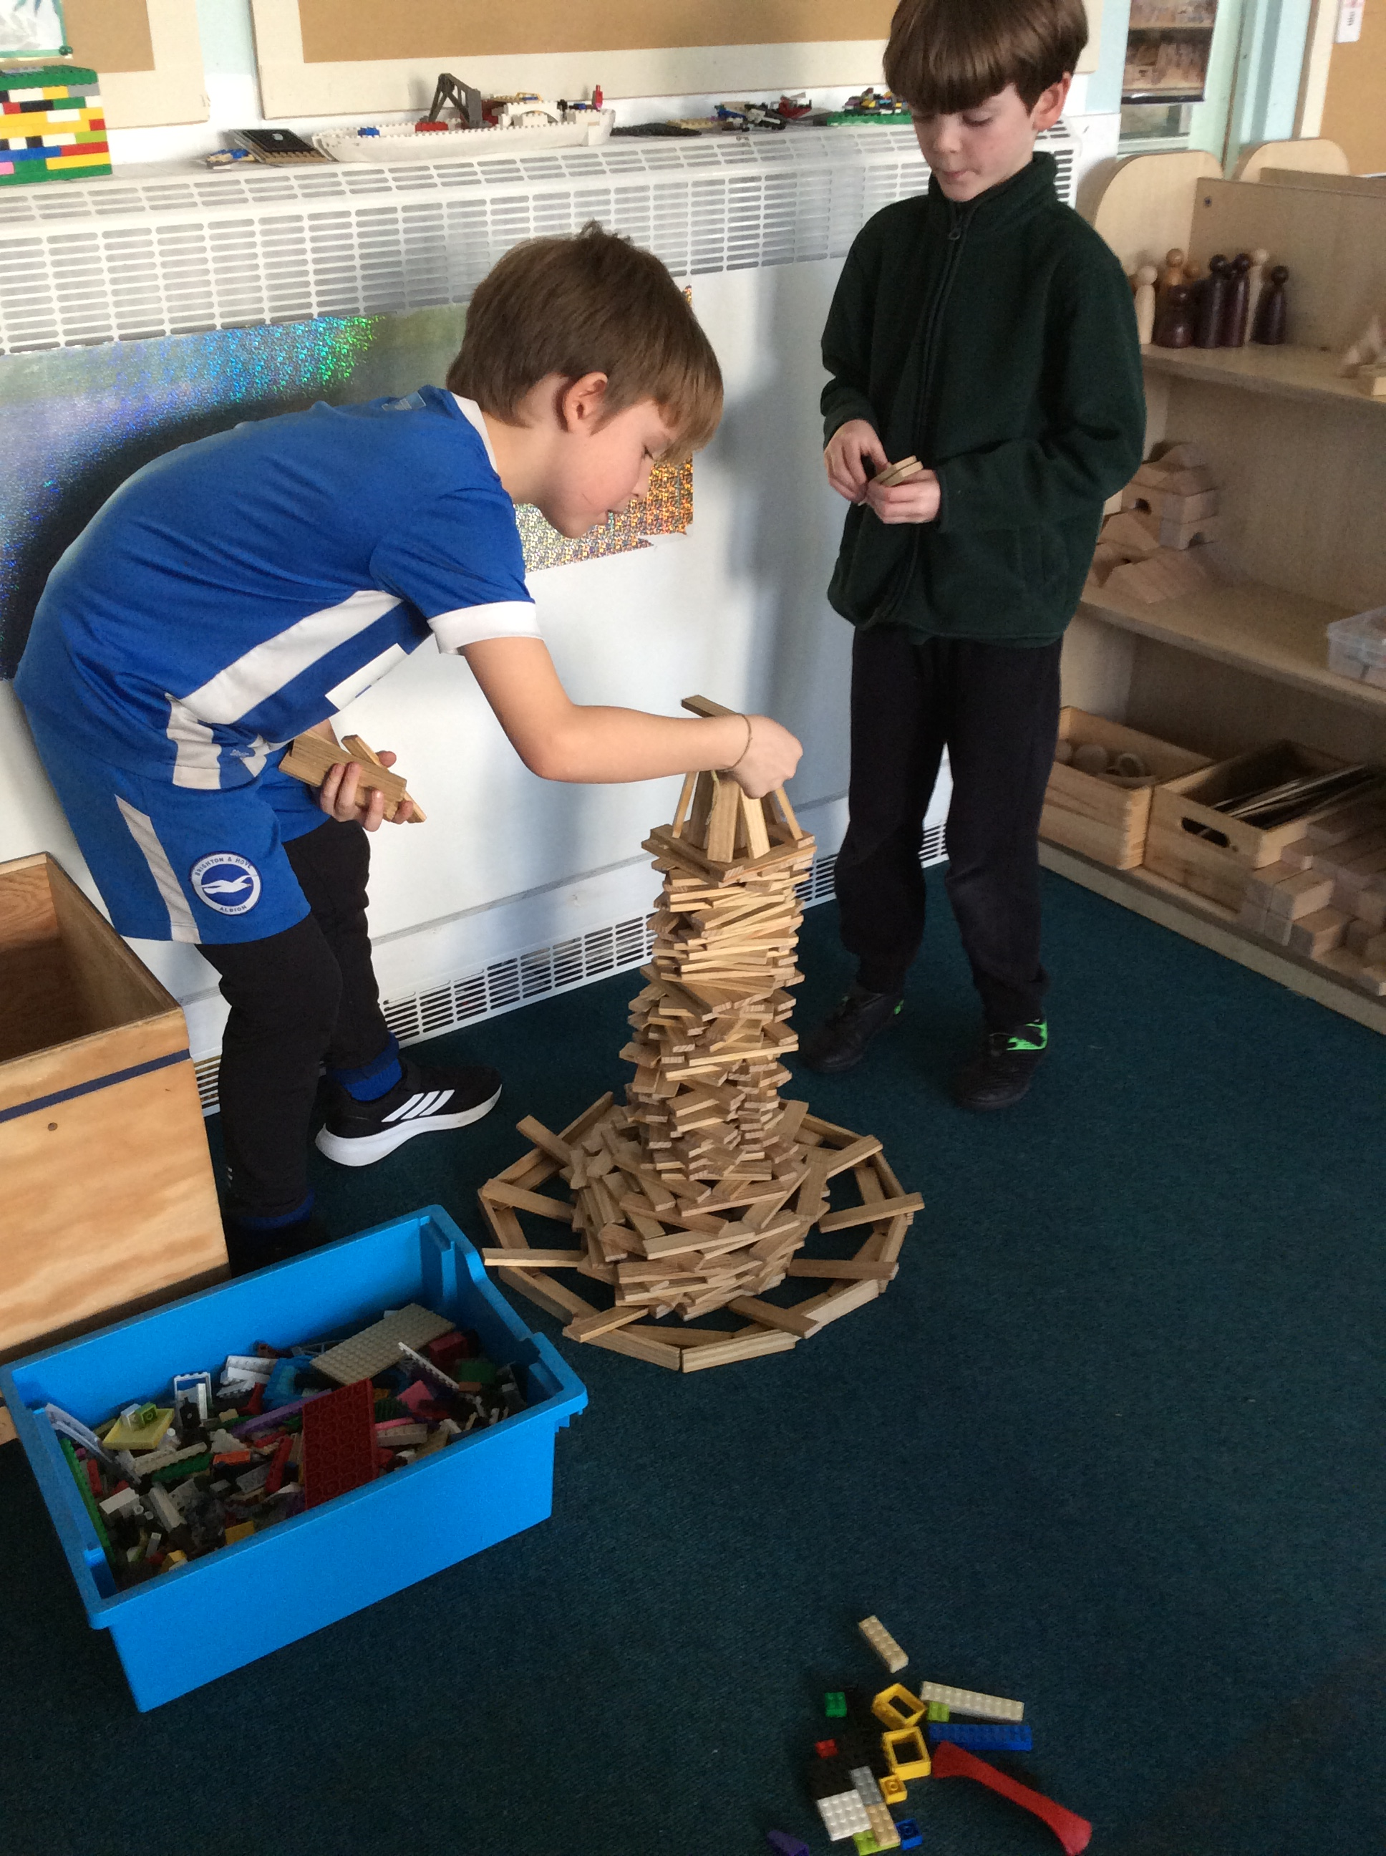
History Round up Spring 1
Here is a little summary of what our History learning has looked like throughout the school. For all year groups, this has included lots of opportunities to build on whole class learning so that the children can be independent, explore their ideas, adapt and improve their skills during Continuous Provision.
Reception
Reception have been given lots of opportunities to practice their chronological thinking by learning days of the week and sharing stories and songs that refer to the past and present. They have explored the changing seasons and have been using their observational skills to notice the difference between old and new when drawing an old bear.
Year 1
Year 1 have got lots of History learning to look forward to later this year and are enthusiastic to learn about Florence Nightingale, Mary Seacole and their part in the Crimean War as well as learning about the history of communication. During COOL times they have been encouraged to observe, research, solve problems and discover. They have produced some wonderful artwork inspired by Frank Bowling during our Black History learning.
Year 2
Year 2 started off the year by learning about the history of the motor car and looking at how wheeled vehicles have evolved over time. This led to lots of thinking about how vehicles have had to be designed to be more environmentally friendly, which linked well with their D&T learning when they had to design a vehicle. A Visit to the Royal Pavilion helped to find out more about the Regency period and King George IV. It also inspired lots of elaborate construction and artwork..
Whole School
Throughout the school we are encouraging children to be curious about the past and reflect on how we have learnt from significant events and people. We all celebrated ‘Black History Month’ by listening to stories about important historical figures and learnt about some inspiring black artists. Timelines are in use in classrooms and children are referring to them to understand and plot any events that come up in all subject learning.

