Slide 1



Assembly
Story
Think
https://youtu.be/Wkn1B7cJYQo

Slide 2

Transport

Slide 3

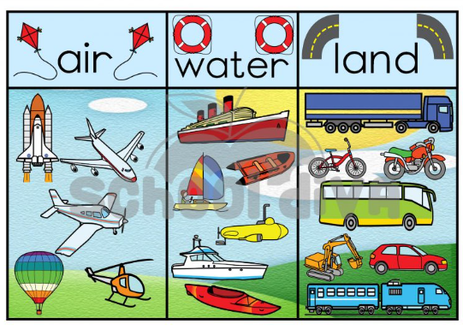
How many different forms of transport can you think of?
In today’s assembly, we're going to be thinking about
travel and transport
Transport is very useful..........
but....

Slide 4
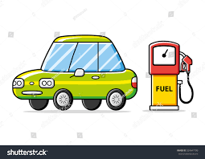
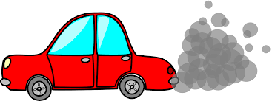
Most cars, buses, planes and trains still run on fossil fuels like petrol or diesel.
And when these fuels are used, engines produce harmful gases, dust and smoke.

Slide 5
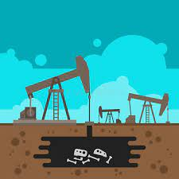

Petrol and diesel come from oil which is made from organisms that lived and died millions of years ago.
When we remove oil from the ground and use it as fuel, carbon dioxide is released. This contributes to global warming. ​

Slide 6
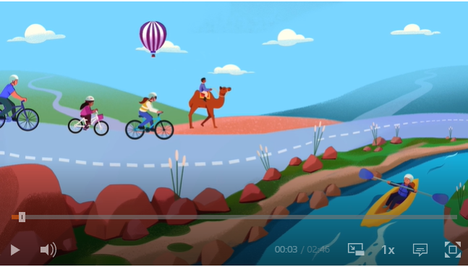

Let's find out more about transport and climate change
Click here

Slide 7
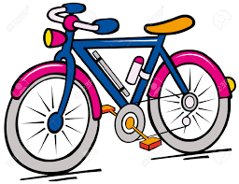
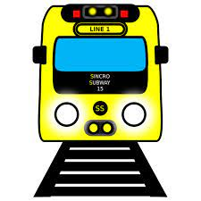
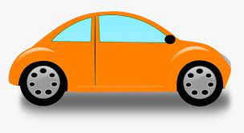

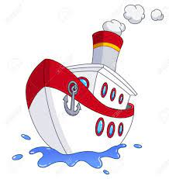

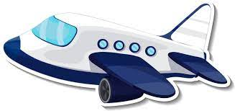
Which form of transport produces the most emissions?

Slide 8
Which form of transport produces the least emissions?

Slide 9


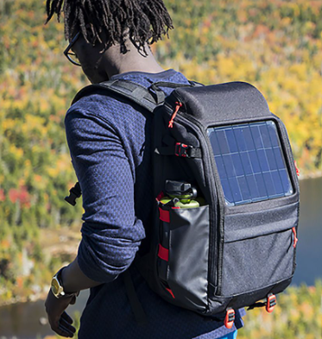
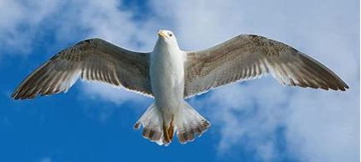
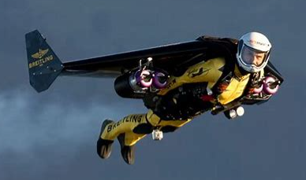
Creativity

Slide 10





Slide 11
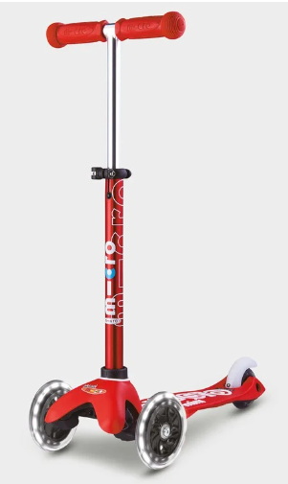
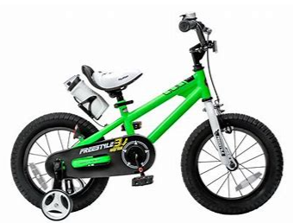
Transport
https://youtu.be/Wkn1B7cJYQo

