Slide 1

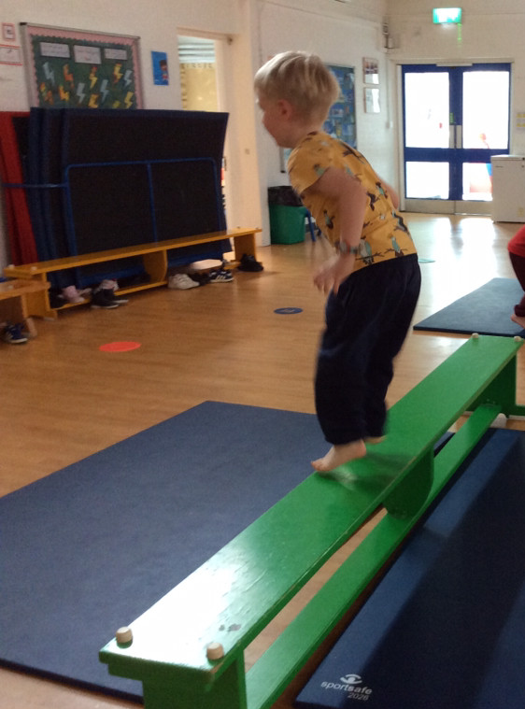
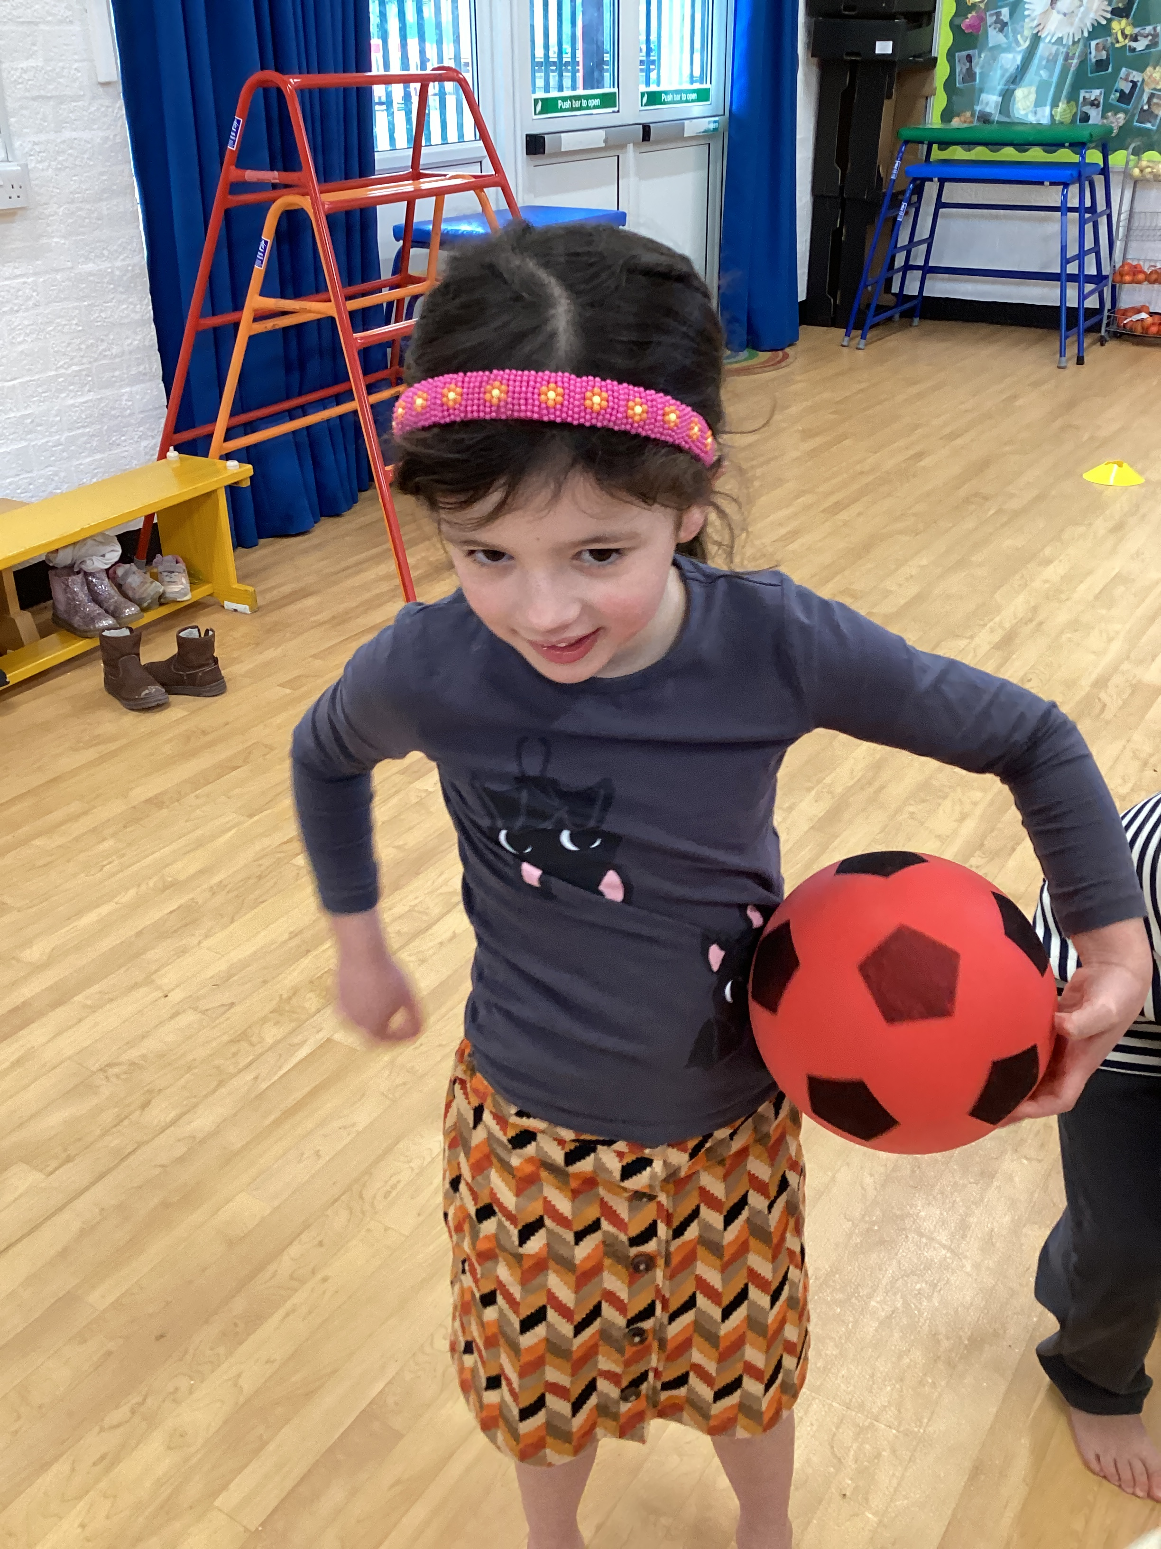
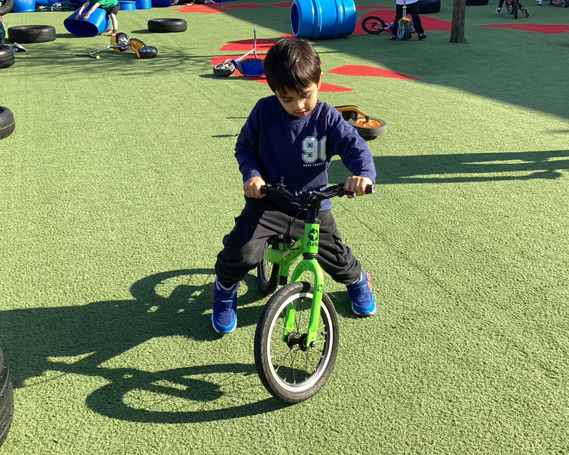
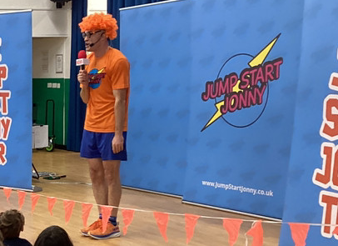
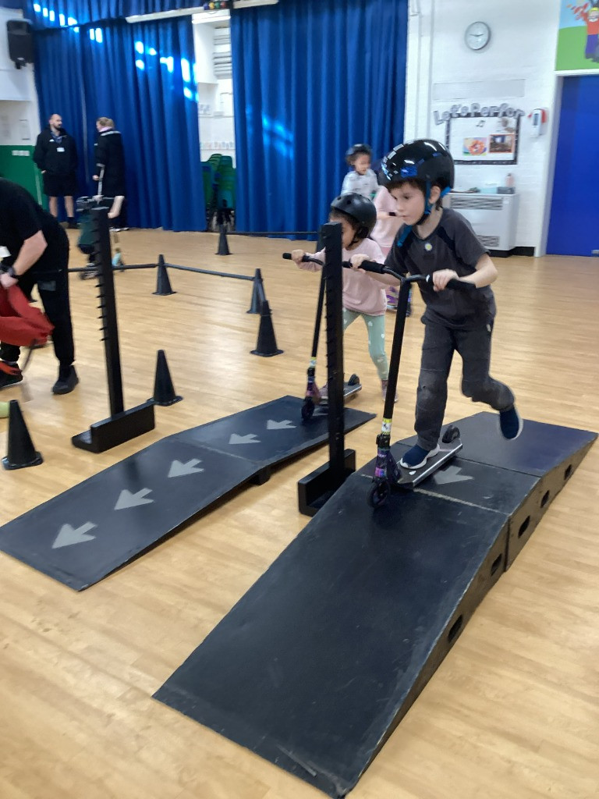
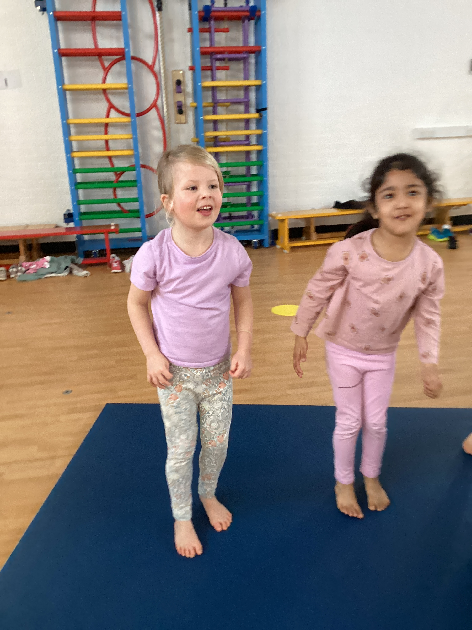
PE Round up Spring 2
Here is a little summary of what our PE learning has looked like throughout the school this term.
Reception
In Reception the children have one PE lesson a week. This term we continued our gym journey and the children have been learning flight and rotation skills on the floor and apparatus. They have loved testing different ways to jump including star and tuck jumps. They have also been developing a range of fundamental movement skills in ‘COOL time’ and during Workout Wednesday.
Year 2
In Year 2 the children have been having two PE lessons each week. In one lesson they have been learning how to further develop their ball skills. In the second lesson, they have been taking part in gymnastics learning trickier flight and rotation skills on the apparatus and learning how to link different movements together.
I like climbing on the apparatus!
I feel flexible, just having a go at things!
I like climbing on the ropes.
I have two skills I can connect together!
I loved going on the scooters, and we even did ramps!
I like doing clown moves.
Wider PE opportunities and events
This term we were lucky to have ‘Jump Start’ Johnny visit the school which the children loved and he got all of our hearts racing fast with his fast paced exercise routines!
We all got to enjoy an assembly by ‘Terry’,a world-class scooter expert! We hope this has inspired children to reach for their own goals, and to not give up even when it’s tricky!
Year 2 enjoyed developing their scooter skills during Terry’s workshops and are now having fun applying their skills on our scooters at lunchtimes.
Year 1
In Year 1 the children have been having two PE lessons each week. In one lesson they have been developing and applying their ball skills and learning how to counter balance with a partner! In the second lesson they have been doing gymnastics lessons, learning more complex flight and rotation skills. Children have also been developing their fundamental movements skills during ‘COOL time’ in the Woodland.

