Slide 1
Reading and phonics Meeting
Reception 2024

Slide 2
How many words can you make using these letters?
s a t p i n

Slide 3

Reading- Why is it so important?

Slide 4
It is vital to functioning in today’s society (road signs, medicine bottles, maps).
Develops the mind and language skills.
Develops the imagination.
Develops the creative side of people.
People who can read generally have higher self esteem.
Good reading skills improves spelling and expands vocabulary.
A person who knows how to read can educate themselves in any area of life they’re interested in.

Slide 5
How do we help children to become readers?
It is vital that the school and family work in partnership to develop children’s reading.
The school will:
Promote a love of reading.
Read lots of stories and share information books with your children.
Read with your child once a week (this may be games or books).
Teach systematic phonics daily.
Teach sight words.
Send reading scheme books home twice a week.
Visit the library weekly where children can enjoy books with their friends and also choose a book to take home.

Slide 6
Home grown ups will:
Promote a love of reading.
Read and share a range of stories/ non-fiction daily with your child.
Read your child’s reading scheme book 5 times a week (books will be changed 2 times a week)
Complete the reading diary each time you read their school book.
Keep the reading book and diary in book bags every day and ensure they are returned to be changed twice a week.
Support our teaching of phonics using the sound book that is sent home.
Play phonics/ reading games when they are sent home.
Practise reading sight words (wizard words) when they are sent home.
Volunteer as part of our school reading army if you have any spare time.

Slide 7
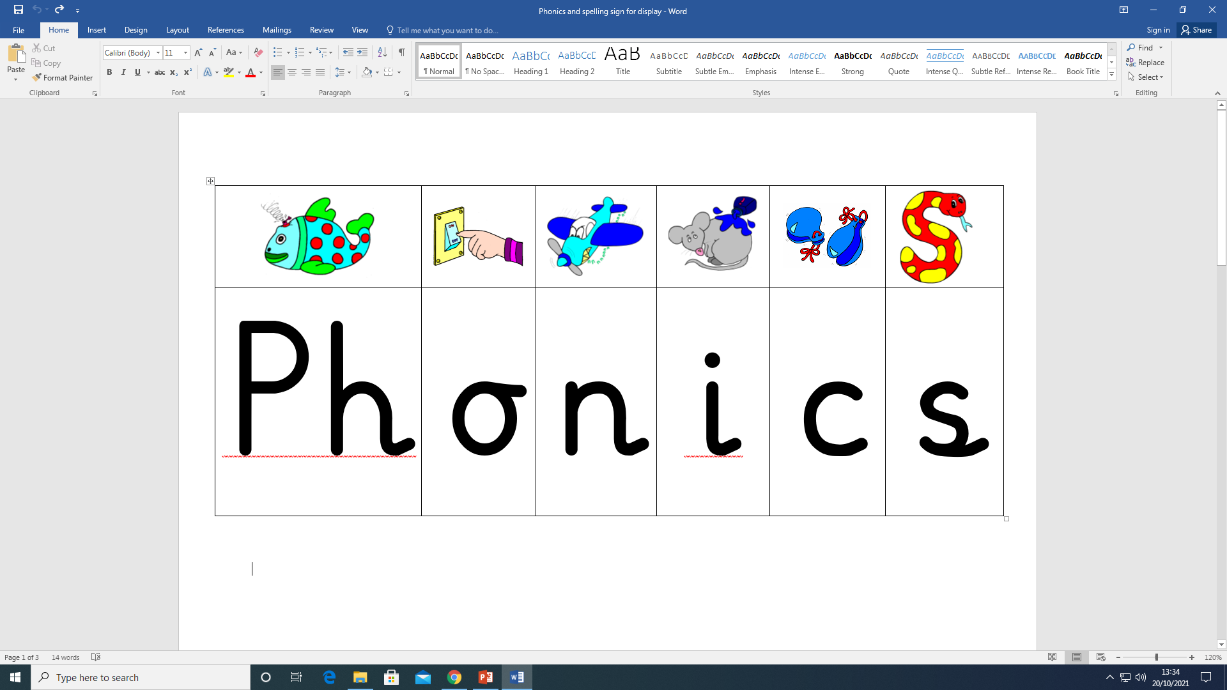

Slide 8
What is Phonics?
Phonics is a way of teaching children how to read and write. It helps children hear, identify and use different sounds that distinguish one word from another in the English language. Written language can be compared to a code, so knowing the sounds of individual letters and how those letters sound when they’re combined will help children decode words as they read.
Understanding phonics will also help children know which letters to use when they are writing words.
Phonics involves matching the sounds of spoken English with individual letters or groups of letters. For example, the sound k can be spelled as c, k, ck or ch.
Teaching children to blend the sounds of letters together helps them decode unfamiliar or unknown words by sounding them out. For example, when a child is taught the sounds for the letters t, p, a and s, they can start to build up the words: “tap”, “taps”, “pat”, “pats” and “sat”.

Slide 9
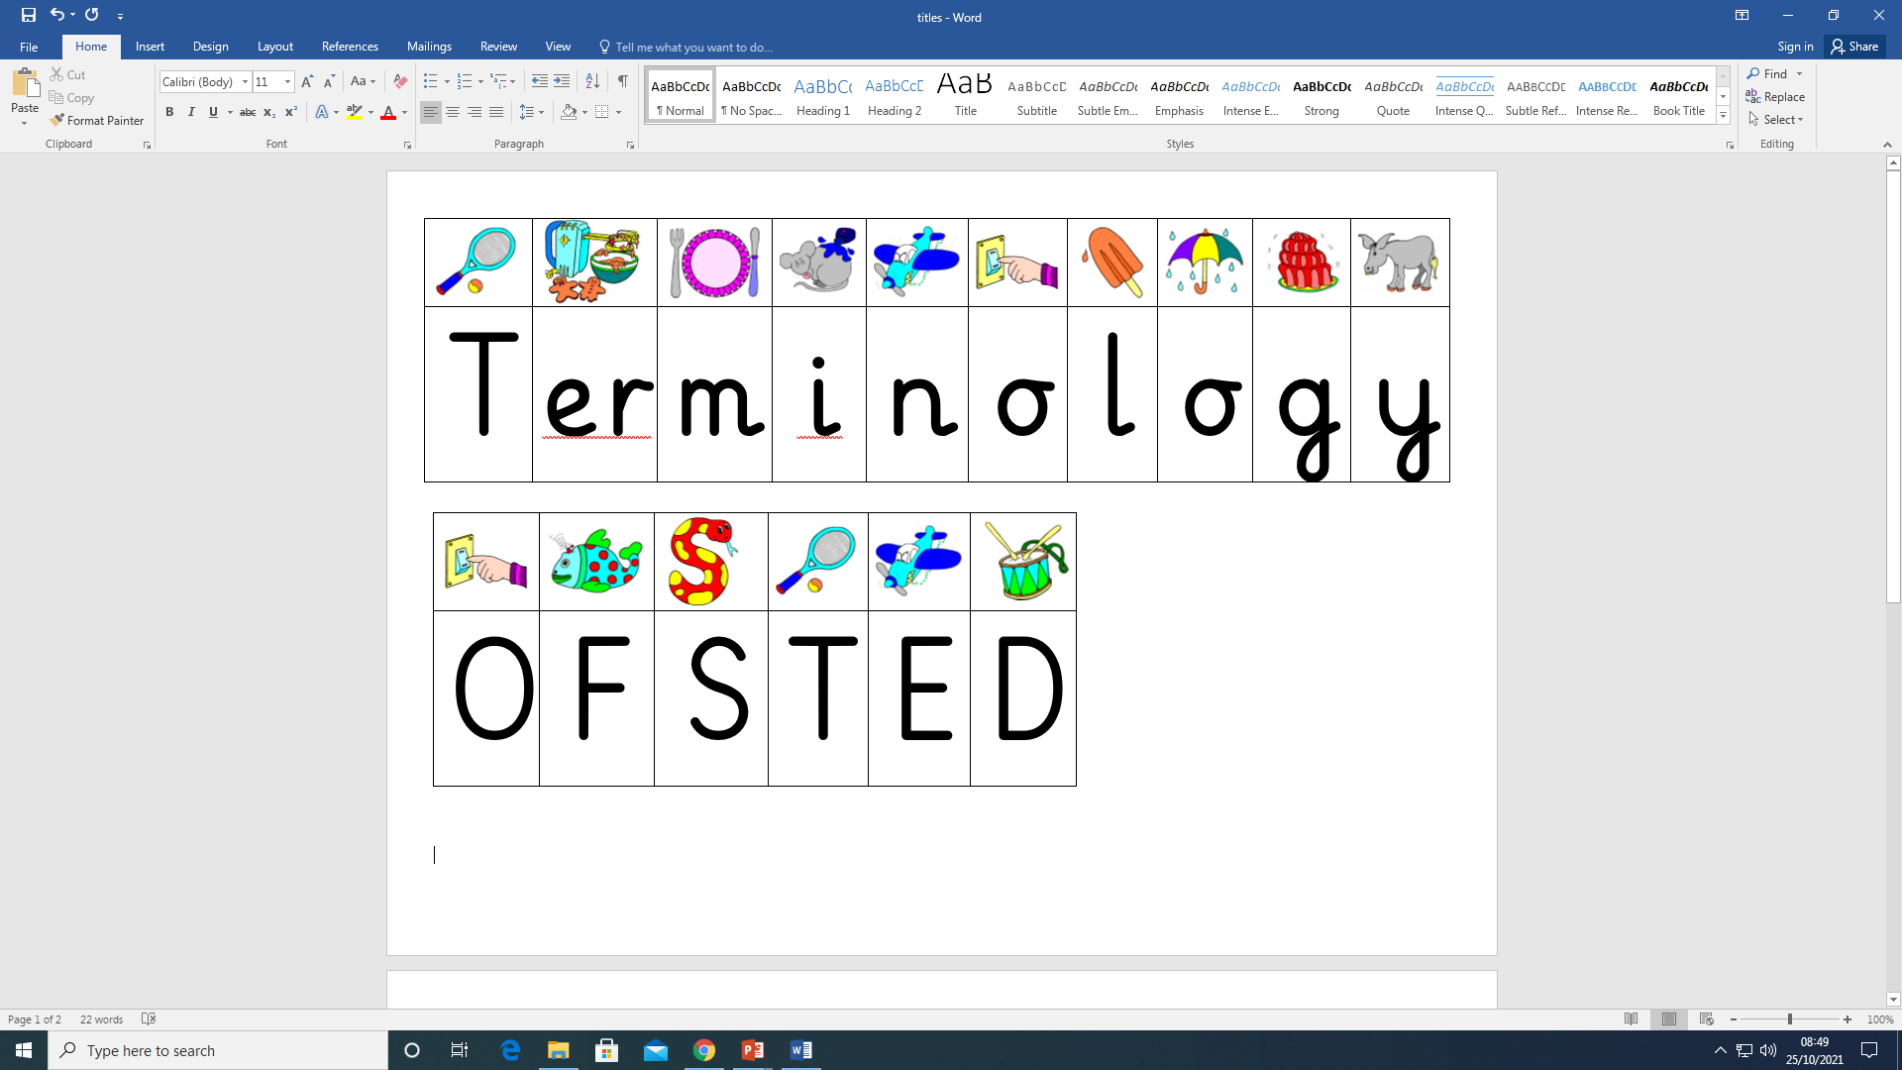

Slide 10
Phoneme
The smallest unit of sound. There are approximately 44 phonemes in English (depending on accent). Phonemes can be put together to make words.
Grapheme
A way of writing down a phoneme. Graphemes can be made up of 1 letter e.g. t, 2 letters e.g. ch, 3 letters e.g. igh or 4 letters e.g. eigh.
GPC
This is short for Grapheme Phoneme Correspondence. Knowing a GPC means being able to match a phoneme to a grapheme and vice versa.
Digraph
A grapheme containing two letters that makes one sound (phoneme).
Trigraph
A grapheme containing three letters that makes one sound (phoneme).

Slide 11


Applying phonics in reading
Oral Blending
Hearing phonemes and being able to merge them together to make a word. Children need to develop this skill before they will be able to blend written words.
Blending
Looking at each grapheme within a written word and using knowledge of GPCs to work out which phoneme each grapheme represents. The phonemes are then merged together to make a word. This is the basis of reading.
sh- i- p
ship

Slide 12
Applying phonics in spelling
Oral Segmenting
Hearing a whole word and then splitting it up into the phonemes that make it. Children need to develop this skill before they will be able to segment words to spell them.
Segmenting
Splitting up a heard word into the phonemes that make it and using knowledge of GPCs to work out which graphemes represent those phonemes. Those graphemes are then written down in the right order. This is the basis of spelling.
ring
r - i - ng

Slide 13
How is Phonics taught here?
Children have a daily phonics lesson.
A new sound is introduced on 4 out of 5 lessons each week through a multi sensory approach.
A typical lesson structure…
Children are taught to recognise sounds in isolation and to apply this knowledge to be able to blend and segment words when they read and write.
Sound books are sent home with new sounds added weekly for you to practise with your child daily.
Reading books closely match the stage of phonics children are at and these are read in school and at home.

Slide 14
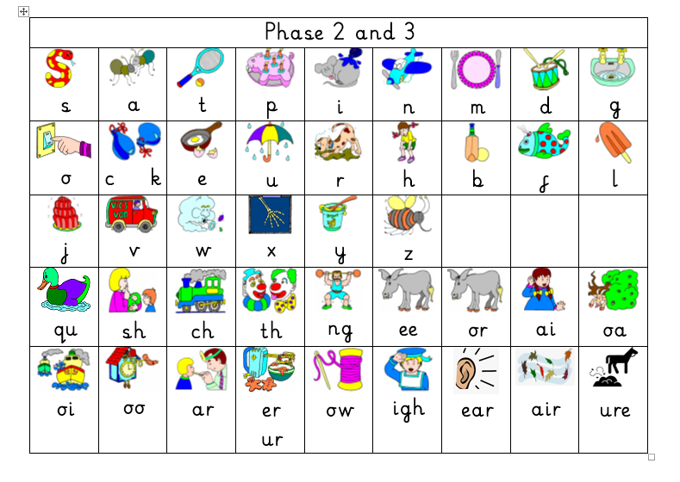
Sound mats

Slide 15
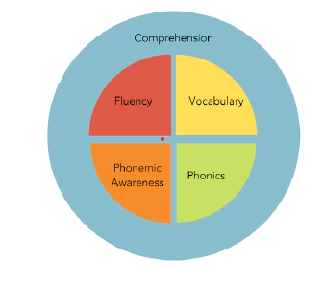
Is reading only taught through phonics?

Slide 16

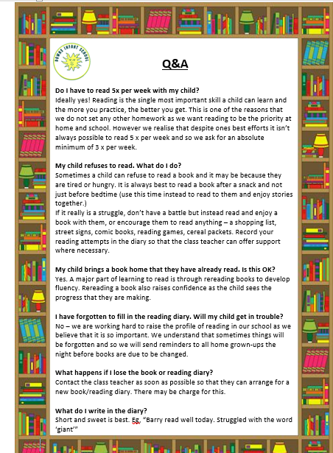

Slide 17
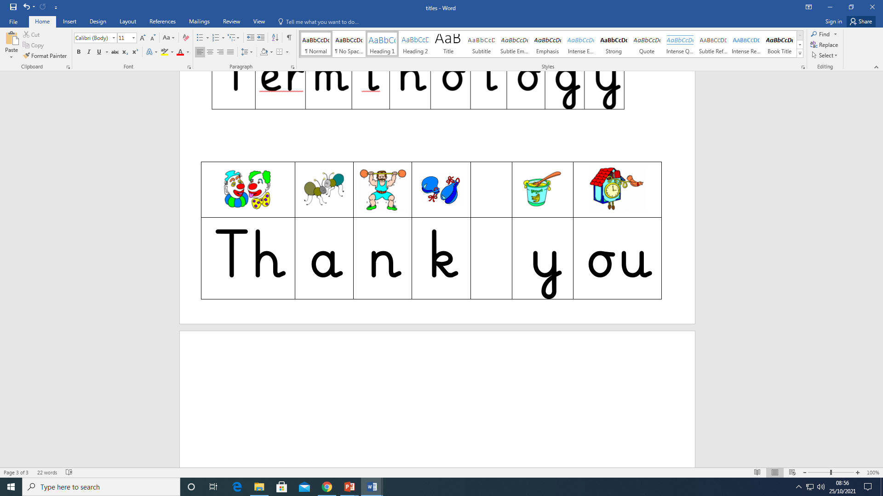
Notes:
Take a way

