Slide 1
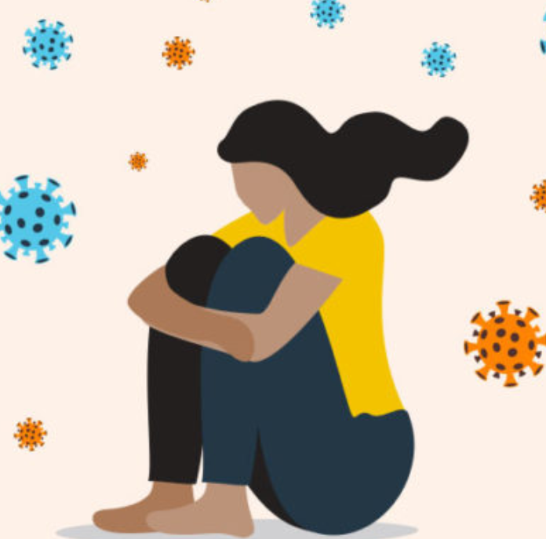
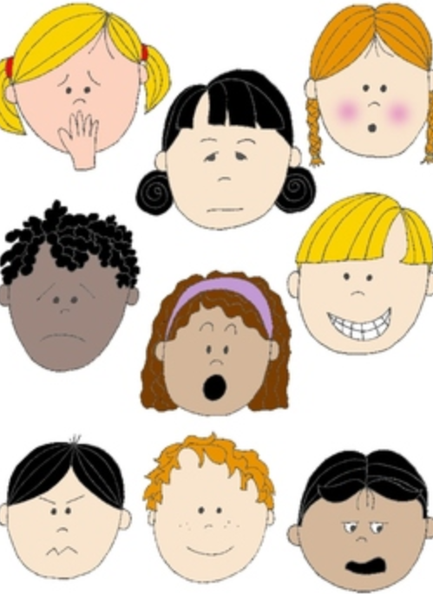


Part 1:Thinking About Feelings Ks1
KS1
Notes:
All film clips are hyperlinked on the image

Slide 2
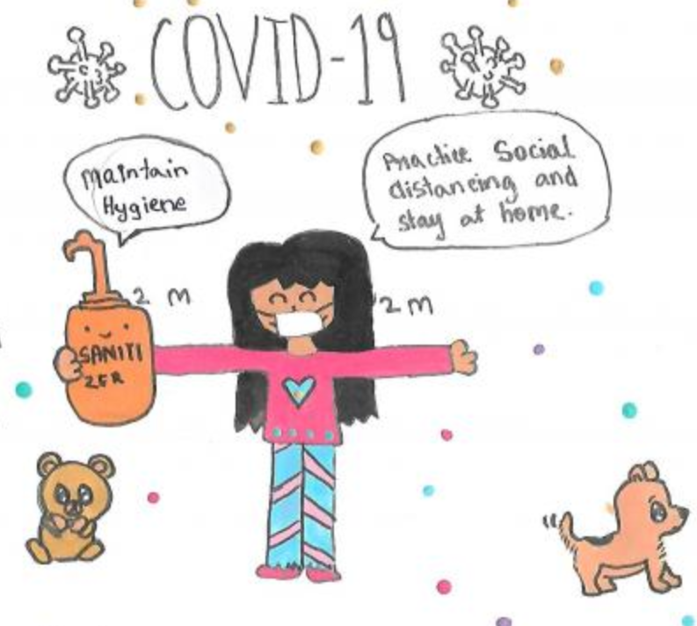
The aim of this resource is to offer ideas for managing your child’s feelings during this difficult and uncertain time.
You will also find out about ways to boost your well-being whilst we need to stay in at home

Slide 3
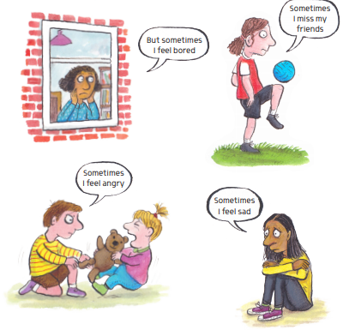
Let’s think about our feelings?
How do you feel today?
Can you name your feelings?
Lets draw some of the feelings we have had over the last few days.

Slide 4
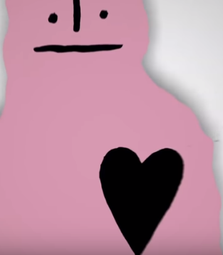
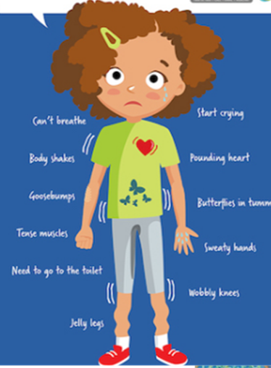
Feelings and your body
Many children and grown ups maybe feeling worried or stressed by what has been happening in the world .
Where might you feel worry/stress in your body? What does it feel like?

Slide 5

Thinking more about your feelings
Do you feel like this all of the time?
Do you have a mixture of feelings?
Do these feelings come in waves and so come and go?
Are some stronger than others?
Do you get some feelings more strongly depending what you are doing? For example, watching the news? Playing a game online? Talking to a friend?

Slide 6
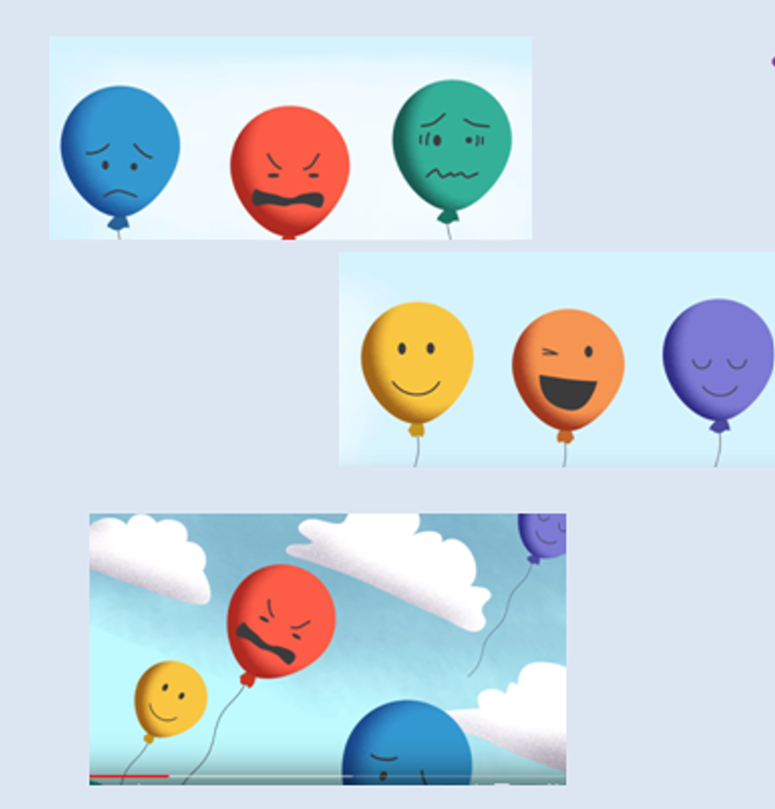
Feelings go up and down. We have many different feelings everyday. This is normal.

Slide 7
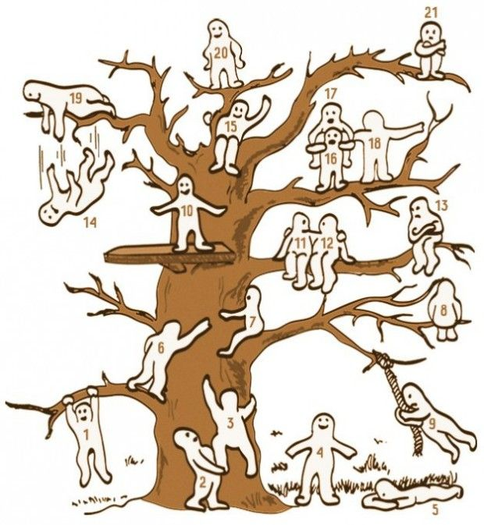
Feelings Check in
It can be helpful to check in and notice how we feel each day.
Which one do you feel like at the moment?

Slide 8


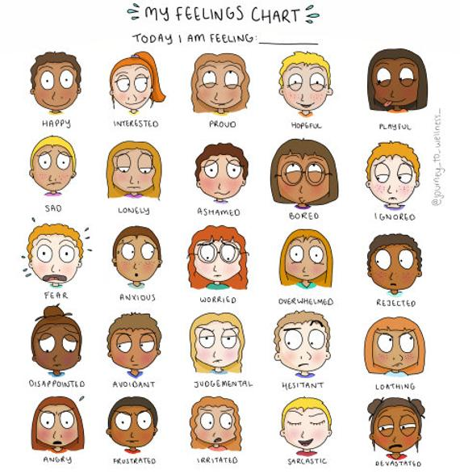
Talking about our feelings can help everyone!
Let’s do a feelings check in each day.
Use a blob tree or other feelings chart to help.

Slide 9
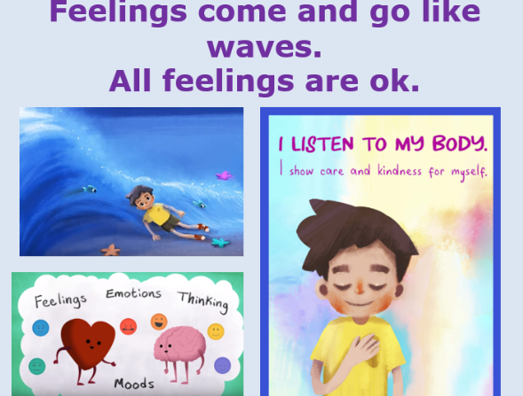

Slide 10
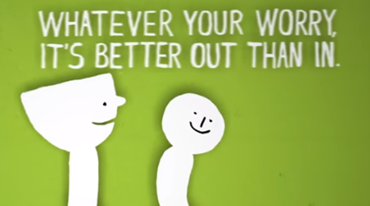
We may not have all the answers about what is happening because of the Covid-19 virus or when things may change – but it can help to share how we are feeling.

Slide 11
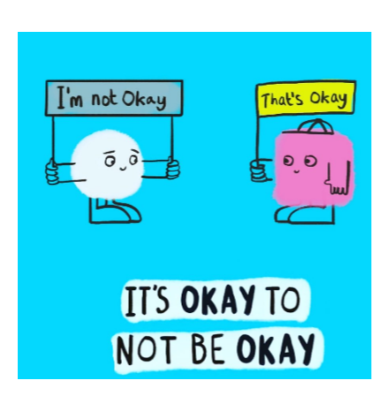

It always helps to talk to someone if we have a worry.
Remember it is normal to feel a mixture of feelings, both big and small, happy and sad, especially during these difficult and uncertain times
If you have a big feeling that is making it hard to think about anything else, to concentrate or stopping you getting to sleep, it’s time to get some help.

