Slide 1

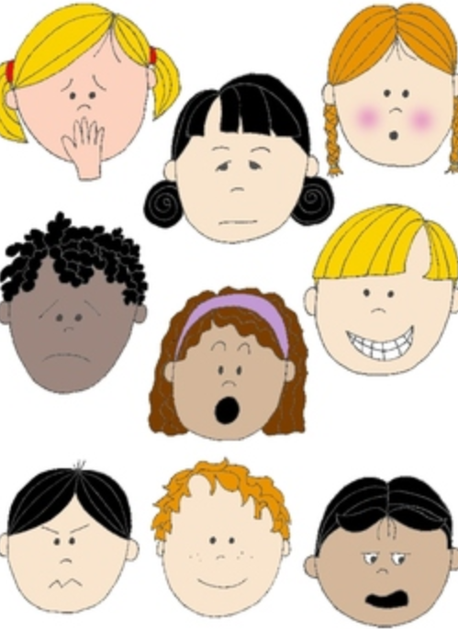


Part 2: Managing difficult feelings about the Coronavirus
KS1
Notes:
All film clips are hyperlinked on the image

Slide 2

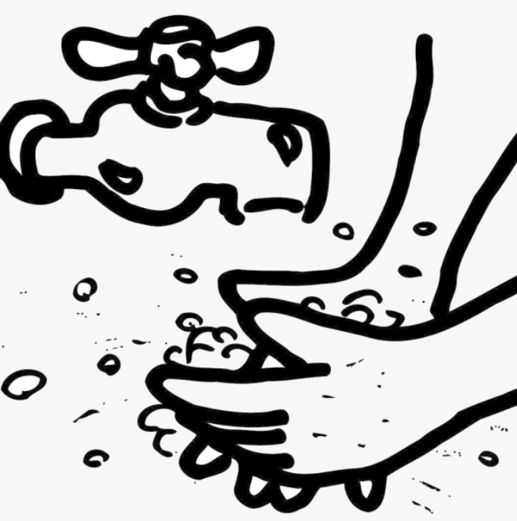
Managing worries and fears about the Covid-19 virus
One way to manage worries and fears about this virus is to find out the facts.
Most people who catch the virus will recover well and many people have had it and now feel better.
Staying at home, limiting who we see, staying at a distance and washing our hands are all ways to help us all stay well and safe.

Slide 3
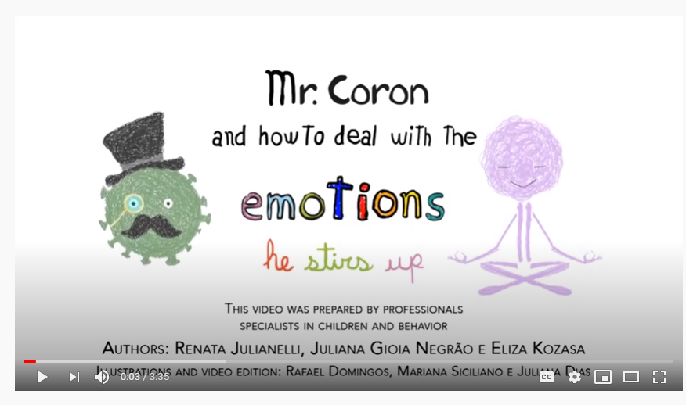
https://www.youtube.com/watch?v=cyOU_fHYrIg

Slide 4

Understanding Covid-19 virus
This book has been written especially for children.
You could read it together, or use to to help answer any questions
https://nosycrowcoronavirus.s3-eu-west-1.amazonaws.com/Coronavirus_ABookForChildren.pdf

Slide 5

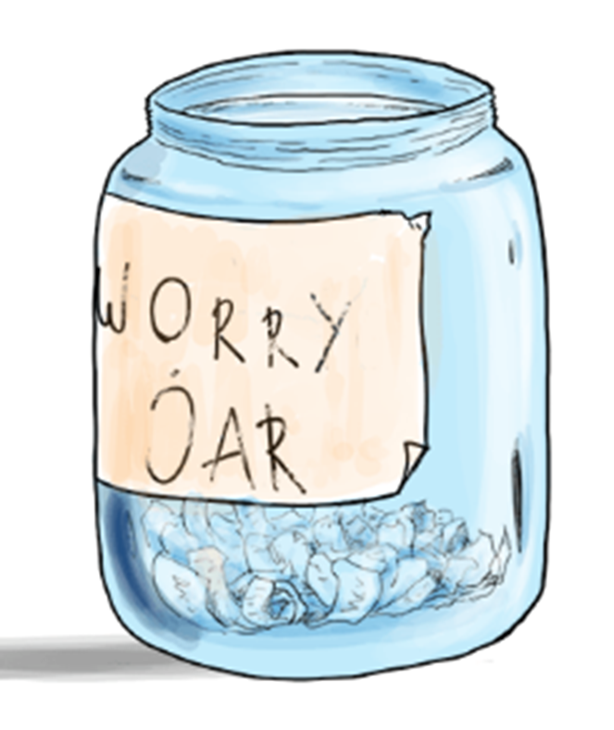
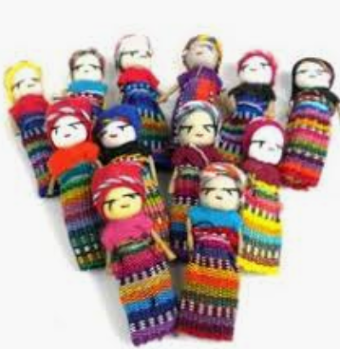
Managing worries and fears
You could try making a worry jar or using worry dolls (or a cuddly or a pet) to tell our worries to.

Slide 6



Managing worries and fears
We need to recognise a worry, but try to stop worrying all of the time.
We need lots of time to do things we enjoy which help us to stop thinking about the virus for a while.

Slide 7


We may not be able to make the worries go away, but we can do things which help us feel better.

Slide 8
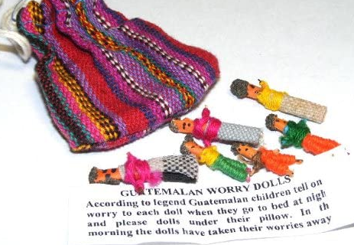

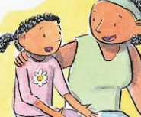


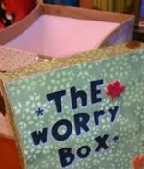

If the worry won’t go away…it will help to talk about it with someone.

Slide 9

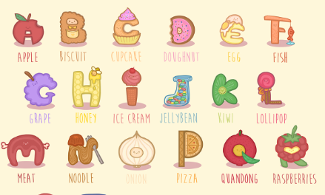
Let’s play the alphabet game to help take our minds off a worry for a while…
Choose a category, eg food, animals, places, toys
Take turns to say something in alphabetically order

Slide 10

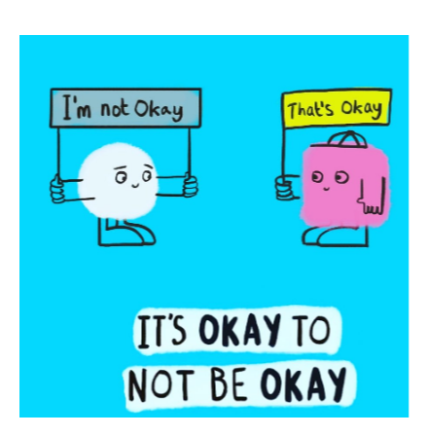

It always helps to talk to someone if we have a worry.
Remember it is normal to feel a mixture of feelings, both big and small, happy and sad, especially during these difficult and uncertain times
If you have a big feeling that is making it hard to think about anything else, to concentrate or stopping you getting to sleep, it’s time to get some help.

