Slide 1

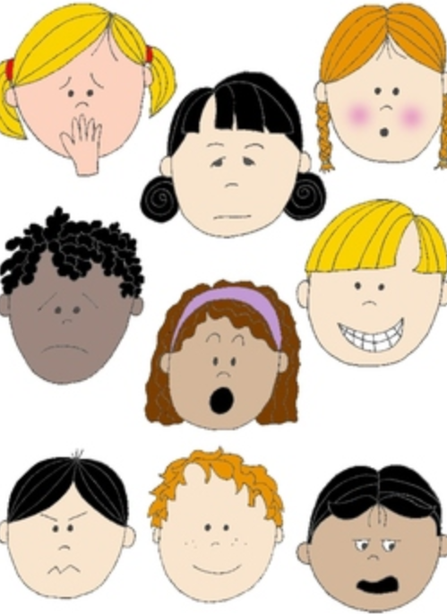


Part 3: Ways to be calm
KS1
Notes:
All film clips are hyperlinked on the image

Slide 2



What can help us feel better?
There are different ways to feel calm and to boost our feelings of well-being
(feeling happier and more positive)
Try out some of these ideas and find out what works for you

Slide 3
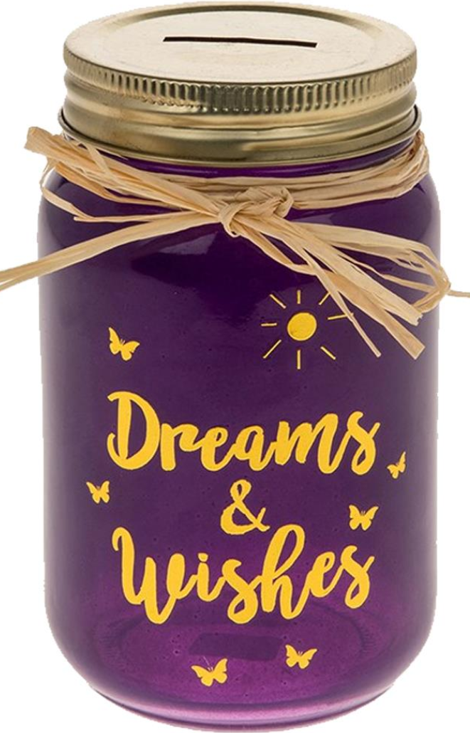

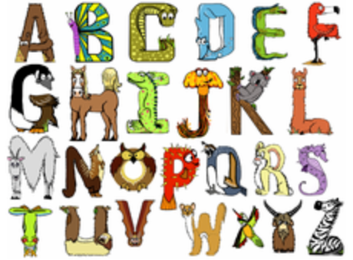
Some quick ways to feel calmer
Imagine your favourite or happy place
Think of your favourite things or something you are looking forward to Name something alphabetically, for example animals, alligator, bear, cat …

Slide 4
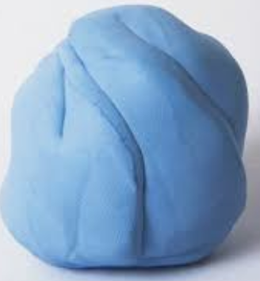
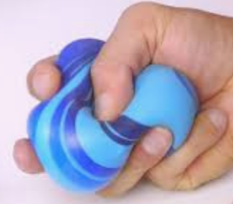


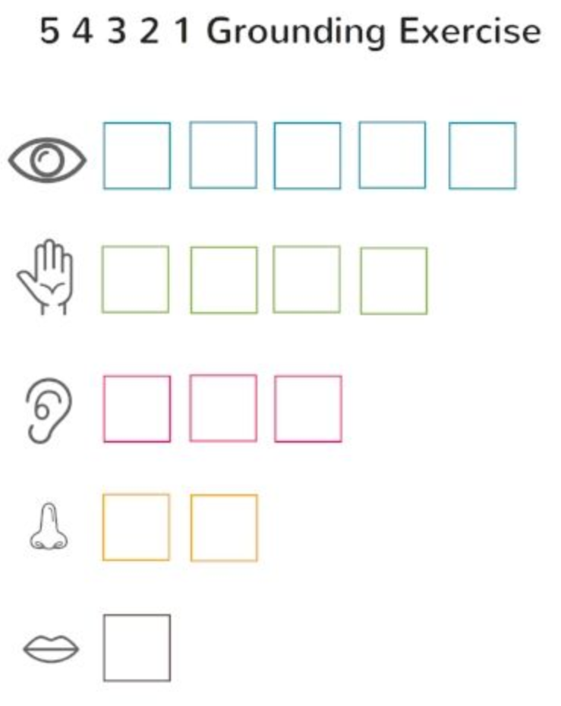
Some quick ways to feel calmer
Squeeze something (blu-tac, putty, a stress ball)
Get a drink of cold water
Smell something calming like a lavender bag
Try a 54321-grounding technique – name 5 things you see, 4 things you can hear, 3 things you can touch, 2 things you can smell and 1 thing you can taste.

Slide 5
Some quick ways to feel calmer
Squeeze something (blu-tac, putty, a stress ball)
Get a drink of cold water
Smell something calming like a lavender bag
Try a 54321-grounding technique – name 5 things you see, 4 things you can hear, 3 things you can touch, 2 things you can smell and 1 thing you can taste.

Slide 6
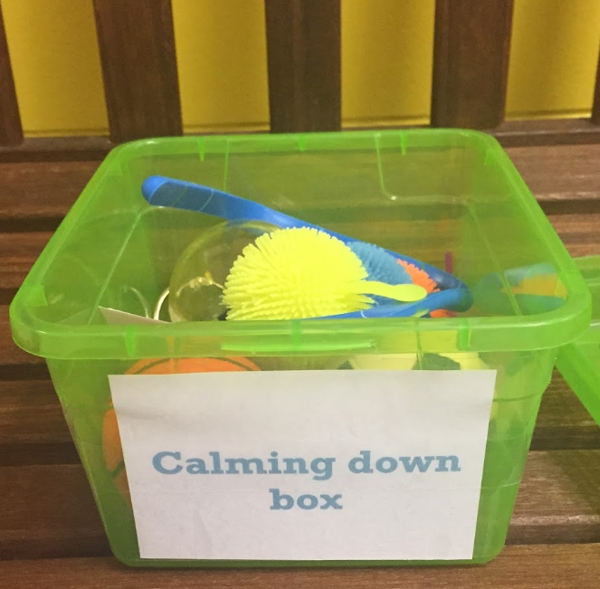
Making a calm box
Make yourself a calm box to help soothe yourself, keep it somewhere safe ( check with a grown up) and go to it when you need to
It could include:
A favourite story; a photo album; a cuddly; a blanket, a lavender bag; a stress ball and your idea

Slide 7

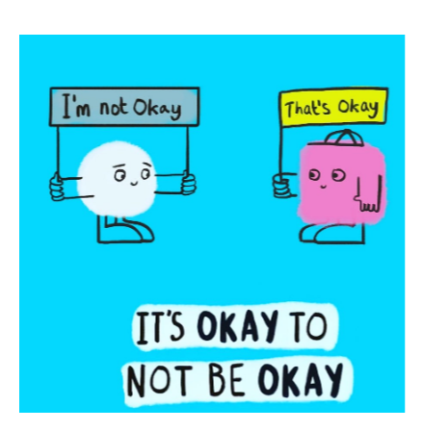

It always helps to talk to someone if we have a worry.
Remember it is normal to feel a mixture of feelings, both big and small, happy and sad, especially during these difficult and uncertain times
If you have a big feeling that is making it hard to think about anything else, to concentrate or stopping you getting to sleep, it’s time to get some help.

