Slide 1

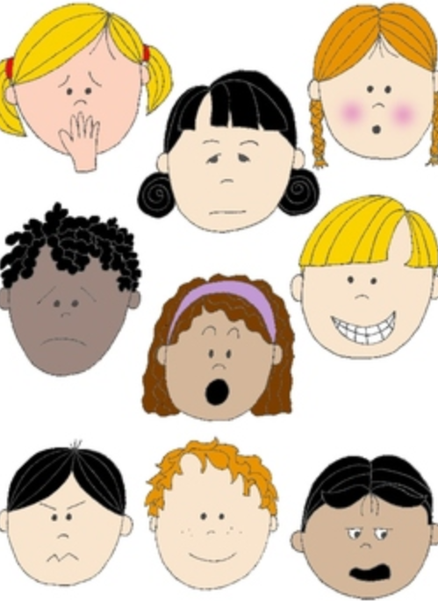
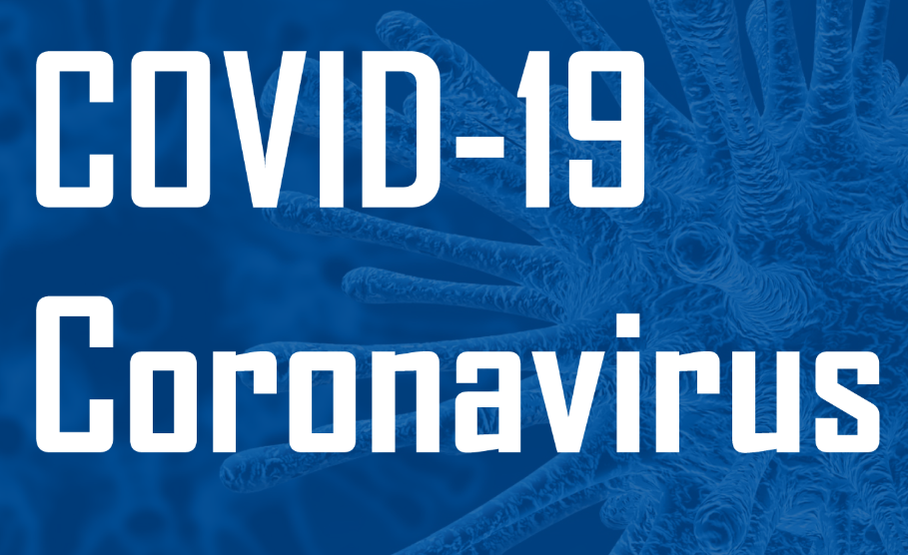
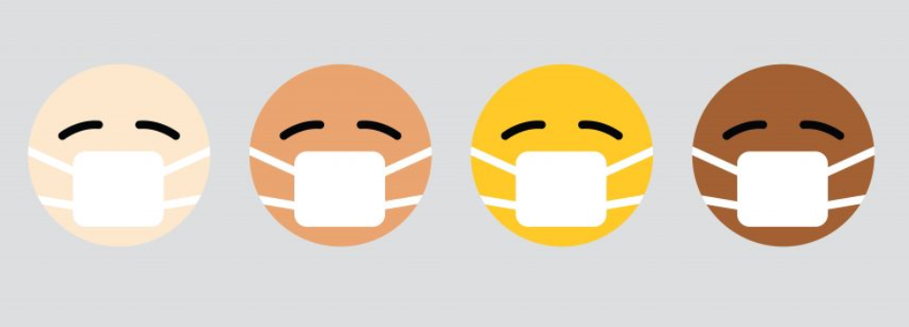
Part 4: More ways to be calm through breathing
KS1
Notes:
All film clips are hyperlinked on the image

Slide 2
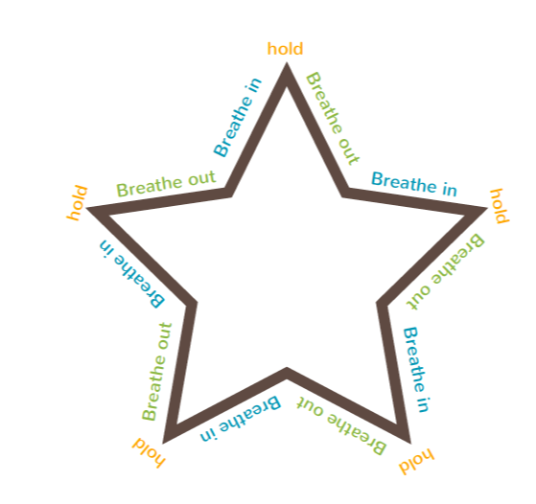
Let’s grow some breathing and focus skills to help feel calmer
Star breathing:
Start at any breath in side, hold your breath at the point, then breath out. Keep going until you’ve gone around the whole star.
Things you could say or do to help you focus and be successful:
Breathe in like you are smelling a flower, breathe out like you are blowing out birthday candles
Arms up and breathe in, arms down and breathe out
Pretend your belly is a balloon. Breathe in and make the balloon bigger, then breathe out and make the balloon shrink

Slide 3
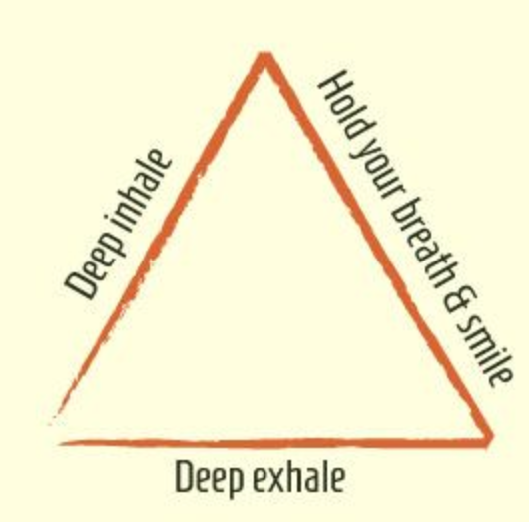
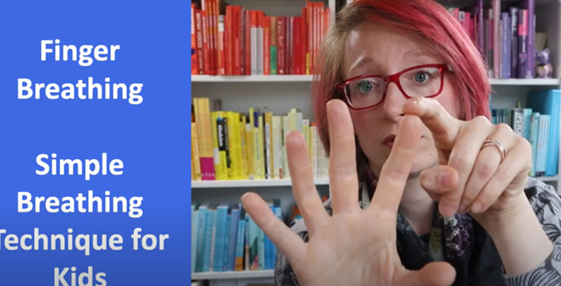
Breathing techniques
Finger Breathing
Triangle Breathing
https://www.youtube.com/watch?v=HQVZgpyVQ78
Notes:
https://www.youtube.com/watch?v=HQVZgpyVQ78

Slide 4

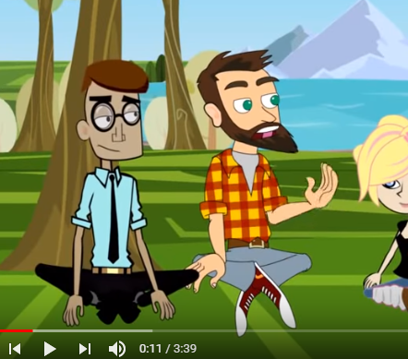
Find a breathing technique that you like and practise everyday until it becomes a healthy habit
Notes:
https://www.youtube.com/watch?v=Uxbdx-SeOOo&list=PLJdq3OzEoR1iygD0ReUDwOh7Pmn42TcKN&index=11

Slide 5
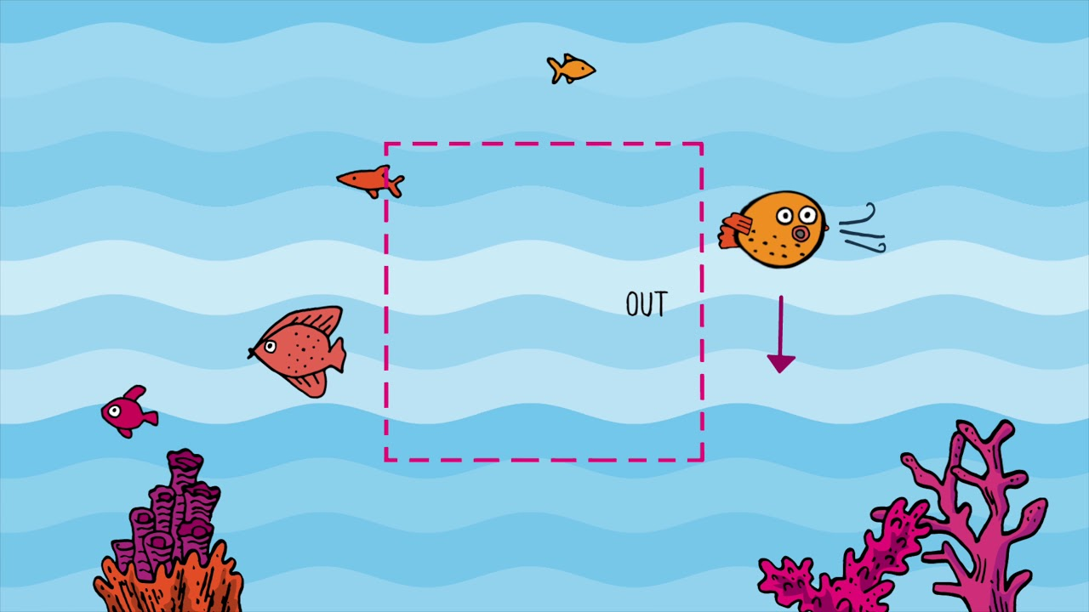
Let’s try Square Breathing together
https://www.youtube.com/watch?v=YFdZXwE6fRE

Slide 6

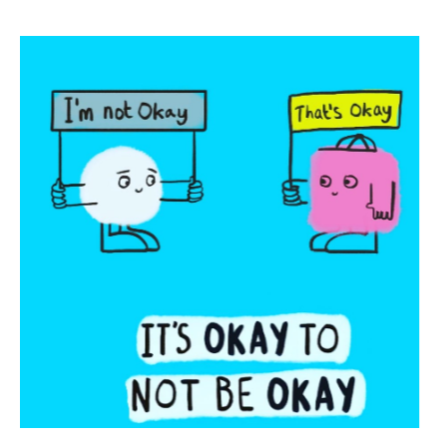

It always helps to talk to someone if we have a worry.
Remember it is normal to feel a mixture of feelings, both big and small, happy and sad, especially during these difficult and uncertain times
If you have a big feeling that is making it hard to think about anything else, to concentrate or stopping you getting to sleep, it’s time to get some help.

