Slide 1

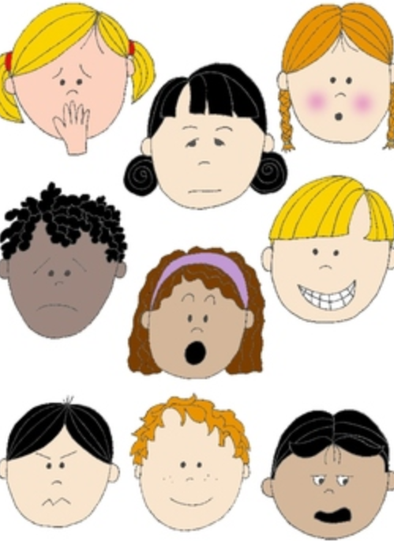

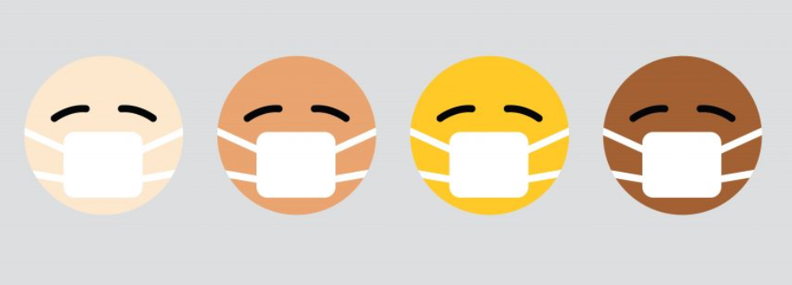
Part 5: Positive Self talk
KS1
Notes:
All film clips are hyperlinked on the image

Slide 2
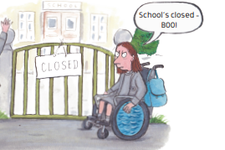
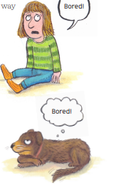
What we can and can’t control
There are some things we cannot control at the moment.
School is closed because the government have said this will help keep more people safe from the virus.
There are some things we can control like how we plan our time while we are at home.

Slide 3
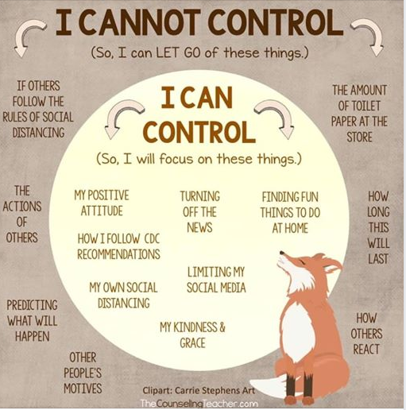
Some things we cannot change..

Slide 4

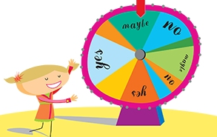
What can we change?
We can plan what home learning we do each day
We can choose what to play, read , listen to or watch
We can choose when and how to exercise each day.
We can choose which family and friends we might speak to

Slide 5
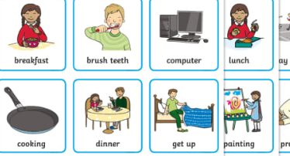


What’s on our plan for today?
Is there anything you would like to change or add?

Slide 6
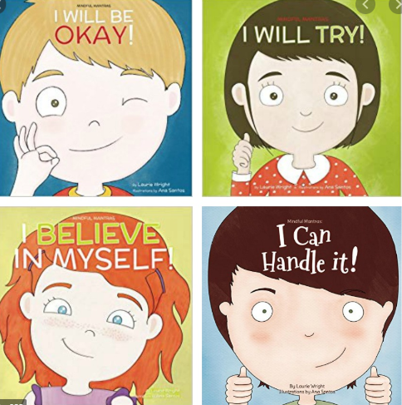
Positive self talk
When we are feeling tired, sad, bored, fed up or worried, it can be hard to do things, even things we usually find easy.
We need to be kind to ourselves.

Slide 7


Positive thinking
If something is not going well, take a break and try again later.
Remember we learn when we make mistakes.
It’s ok to ask for more help with things.

Slide 8


Positive thinking
Make a list of positive ‘I am..’ sentences.
Put it up where you can see it each day!

Slide 9
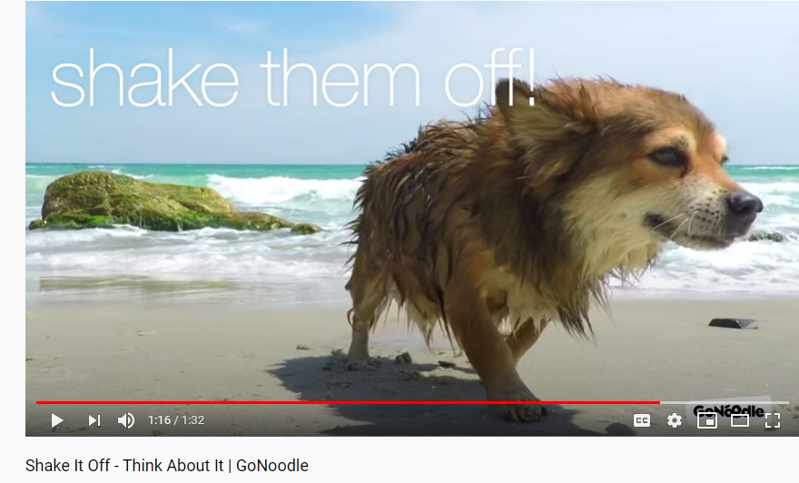
Let’s shake off any negative thoughts
https://www.youtube.com/watch?v=eSUbuM3pT4E

Slide 10

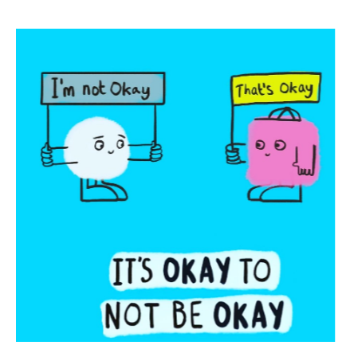

It always helps to talk to someone if we have a worry.
Remember it is normal to feel a mixture of feelings, both big and small, happy and sad, especially during these difficult and uncertain times
If you have a big feeling that is making it hard to think about anything else, to concentrate or stopping you getting to sleep, it’s time to get some help.

