Slide 1
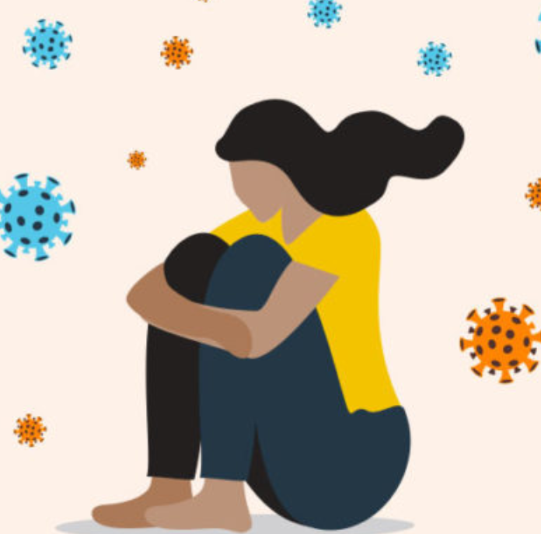
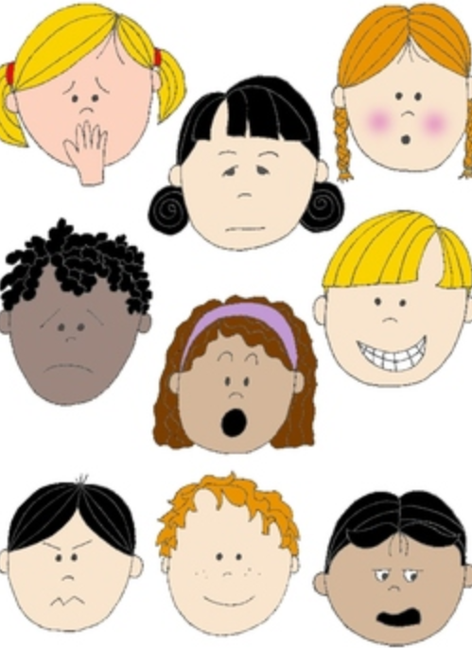

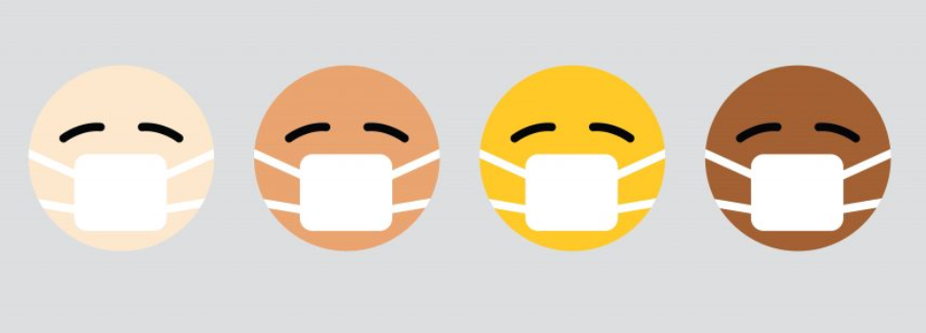
Part 6: Ways to Well being
KS1
Notes:
All film clips are hyperlinked on the image

Slide 2


Ways to boosting your well-being
What do you usually do to help yourself feel happier and more positive?
Make a list of these activities
What could you still do or adapt to do whilst in isolation?
Make a daily list or a timetable for the week to have a go at one of these activities
Check the list after worry time to help your mood

Slide 3
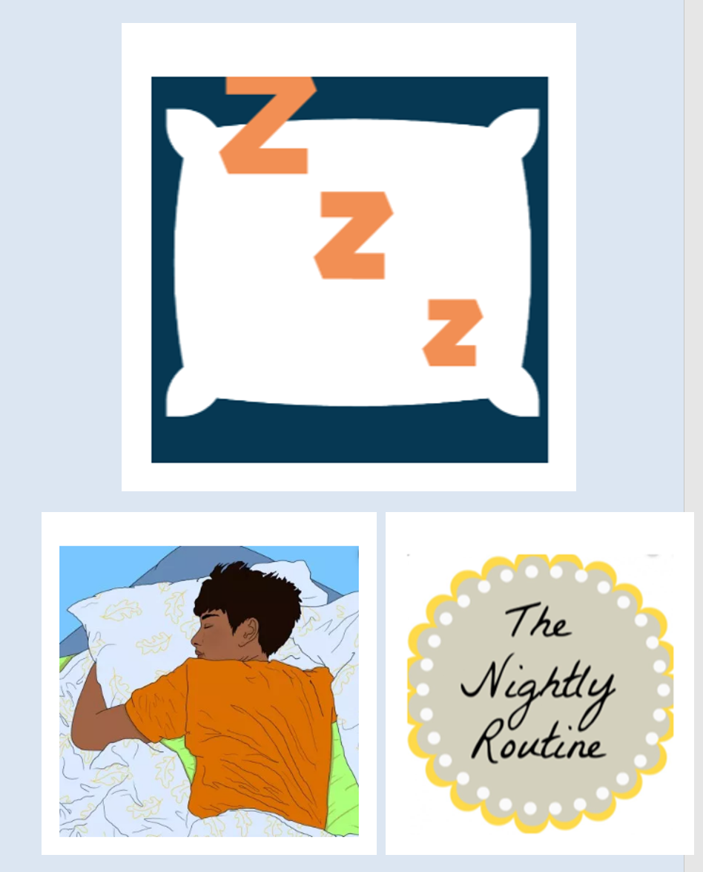
Sleep
Enough sleep helps us to feel mentally and physically well.
In these uncertain and worrying times your sleep is really important.

Slide 4
Sleep
To help you get the best night’s sleep think about the following questions:
Hungry? Or too full?
Thirsty?
Dark? Too light?
Too hot or too cold?
Funny noises?
Different grown ups looking after you?
Busy brains?
Worries…

Slide 5
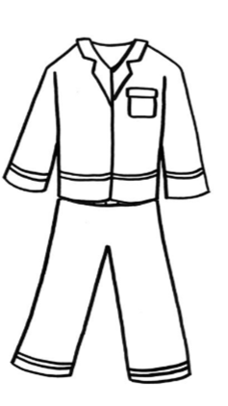
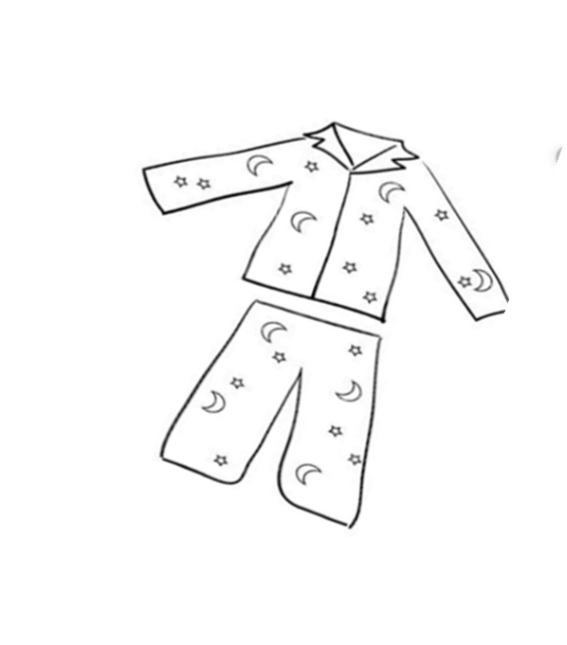
Better sleep action plan
You could make yourself a plan for better sleep and write or draw your ideas inside a pair of pyjamas.
Top tips! Try to keep to similar times for getting up and going to bed
Talk about any worries before bedtime

Slide 6
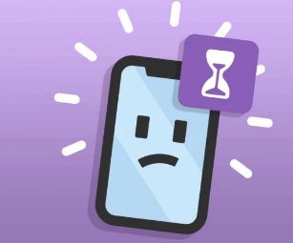
Screen time
In these challenging times, many families are we need our screens for communicating learinng and entertainment..
…but is important to stayioff screens for at least an hour before sleep.

Slide 7
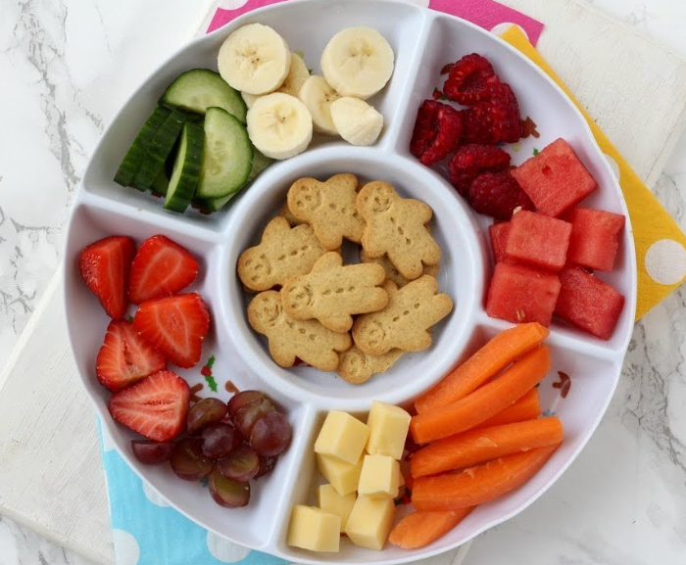
Healthy eating
It is easy in a time of stress a to rely on treats for quick ways to feel better.
Try to build a balance with fruit and vegetable snacks as well.

Slide 8
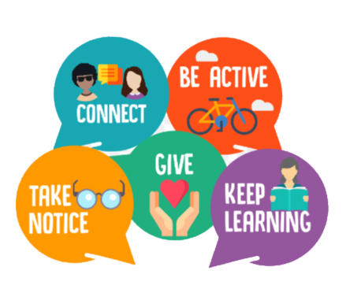
The 5 ways to well-being whilst in isolation
Scientists say that there are 5 ways that can really help our well-being and help us to feel happier.
Let’s think about ways to do this whilst we are staying in at home

Slide 9

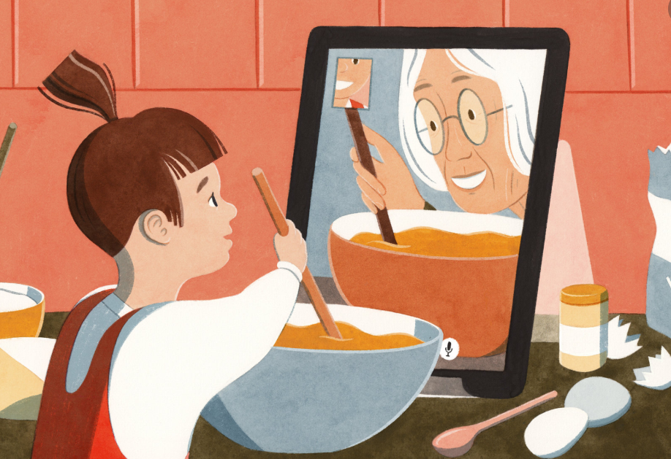

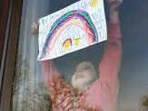
How can we stay in touch?
Try some of these ideas…
Play a game, sing a song or do some exercise together as a family watch day
Use an apps like What’s app, Skype etc to talk with a friend or family member
You could put messages and posters in your window
Write a letter to someone you haven’t seen for a while!

Slide 10
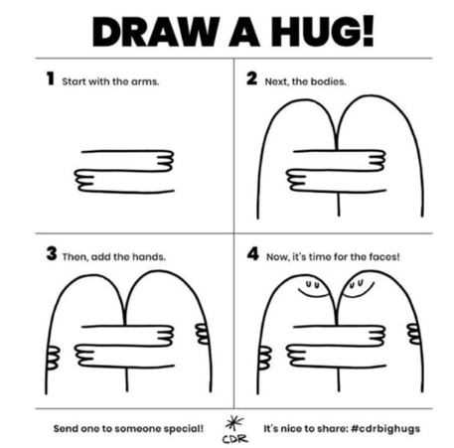

Slide 11

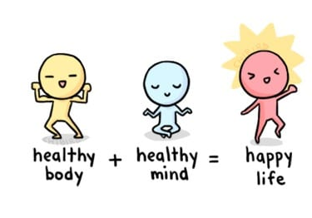
Physical exercise
Did you know?
Having a healthy active body is linked to having a healthy, happy mind?
Scientists have found out that being physically active causes chemical changes in a person’s brain which can positively change someone’s mood and help a person feel happier.

Slide 12
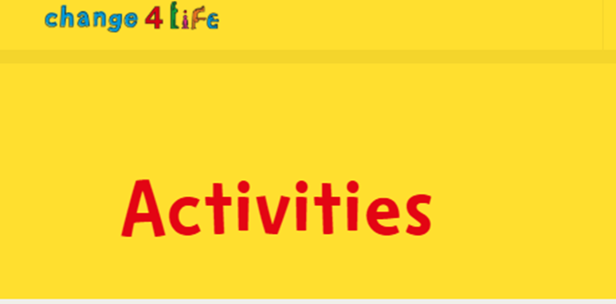
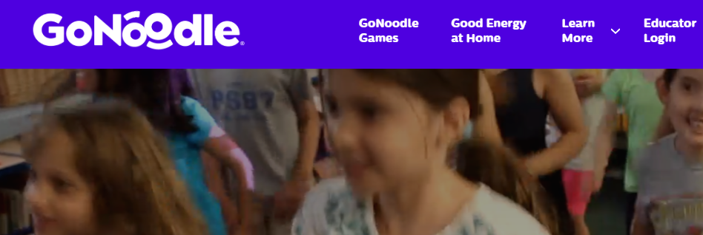
Try some of these!
Get active and shake off the tension!
Try a Go Noodle exercise
What other simple get active ideas could you do at home?
https://www.nhs.uk/change4life/activities
https://www.gonoodle.com/

Slide 13
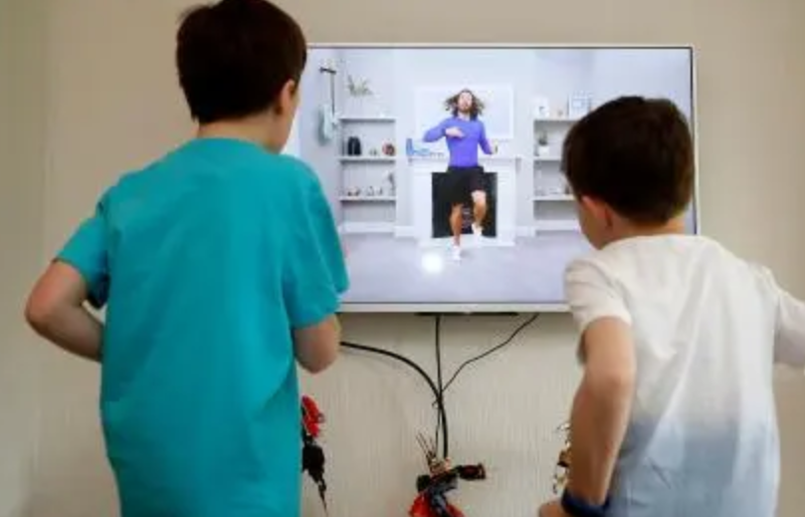

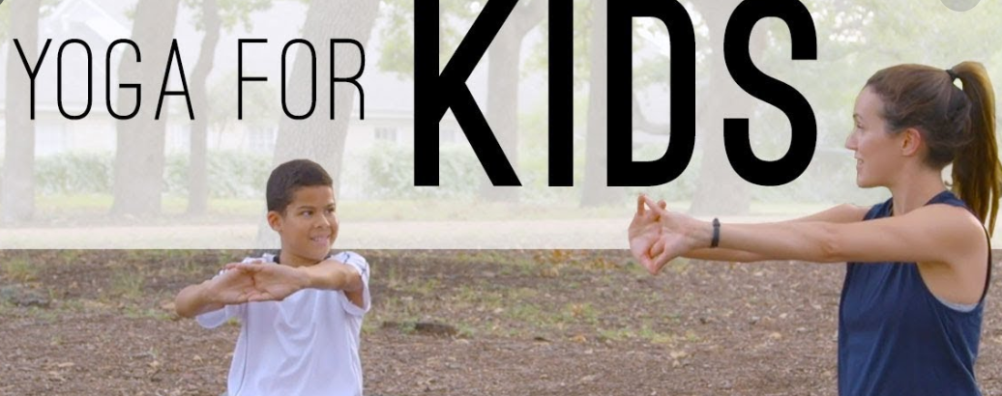
Keeping active!
Try out different things and find one you all enjoy to do each day
Or just stick some music on and dance!

Slide 14

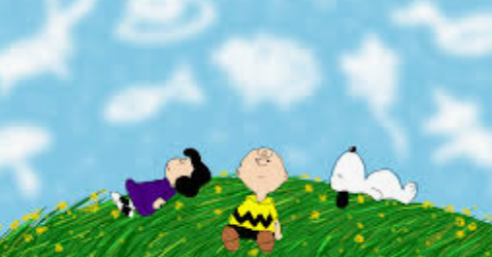

Take notice
You could try some of these ideas:
Try noticing what is out side in your garden or (safely) through a window.
Try cloud-gazing or listening to bird song.
Plant a seed (from an apple, orange or bean) and watch how it grows.

Slide 15
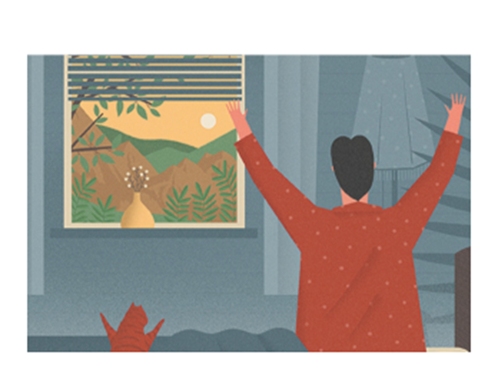

Taking notice of what we are grateful for
Scientists have found out that being grateful activates parts of our brain and helps us to boost our well-being and helps us to fell happier

Slide 16
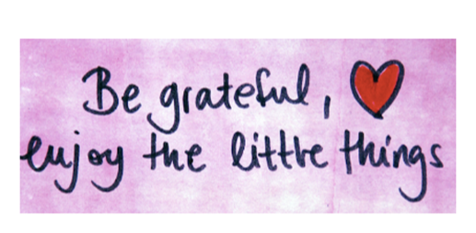
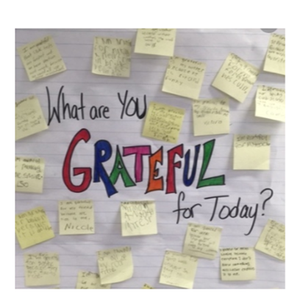
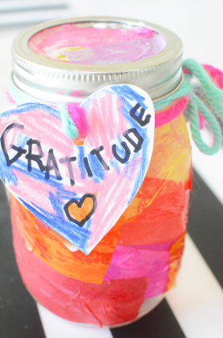
What are you and your family grateful for?
You could notice what you are grateful for and make a family gratitude jar and write down some positive things that have happened each day at the same time.

Slide 17
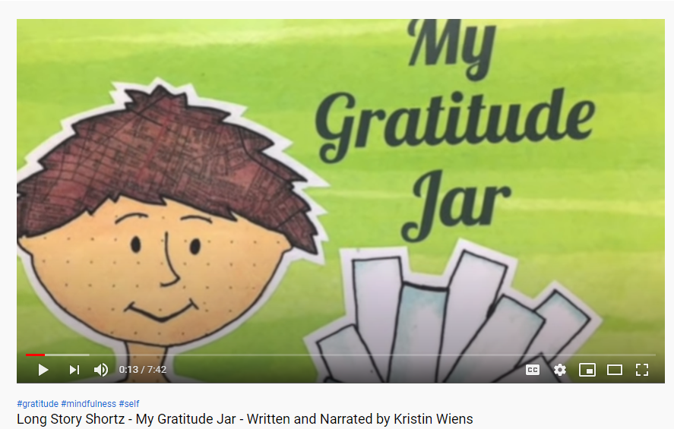
Listen to this story of the Gratitude Jar!
https://www.youtube.com/watch?v=6TYvJh5Cwvw

Slide 18



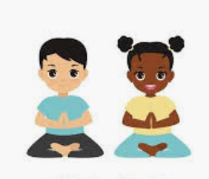
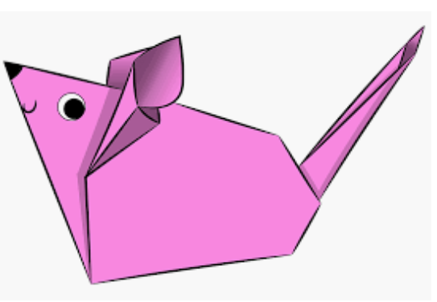
Learning something new!
If you feel like it you could learn something new.
Learning can involve any manner of subjects, not just what you have to do in school. Set a goal. Learn something new. Try something fun.
It could be yoga, some words in a new language, a new game, a card trick, paper folding !

Slide 19



Being kind makes everyone feel better!
Be a bucket filler!
See what you can do for someone else today

Slide 20

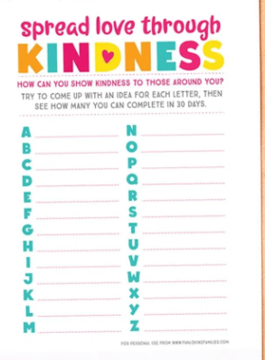
An Alphabet of kindness
Can you think of something for each letter?
Then pick one out to do each day!

Slide 21
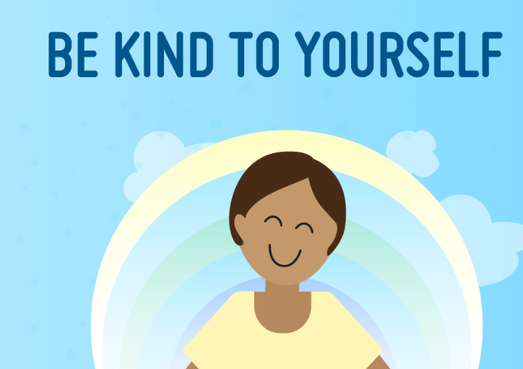
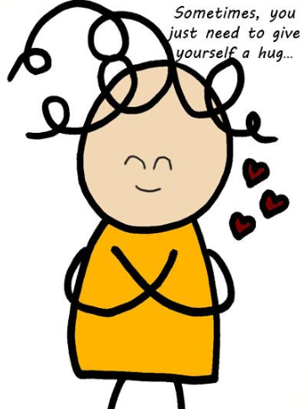
Being extra kind to ourselves
Taking care of ourselves is very important for everyone at this time.
Be kind to yourself – this is a difficult time and things are very different from usual
Be kind to others – they might be struggling with worries– can you help them sometimes?
Being kind makes us feel good.

Slide 22

Let’s end by taking notice of what makes you… amazing!
Notes:
https://app.gonoodle.com/activities/celebrate-the-little-things?s=category&t=Breathe&sid=40

Slide 23
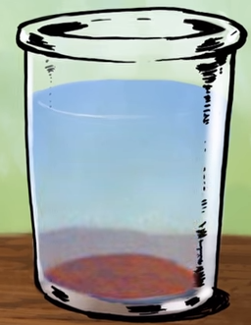
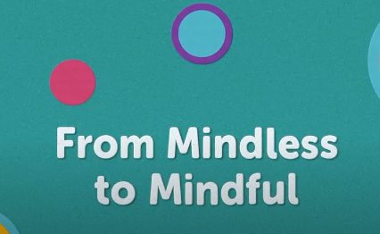
Find out some more about mindfulness
https://www.youtube.com/watch?v=QNmMH6tqiMc
https://app.gonoodle.com/activities/from-mindless-to-mindful?s=Search&t=from mindless to mindful
Notes:
https://www.youtube.com/watch?v=QNmMH6tqiMc
https://app.gonoodle.com/activities/from-mindless-to-mindful?s=Search&t=from mindless to mindful

Slide 24
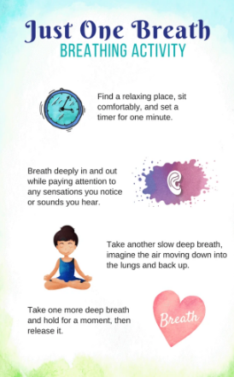
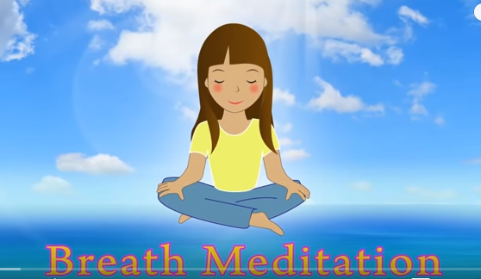
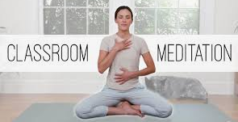
Try some of these activities!
https://www.youtube.com/watch?v=CvF9AEe-ozc 😊 🌺 Breath Meditation for Kids 😊 ❤️‍ Mindfulness for Kids
https://www.youtube.com/watch?v=vYQy8-7Ut1E meditation 6 mins
Notes:
https://www.youtube.com/watch?v=CvF9AEe-ozc 😊 🌺 Breath Meditation for Kids 😊 ❤️‍ Mindfulness for Kids
https://www.youtube.com/watch?v=vYQy8-7Ut1E meditation 6 mins

Slide 25

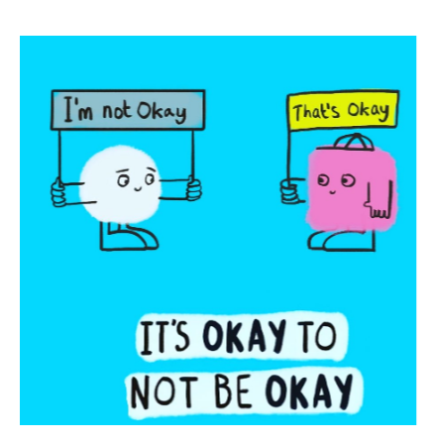

It always helps to talk to someone if we have a worry.
Remember it is normal to feel a mixture of feelings, both big and small, happy and sad, especially during these difficult and uncertain times
If you have a big feeling that is making it hard to think about anything else, to concentrate or stopping you getting to sleep, it’s time to get some help.

