Slide 1
Notes for schools
This PPT is intended to support young people with worries and fears related to Covid-19 including the death of a loved one or themselves
This PPT can be used in school with students or potentially sent home for a home learning task
Please adapt and make changes to make this in line with school values, policy and practice and share any resources you develop with pshe@brighton-hove.gov.uk

Slide 2

Living with uncertainty
It’s hard, but we can do it.

Slide 3
To start with…
Write down or draw all the feelings you have experienced in the last week
Some people think writing or drawing can help us to process what is happening and difficult feelings. If it helps you then ‘journalling’, keeping a diary, song writing etc. be something you do more of at this time.

Slide 4
What feelings did you identify?
Fear
Anger
Boredom
Frustration
Loneliness
Anxiety
Sadness
Peacefulness
Amusement
Calmness
Resignation
Love
Acceptance
Etc.

Slide 5
What did you notice?
Was there a mixture of feelings?
Do these feelings come in waves and so come and go?
Are some stronger than others?
Do you get some feelings more strongly depending what you are doing? For example watching the news? Playing a game online? Talking to a friend?

Slide 6

What is helpful to know about feelings?
Feelings are normal
Feelings serve a useful purpose – they might be telling us something we need to know - they can be a message
Feelings come and they go
We can do things to help us increase positive emotions and to manage the more challenging ones

Slide 7
Let’s start with the facts
Go to the NHS website and find out who is most at risk of death from Covid-19.
https://www.nhs.uk/conditions/coronavirus-covid-19/
The vast majority of people even if they get the virus will survive.

Slide 8
Accepting uncertainty
Perhaps you or someone close to you is in the high risk group.
This is hard, very hard.
We are living in uncertain times, but remember that worrying now does not change what might happen in the future.
Let’s think about what else we can do to manage anxiety, worry and fear in the here and now.

Slide 9
More facts – watch one of these films about Flight, Fight and Freeze
Anxiety explained for kids
https://www.youtube.com/watch?v=FfSbWc3O_5M
Anxiety explained for teens
https://www.youtube.com/watch?v=rpolpKTWrp4
Fight, Flight Freeze response
https://www.youtube.com/watch?v=jEHwB1PG_-Q
These films weren’t made for the current situation, but they explain what is going on in our bodies when we feel worry and anxiety.

Slide 10
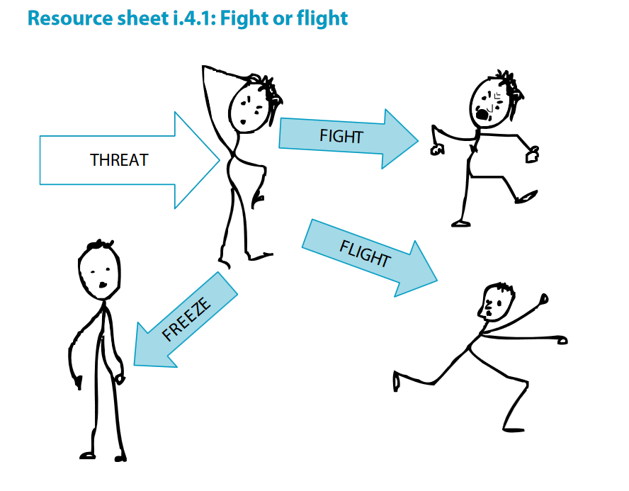
How do you respond to a ‘threat’ (a fear or a worry)? Perhaps you do all 3?
Now you know what is going on in your body can you do things to interrupt this response and calm yourself?

Slide 11
So what can we do?
1. Build on what already works
List all the things you do that make you feel good and lift or change your mood or feelings?
Which of these things can you still do during lockdown and social distancing?
How can you build these things into your day?
Perhaps write yourself a time table for the week showing when you do will do these things or versions of it?

Slide 12
2. Worry time
This is a technique that might be helpful
Set aside a time once a day which is when you will worry
Then each time you feel a worry or a fear, acknowledge it ‘There is the worry I have that grandma might die’ and then say to yourself ‘I will worry about that at X O’clock’
At worry time - give yourself 10-15 minutes to worry about all the things you have to worry about
At the end of that time go and do something else, perhaps one of the things that makes you feel more positive.

Slide 13
3. Be aware of what you can and can’t control
What I can’t control
What I can control
Draw two circles
Around the outside draw or write all the things you can’t control in the current situation
In the middle draw or write all the things you do have control over.

Slide 14
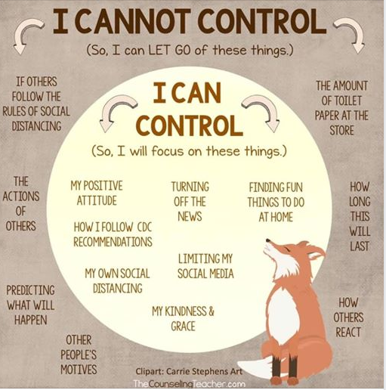
4. Positive self talk
What things can you say to yourself that might help? For example:
I can’t do anything about that, I am going to let it go and focus on X
This feeling / thought will pass
I am strong, I’ve got this
Take it one day / one hour / one minute it a time
This is tough but I am grateful because…
Maybe some good will come out of this…

Slide 15

5. Be kind
Be kind to yourself – this is a difficult time for us all, it’s alright to struggle some days, but do tell someone if every day is very difficult
Be kind to others – they are struggling with their worries and fears too – can you help them sometimes?
Being kind makes us feel good

Slide 16
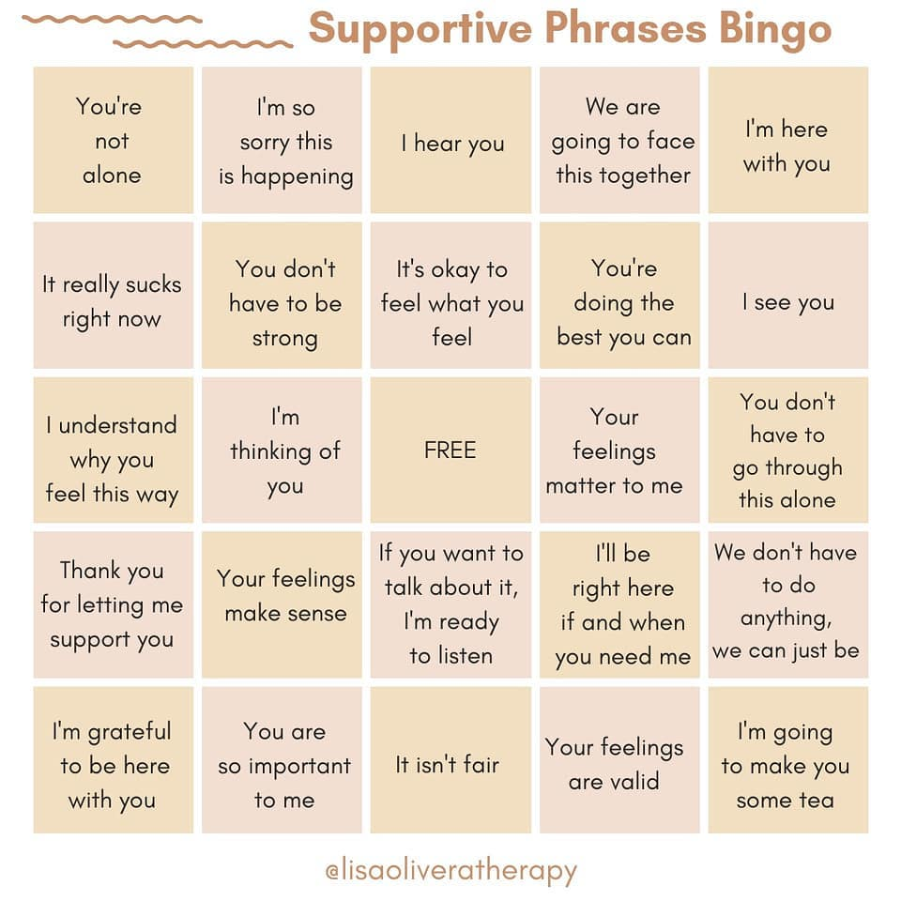
6. Supporting a friend or family member – how many can you use in a week?

Slide 17
7. Put more tools (or coping strategies) in your tool box
Advice from Young Minds
https://youngminds.org.uk/blog/what-to-do-if-you-re-anxious-about-coronavirus/
Fiveways to Wellbeing
https://www.nhs.uk/conditions/stress-anxiety-depression/improve-mental-wellbeing/
Ideas from Dr Pooky on YouTube
https://www.youtube.com/channel/UCouKr8JeXinK6v_nf5dWA1A

Slide 18
8. Finally
We could be living like this for a while, but time will pass quicker than we might be worried it will
If possible try and use the time to learn something new, get fit with online help, build relationships differently with family and friends
If you or a friend are struggling ask for help from those around you, from school or from national or local services.
https://findgetgive.com/services?loc=brighton-hove
https://youngminds.org.uk/

