Slide 1

DOWSON’S APPROACH TO PHONICS AND HOW TO SUPPORT YOUR CHILD AT HOME

Slide 2

How do we teach phonics at Dowson?
We use the ‘Read Write Inc.’ phonics scheme to teach phonics.
It is a systematic and discrete approach to the teaching of phonics.
It relies on repetition and a specified format in the teaching of sounds.
Sounds (phonemes) and associated graphemes (what the sound looks like) are taught in a specified order. This order is listed on the next page.
Phonics is taught every day in Reception and Year 1.
Children are grouped in classes and sometimes some children will work in smaller groups .

Slide 3
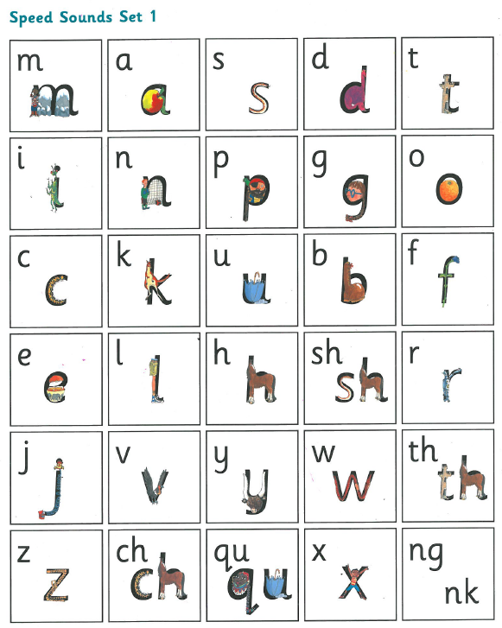
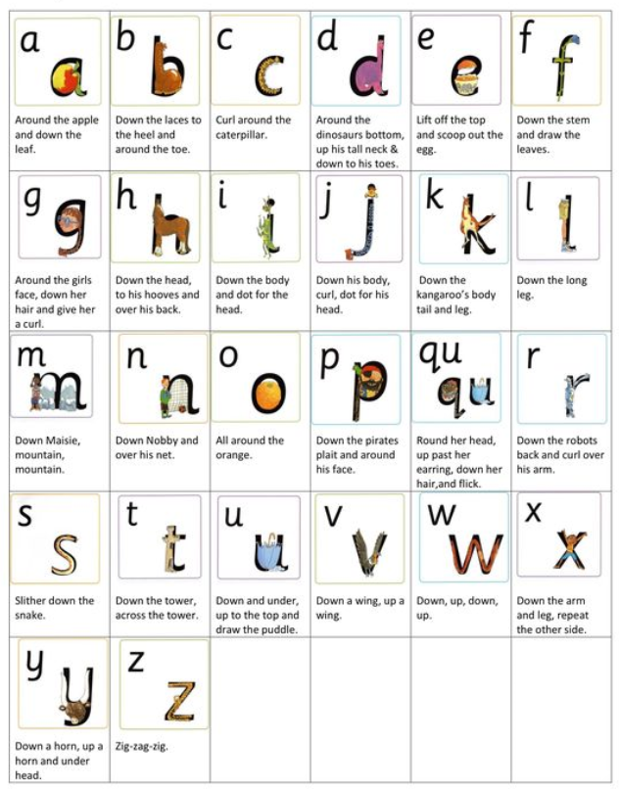
Set 1 sounds
Rhymes to support letter formation.
Set 1 sounds have a ‘ditty’ to help the children remember how to write the letter using the correct letter formation. Please use these to support your child when they are writing at home. It is crucial that they form good habits in handwriting now, so they are embedded for the future.

Slide 4
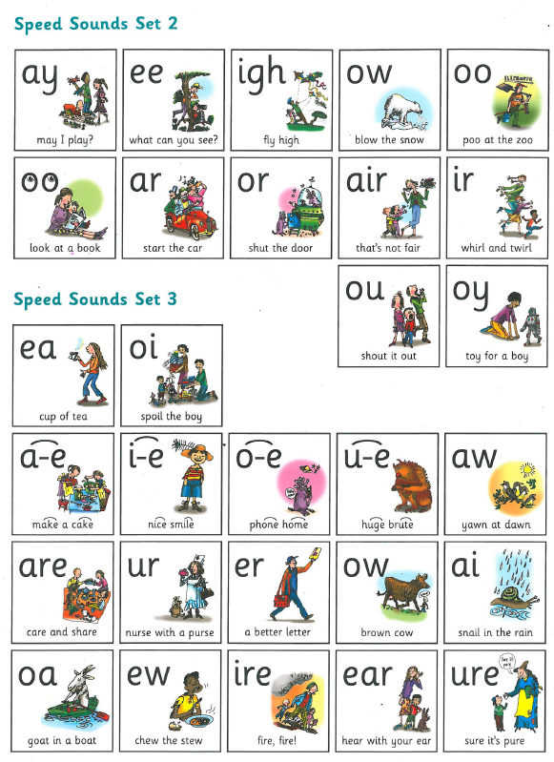
Set 2 sounds
Set 3 sounds

Slide 5
Book Progression:
Year group | Half termly milestones | Read Write Inc book band
Nursery | Spring term | Begin teaching set 1 speed sounds
Reception | Autumn half term | Begin to sound blend with taught sounds
 | End of Autumn term | Ditty papers
 | Spring half term | Red Ditty Books
 | End of Spring term | Red Ditty Books
 | Summer half term | Green books (Begin to teach set 2 sounds)
 | End of Summer term | Green / Purple books
Year 1 | End of Autumn term | Pink/ Orange books (know set 2 and begin teaching set 3)
 | End of Spring term | Yellow books
 | End of Summer term | Blue books

Slide 6
In Nursery, children will focus on phase one of Letters and Sounds, incorporating the following aspects…
Environmental Sounds.
Instrumental sounds
Body Percussion
Rhythm and Rhyme
Alliteration
Voice Sounds
Oral segmenting and blending
In the Spring term children in Nursery will begin to learn set 1 sounds in a phonics session

Slide 7
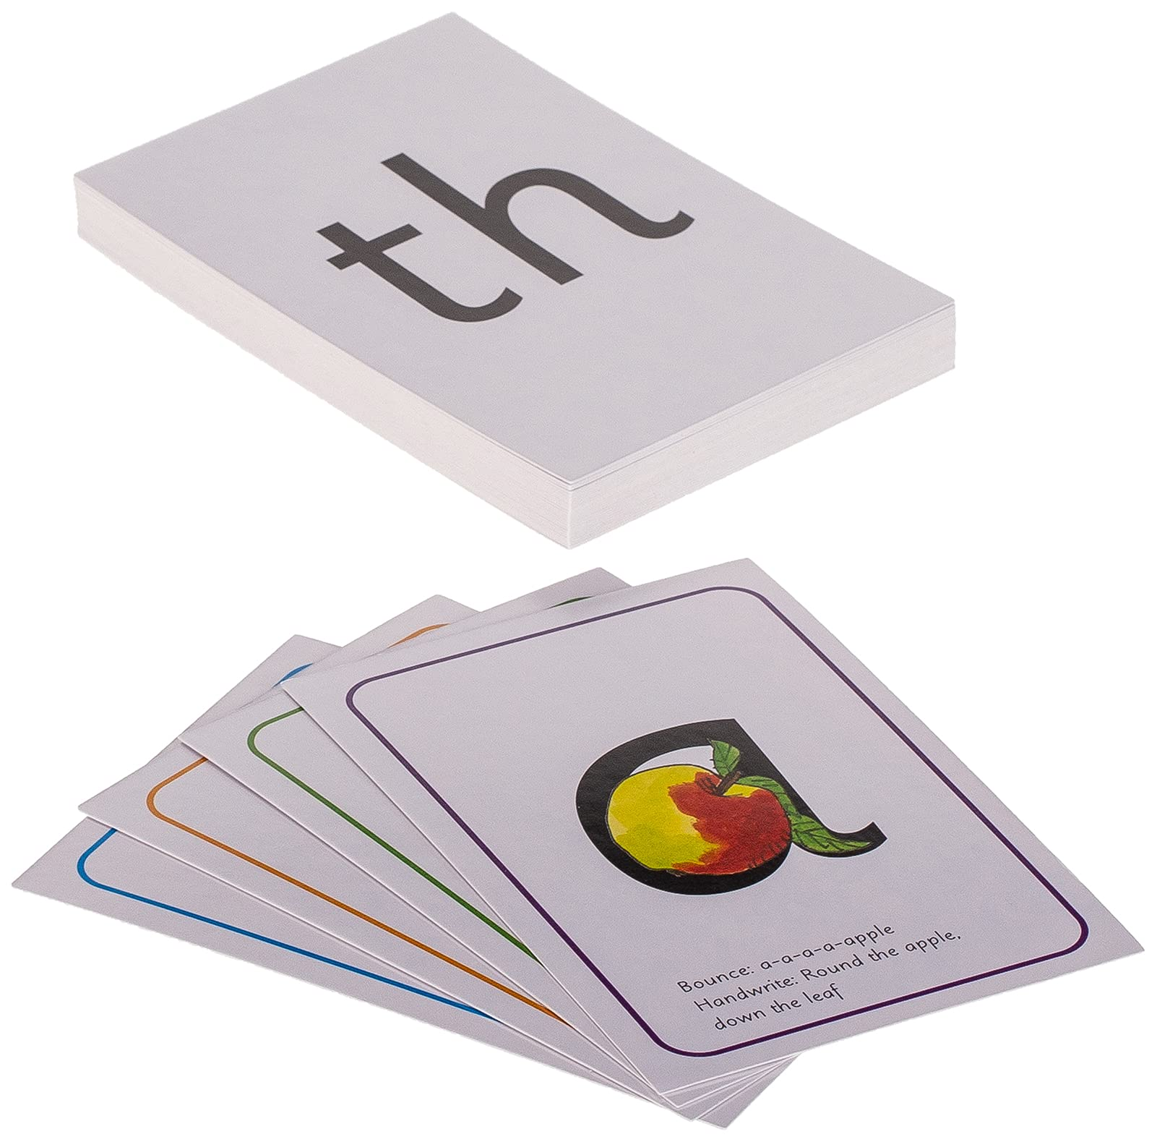
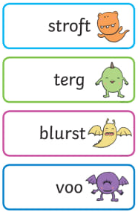
Speed sounds session
Every RWI phonics session begins with a speed sounds session. This is where sounds are revisited and new sounds are taught. During this session children will be taught how to blend sounds to read words.
Speed Sounds structure
Review speed sounds taught
Teach new sound
Letter formation
Green words
Red words
Alien words
Set 2 and 3 – spell with Fred fingers

Slide 8




Ditty lesson structure
The structure of a lesson when Ditties (photocopiable) and red books are introduced:
Every phonics session starts with:
Speed sounds session
Story green words
Story Red words
Day 1- Ditty introduction and first read
Day 2- second read, questions to talk about and complete a sentence
Day 3- Hold a sentence and handwriting

Slide 9




Green, Purple, Pink and Orange storybooks lesson structures
Every phonics session starts with:
Speed sounds session including spelling
Story green words
Story red words
Day 1- introduce the book, key vocabulary and first read with oral comprehension questions.
Day 2- Read the story and Hold a sentence
Day 3- Read the story and Hold a sentence and corrections
Day 4- Planning ideas and SPAG ready for writing
Day 5- Writing activity linked to book

Slide 10




Yellow and Blue storybooks lesson structures
Every phonics session starts with:
Speed sounds session including spelling
Story green words
Story red words
Week 1-
Day 1- Read RWI book followed by reading activity
Day 2- Read RWI book followed by reading activity
Day 3- ERIC time and handwriting
Day 4- Read RWI book followed by reading activity
Day 5- Read RWI book followed by reading activity
Week 2- VIPERs week
Day 1- RWI book and introduce vocab and predicting
Day 2- RWI book and oral and written retrieval
Day 3- RWI read and handwriting
Day 4- RWI book and oral inference
Day 5- RWI book and written inference

Slide 11
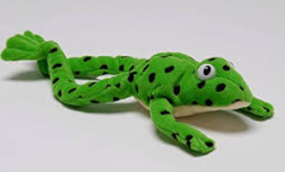
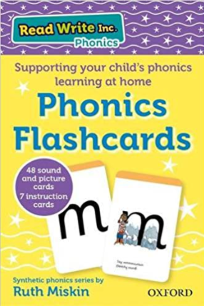


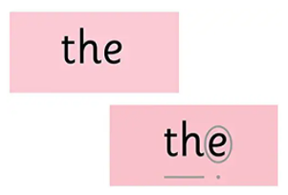
Resources to support the teaching of phonics.
Fred the Frog
Fred only speaks in sounds. He loves to hear the children segmenting and blending words.
Sound Cards
We use sound cards as we introduce a new phoneme and love playing ‘get back in the pack’, where you choose a phoneme, hide it in the pack, turn and say each phoneme in question, then say ‘get back in the pack’ when the focus phoneme is found. These cards are for sale on amazon and you could use them to play games and support your child’s learning.
Red Words
These are tricky words, because some parts of the word cannot be sound out. The tricky part is circled, as you can see in the word ‘the’.
Green Cards
These are introduced as soon as the children have learned the phonemes the words contain so we can practice segmenting words to read them.

Slide 12
Behaviour and expectations
Pace
Stop signal (hand)
Turn to your partner (TTYP)
123 signals to the tables
Participation
All to participate in ‘my turn your turn’ MTYT
Sit spot light children where they can be accessed easily.
Select partners to work together
Teacher move around, don’t be a partner to an odd number
Praise phrases
FANtastic!
Hip, hip, horay!
Whit whoo get you!
Firework!
1,2,3 - Well done me!
Instructions
Magnet eyes
MTYT – My turn your turn
Fred talk (sound out the word and blend)
Fred in your head (sound blend in your head)
Fred fingers
1,2,3, signal

Slide 13
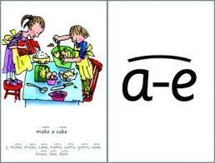
Phonic terms your child will learn at school
Fred fingers- used to count phonemes in words.
Grapheme: What the phoneme looks like when it is written down.
Phoneme: An individual unit of sound that can be represented by one or more letters e.g. ‘a’ ‘ee’ ‘th’ ‘igh’
Special friends- letters that work together to make one sound.
Diagraph: Two letters that make one sound when read. E.g. ‘ar’ ‘th’ ‘ch’ ‘ay’
Split Digraph- a-e, e-e, i-e, o-e, u-e when the e on the end of a word changes the vowel phoneme from it’s sound to it’s name in the alphabet. E.g in the words cake, spike, tune.
Trigraph: Three letters that make one sound. E.g. ‘igh’ ‘air’
CVC: Stands for consonant, vowel, consonant. E.g. cat, dog, man
Segmenting is breaking up a word into it’s sounds. t-o-p
Blending is putting the sounds together to read a word. t-o-p top
Red words: Words that cannot easily be decoded. E.g. the, was, where

Slide 14

Pronouncing Phonemes
We teach the sound a letter makes before it’s letter name. These sounds (phonemes) are pronounced in particular ways to allow children to blend and segment words more easily. This YouTube video will support you in how to use the correct pronunciation when working with your child at home.
https://www.youtube.com/watch?v=TkXcabDUg7Q
Speech support
If your child finds it difficult to pronounce different phonemes, it may help them to use a mirror and look at the shape their lips make.
Blowing bubbles and windmills can help in making our mouths more flexible.

Slide 15
Ways to help with reading at home
Listen to your child read their RWI home reading book each night.
Develop your child’s love of reading and books by sharing them regularly. In books that rhyme, stop and let them complete the sentence/ rhyming word.
Use ‘Fred talk’ to segment and blend words. Use ‘Fred in your head’ if your child is becoming a more fluent reader.
Sing nursery rhymes and songs and identify the rhyming words.
Ask questions (what, when, who, how, where) to develop children’s understanding of texts.
Re-call the main events of stories. Maybe they could re-enact them with home made puppets or soft toys or you could make a story box with your child to explore and develop the story further.
Model to children how simple words can be segmented into sounds and blended together to make words.
Explain the meanings of unknown words you come across in books.
Encourage children to tell their own stories using language they have heard in books, e.g. Once upon a time, One day, They all lived happily ever after etc.
Before turning over predict what might happen next and talk about why.

Slide 16
Useful links
https://home.oxfordowl.co.uk/reading/reading-schemes-oxford-levels/read-write-inc-phonics-guide/
https://www.ruthmiskin.com/en/parents-copy-2/
https://www.oxfordowl.co.uk/login?active-tab=students

