Slide 1
Drove Early Years
2024-2025
Independence and Physical Development Workshop

Slide 2

Class Teachers
Miss Coleman & Mrs Revis
Class Teacher

Slide 3
Why is independence important?
Independence plays an important role in children's learning. Having independence allows children the opportunity to makes decisions and take responsibility. This is a very important life skill for children to learn in order to cope with situation in their adult life.
Having independence allows children to have a sense of pride and achievement. Children enjoy experimenting and exploring as this is how they learn. Being able to complete a task or activity that they have been working on gives the children a sense of accomplishment and it is vital that we allow children to have those experiences.

Slide 4
Why is independence important?
During the exploratory phase of your child’s development, they will get muddy and they may have a few bumps along the way, however this allows the children to develop their risk and challenge. Along with independence they will develop their problem solving skills as they can take a situation and re-evaluate and try it again. This is also known as “Thinking Critically”

Slide 5
Why is independence important?
It is important that the children are given the opportunities to play, explore and problem solve as this is what makes a child. They are inquisitive and enjoy trying things and having ago as this is how they learn best.

Slide 6
What we do at school to promote independence
During Terms 1 and 2 we will support the children in their daily routine, however we will then begin to allow the children opportunity to do things for themselves:
Putting their coats and bags on their pegs
Getting changed for PE
Finding their writing name card
Cutting up their food at lunchtimes

Slide 7
What we do at school to promote independence
In Term 3 to Term 6, we will encourage the children to:
Get undress/dressed independently for PE
Putting their coats on independently
Completing the morning routine without adult support
Cutting up their food and feeding themselves
Getting out their homework books when asked
Following instructions without adult support
Using the toilet without support

Slide 8
What we do at school to promote independence
We understand that some children will need a little helping hand and we do provide support when needed. We will show the children and guide them on how to complete a certain task.

Slide 9
How can you help at home?
As you are the child’s 1st educators, it is important that you also give your child the independence they need when at home. We understand that things take time and you have busy lives, however if the children are not given the opportunities, they will not be able to learn the skills in order to complete a task efficiently.

Slide 10
How can you help at home?
Ways you can help at home:
Allowing your child to get dressed independently
Getting your child to feed themselves. We do not feed them at school, so this is an important skill for them to learn.
Cutting up their own food
Getting things ready/helping themselves- Can they help you cook the dinner? Set the table? Get themselves a drink? Getting a snack?

Slide 11
Physical Development

Slide 12
Importance of physical activity
Develops their moving and handling skills
Helps to develop their Fine and Gross motor skills
Not only strengthens muscles but helps the development of the heart, lungs and brain.
Physical development also develops shoulder stability, hand strength, and coordination – which is important when it comes to holding a pencil.

Slide 13
Fine and gross motor skills
Large muscle (Gross) control, develops before fine motor control. The children need lots of opportunities to make big movements with their arms before they can develop the fine motor control needed for holding a pencil.
Small muscle (fine) control is important when the children begin to write. It is the strength they have in their hands, which helps them to hold a pencil. It is also important for their hand eye coordination.

Slide 14
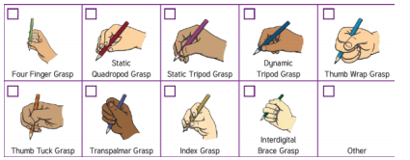
Pencil grips
Each child will go through many different pencil grips. Do not force them to hold the pencil in a certain way.
If they can form letters correctly, that is ok with us.
They will find they own way of holding a pencil.

Slide 15
Wakey shaky and fine motor time
Every morning we have ‘wakey shaky’ time. This allows the children to get their muscle moving and brain working ready for the day by taking part in dances and stretching the big muscles.
Every morning we have fine motor time: threading, tweezers, cutting, colouring and manipulating materials.

Slide 16
Gross Motor time
The children have many opportunities to develop their gross motor skills:
Physical Education (PE)
Outside time
- Climbing frame
- Ball Games - balancing
- Chalking (using arms and shoulders)

Slide 17
Physical education
We have PE every Thursday.
Please ensure their PE kits are in school:
- White t-shirt
- Black shorts/long bottoms
- Trainers/black daps
- Jumper (for when it gets cold)

Slide 18
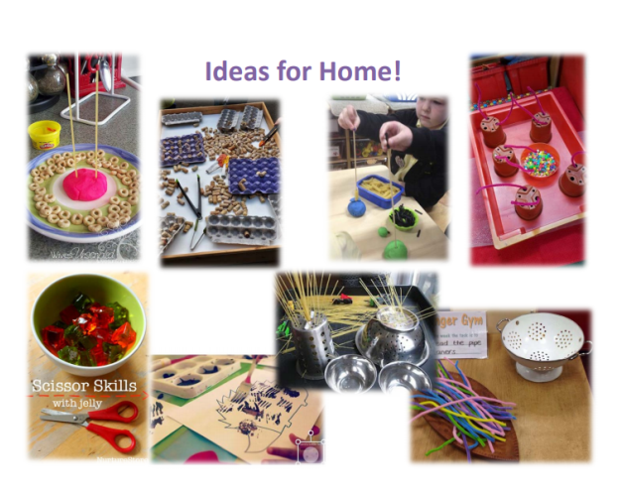

Slide 19
How you can help at home
Walking (children are old enough now to not need buggies).
Trips to the park
Balancing activities
Jobs around the house- cleaning, washing up
Allowing them to get changed independently.

