Slide 1
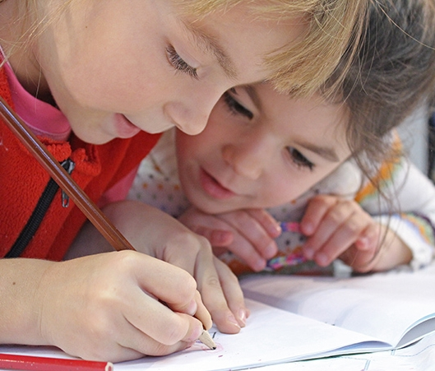
Welcome to Nursery!
September 2026
Drove Nursery Welcome Meeting

Slide 2
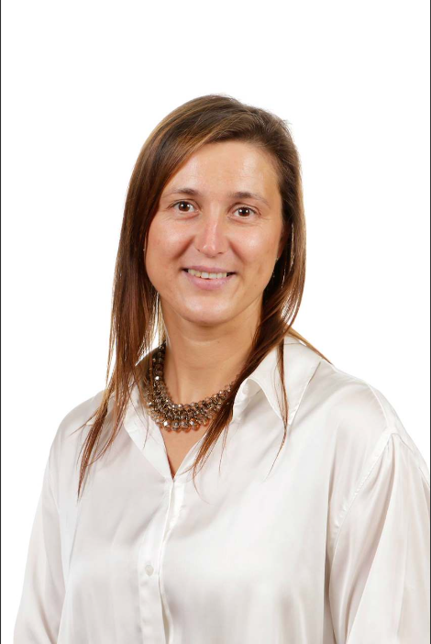
Green Nursery
Staff Members
Class Teacher: Miss Lazecka

Slide 3
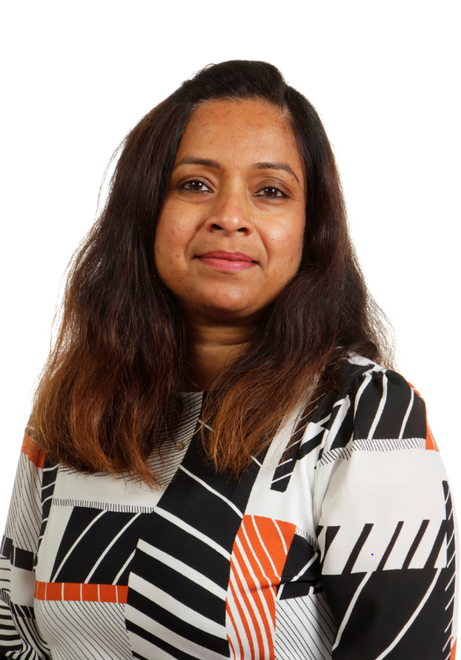
Yellow Nursery
Staff Members
Class Teacher:
Mrs Fernandes

Slide 4
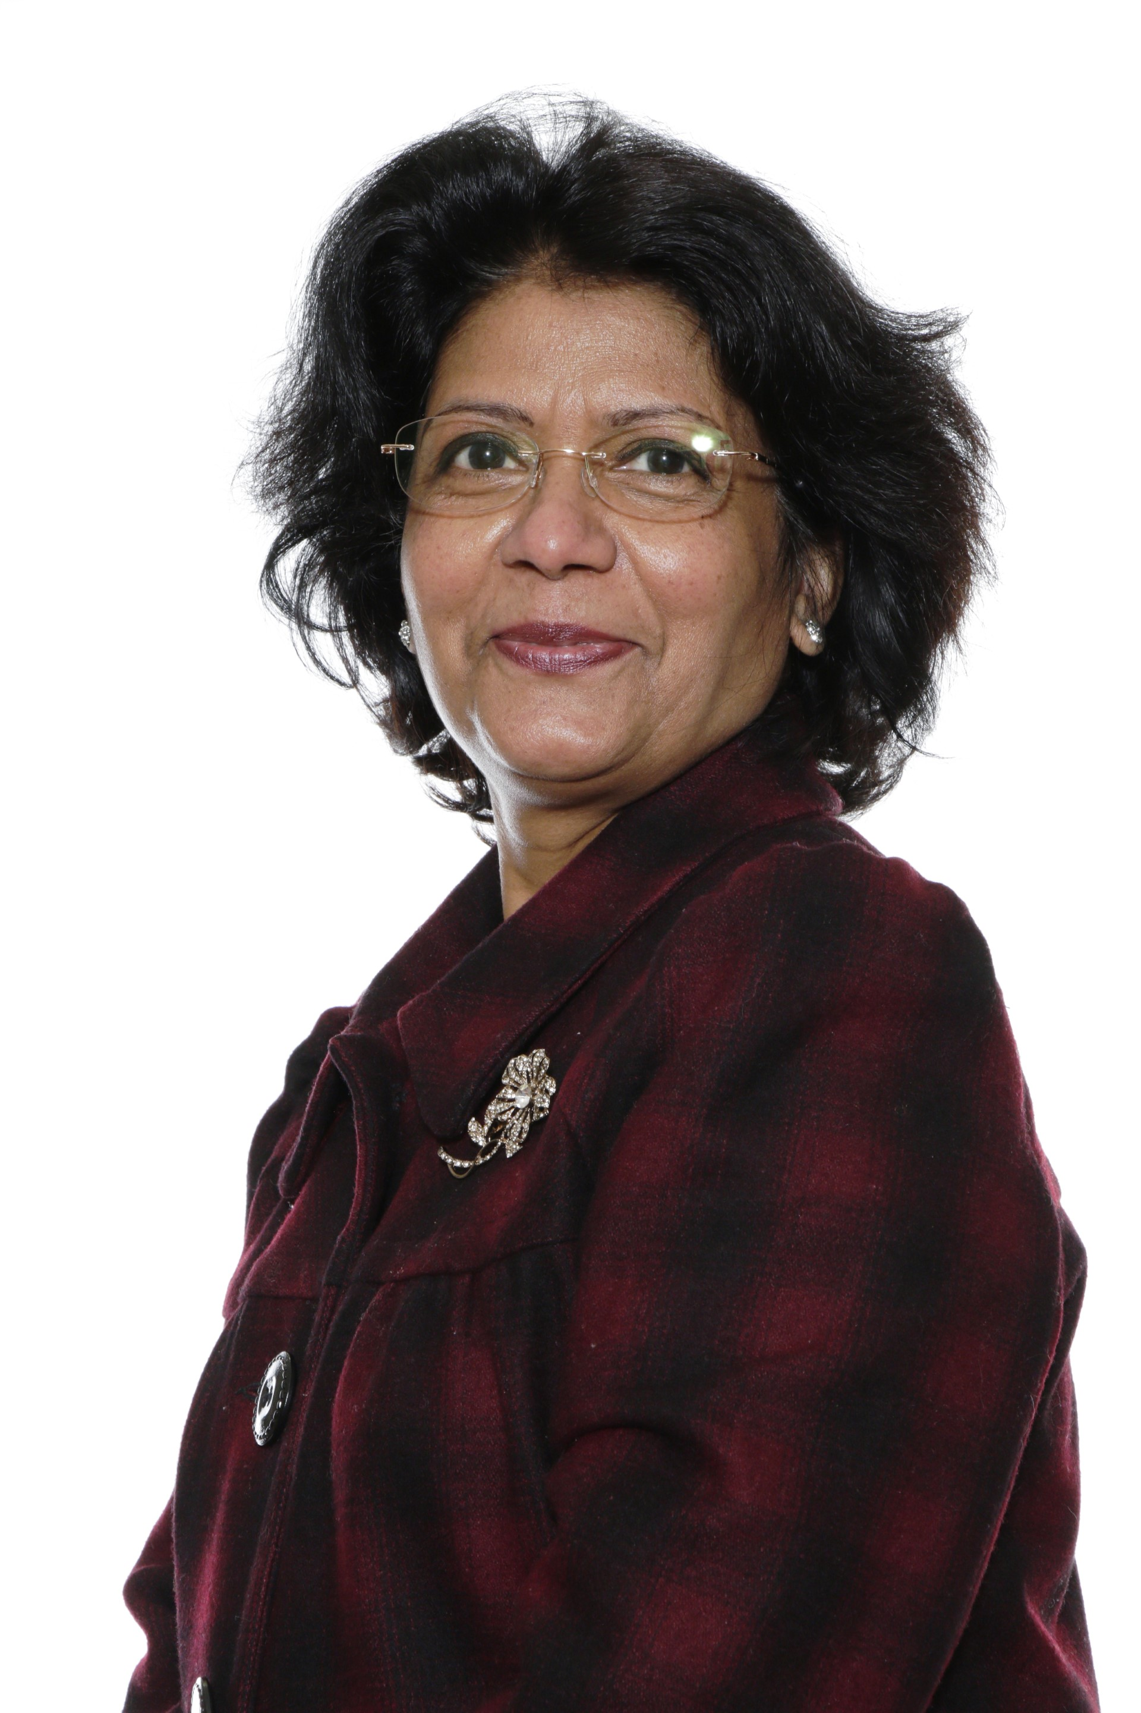
Blue Nursery
Staff Members
Class Teacher:
Mrs Pereira
Key Workers:
Mrs Szuster

Slide 5
Key Workers
For the first couple of weeks we like the children to settle in to the nursery routines and form good relationships with both staff and children before we allocate each child a key worker.
Each key worker is responsible for a small group of children. They will keep up to date observations for their learning journeys and providing close support to the children in their group.
Key workers will be available to talk to at the beginning and end of the session, however there will be parents meetings scheduled throughout the academic year. You can also schedule a meeting outside of parents evenings.

Slide 6
Our Day
`010 | AM | PM
Gates open | 8.30 | 12.30
Welcome/registration/wake up shake up | 8.30 – 8.50 | 12.30 – 12.50
Maths/Literacy | 8.50 – 9.10 | 12.50 – 13.10
Free flow | 9.10 – 10.00 | 13.10 – 14.00
Handwashing + Snack | 10:00 – 10.20 | 14.00 – 14.20
Free flow & interventions | 10.20 – 11.10 | 14.20 – 15.10
Story Time | 11.10 – 11.25 | 15.10 – 15.25
Getting Ready Home Time | 11.25 – 11.30 | 15.25 – 15.30
For the first couple of weeks we like the children to settle in to the nursery routines and form good relationships with both staff and children therefore the timetable is more flexible and may not look exactly like this.

Slide 7
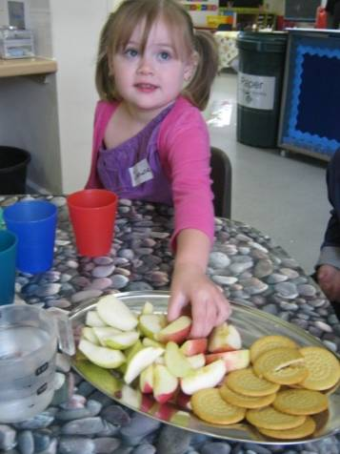
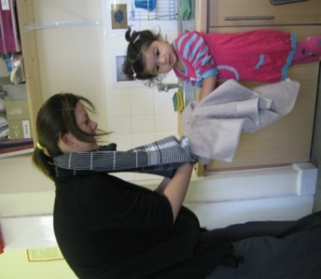
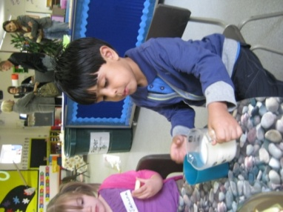
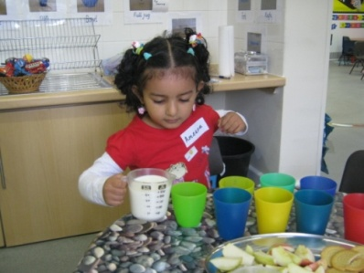
Snack Time
Children learn about healthy eating, how to feed themselves and independence. Please do not allow your child to bring any food or drink in to nursery as we have children with allergies who may be affected by what they bring.
Snack is provided and prepared by nursery staff for £3 per week.
Within the first few weeks of starting nursery you will receive information from the office on how to pay for snack using our system Arbor.

Slide 8
Toileting
The summer holidays are a great opportunity to get your child toilet trained. If they are still getting the hang of it when they get to Nursery we can continue the process. We would expect that the majority of children in Yellow and Green Nursery are toilet trained by Christmas.
We have changing mats, potties and small toilets in every nursery classroom.
If your child is in nappies they will be able to be changed at nursery by staff. Parents will need to sign a consent form for this that will be provided.
Please supply your own nappies/wet wipes.

Slide 9
What you need
Every child should bring a backpack that contains:
Spare clothes
Water bottle
Nappy changing materials if required
We also request that a raincoat and a pair of wellington boots are left at nursery for your child.
In summer we ask that sun cream be applied before nursery and that sunhats are brought to nursery.

Slide 10
Settling In
The Process:
To start with, not all children will attend nursery at the same time. We allocate 1 hour slots to each child and we slowly build this up to the full three hours.
Each child is an individual. We base the amount of time that they are in the classroom on how they are coping with the settling in process, eventually working up to the full 3 hours.
Coming to nursery is a big step!
We have a carefully monitored settling in process that we follow to make sure your child settles in as quickly as possible.

Slide 11
Looking forward to seeing you in September.
Nursery Office
Please contact the Nursery Office on
01793 818600
If:
Your child is sick and cannot attend nursery.
You have changed address or contact number
Your child has a hospital or Doctors Appointment
If your family is going on holiday during term time.
Mrs Lucey

Slide 12
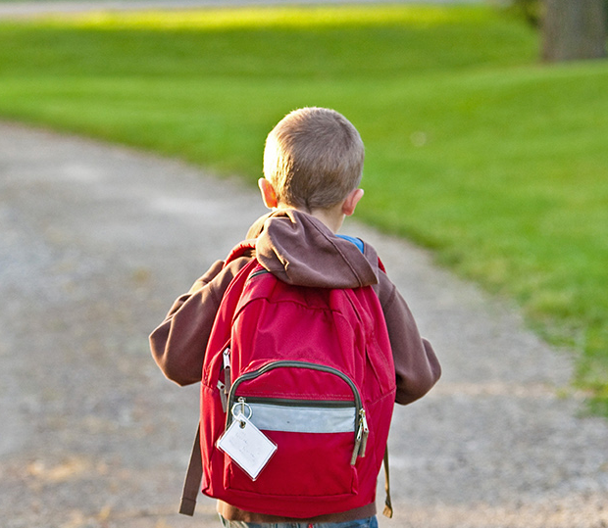
Thank You!
Mrs Hooper
We can’t wait to meet you!
If you have any questions please call our Nursery Office.

