Slide 1

Welcome to Reception
September 2025-2026
‘The Roots to Grow and the Wings to Fly’

Slide 2
What will be covered today?
Meet the team
Parent Pay
Home Visits
School Meals and Snack
School Uniform
Class Dojo
Our Daily Routine
Phased Start Dates
Visits to Reception
Open Evening
The First Few Days
Points to Note
At Drove We Will…
Contact Information

Slide 3
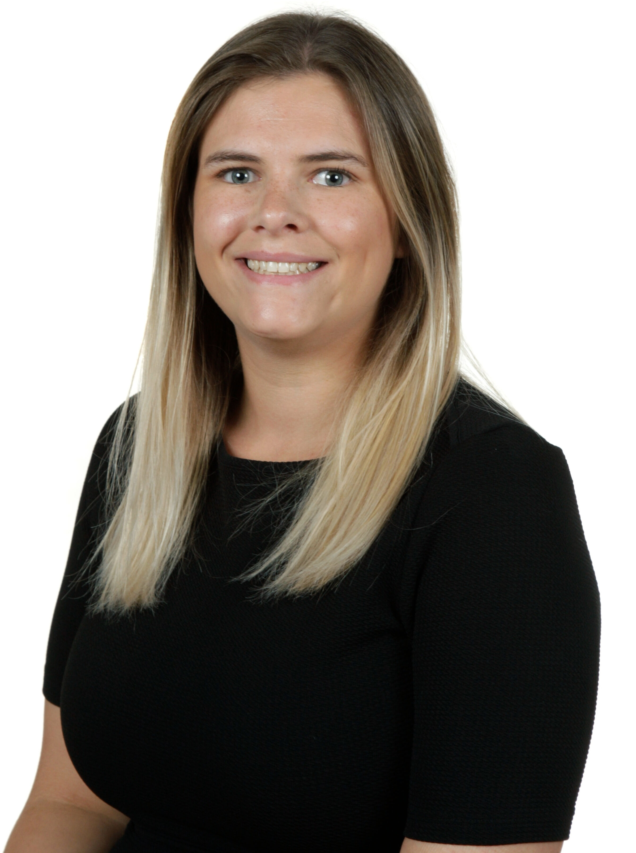
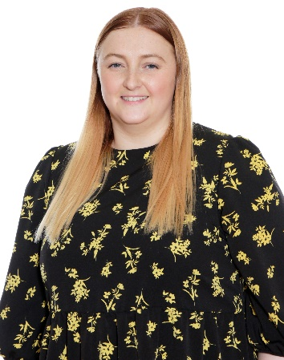
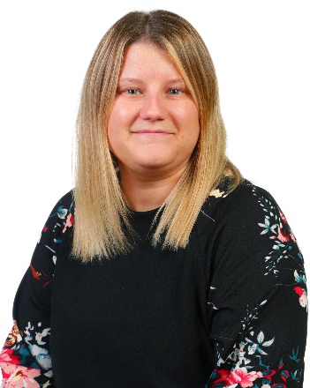
Meet the team
Mrs Bardwell
Principal
Miss Leach
Class Teacher and Early Years Lead
Miss Liddiard
Class Teacher
Mrs Cuming – SENCO
Emma Rant – School Family support
Mrs Ainsworth – School office
Mrs Hooper – School office
Mrs Ellis-Obote – School office

Slide 4
Parent Pay
Mrs Ainsworth
At Drove we are a cashless school. This means that you will need to pay for all of your school trips, dinners or clubs via the parent pay website.
You will have ParentPay login details once your child has started with us. For any children who are in our Nursery your ParentPay details will stay the same.
Once you have you login details make sure you change the password to something you can remember as we can not reset your passwords.
If you have more than one child you are able to add children to one account.
Your child will automatically be booked in for a school lunch everyday based on their dietary requirements but you are able to go on and change any meals booked in but this must be done a week in advance.
You can purchase PE & Book bags on ParentPay once your child has started with us.

Slide 5
Arbor
Mrs Ainsworth
Once your child starts with us you will receive an email with log in details for the Arbor app. If your child is currently in our nursery your log in details will be the same as you use now.
Each parent will have their own log on details based on their email address which means both parents will get the messages.
The Arbor app is the way that we communicate with parents so please make sure that you download it and check it regularly for messages.
If you change any of your details such as phone numbers, address etc you are able to change these on the app or letting us know in the office and we can change it for you. It is really important that your child’s details are always kept up to date.
Children who are in our nursery your details are already on our system but if any details have changed please let us know.
The app also allows you to view your child’s attendance which we regularly monitor and should be above the national average of 95%.

Slide 6
School Office
Mrs Ainsworth
If your child is unwell or unable to come to school you must let us know by 8:30am. Either phone the school office on 01793818608 or message us on the Arbor app. If your child misses more than 3 days off school unwell we would like to see medical evidence that they are unwell.
If your child is off for 3 days and we have had no contact from yourselves a member of staff will come round and do a door knock to check on the welfare of your child.
If your child has any sickness/ loose motions you have to keep them off for 48 hours to prevent infection.
We do understand that children sometimes might have a medical appointment during the school day. If your child has an appointment please provide us with the evidence of the appointment so we can mark them out correctly. We do expect your child into school before or after their appointment depending on the time of the appointment.

Slide 7
School Office
Mrs Ainsworth
Please note that children are expected to be in school everyday and on time, the gates open at 8:20am. Bringing your child late will effect their attendance. If you are regularly late for school you will be required to have a meeting with the Principal.
If your child arrives to school after the gates have closed at 8:30am, you will need to bring your children round to the main office and wait outside until we let you in.
If you are looking at taking your child out of school during term time NO time off will be authorised. You must complete a pink holiday request form in the office. Please note you may be fined for taking your child out of school.
You can email the office on: admin@drove-pri.swindon.sch.uk – please note this email address is not checked daily throughout the school holidays.
The School Office is open from 8-4:00- Mon/ Thursday and 8-3:30 on a Friday.

Slide 8
School Meals and Snack
From Reception to Year 2, all children are provided with free hot school meals.
We provide a meat and vegetarian option and a jacket potato with tuna, beans and/or cheese. We do not offer halal. You are able to book your child’s meals via ParentPay (You will receive account details in September).
If you wish for your child to have a packed lunch, then you are welcome to provide one, however please ensure it is a healthy lunch. We are a nut free school so please do not add nuts into your child’s lunchbox.
As a school we provide the children with free milk and fruit (milk is provided until they are 5). You do not need to provide your child with extra food for snacks.
Your child can bring to school a water bottle, which will be accessible to them throughout the day. PLEASE ENSURE THE BOTTLE IS CLEARLY LABELLED.

Slide 9
School Uniform
Uniform:
Blue Jumper/cardigans (with or without the school’s logo)​
White polo shirts/short or long sleeve shirts/blouses​
Black trousers/skirts/shorts​
Sensible black shoes (not boots or trainers)​
PE Kit:
White PE shirt (with or without the logo)​
Black shorts​ and jogging bottoms (jogging bottoms will be worn for outdoor PE sessions)
Dap/plimsolls/trainers​
Jumper (for when we do PE outdoors)
Other Items:
Book bag- £4.50
PE Bag- £3.50
Wellies (we explore outside even
if it is raining)
These items can be bought on ParentPay.

Slide 10
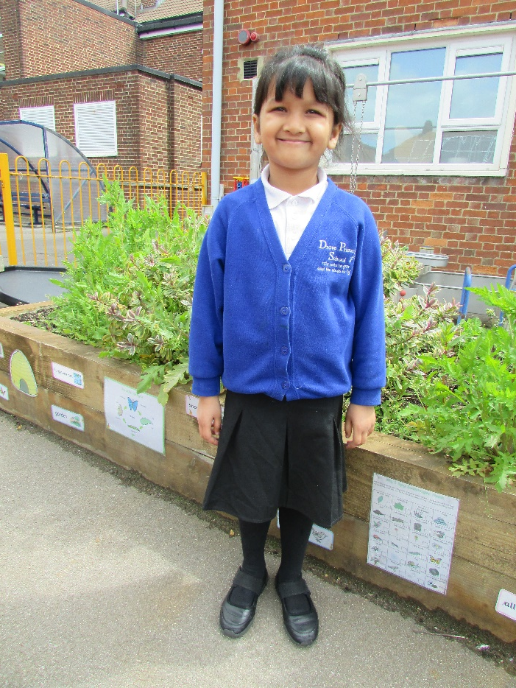
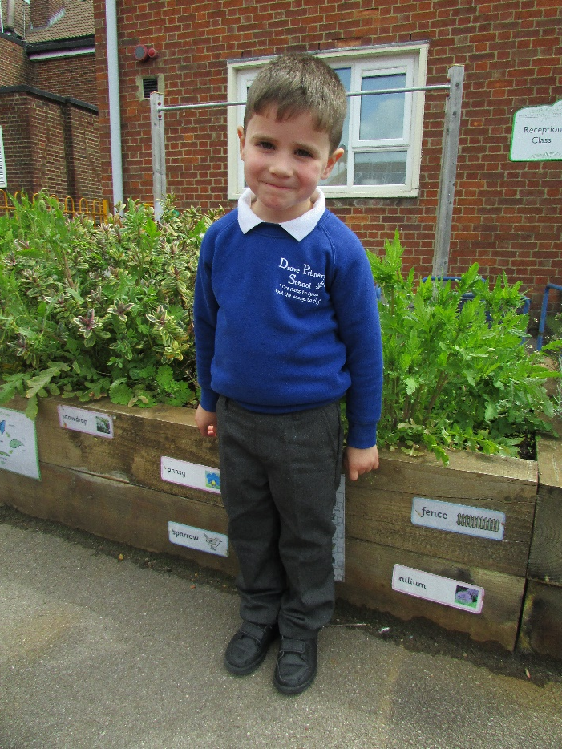
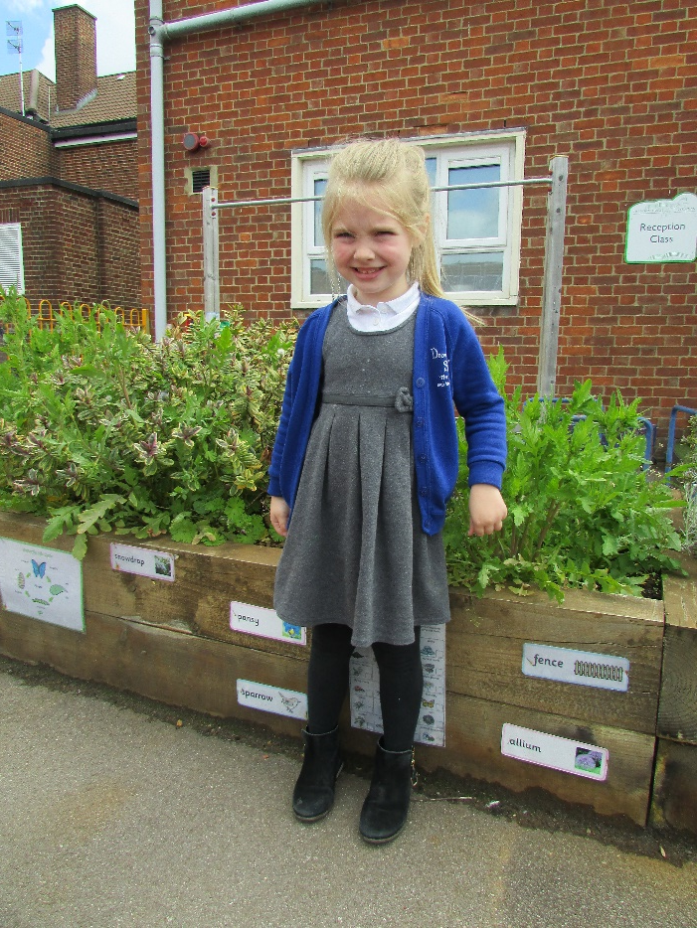
School Uniform Examples

Slide 11
School Uniform
Our school uniform can be purchased at all the big supermarkets (Sainsbury’s, Tesco, Asda, Morrisons)
If you would like to have the logo printed onto your child’s uniform you can go to Monkhouse schoolwear specialists and they will be able to provide you with our school uniform. Address: Monkhouse schoolwear address: 1B, Plaza, 21 Sanford St, Swindon SN1 1HE​
You can view the uniform online and see how much is available or if you need to pre-order items: https://www.monkhouse.com/school/drove-primary-school-urn-138309

Slide 12
Home Visits
We will be conducting Home Visits in September so we can meet you and see your child in their home environment. As you know your child best, we will ask you a few questions, so we are able to get an understanding of your child before they start with us.
Home visits will start on Wednesday 3rd September. A letter will be sent to you with the time and date of your visit.
Home visits are only for children new to Drove!

Slide 13
Phased Starts
We slowly welcome the children into Reception as this is a big step for them and we want a smooth transition
for you, your child and your family.
You will be sent a letter regarding your child’s start date and timings.
Reception
03/09/2025 (Wednesday) | Home Visits - New to Drove Children
04/09/2025 – 05/09/2025 (Week 1) | 2 groups of 15 children Thursday and Friday (your child will attend 1 of these). Gates open 8:20am (8.30am latest) - 11:30am
08/09/2025 (Week 2) | Whole Class- Staying for lunch Gates open 8:20am (8.30am latest) -13:30pm We finish at 1PM on Fridays.
15/09/2025 (Week 3) | Full time Gates open 8:20am (8.30am latest) -15:30pm We finish at 1PM on Fridays.

Slide 14
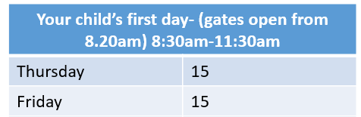
Your Child’s First Day
We welcome the children in small groups of 15 on the Thursday and Friday. We then welcome all the children in together the following week. During their first week, we spend time getting to know them and allow them to explore their environment with their new friends.
On their first day please bring:
Their book bag/rucksack
Spare pair of clothes- including pants, socks and shoes, accidents will happen and this is ok. We will use the spare clothes and put their dirty clothes in a bag and will give it to you at the end of the day. As well as accidents, there maybe a chance that they will get dirty. Again this is ok, it means they are have fun and learning.
Labelled water bottle

Slide 15
Visits to Reception
Children from outside of Drove (other Nurseries/no Nursery): Group 1 and Group 2
(Enter via Blue Gates on Southampton Street)
This will be an opportunity for your child to come into our playground, interacting with their soon to be peers and a chance for you to meet other parents. We will also be on hand for you to ask any questions you may have.
Group 1: Tuesday - 17/06 and 24/06 @ 9:45-10:30am
Group 2: Tuesday - 17/06 and 24/06 @ 10:45-11:30am
The letter you have already received will tell you what group/session you and your child are invited to attend.
No phones are allowed in the playground, please put them away before entering the school gates.
Drove Nursery children:
Your child will come over to Reception with a member of staff from their nursery.
Morning children: Wednesday 18/6 @ 9:45-10:30am
Afternoon children: Wednesday 18/6 @ 1:30pm- 2:15pm
There may be other times during the term when the Nursery children come over.

Slide 16
Open Evening
As we are not able to welcome you into the classrooms during your transition visits as we will have our children inside, we will be holding open evenings.
You will be able to enter the classrooms and walk freely around the Reception department. We will have a sample of uniforms, our school book bags and PE kit bags.
The Reception teachers will be present, so please come along with any questions you have and we will be happy to answer them for you.
A link will be made available at the end of this meeting for you to sign up to ONE of the dates below. Please sign up to a date by Wednesday 18th June.
Dates: Tuesday 24th June or Monday 30th June @ 4:00-4:45pm

Slide 17


Class Dojo
At Drove we use Class Dojo as a reward system. When a child does something above and beyond, they will be able to give their monster a dojo point. These dojo points transfer into house points and children are celebrated with badges for every 50 points until they receive their gold badge.
Class Dojo has a class story page where teachers post reminders and pictures of exciting things your child is up to at school.
A ‘How To’ sheet has been created to provide you with the information on how to join Class Dojo.
These will be provided at your child’s home visit/on their first day in Reception.
You do not need to pay for an account to join your child’s class.

Slide 18

Tapestry
At Drove we use Tapestry to share your child’s highlights in school, where you will get to see some of the amazing work your child has been doing.
If your child already attends Drove Nursery you should have joined up to your child’s account this academic year.
Children new to Drove will receive an email in September from Tapestry asking you to create an account to join up to your child.
This service does not cost anything.

Slide 19
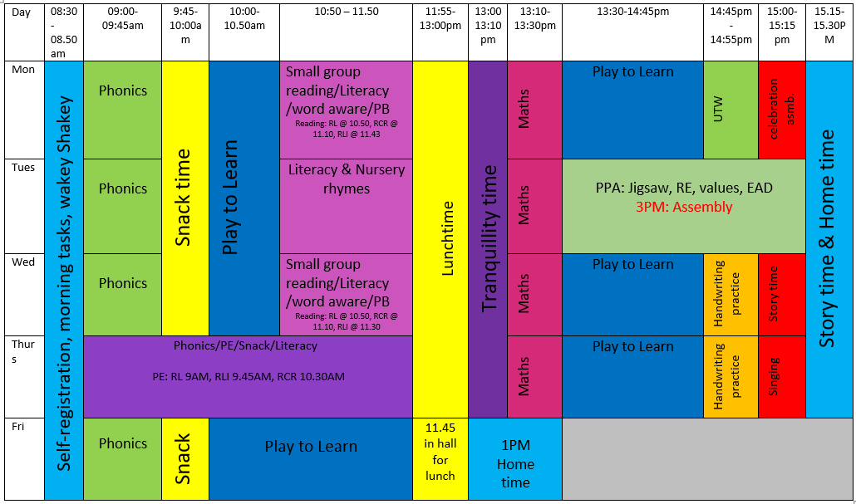
Routine
This is our current timetable – changes may be made throughout the year

Slide 20
The First Few Days
There is a lot to remember on your child’s first few days. The main things we need you to remember is:
- Clothes are ALL named (even shoes)
- Book Bag/back pack to be bought in everyday for your child to bring home their work and letters (children will be sent home with reading books that need to be looked after).
- Send in a spare bag of clothes which can stay on your child’s peg
- Water bottle- please ensure to label (your child should be drinking water in school and not squash)
- You do not need to give your child snack. This is provided for them.

Slide 21
Points to note
Holiday- Please inform us if your child is going on holiday during term time. No time off during term time will be authorised. If you are taking time off during term time, please collect a pink form from the office where they will discuss it with you.
Sickness- If your child is sick please phone the school in the morning. If there is no answer, please leave a message.
Absence- If you child is going to be absent for any reason, please inform the school. If there is no answer, please leave a message.
Password- In your admissions packs, you will need to provide the school with a password for your child. This is apart of our Safeguarding policy.
Lunches- We are a nut free school. When you child begins to bring in lunches, please do not give them nuts. The food options are Meat or Vegetarian. We do not offer Halal meals.
Please ensure you label all of your child’s items (even shoes). We have 90 children is Reception and all uniform looks the same.

Slide 22
Points to note
When your child starts school you will receive:
Parent pay letters
Arbor account
Class dojo letter
Tapestry account
Dates for upcoming parent workshops
Compulsory Items your child needs
School uniform (all items labelled)
Labelled water bottle
A school bookbag/backpack
Wellies
Spare clothes to stay on their peg (top, trousers, socks and underwear)
PE kit (labelled)

Slide 23
At Drove We Will:
Provide a happy, safe and secure environment which promotes respect for each other
Create a stimulating, fun and engaging environment with child centred and adult initiated play which promotes children’s enthusiasm towards learning.
Have positive and mutual partnerships with parents and value the help and guidance.
Help children make sense of the world they live in.
Promote and encourage independence and decision making.

Slide 24
Contact Information
Email: admin@drove-pri.swindon.sch.uk
Office Staff: Mrs R Ainsworth Mrs P Hooper ​​ Mrs B Ellis-Obote
Website: www.drove-pri.swindon.sch.uk
Telephone: 01793 808608
Facebook: Drove Primary School
Twitter: DrovePriSchool
Please do not hesitate to contact us with any questions that you may have.

