Slide 1
Year 1
Parent Workshop
14.07.2026

Slide 2
What will be discussed
Introduction to the Year 1 Team
Attendance at Drove
Your child’s day
Uniform/What your child needs
Trips/Volunteering
Homework in Year 1
Expectations: partnership, uniform

Slide 3
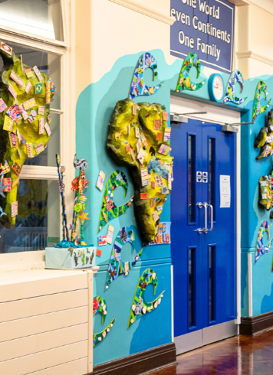
Introductions to the Year 1 Team

Slide 4
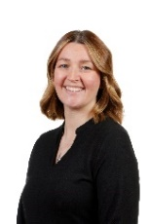
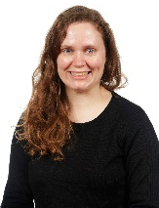
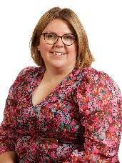
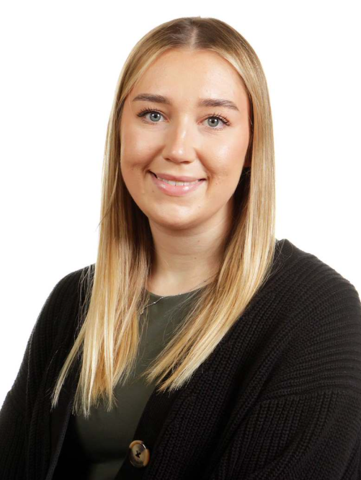
1PR
Mrs Phillips (Assistant Principal) and
Mrs Revis
Teachers
1W
Mrs Willoughby
(Phase Leader)
1S
Miss Smith

Slide 5
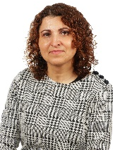
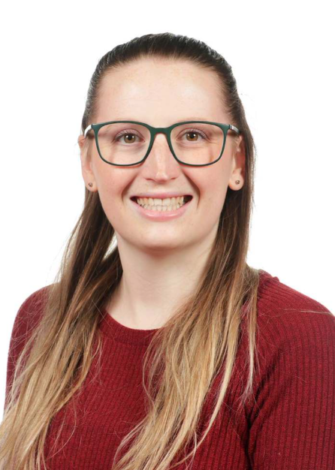
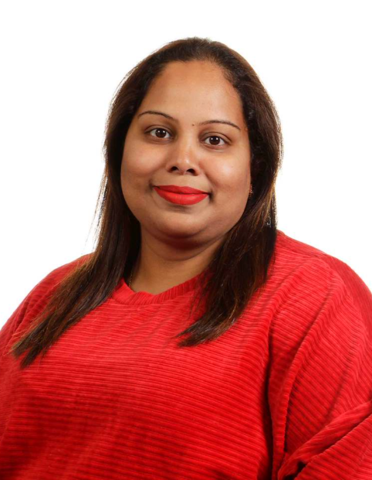
Mrs Moledina
Teaching Assistant
Miss Cresswell
Mrs Palha

Slide 6
Attendance at Drove

Slide 7
Why is having good attendance important?
Better Grades: Regular attendance boosts academic performance.
Strong Habits: Builds responsibility and time management.
Social Growth: Encourages friendships and teamwork.
Higher Success Rates: Increases chances of graduating on time.
More Confidence: Staying on track reduces stress and builds self-esteem.

Slide 8
Attendance at Drove- Absences
- It is your responsibility to inform the school if your child is unable to attend school, this should be done before the start of the school day and can be done by telephoning the office.
- If there is no answer, please leave a voice mail. If we do not receive a phone call/voicemail, you will be contact by the office so we know why they are off.
- If we cannot get in contact with you, we will phone the other contacts we have for your child on our system. Again, if we cannot get a hold of them, your child will be marked down as unauthorised.
- The school reserves the right to refer a child who has a pattern of unauthorised or authorised absence to the Education Welfare Team. This could ultimately result in legal action being taken.
- At Drove, you will receive a 1st warning letter, your child’s attendance is the monitored. If this doesn’t improve, you will receive a 2nd letter. If no improvement a meeting will be held with either myself or our Educational Welfare Officer.

Slide 9
Reasons for absence
Coughs and Cold:
If your child still has a minor cough and/or cold or even a runny nose, please still send them into school.
All staff are first aid trained and will contact you if we feel your child is too poorly and needs to be collected from school.
Sickness and Diarrhoea:
If your child has sickness and/or diarrhoea, they should not be attending school. They can return to school after 48 hours after their last motion.
Medical Appointments:
- You should try to make appointments for dentists and doctors and opticians etc. outside of school hours.
We understand hospital appointments cannot be helped as they are booked through the NHS and not by yourselves.
We will ask to see proof of your appointment, so please see the office and ensure to bring any letters you have with you.

Slide 10
Lateness
We understand that there are a number of reasons as to why your child might be late i.e. traffic or travelling by bus.
However, traffic is bad in the mornings and it is your responsibility to ensure you leave home with plenty of time to arrive and drop your child off.
We monitor the reasons as to why children are late and if we notice a pattern, we will book in a meeting to discuss the reasons and if there is anything we can help with from a schools point of view.

Slide 11
Holiday Requests- Pink Form
As a school, we do not authorise holiday requests during term time. This is the time where your children should be in education.
Holidays should be taken during half terms.
As your time will not be authorised, you will receive a letter outlining our policy and if your request is over 5 days, a meeting with myself will be arranged to discuss the implications.
Teachers will not provide your child will homework whilst they are on holiday.
If you are absent for more that 5 days, you will be fined £160 per parent.
It can be reduced to £80 per child, per parent is paid within 21 days.
PLEASE NOTE: Swindon Borough Council changed their policy on School Attendance and Fines.
1st Fine: £160 per child, per parent. Will reduce to £80 if paid within 21 days.
2nd Fine (with in 3 years of your first fine): £160 per child, per parent. This is a flat rate and will not reduce.
3rd Fine cannot be issues and will processed to alternative legal action

Slide 12
Summary
Your child should be in school everyday
If they have a cough or cold, they can still come in.
Do not take your child on holiday during school time.
- If you take your child out for school for 5+ days that’s means they will be missing 5+ phonics/English/maths lessons
If you need to take your child out of school, you need to complete a pink form and return to the office
Medical appointments- please show the office medical evidence
Holiday requests and low attendance will trigger an attendance meeting with the attendance lead.

Slide 13
Your Child’s Day

Slide 14
Difference between Reception and Year 1
The transition from Reception to Year 1 is a significant milestone for children. In Reception, learning is largely play-based, whereas Year 1 introduces a more structured approach, with most learning taking place at tables.
We recognise that this is a big change, and it can take several weeks for children to fully settle into their new routine. We take this adjustment period into account and provide the support and reassurance children need as they adapt to the expectations of Year 1.

Slide 15
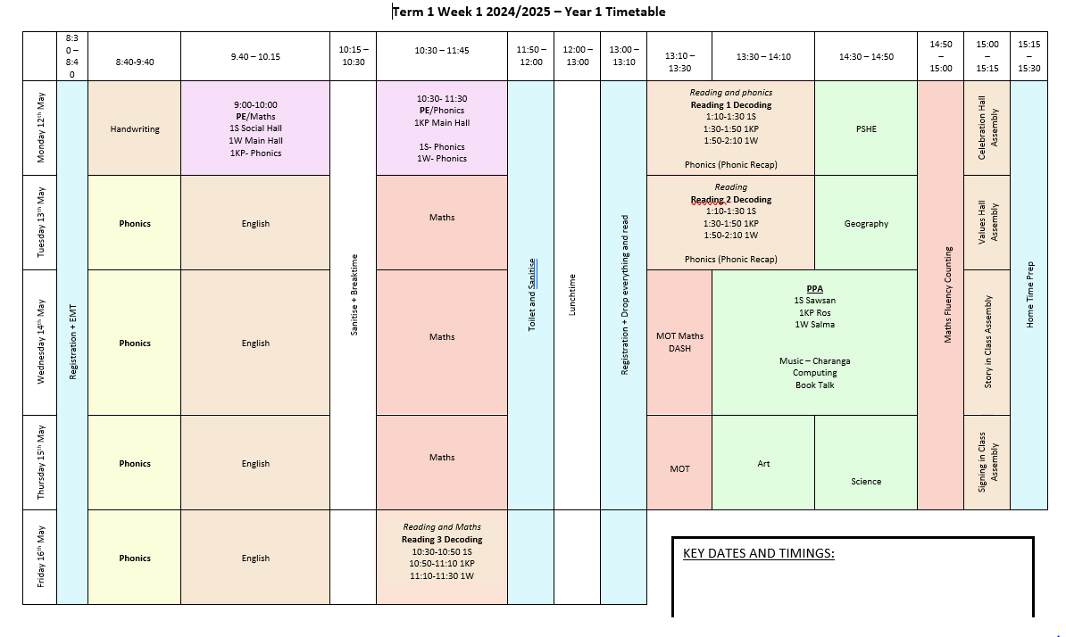
Timetable
The timetable can and will change throughout the year.

Slide 16
Uniform / What your child needs

Slide 17
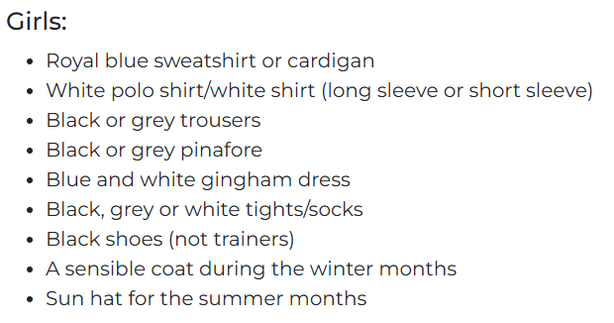
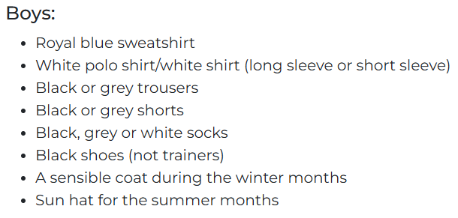
School Uniform
School uniform is the same as it was in Reception. Please ensure the children are wearing the appropriate shoes. Colourful trainers/shoes are not apart of the school uniform policy.

Slide 18
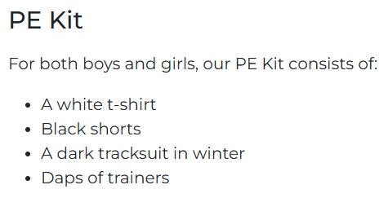
PE
Our PE days is every Monday morning.
The children need to have a PE kit in school and it will remain on their pegs until the end of term. Kits will be sent home at the end of every term, to be washed, and they need to come back when term starts again.
PE kits are compulsory so please ensure your children have the correct PE kit uniform.

Slide 19
What does your child need
Named water bottle. Children have access to their water bottles throughout the day
Named lunchbox (if they are having a packed lunch)
Named back pack/ruck sack (please ensure your child has spare clothes in their bags)
PE Kit
Anything that comes into school needs to have their names on.

Slide 20
Year 1 Trips/Volunteering

Slide 21
Trips
In Science, one of our topics is Seasons. We have 2/3 wellie walks to Queen’s Park, to explore the environments and explore seasonal changes.
In Term 2, our History topic is Castles, and we arrange a trip to Warwick Castle. We explore the inside of the castle, as well as examining the details on the outside. We also take part in a workshop called "Castle Life", led by a member of staff, where we learn about the daily lives of the people who lived in and around the castle.
In Term 4 and 5, one of our Science topics is Animals and we arrange a trip to Cotswold Wildlife Park. We have a workshop planned where we learn about herbivores, carnivores and omnivores.

Slide 22
Volunteering
We encourage parents to join us on our school trips and local walks. There will always be an opportunity to put your names forward to volunteer to come with us. When we send letters out about trips, please speak to your class teacher about volunteering
Please notes, for school trips, this is paid for by the school. You will just need to pay for your child.
If you do volunteer, you will be with your child’s class but your child will not be in your group. This is for safeguarding reasons.
It is first come, first serve so please put you name forward as soon as you can.

Slide 23
Homework

Slide 24
Homework
Reading:
- Every week your child will come home with a Little Wandle reading book (just like in Reception). The book your child has is according to their phonics knowledge. Please read with your child 2/3 times a week. This does not need to be the whole book and can be a few pages at a time.
- Children will also come home with a reading for pleasure book. This is a book they have selected themselves. This is a book for you and your child to look through together. You can read it to them or you can talk about the pictures.
Maths Books:
- Children will have maths homework every other Friday. This is focusing on topics they have already learned/explored in school.

Slide 25
Expectations

Slide 26
Expectations
Attendance and Punctuality
- Your child attends school every day, and notifying the school immediately if they are ill.
Academic and Home Support
- The completion of homework and providing a quiet space for learning at home.
- Your child should be correctly dressed in schools uniform and they bring necessary things they need: PE Kits, labelled wated bottle, lunchbox.
- Please engage with your child’s reading or daily learning tasks that are sent home
Communication and Engagement
- Attending parents' evenings and other school consultations to discuss academic progress.
- Checking school bags for letters, signing and returning permission slips, and reading school newsletters or updates.

Slide 27
Workshop Dates

Slide 28
Workshops
Phonics/Writing- Friday 11th September @ 9am-10am
Maths- Friday 18th September @ 9am-9:30am
Reading- Friday 25th September @ 9am-9:30
In these workshops, we will discuss how these subjects are taught in school and how you can help your child at home.

Slide 29
Thank you for attending this meeting.
If you have any questions, please do come and ask!

