Slide 1

Welcome to Reception
September 2023-2024
‘The Roots to Grow and the Wings to Fly’

Slide 2
What will be covered today?
Meet the team
Home Visits
School Meals and Snack
School Uniform
Class Dojo
Our Daily Routine
Parent Pay
Phased Start Dates
Visits to Reception
Open Evening
The First Few Days
Points to Note
At Drove We Will…
Contact Information

Slide 3
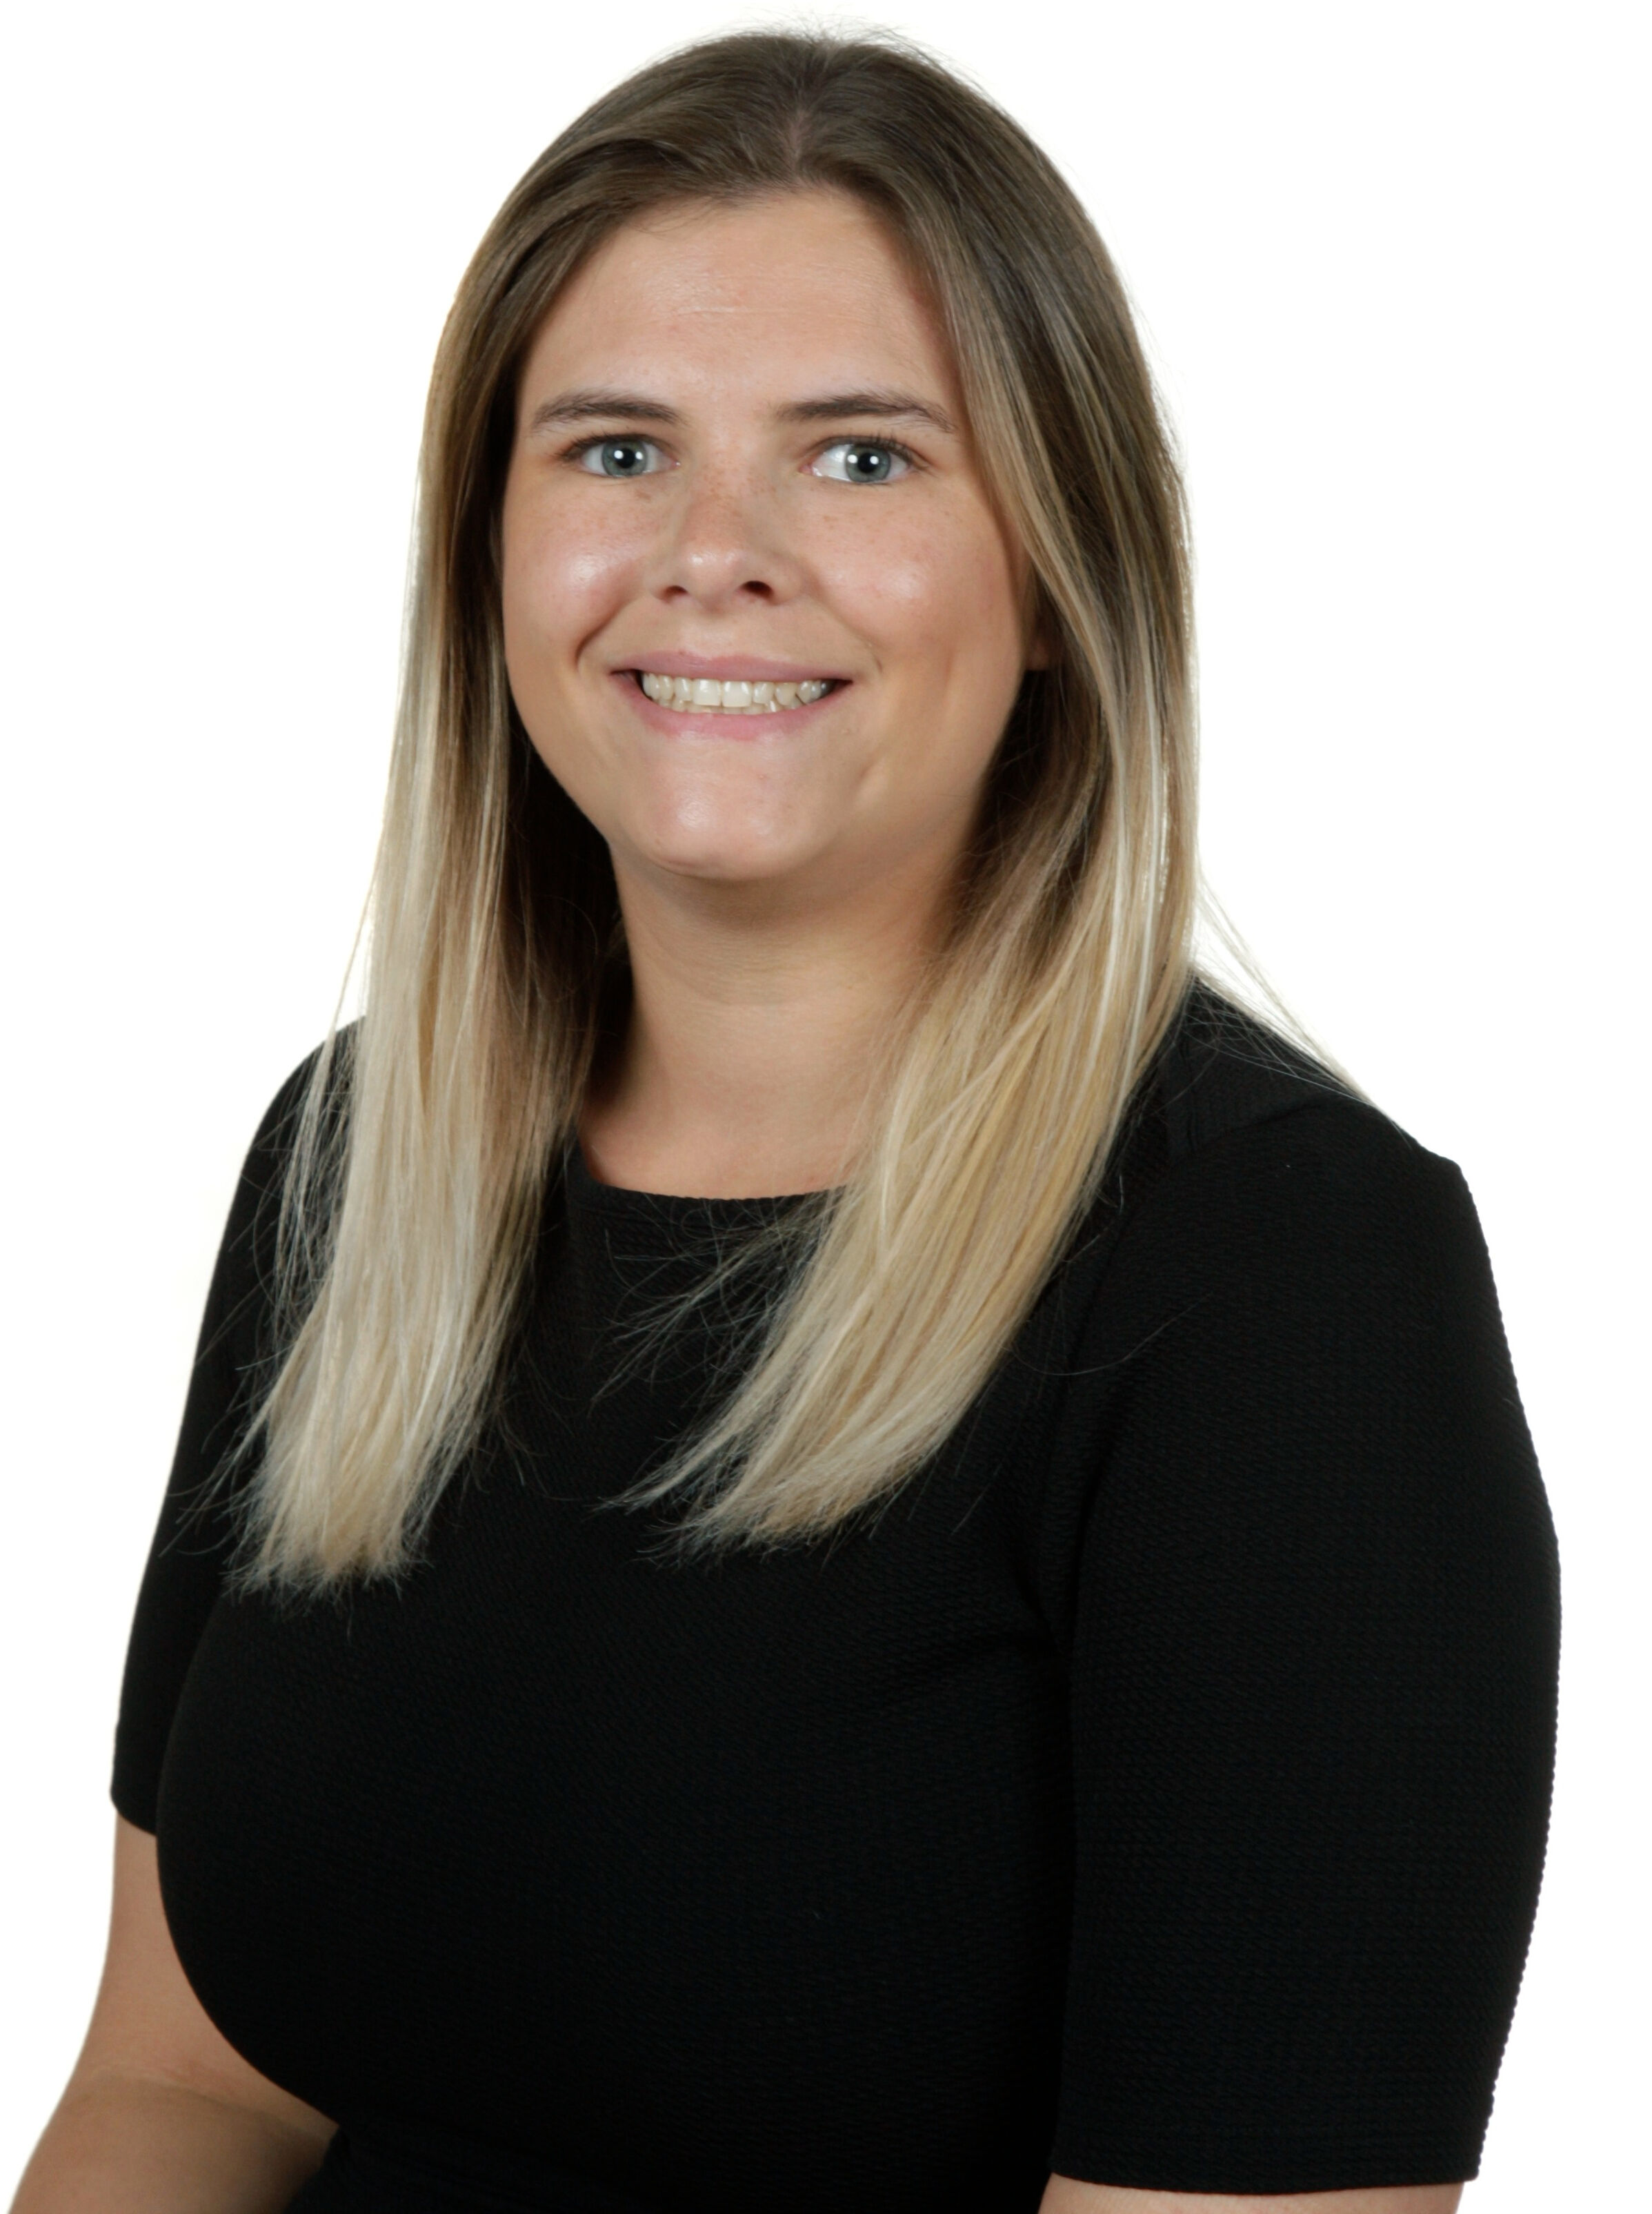
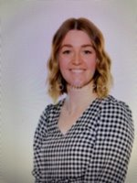
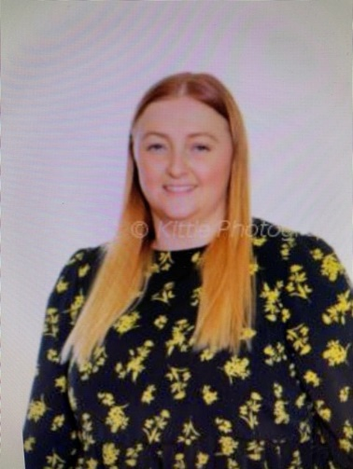
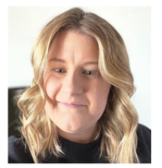
Meet the team
Mrs Bardwell
Principal
Mrs Phillips
Assistant Principal
Miss Leach
Class Teacher and Early Years Lead
Miss Liddiard
Class Teacher

Slide 4
Home Visits
We will be conducting Home Visits in September so we can meet you and see your child in their home environment. As you know your child best, we will ask you a few questions, so we are able to get an understanding of your child before they start with us.
Home visits will start on Tuesday 5th September. A letter will be sent to you with the time and date of your visit.
Home visits are only for children new to Drove!

Slide 5
School Meals and Snack
From Reception to Year 2, all children are provided with free hot school meals.
We provide a meat and vegetarian option and a jacket potato with beans and/or cheese. We do not offer halal. You are able to book your child’s meals via ParentPay (details will follow).
If you wish for your child to have a packed lunch, then you are welcome to provide one, however please ensure it is a healthy lunch. We are a nut free school so please do not add nuts into your child’s lunchbox.
As a school we provide the children with free milk and fruit (milk is provided until they are 5). You do not need to provide your child with extra food.
Your child can bring to school a water bottle, which will be accessible to them throughout the day. PLEASE ENSURE THE BOTTLE IS CLEARLY LABELLED.

Slide 6
School Uniform
Uniform:
Blue Jumper/cardigans (with or without the school’s logo)​
White polo shirts/short or long sleeve shirts/blouses​
Black trousers/skirts/shorts​
Sensible black shoes (not boots or trainers)​
PE Kit:
White PE shirt (with or without the logo)​
Black shorts​ and jogging bottoms (jogging bottoms will be worn for outdoor PE sessions)
Dap/plimsolls/trainers​
Jumper (for when we do PE outdoors)
Other Items:
Book bag- £4.50
PE Bag- £3.50
Wellies (we explore outside even
if it is raining)
These items can be bought on ParentPay.

Slide 7
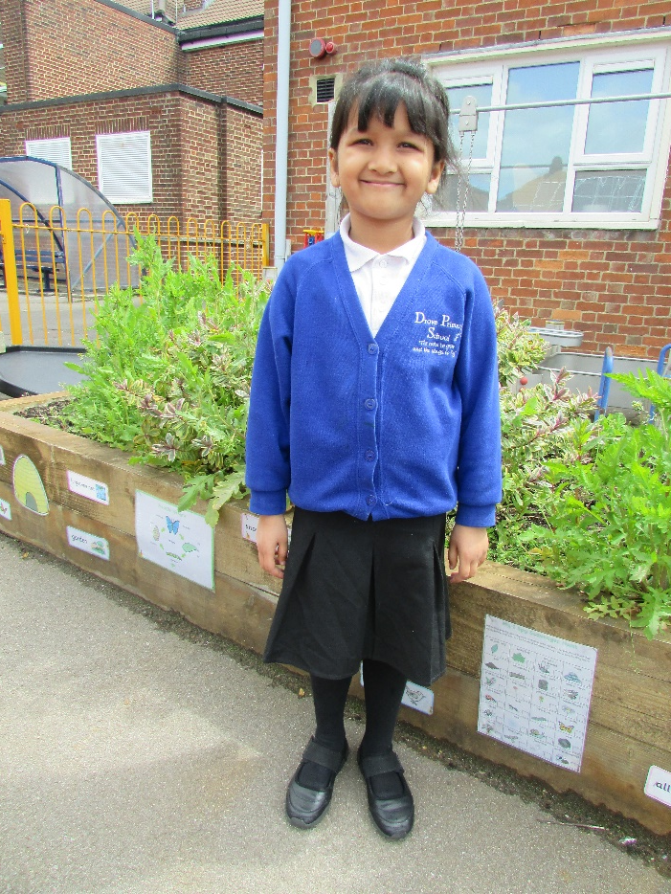
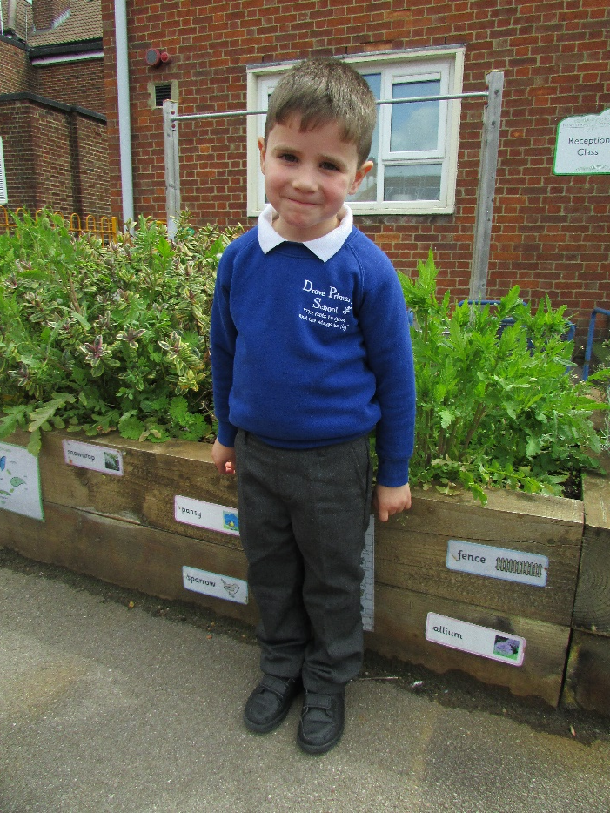
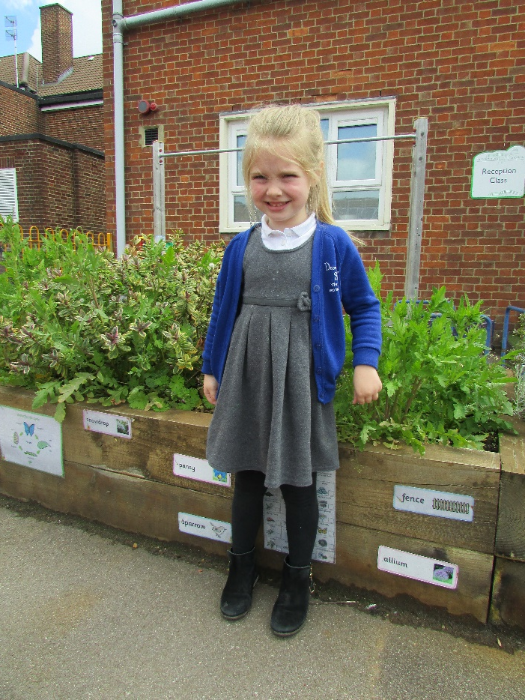
School Uniform Examples

Slide 8
School Uniform
Our school uniform can be purchased at all the big supermarkets (Sainsbury’s, Tesco, Asda, Morrisons)
If you would like to have the logo printed onto your child’s uniform you can go to Famous School Branches and they will be able to provide you with our school uniform. Address: Monkhouse schoolwear address: 1B, Plaza, 21 Sanford St, Swindon SN1 1HE​
You can book an appointment at: https://www.monkhouse.com/parent-guide

Slide 9


Class Dojo
At Drove we use Class Dojo as a reward system. When a child does something above and beyond, they will be able to give their monster a dojo point. The child with the most dojo’s will be given a prize at the end of the week.
Class Dojo has a messaging service which we will open to you. Please note, this is not to have a general conversation with your child’s class teacher. Teachers will respond during working hours 8:00-3:30.
A ‘How To’ sheet has been created to provide you with the information on how to join Class Dojo. These will be provided on your child’s home visit/first day in Reception.

Slide 10
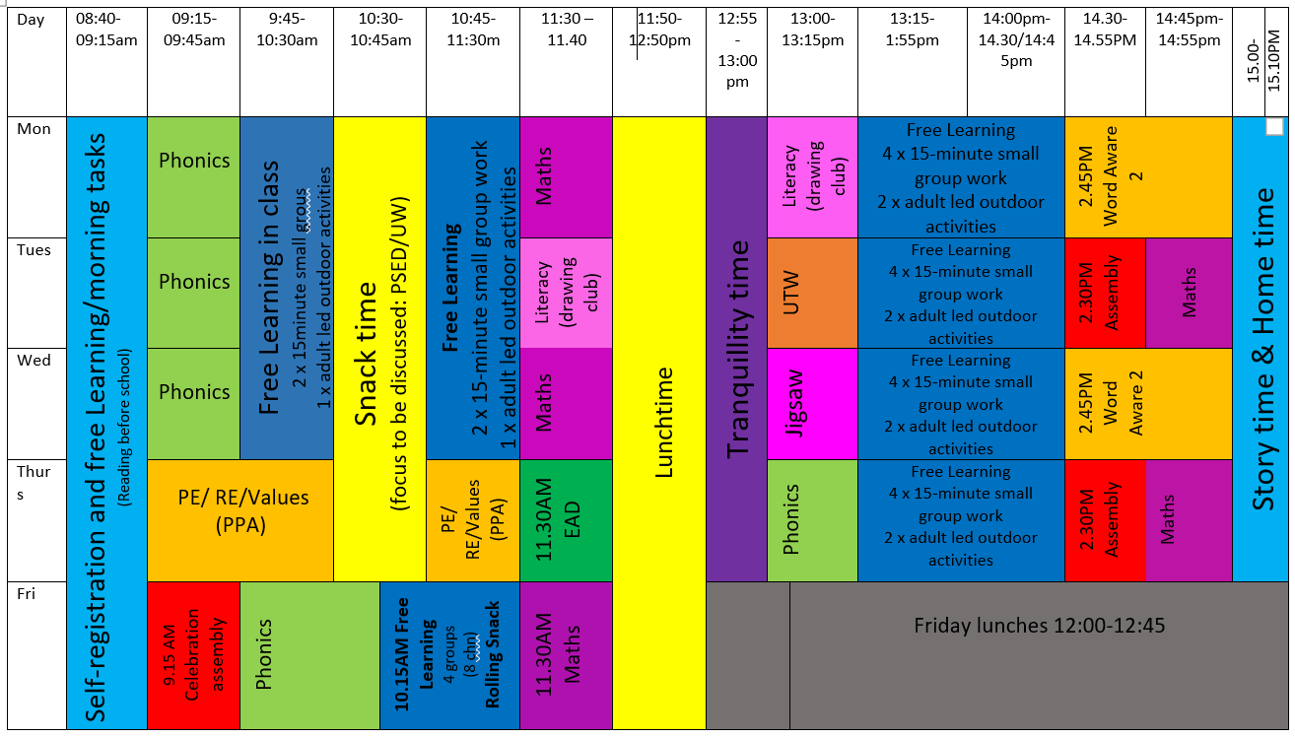
Routine
This is our current timetable – timings will be different next year with the new hours.

Slide 11
Parent Pay
Mrs Hooper
At Drove we are a cashless school. This means that you will need to pay for all of your school trips, dinners or clubs via the parent pay website.
You will have ParentPay login details once your child has started with us. For any children who are in our nursery your ParentPay details will stay the same.
Once you have you login details make sure you change the password to something you can remember as we can not reset your passwords.
If you have more than one child you are able to add children to one account.
Your child will automatically be booked in for a school lunch everyday based on their dietary requirements but you are able to go on and change any meals booked in but this must be done a week in advance.
You can purchase PE & Book bags on ParentPay once your child has started with us.

Slide 12
School Office
Mrs Ainsworth
If you are looking at taking your child out of school during term time NO time off will be authorised. You must complete a pink holiday request form in the office. Please note you may be fined for taking your child out of school.
If your child has an appointment please provide us with the appointment evidence so we can mark them out correctly.
If your child is unwell or unable to come to school you must let us know by 8:30am. Either phone the school office on 01793818608 or you can text in to our text number 07786207779. If your child misses more than 3 days off school unwell we would like to see medical evidence that they are unwell.
If your child has any sickness/ loose motions you have to keep them off for 48 hours to prevent infection.
Please note that children are expected to be in school everyday on time and on time. Bringing your child late will effect their attendance. If you are regularly late for school you will be required to have a meeting with the Principal.

Slide 13
School Office
Mrs Hooper
Children who are in our nursery your details are already on our system but if any details have changed please let us know.
Once your child has started with us you will regularly receive information from us on texts. Please note only one parent can receive the text messages.
If you change your phone numbers/ email or address please come to the office to update your details.
You can email the office on: admin@drove-pri.swindon.sch.uk – please note this email address is not checked daily throughout the school holidays.
The School Office is open from 8-4:30- Mon/ Thursday and 8-3:30 on a Friday.

Slide 14
Phased Starts
We slowly welcome the children into Reception as this is a big step for them and we want a smooth transition
for you, your child and your family.
You will be sent a letter regarding your child’s start date and timings.
Reception
05/09/2023 (Tuesday) | Home Visits - New to Drove Children
06/09/2023 – 08/09/2023 (Week 1) | 2 groups of 15 children (Wed & Thurs). Whole class Friday. Gates open 8:20am (8.30am latest) - 11:30am
11/09/2023 (Week 2) | Whole Class- Staying for lunch Gates open 8:20am (8.30am latest) -13:30pm We finish at 1PM on Fridays.
18/09/2023 (Week 3) | Full time Gates open 8:20am (8.30am latest) -15:30pm We finish at 1PM on Fridays.

Slide 15
Your Child’s First Day
We welcome the children in small groups of 15 on the Wednesday and Thursday. We then welcome all the children on Friday. During their first week, we spend time getting to know them and allow them to explore their environment with their new friends.
On their first day please bring:
Their book bag/rucksack
Spare pair of clothes- including pants, socks and shoes, accidents will happen and this is ok. We will use the spare clothes and put their dirty clothes in a bag and will give it to you at the end of the day. As well as accidents, there maybe a chance that they will get dirty. Again this is ok, it means they are have fun and learning.
Your child’s first day- (gates open from 8.20am) 8:30am-11:30am
Wednesday | 15
Thursday | 15
Friday | All

Slide 16
Visits to Reception
Children from other nurseries: Group 1 and Group 2 (Enter via Blue Gates on Southampton Street)
This will be an opportunity for your child to come into our playground, interacting with their soon to be peers and a chance for you to meet other parents. We will also be discussing the Early Years curriculum and providing you some handouts with advice and tips on supporting your child to be ready for starting school.
Group 1: Wednesday- 14/06, 21/06 and 28/06 @ 9:45-10:30am
Group 2: Wednesday- 14/06, 21/06 and 28/06 @ 10:45-11:30am
Drove Nursery children:
Your child will come over to Reception with a member of staff from their nursery.
Morning children: Tuesdays- 13/06 and 20/6 @ 9:45-10:30am
Afternoon children: Tuesdays- 13/06 and 20/6 @ 1:30pm- 2:15pm
There may be other times during the term when the nursery children come over.

Slide 17
Open Evening
As we are not able to welcome you into the classrooms during your transition visits as we will have our children inside, we will be holding open evenings.
You will be able to enter the classrooms and walk freely around the Reception department. We will have a sample of uniforms, our school book bags and PE kit bags.
The reception teachers will be present, so please come along with any questions you have and we will be happy to answer them for you.
A link will be made available at the end of this meeting for you to sign up to ONE of the dates below. Please sign up to a date by Monday 12th June.
Dates: 20/06, 26/06 and 4/07 @ 4:00-4:45pm

Slide 18
The First Few Days
There is a lot to remember on your child’s first few days. All you need to remember is:
- Clothes are ALL named (even shoes)
- Book Bag and rucksack full with spare clothes to be brought in EVERYDAY
- Water bottle- please ensure to label (your child should be drinking water in school and not squash)
- You do not need to give your child snack. This is provided for them.

Slide 19
Points to note
Holiday- Please inform us if your child is going on holiday during term time. No time off during term time will be authorised. If you do wish to take time off during term time, please collect a pink form from the office where they will discuss it with you.
Sickness- If your child is sick please phone the school in the morning. If there is no answer, please leave a message.
Absence- If you child is going to be absent for any reason, please inform the school. If there is no answer, please leave a message.
Password- In your admissions packs, you will need to provide the school with a password for your child. This is apart of our Safeguarding policy.
Lunches- We are a nut free school. When you child begins to bring in lunches, please do not give them nuts. The food options are Meat or Vegetarian. We do not offer Halal meals.
Please ensure you label all of your child’s items (even shoes). We have 90 children is Reception and all uniform looks the same.

Slide 20
At Drove We Will:
Provide a happy, safe and secure environment which promotes respect for each other
Create a stimulating, fun and engaging environment with child centred and adult initiated play which promotes children enthusiasm towards learning.
Have positive and mutual partnerships with parents and value the help and guidance.
Help children make sense of the world they live in.
Promote and encourage independence and decision making.

Slide 21
Contact Information
Email: admin@drove-pri.swindon.sch.uk
Office Staff: Mrs R Ainswoth Miss B Ellis Mrs P Hooper ​​
Website: www.drove-pri.swindon.sch.uk
Telephone: 01793 808608
Facebook: Drove Primary School
Twitter: DrovePriSchool
Please do not hesitate to contact us with any questions that you may have.

