Slide 1
The Phonics Screening Check at
Duke Street Primary School

Slide 2
What is The Phonics Screening Check?
Children across the country will sit the Phonics Screening Check in June when they are in Year 1.
The children are asked to read 40 words made up from a mixture of real and nonsense words that require them to use their phonics knowledge. Most years, the pass rate is around 32.

Slide 3
What is Phonics?
Words are made up from small units of sound called phonemes.
A Phoneme is the sounds that a letter makes. We teach our children that each letter has a name and a sound.
A Grapheme is the way we write the sound down on paper, essentially, it is what the letter looks like.
Phonics teaches children to be able to listen carefully and identify the phonemes that make up each word. This helps children to learn to read words and to spell words.

Slide 4
In phonics lessons children are taught three main things:
1. GPCs - They are taught GPCs. This stands for grapheme phoneme correspondences. This means that they are taught all the phonemes in the English language and ways of writing them down. These sounds are taught in a particular order. The first sounds to be taught are s, a, t, p, i, n.

Slide 5
In phonics lessons children are taught three main things:
2. Blending - Children are taught to be able to blend. This is when children say the individual sounds that make up a word and are able to merge the sounds together until they can hear what the word is. This skill is vital in learning to read unfamiliar words independently.
Here are some examples of blending...

Slide 6
Building words from phonemes to read.
c a t
cat
These are
called sound buttons.
They help the children
recognise how many sounds make up that word.
Notes:
Talk about the different types of blending, robot blending, smooth blending etc.

Slide 7
queen
queen
These are
called sound buttons.
They help the children
recognise how many sounds make up that word.

Slide 8
In phonics lessons children are taught three main things:
3. Segmenting - Children are also taught to segment. This is the opposite of blending. Children are able to say a word and then break it up into the phonemes that make it up. This skill is vital in being able to spell words.
Here are some examples of segmenting...

Slide 9
Breaking down words for spelling.
dog
d o g
Notes:
Discuss slowing the word down to help segment.

Slide 10
shop
sh o p

Slide 11
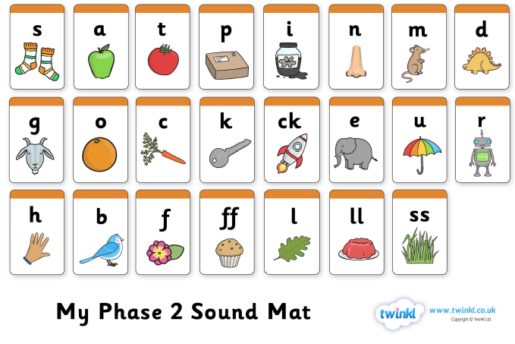
Sounds your child will have learnt in Reception…
Notes:
Talk about digraphs and the importance of making the correct movement with your mouth.

Slide 12
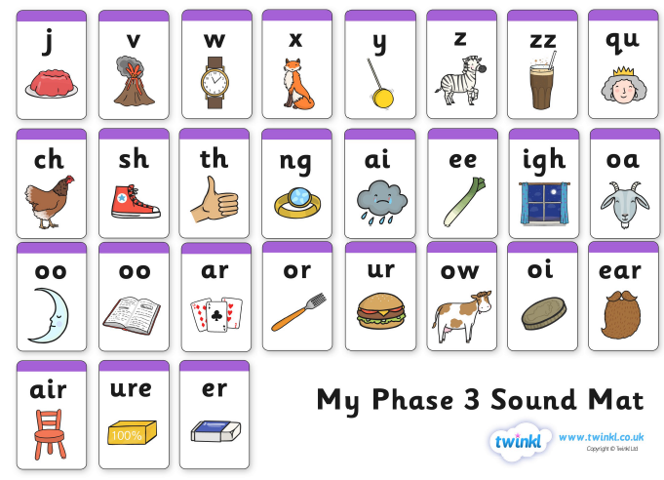
Sounds your child will have learnt in Reception…
Notes:
Talk about Trigraphs.

Slide 13
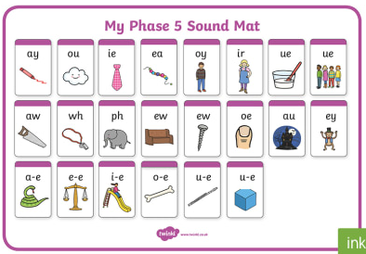
Phase 5 in Year 1...
Phase 5 – Introduces some new phonemes, then looks at how some graphemes can be pronounced in different ways, and some phonemes can have alternative spellings.
Notes:
Discuss

Slide 14
The /ai/ sound
train
stable day break - speak grey
cake
Notes:
Chat about the best fit way of teaching, and how spelling rules apply.

Slide 15
Terminology...
VC words – The first words children are taught to blend in Phase 2. Words made up from a vowel and a consonant e.g. it, in, at.
CVC words – Words made up from a consonant, vowel, consonant e.g. cat, dog, pig
They then go on to learn longer words towards the end of Reception in Phase 4 e.g. CCVC - clap
In Phase 3 children are introduced to...
Digraph – Two letters that make one sound e.g. sh in shop.
Trigraph - Three letters that make one sound e.g. air in hair.

Slide 16

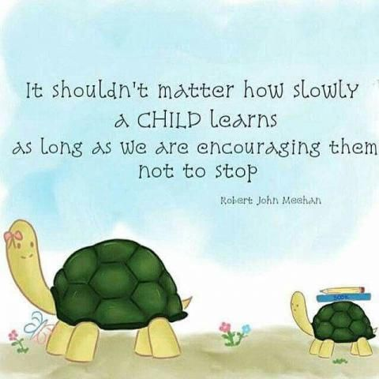

Slide 17
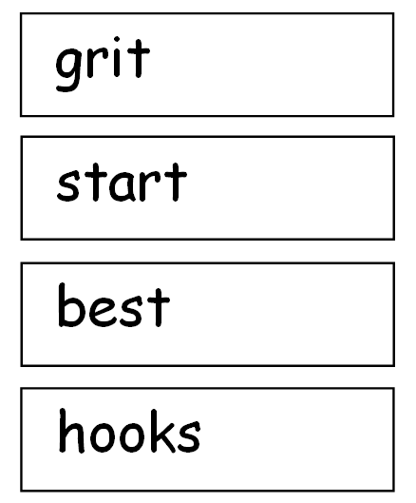
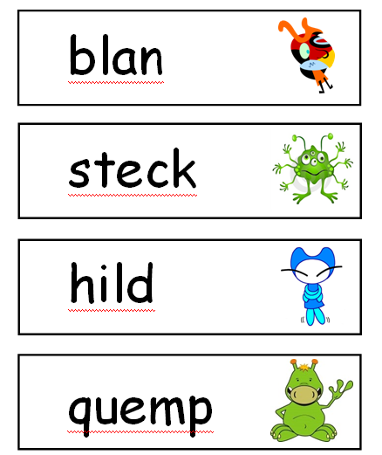
Year 1 Phonic Screening Check example.
The Phonics screening check is made up of real words like the ones on the left side and nonsense words also called Alien words. They are words that make no sense and are used to assess how well the child can recognise and blend sounds. There is a picture of an alien next to these words in the check so that the children can recognise it is a nonsense word.
Notes:
Discuss the Y1 phonics screening test.

Slide 18
How can you support your child in Phonics?
Make time to listen to your child talking!
As you meet them from school, as you walk, or travel home by car, in the supermarket as you shop, at meal times, bath times, and bedtimes – any time!
Modelling correct sounds and pronunciation is vital for children to learn to pronounce sounds correctly themselves.

Slide 19

Be a robot!
Play I spy….. ‘I spy a c-u-p…cup’
Where is you other s-o-ck?…..sock
Simon says touch your ch-i-n….chin

Slide 20
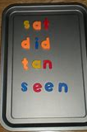
Reading
Read to your child.
Listen to your child read to you.
Spellings
Year 1 upwards have spelling tests each week.
Magnetic letters
Source some magnetic letters for your fridge or on a baking tray.

Slide 21
Tricky Words
Most words are phonically regular.
Some exceptions – for example
the, was, no, go, you, are, said
need to be directly taught on sight.
There are NO tricky words in the phonics screening check.
Notes:
Talk about when they are reading or writing with their child.

Slide 22
Remember…….
These sounds and words are hard to remember and need LOTS of practice!!

Slide 23
Interactive phonics games for the tablet...
Phonics bloom
Phonics play
Top marks
Education.com
Listen to how each sound is pronounced correctly...
Phase 2 sounds https://www.youtube.com/watch?v=DIpcahxNSU4
Phase 3 sounds https://www.youtube.com/watch?v=vU2vWZKS7rY
Phase 5 sounds https://www.youtube.com/watch?v=R3S5sJw7MfI

