Slide 1


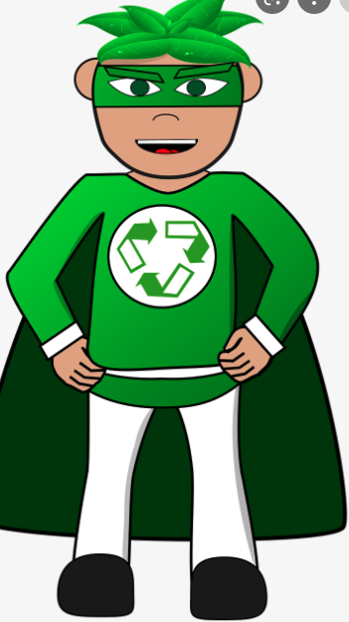
Eco Warriors
Hello Eco-warriors of Eastbury Primary School!
I hope you’ve been having fun doing your bit to help us save the planet, a little step at a time!
Here are some ways that YOU can help at Eastbury Primary School to keep our environment clean and GREEN!

Slide 2
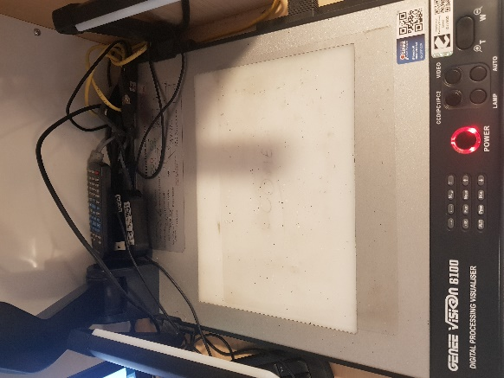


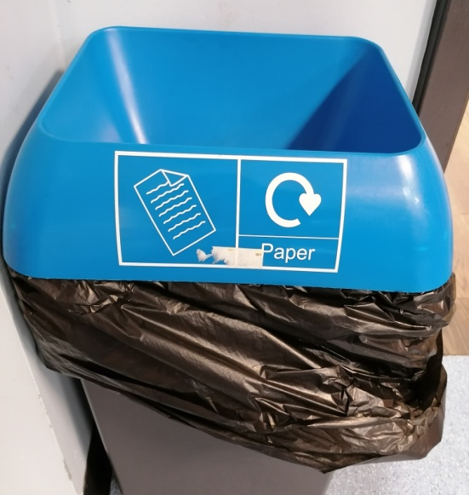
Eco-warriors roles
Remember to:
Switch off the classroom lights when leaving
Switch off the visualizer
Turn off the taps
Close the windows
Check bins are being used correctly

Slide 3
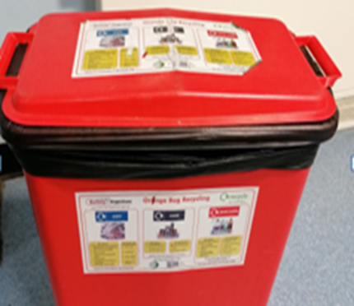

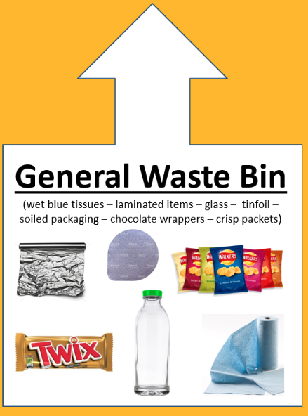
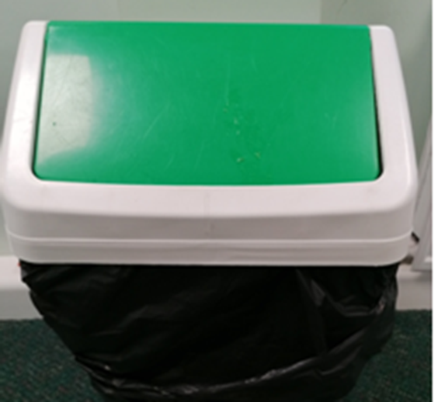
Bins
There are 2 bins in each classroom.
(General Waste Bin and a Recycling Bin)
Both bins should be labelled with the right signs!

Slide 4

Eco-warriors
Two children are chosen from each class.
Eco-warriors are to wear the Eco Warrior Badge daily.
Eco-warriors will change very 2 weeks (… because EVERYONE can help to make a difference).
Eco-warrior badges are to be kept in class at the end of the day.

Slide 5
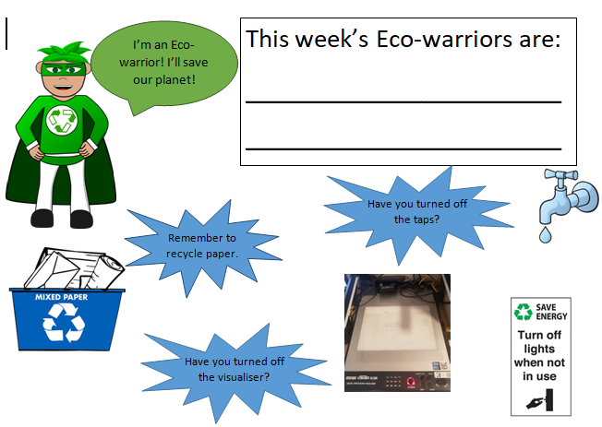

Slide 6
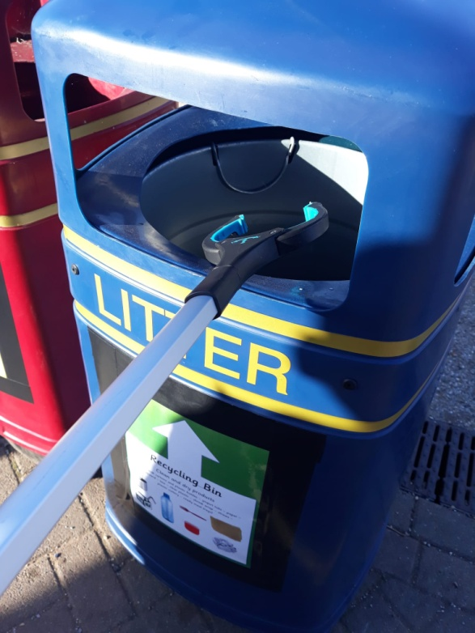
Litter picking at Playtime:
Eco-warriors can litterpick the playground during Playtime.
Remember to keep the litterpick
down on the ground.
Always hold the handle.
Put rubbish in the correct bin.
P.S. Leaves do NOT count as litter ☺

Slide 7
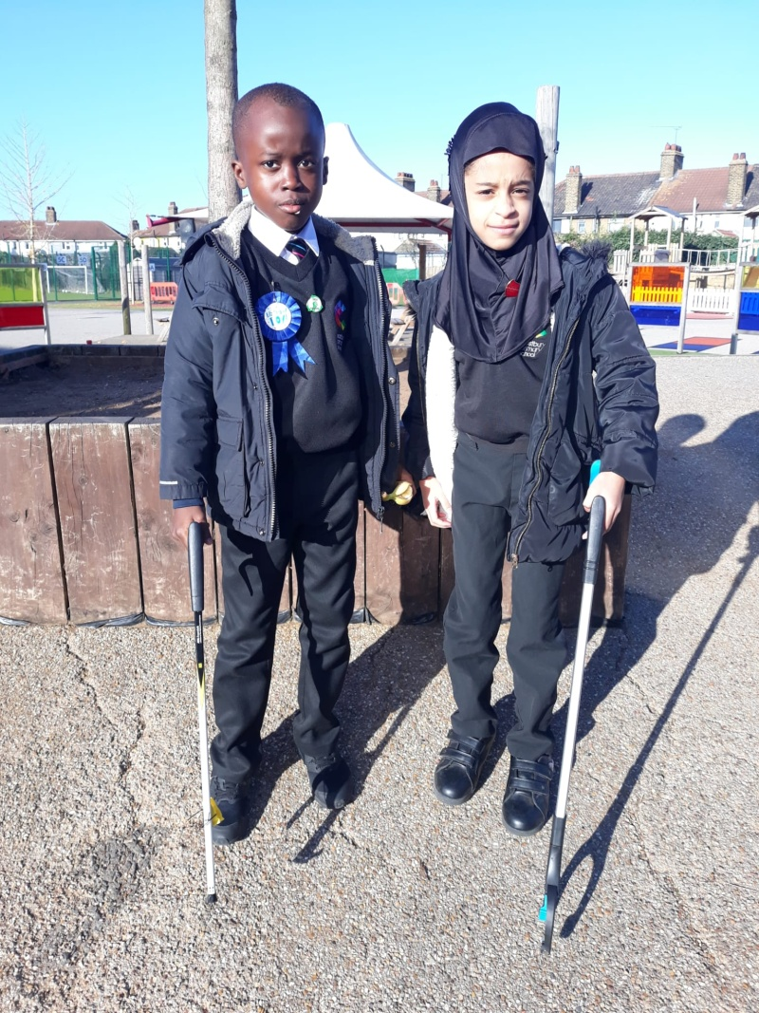
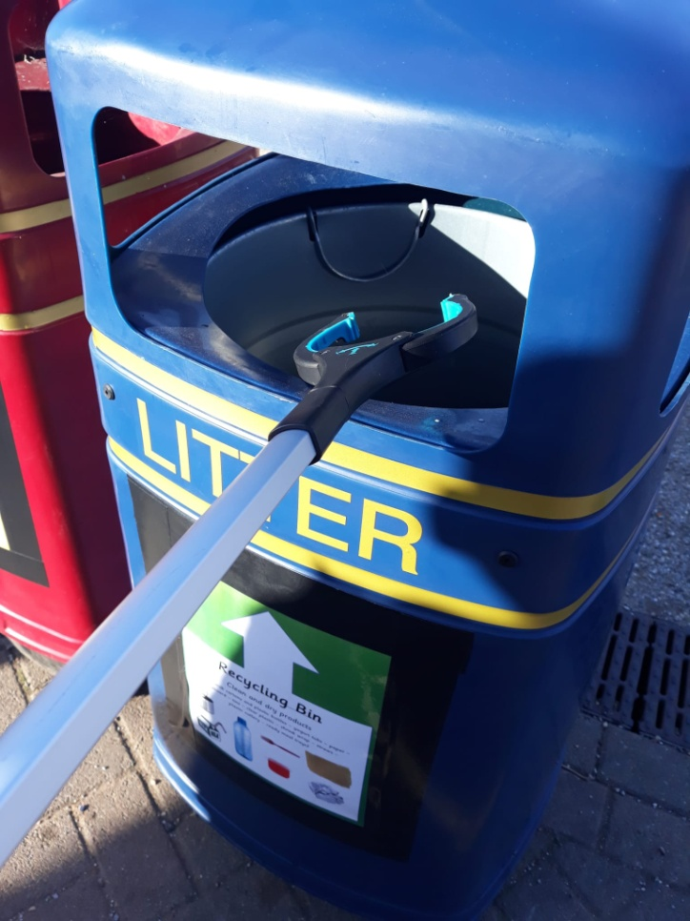
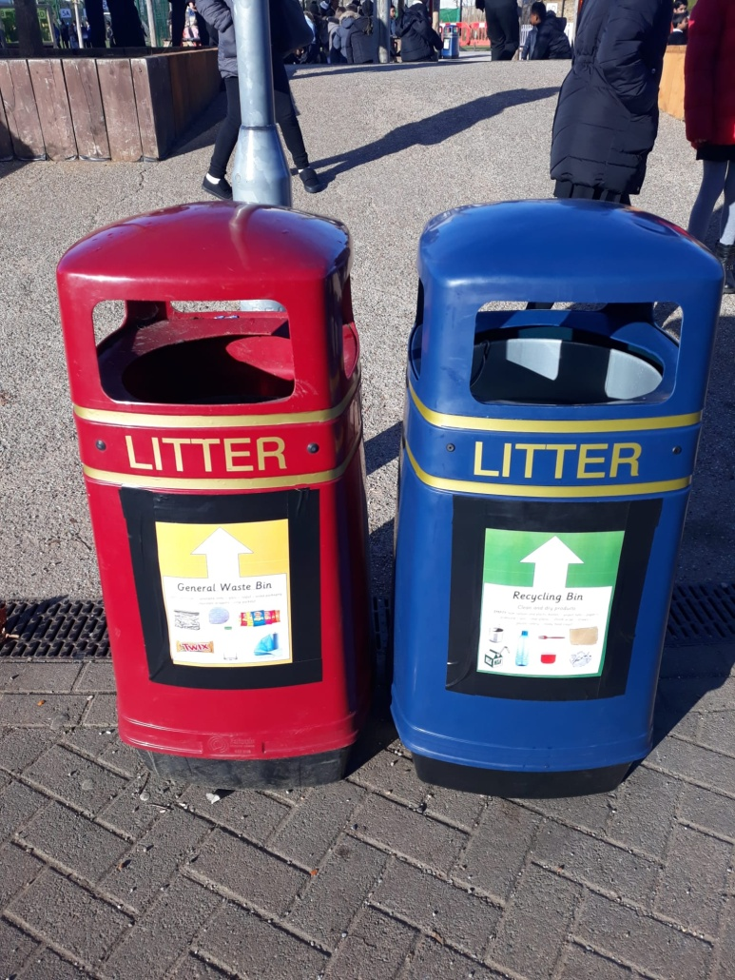
Litterpicking at Playtime

Slide 8
Eco-warriors online
Look out for our Eco-Warriors section on our school website https://www.eps.barking-dagenham.sch.uk/eco-warriors/
Visit our website and find out all about what we have been doing and how YOU can get involved.

Slide 9

Eco-warriors Display Board
Look out for our Eco-warrior display board
(near the Sports Hall).
Take a look and find out all about how we sort our rubbish and what we recycle here at Eastbury.

