Slide 1
Welcome to Eastbury Primary School
Welcome to Reception

Slide 2

Who is Who at Eastbury?
Head Teacher: Lisa Shepherd
Deputy Head: Claire Trench
Assistant Head: Jo Hodges
4 Reception Teachers:
RA – Mrs Villarin
RB – Miss Farhana
RC – Mrs Martinez (Leader of Learning)
RD – Ms Khatun
4 Reception TA’s:
Mrs Kaur, Miss Baxter, Mrs Edyta and Mrs Da Silva.
Family Liaison Officer: Tasnim Sultana
Kamali

Slide 3
A Typical Day in
RECEPTION
When the children start with us they have the opportunity to participate in:
Free –flow indoor and outdoor (they choose where to play, who to play with and what to play with).
We gradually move towards a more balanced and structured approach to include:
Focused group work
Whole class sessions
Group phonics
Free-flow sessions in the afternoons
EAD (art & design), Science and other foundation subjects.

Slide 4
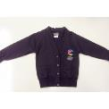

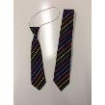
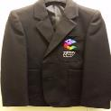
Uniform
 | Boys | Girls
Reception | Black/dark grey trousers White polo shirt/shirt V-Neck sweatshirt Black school shoes | Black/dark grey trousers or knee length skirt White polo shirt/shirt or any colour summer dress V-Neck sweatshirt or cardigan Black school shoes | Children may wear ties if they wish to, but it is not compulsory for these year groups.

Slide 5

Uniform
Every child is expected to wear the correct uniform every day.
Children should be smart and tidy with shirts tucked in and ties on straight.
Please remember to put your child’s name in jumpers so they are not lost.
Uniform Checks.
If your child is wearing incorrect uniform, they will on the first occasion be reminded to wear it the next day.
On the second occasion if it is not correct, a slip will be sent home letting the parent know which part of their uniform was incorrect.
On the third occasion the class teacher will speak directly to the parent.
If it is still incorrect, then a member of the senior leadership team will contact the parent.
Please label all items of uniform with your child’s name and class.

Slide 6
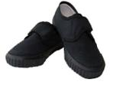
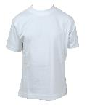
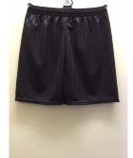
Book Bag and P.E Bag
Your child will need a book bag. This needs to be brought into school every day. Your child will use the bag to carry:
Reading books and reading records
Letters
Homework book
Clearly label the bag with your child’s name and class RA, RB, RC, RD
A PE bag and kit is also needed (Black shorts/trousers, a white t-shirt and black trainers or plimsols).
Please ensure all items, clothes trainers etc. are clearly labelled.

Slide 7

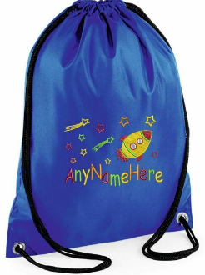
Change of clothes
Your child will need a change of clothes bag. This will remain in school till the end of the year unless an accident occurs. Clearly label the bag and clothing with your child’s name and class RA, RB, RC, RD.
Please make sure to return the clothes
You will need;
(Black trousers, a white t-shirt, socks and undergarments).

Slide 8

How can I support my child Reception?
Attend school everyday and make sure your child is on time
Encourage your child to be independent with taking off/putting on coats and hanging coats and bags on their peg.
Read/share books everyday at home.
PHONICS – encourage children to use their sounds and practice their sounds when reading.
Encourage name writing, writing in cards, shopping lists etc.
Use lower case letters (unless it is at the start of a sentence or when writing their name) -
Ensure your child completes their homework and half termly projects.
Encourage children to talk in full sentences not one-word answers.
Practise counting and recognising numbers and shapes.

Slide 9
Packed Lunch or Hot Dinner?
A healthy and free school meal is provided to all Reception children.
Healthy packed lunch may be provided by Parents/Carers- you will need a packed lunch box and a sealed drink (clearly labelled with name and class).
Do not include sweets, chocolate, fizzy drinks in packed lunches.
Our school is nut-free which means we cannot have nuts in our setting.

Slide 10


Lunch Times
During this time there are supervisors on duty.
All staff will wear a high visibility vest to ensure they are easily identified by the children.
All issues/accidents will be dealt with and recorded.
Please support in reminding your children to always use the adults around them when they need help, this ensures all accidents, issues or support needed by them are completed.

Slide 11
First Aid
A paper wristband will be applied to a child's wrist to show that they have received first aid if they have had an accident
Green paper wrist band – general accident
Yellow paper wrist band – head injury
With all head injuries you will receive a phone call home, so you are aware of the accident in advance.

Slide 12
Collection
Please collect your child on time
All children in Reception, should be picked up from the school site by a known adult or siblings provided they are 14 years old or above (as advised by the NSPCC).
If the person who normally picks a child up is not doing so, then a note should be sent to school to inform us who is to pick up that day. Should arrangements change during the day the school should be contacted by telephone to the office not via tapestry.
We will not allow a child to leave school with a new adult that has not collected the child before, we will then complete calls to ensure this is correct before releasing the child.
If you are late to collect your child at the end of the day, your child will be taken to the late room and you will need to collect your child from the welcome centre.
See collection policy for further information. https://www.eps.barking-dagenham.sch.uk/wp-content/uploads/2020/11/collecting-children-from-school-2020.pdf

Slide 13
GDPR: Data Protection
Due to new GDPR regulations with effect from May 2018, schools must now provide parents with an opportunity to opt in or out of any data sharing. We will not give information about you to anyone outside the school without your consent unless the law and our rules permit it.
We would be grateful if you could please complete the consent form when received which will then allow us to update our records. If you have more than one child currently attending the school, please complete a separate form for each of your children.
Our online consent form can be filled in using this link: https://forms.office.com/pages/responsepage.aspx?id=AKWCKQcCTE6OAgnqmAyAl4F0OAv-e_hPj0uQcdlCf2BUQUU4MTdEVVRNWUs0SVNONVVCRFBMNlFXNC4u

Slide 14


Log in!
Your child will be given login details to join the above online platforms.

Slide 15



Slide 16
For further information please visit our website https://www.eps.barking-dagenham.sch.uk/

