Slide 1
































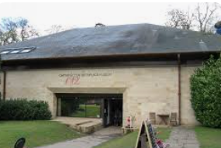






Personal Development
Year 1
Transition
Parents
evening
Exceptional attendance award
Art gallery for parents
Exceptional attendance award
KS1 Graduation
Class party
Economic Well-Being
Enquiry Question 4
Would you prefer to live in a hot or cold place?
Exceptional attendance award
Citizenship
Exceptional attendance award
Chinese
New Year
Valentines Disco
Valentines themed lunch
Safety & The Changing Body
Exceptional attendance award
Open morning
Enquiry Question 3
How did we learn to fly?
Christmas
carols
Parents consultation day
Christmas
Lunch
Health & Well-Being
Exceptional attendance award
Enquiry Question 2
What is the weather like in the UK?
Open morning
Fire Brigade visit
Remembrance
Assembly
Parents
evening
Halloween
disco
Family & Relationships
Enquiry Question 1
How have explorers changed the world?
Visit: Captain Cook Museum
Meet the teacher

