Slide 1









































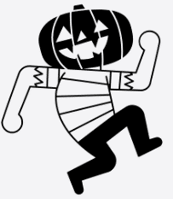




Personal Development
Year 3
Sports Week
Transition
Parents
evening
Sports Day
Exceptional attendance award
Art gallery for parents
Exceptional attendance award
Hindu Temple Visit
Class party
Transition Day
Economic Well-Being
Enquiry Question 4
Why do people live near volcanoes?
Exceptional attendance award
Citizenship
Exceptional attendance award
Chinese
New Year
Valentines Disco
Valentines themed lunch
Roman Activity Trip
Safety & The Changing Body
Exceptional attendance award
Enquiry Question 3
Why did the Romans invade and settle in Britain?
Christmas
carols
Parents consultation day
Christmas
Lunch
Health & Well-Being
Stone Age Survival Workshops
Exceptional attendance award
Enquiry Question 2
Why are rainforests important to us?
Ice Skating
Open morning
Fire Brigade visit
Judo taster sessions
Remembrance
Assembly
Parents
evening
Family & Relationships
Halloween
disco
Enquiry Question 1
Would you rather live in the Stone Age, Bronze Age or Iron Age?
Meet the teacher

